Slide 1
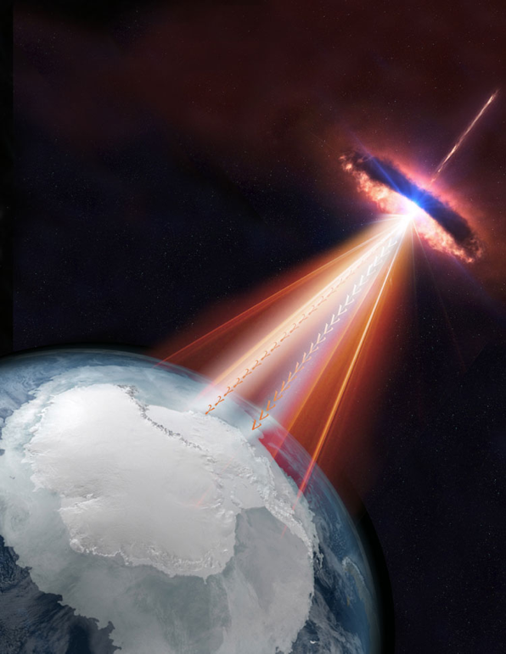
Introduction to the 10th VHEPA (Very High Energy Particle Astronomy) Workshop
Tom Browder (University of Hawai’i at Manoa)*
Roberto Mussa (INFN Torino/UHM)**
Themes for this workshop:
Anni Mirabiles
Multiple messengers and other kinds of correlations
(in space or time).
Pevatron cosmic accelerators
Why are VHE tau neutrino’s important ? How can we observe them ?
One more missing piece
*Non-expert in particle astrophysics
**Auger member. Not able to attend in person.
Notes:
Will not review all the instruments and future projects. I accept full responsibility for all wrong and misleading statements.

Slide 2
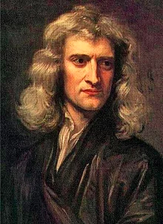
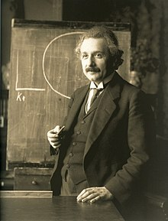
Let’s review our Latin
“Annus mirabilis (pl. anni mirabiles) is a Latin phrase that means "wonderful year", "miraculous year" or "amazing year". This term was originally used to refer to the year 1666, and today is used to refer to several years during which events of major importance are remembered.”
1666- Issac Newton discovers calculus, kinematics, optics and gravitation. “Issac Newton’s annus mirabilis”
1905- Einstein publishes 4 papers on the photo-electric effect, Brownian motion, special theory of relativity and E=mc². 1905 was one of Einstein’s anni mirabiles. 1915 -he managed to publish a correct version of GR.

Slide 3
Anni Mirabiles in Particle Astrophysics
1987: SN1987A exploded and sent EM radiation to telescopes and a blast of neutrinos to underground detectors on Earth.
2012: Bert and Ernie, PeV neutrinos are detected in IceCube.
2015: First Gravity Waves from a binary black hole merger observed in LIGO (100th anniversary of GR !)
2017: First neutrino from a point source in IceCube (associated with a blazar), TXS 0506+056.
2017: First Gravity Waves and Multiple messengers from a neutron-star merger, GW170817
What is next ?

Slide 4
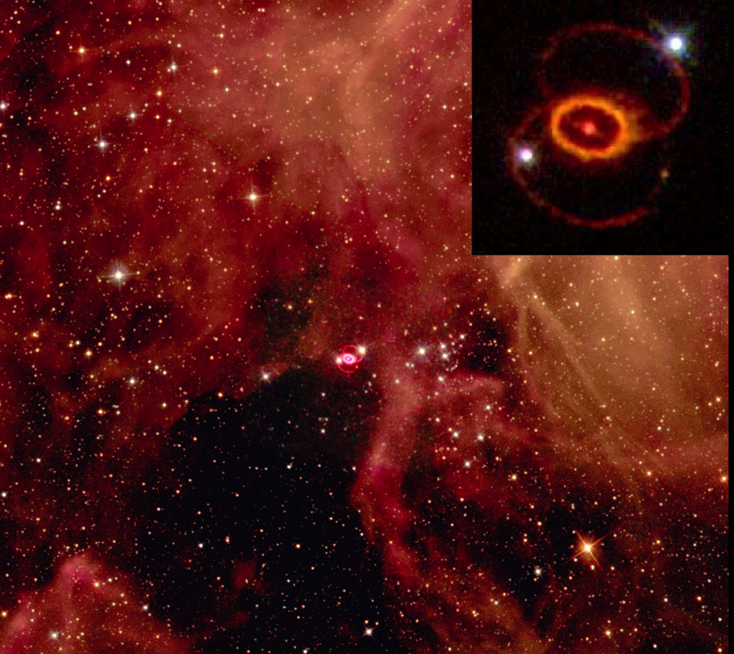
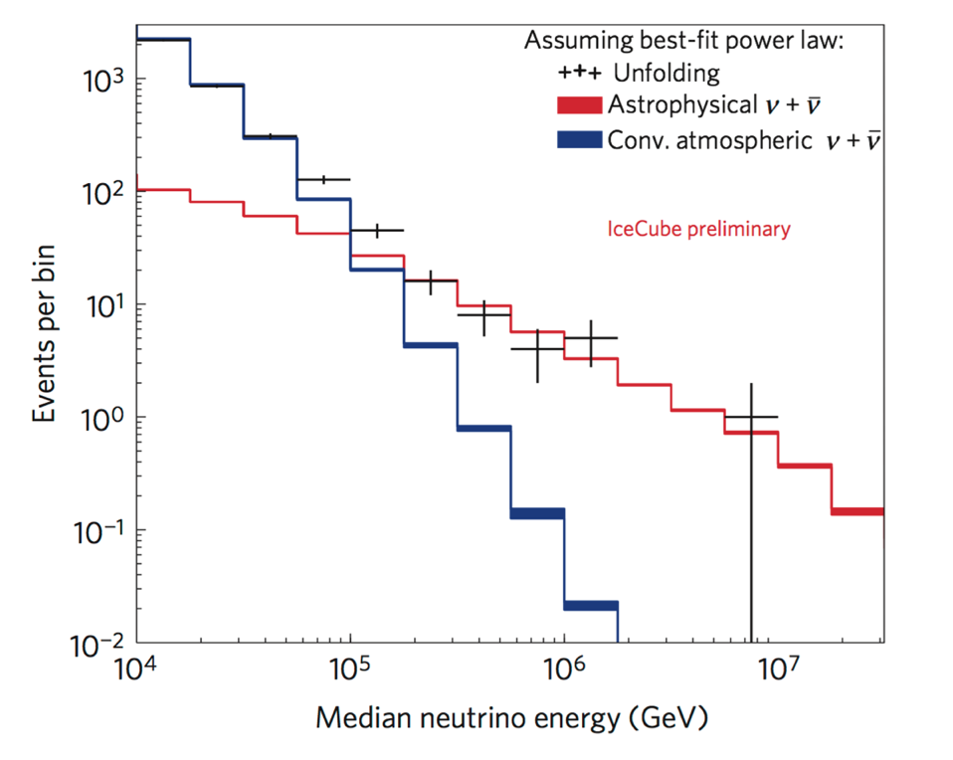
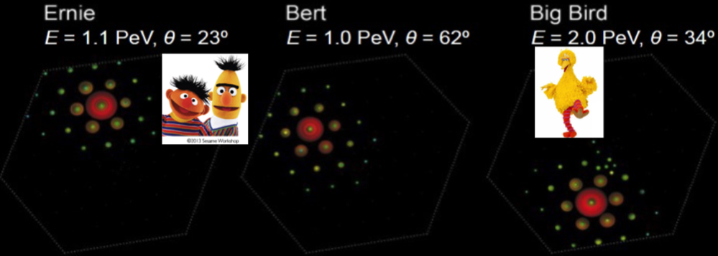
Astrophysical ν's in 1987 and 2012
The real birth of Multi Messenger Astronomy : SN1987A
Simultaneous detection of 24 neutrinos in three detectors
(Kamiokande, IMB, Baksan) in coincidence with an optical transient.
And , finally , IceCube in the PeV range !

Slide 5
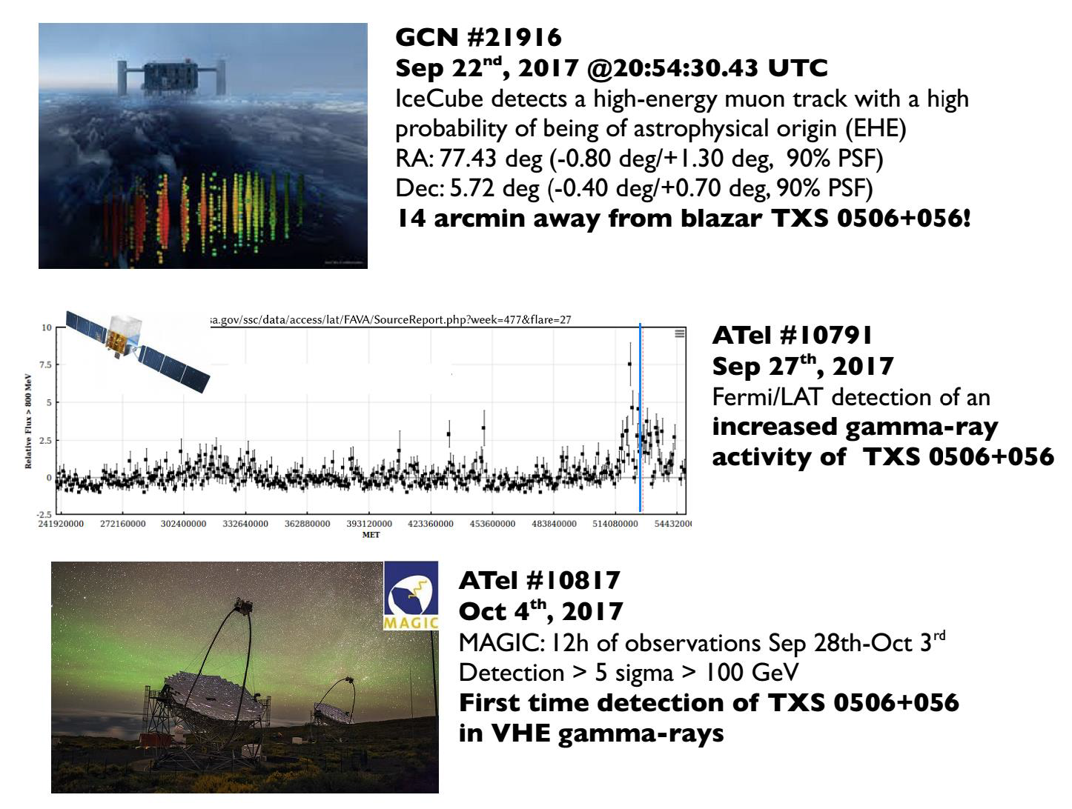
2017/09/22: Rebirth of MM neutrino astronomy (after SN1987A)
Courtesy: Satalecka, ICHEP2018

Slide 6
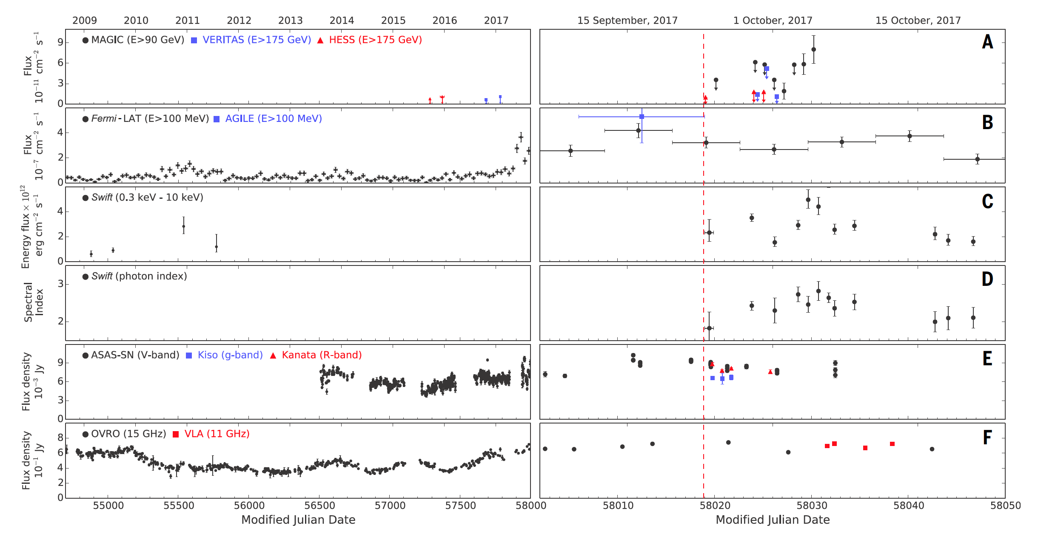
Multiwavelength observations of TXS source
IceCube
event
All the data were shared and correlated !!

Slide 7
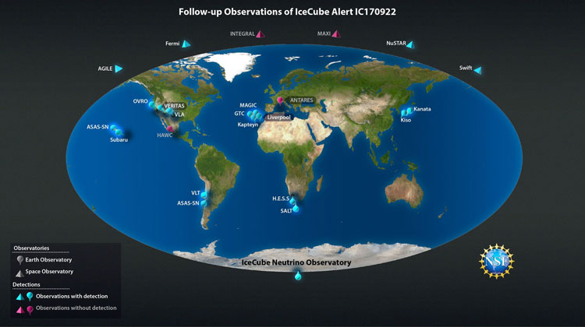
Sept 22, 2017
Impressive coordination around the Earth !

Slide 8
Annus Mirabilis 2017
And again in 2017

Slide 9
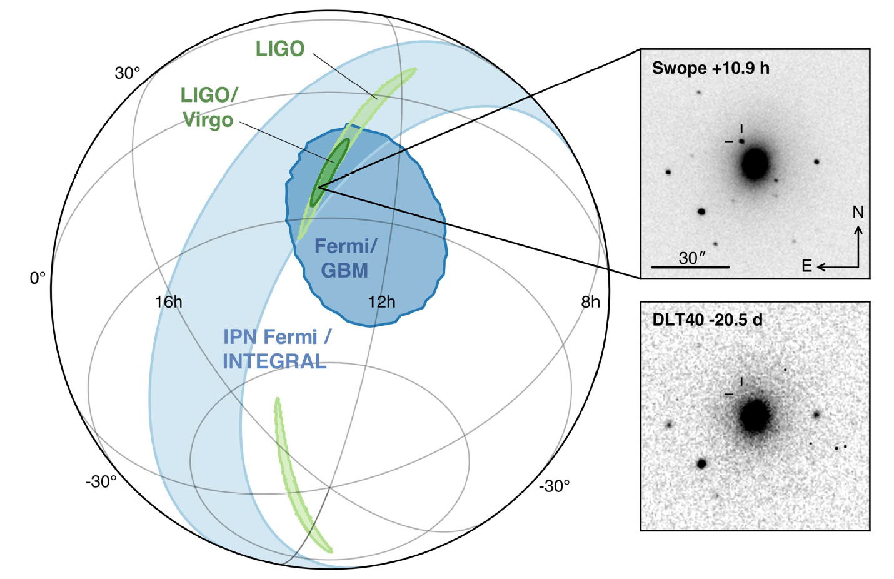
Birth of Multi Messenger Astronomy : GW170817
Negative Signal n.1 : VIRGO

Slide 10
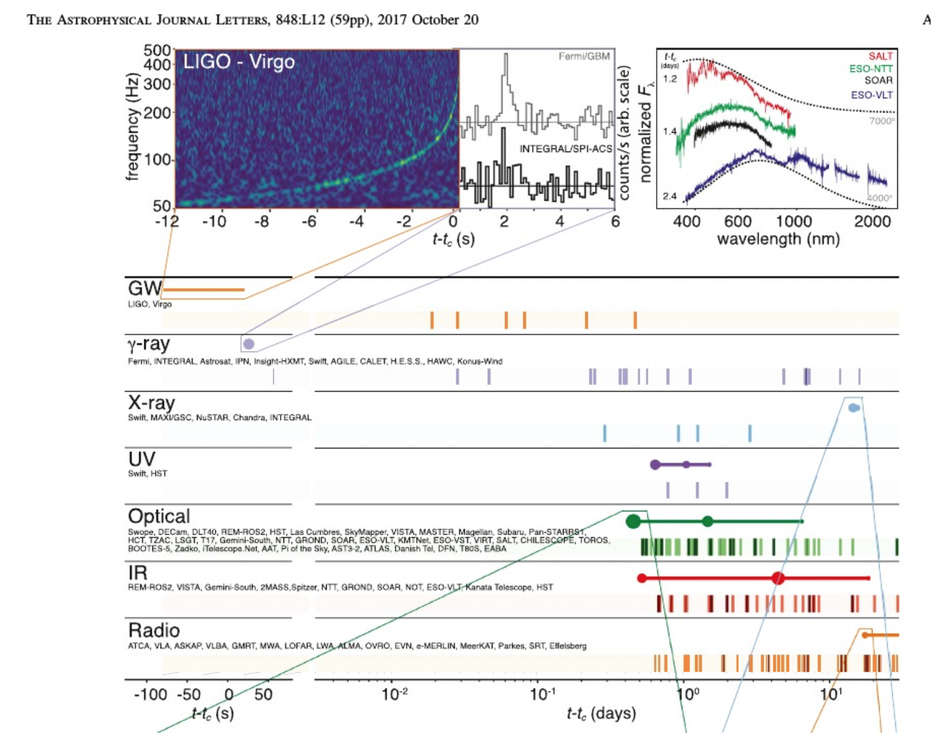
Birth of Multi Messenger Astronomy : GW170817
Negative Signal n.1 : VIRGO
All the data were shared and correlated !!

Slide 11
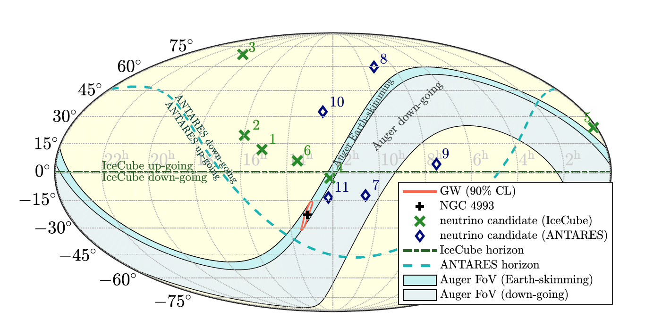
Birth of Multi Messenger Astronomy : GW170817
Search for neutrinos in IceCube, Antares, Auger

Slide 12
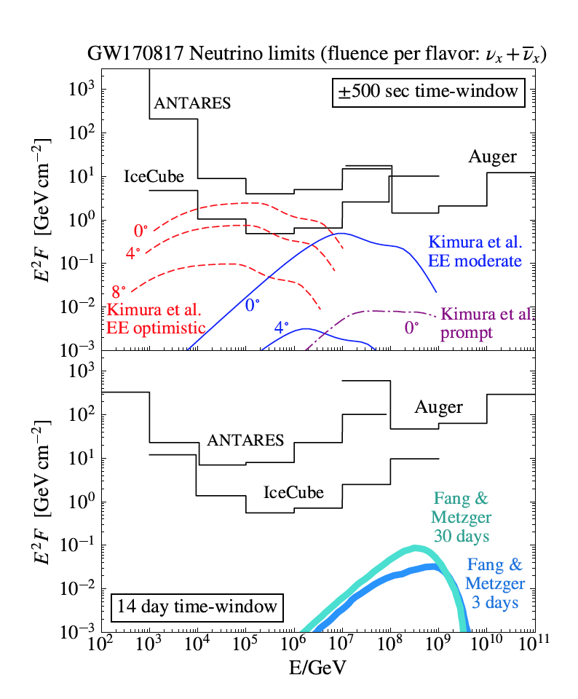
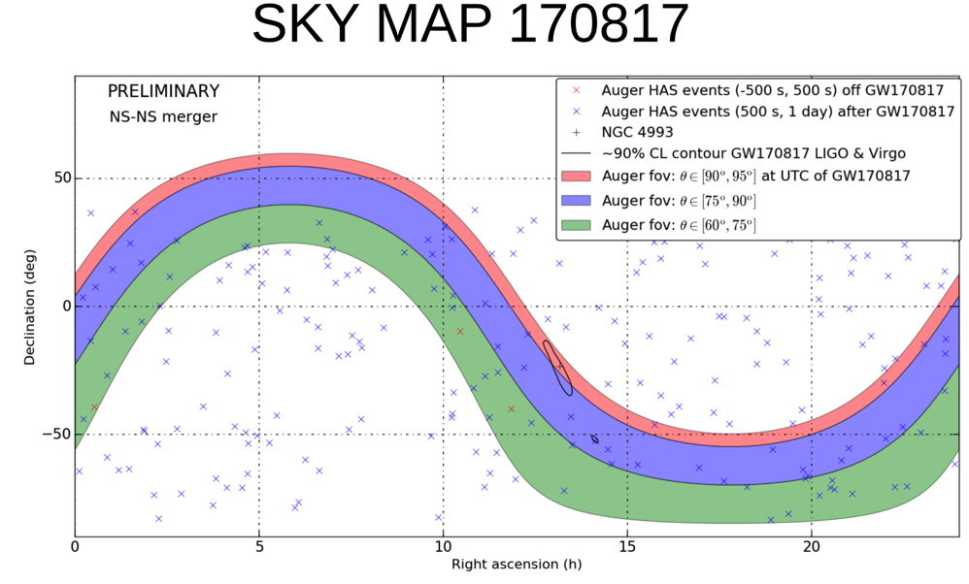
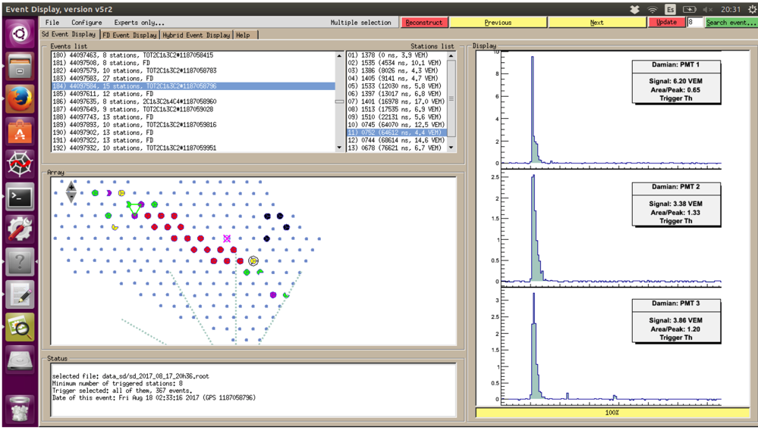
Birth of Multi Messenger Astronomy : GW170817
Search for neutrinos in IceCube,Antares,Auger
But no high energy neutrinos seen for the first neutron star merger.
Auger HAS within the ±500 sec time window

Slide 13
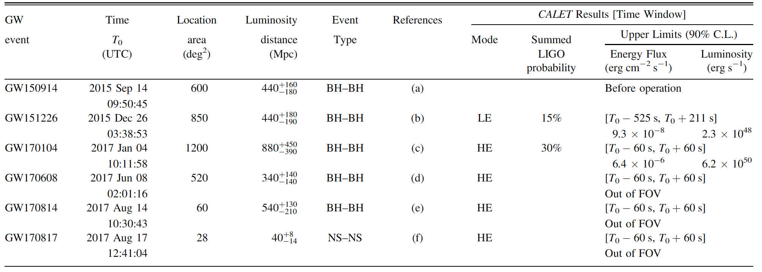
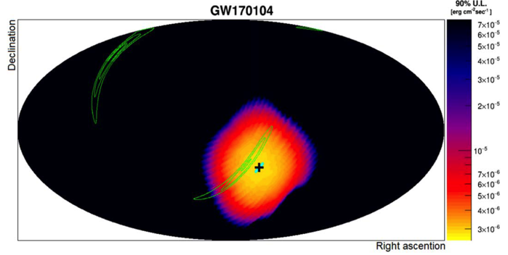
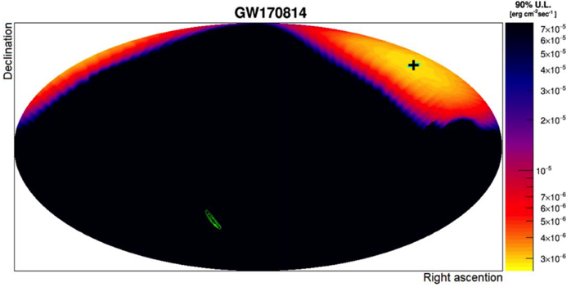
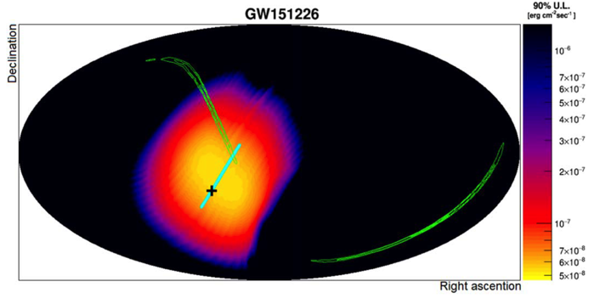
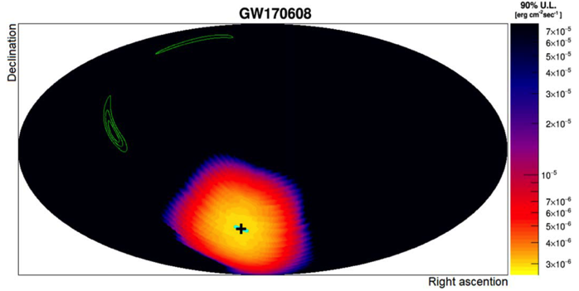
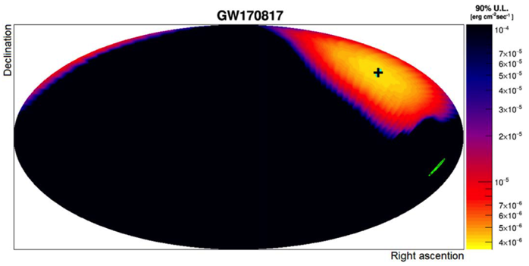
CALET limits on gammas in 10-100 GeV range on GW events
The first two sources were in CALET FoV: no events were seen.

Slide 14
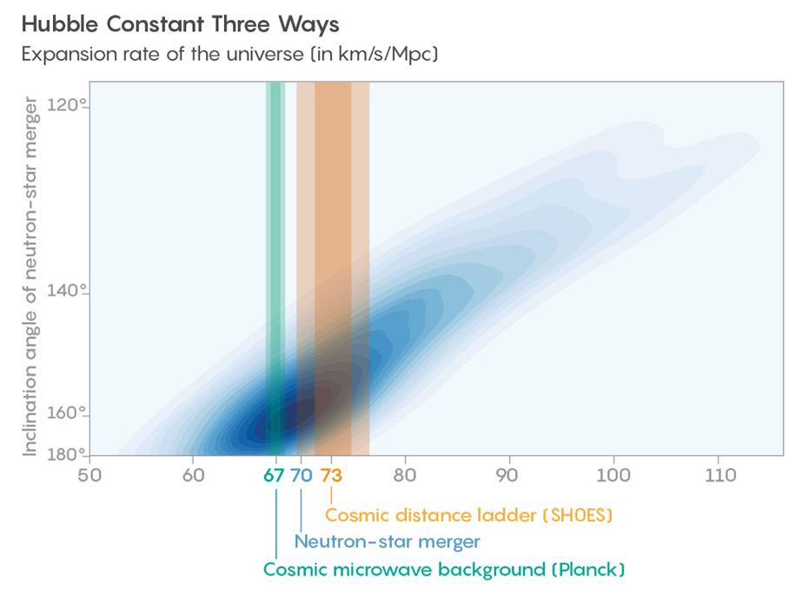
Non-expert summary of gravity waves so far
Observed around 10 black hole (BH)- black hole (BH) mergers. LIGO-VIRGO released its first “catalogue” of BH-BH merger events.
Observed 1 neutron-star (NS) – neutron start (NS) merger
This special event was seen in many frequency bands.
This single event provided many insights including the origin of heavy elements by r-process nucleosynthesis, constraints on GRB’s afterglow mechanisms and a new path to precisely determine Hubble’s constant (“new standard sirens”).
Have not yet observed a NS-BH merger event
(also a “standard siren” for cosmology).
Have not yet observed “echoes” from
BH-BH mergers
Consistency
checks of GR
Expect 5-10 times the rate of events from LIGO-Virgo in the next run due to improved sensitivity (better be ready)

Slide 15
First Catalogue

Slide 16
Black holes observed in gravity waves seem to be too heavy (disagree with EM black hole population masses c.f. purple points). May be a selection effect.
No significant signal for spin after the BH mergers.
Notes:
Selection effect or physics ?

Slide 17
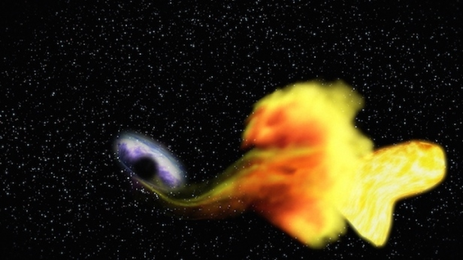
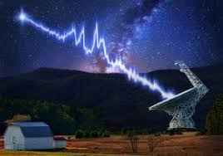
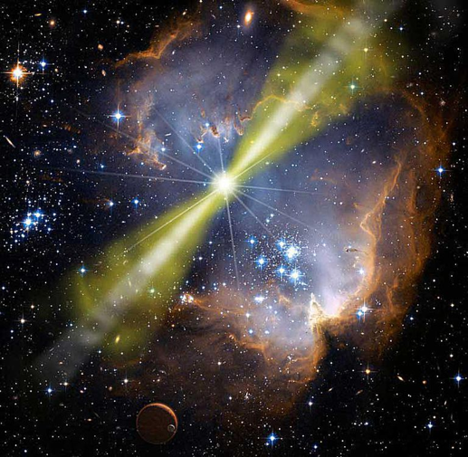
Some new signatures (non-expert summary)
TDE (Tidal Disruption Events)
Supermassive black hole chews up a star.
FRB (Fast Radio Bursts)
CHIME just turned on
(Two classes: Fast pulsars (repeaters) or a neutron star merger forming a black hole (single event))
Old new signatures:
GRB (Gamma Ray Bursts)
“In the field of observation, Chance favors the prepared mind” –
Louis Pasteur, 1854
Notes:
So far only seen in EM radiation.

Slide 18
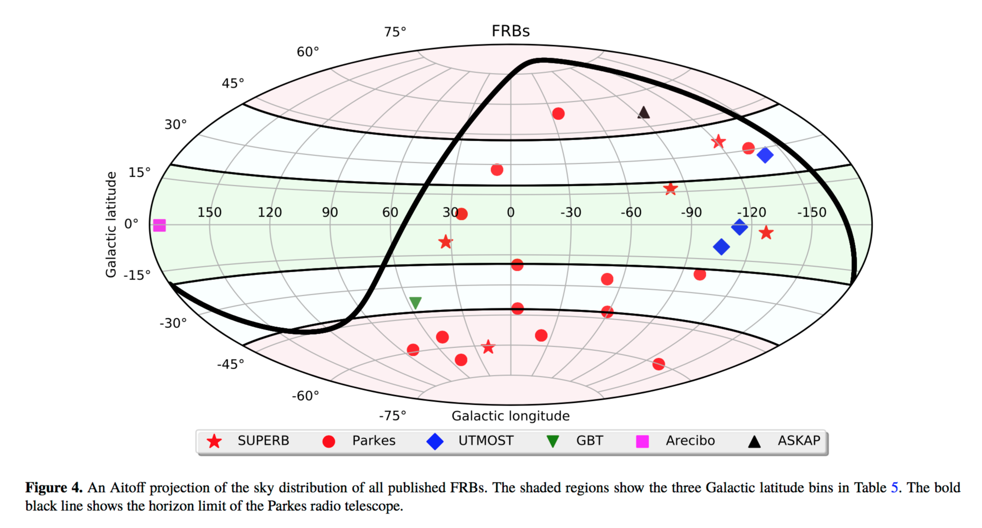
FRB: high energy counterparts?
But CHIME will increase the sample of FRB’s by an order of magnitude.
Antares searches for neutrino counterparts of all detected FRB's

Slide 19
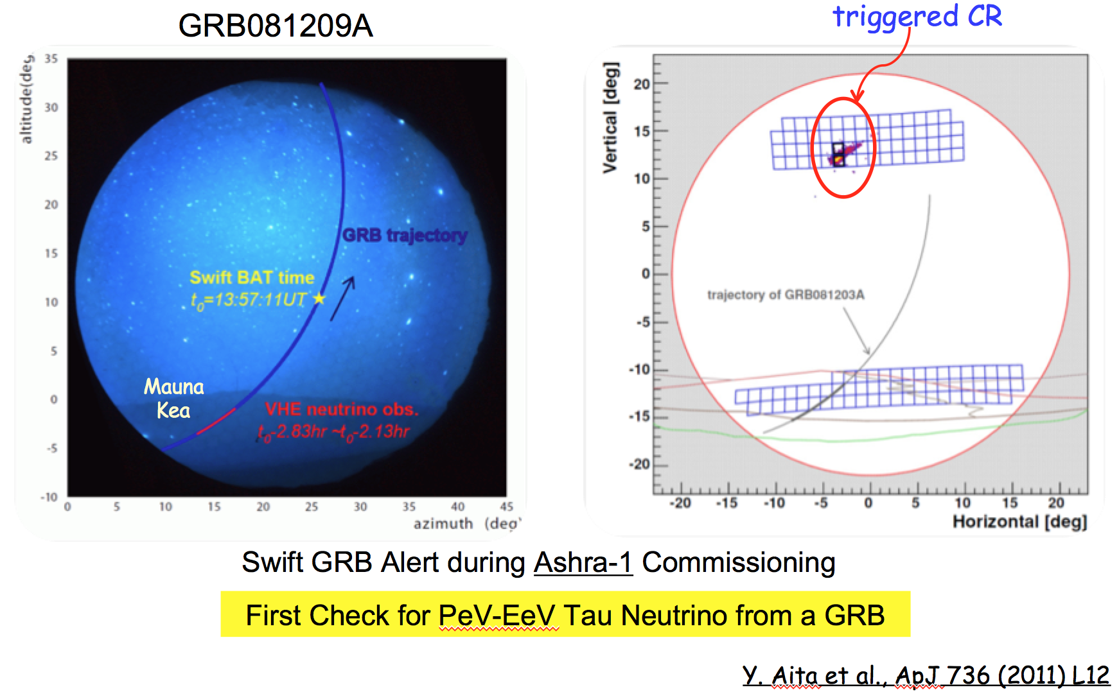
Ashra-1: First search for ν_{τ} from GRB

Slide 20
Pevatron++ Cosmic Accelerators
Neutrino and gamma beams point at the source.
F. Halzen, Paris 2018.

Slide 21
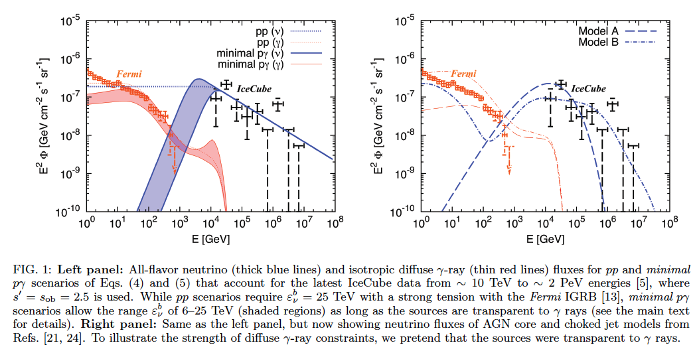
Pevatron++ Cosmic Accelerators
What kind of accelerator and fundamental reaction are making the PeV neutrinos seen in IceCube ?
What kind of accelerator makes the sub-GZK events in Auger, TA, ANITA etc… ?
e.g. Murase et al, 2015 (γp or pp are two possibilities)

Slide 22
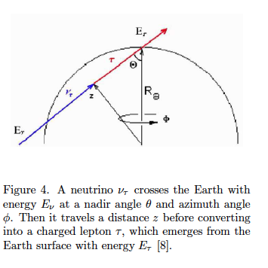
tau neutrino motivation and possibilities
Here is how it might work in Auger or in ANITA**
**Two ANITA events do not fit well to this possibility

Slide 23
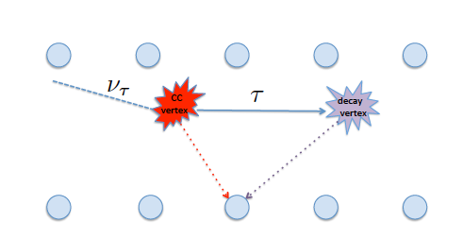
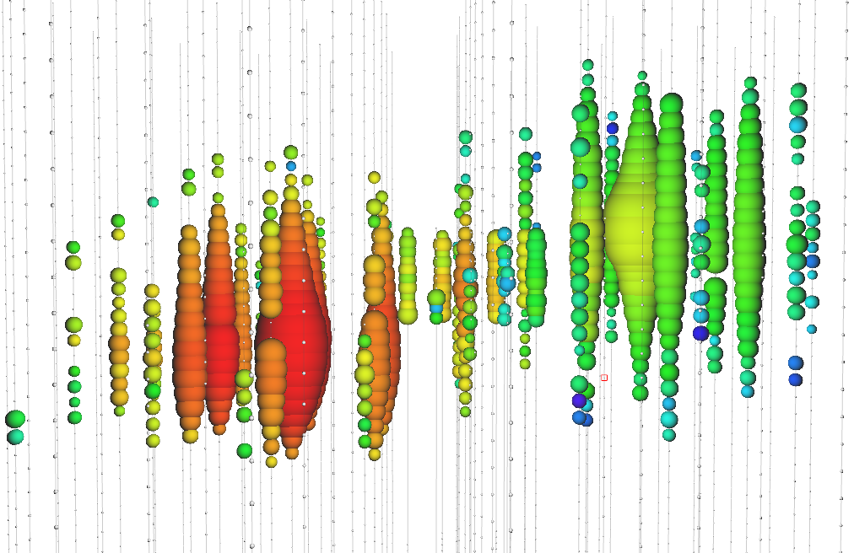
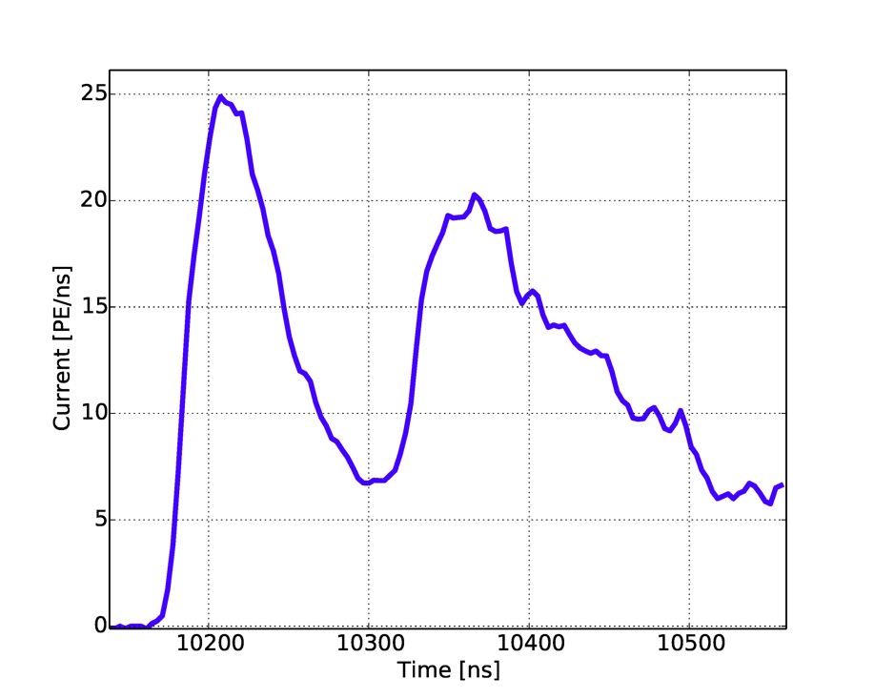
A simulated double pulse waveform obtained in one IceCube sensor, or DOM, from a tau neutrino event. The primary neutrino energy for this event is 2.4 PeV. About 75% of this energy transfers to the outgoing tau lepton, which travels 40 meters before decay.
A simulated “double bang” event in IceCube
First proposed by J. G. Learned and S. Pakvasa, Astroparticle Phys. vol 3 (1995), p. 267

Slide 24
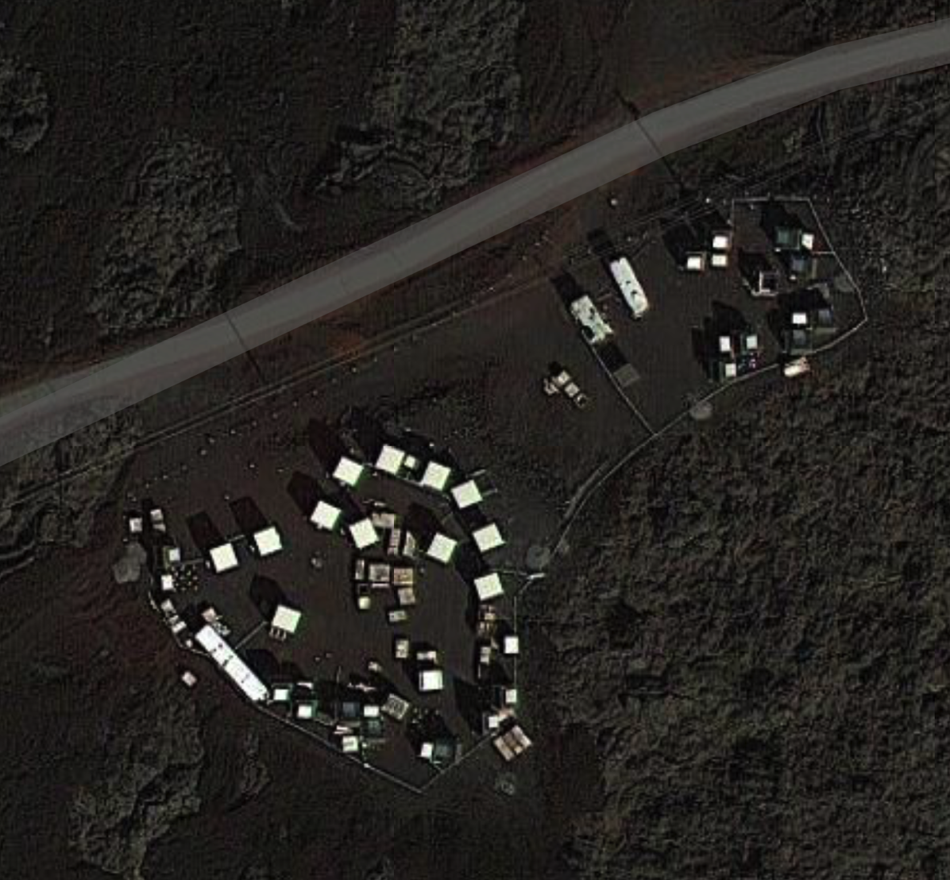
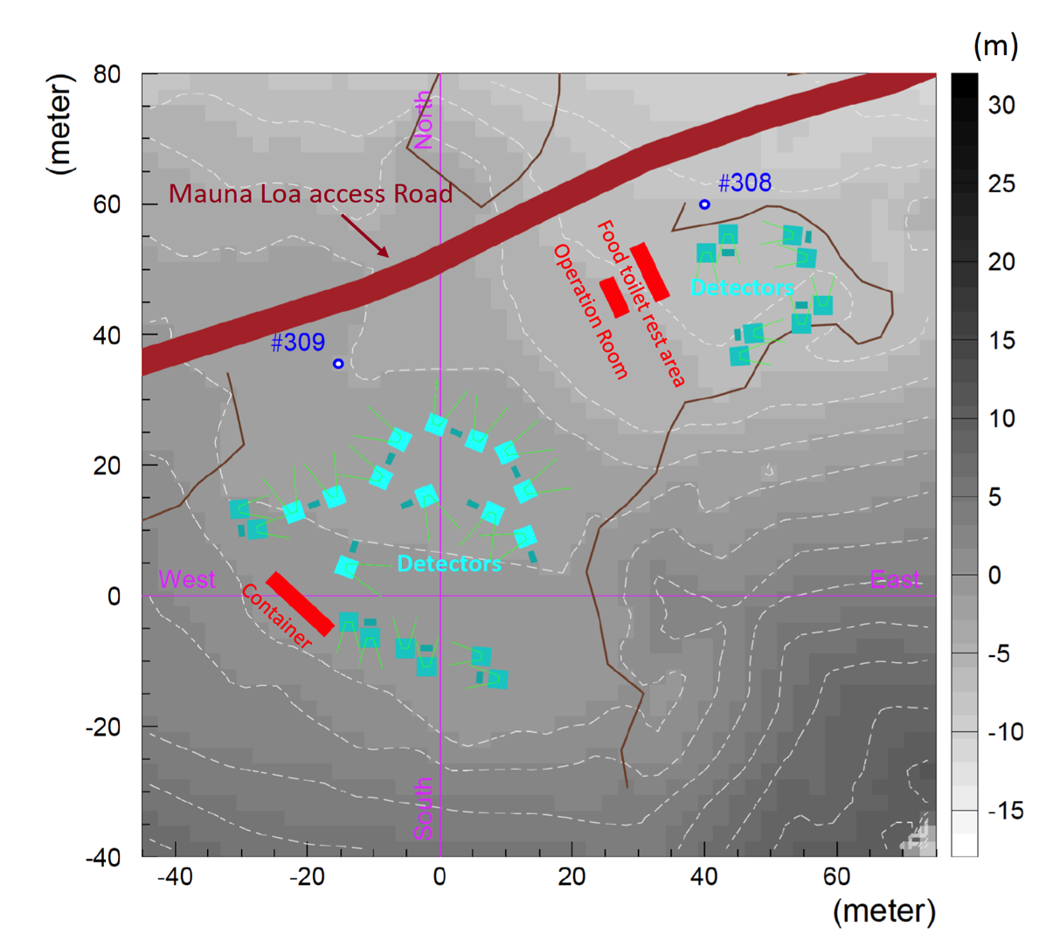
ASHRA/NTA site on Mauna Loa in Hawaii.

Slide 25
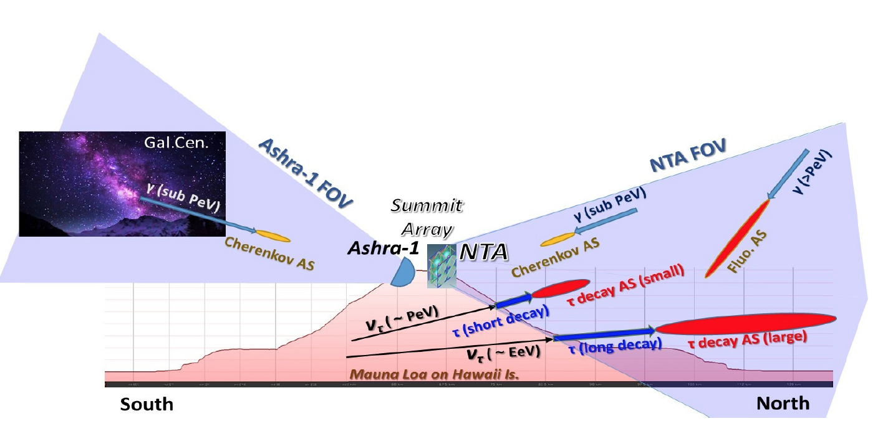
One possibility

Slide 26
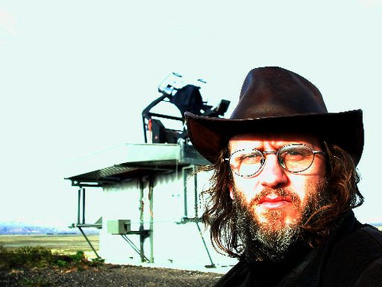
Nota Bene (more Latin):
Duty cycle issues for nu_tau detection
For the northern part of the sky, Ice Cube has a 100% duty cycle.
With surface detectors, Auger is sensitive to neutrinos skimming the earth only for 1% of the full sky.
Any effort to detect upward going showers with a fluorescence technique (either Auger or NTA etc) will be facing a duty cycle, which will be 5% or lower.

Slide 27
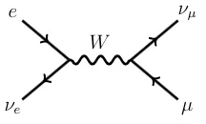
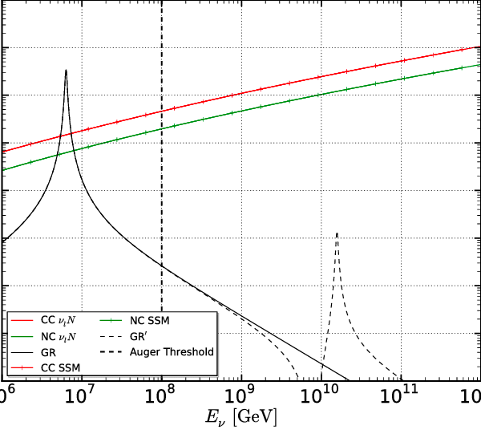
One more missing piece: the Glashow resonance (sqrt(s) = W)

Slide 28
Conclusions of the Introduction
Let’s try to address these issues in the VHEPA2019 workshop while discussing the many individual and wonderful astroparticle projects of the world and recent theoretical developments.
Exchanging data
Correlating data
Review new signatures
How to observe ultra-high energy tau neutrinos
Where is the Glashow resonance ?
“In the field of observation, Chance favors the prepared mind”
Louis Pasteur, 1854

Slide 29
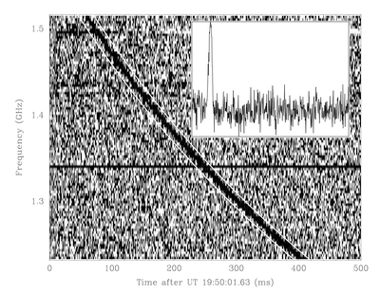
Backup Slides
The first fast radio burst from an extragalatic source.

Slide 30
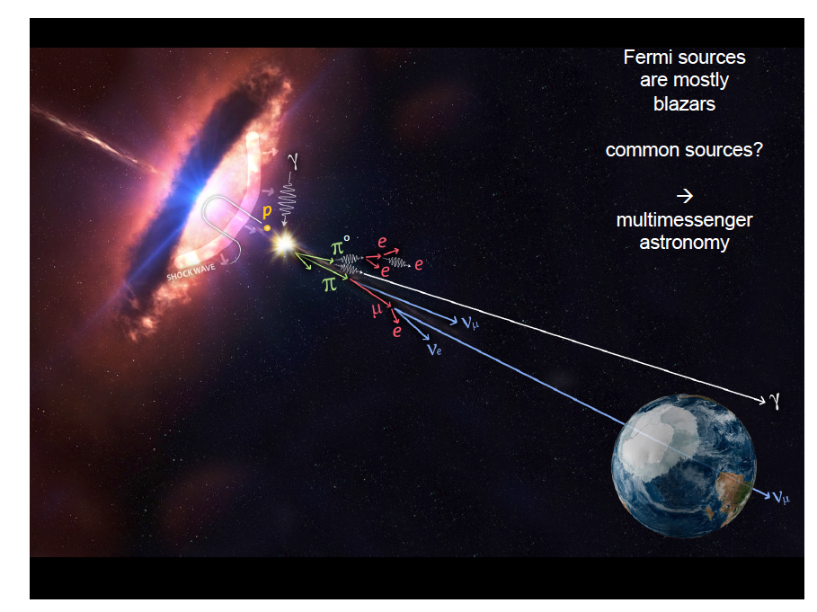
Francis Halzen, Paris 2018

Slide 31
Another Multi Messenger on Sept 22, 2017 ?
GCN21916
IceCube detected a track-like, very-high-energy event with a high probability of being of astrophysical origin. The event was identified by the Extremely High Energy (EHE) track event selection. EHE events typically have a neutrino interaction vertex that is outside the detector, produce a muon that traverses the detector volume, and have a high light level (a proxy for energy).
Date: 22 Sep, 2017 Time: 20:54:30.43 UTC
RA: 77.43 deg (-0.80 deg/+1.30 deg 90% PSF containment) J2000
Dec: 5.72 deg (-0.40 deg/+0.70 deg 90% PSF containment) J2000
ATEL 10791
Fermi-LAT detection of increased gamma-ray activity of
TXS 0506+056, located inside the IceCube-170922A error region.
ATEL 10817
First-time detection of VHE gamma rays by MAGIC from a direction consistent with the recent EHE neutrino event IceCube-170922A
ATEL 10794
ASAS-SN optical light-curve of blazar TXS 0506+056, located inside the IceCube-170922A error region, shows increased optical activity
ATEL 10844
Kanata optical imaging and polarimetric follow-ups for possible IceCube counterpart TXS 0506+056

