Slide 1
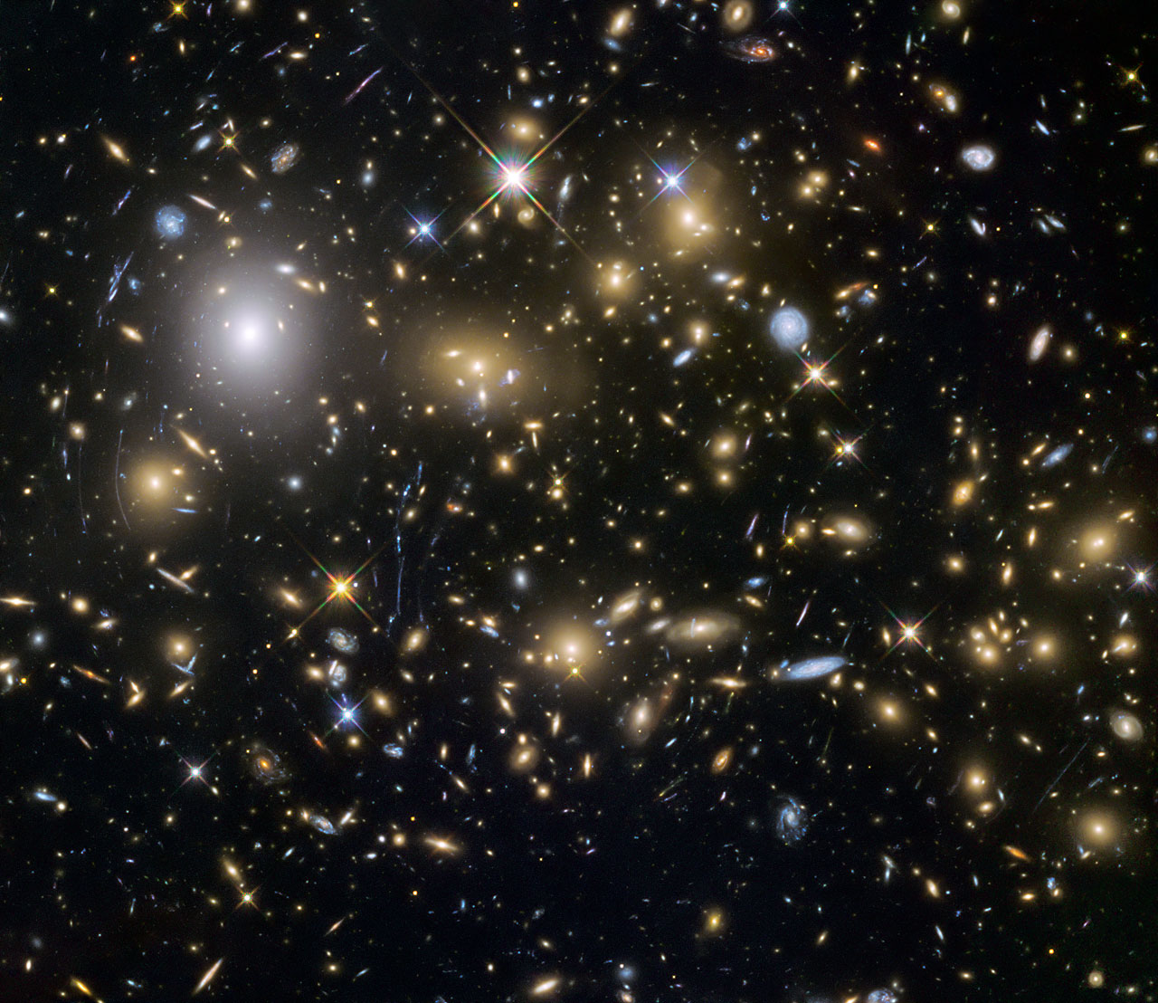
Observational Cosmology Group
≲ ≳
Masami Ouchi
Associate Professor
ICRR, Univ. Tokyo
Credit:NASA, ESA and the HST Frontier Fields team (STScI)
Notes:
This picture shows the optical-NIR image of galaxies in the MACSJ0717 cluster observed with Hubble Space Telescope.
Galaxies are basic gravitational systems in the cosmic structures, representing the cosmic evolution.
Galaxy formation and the related cosmic reionization are key for understanding the cosmic evolution.

Slide 2
Scientific Goal
Understanding the evolution of the universe including
Structure/galaxy formation, and
Cosmic reionization
by observations

Slide 3
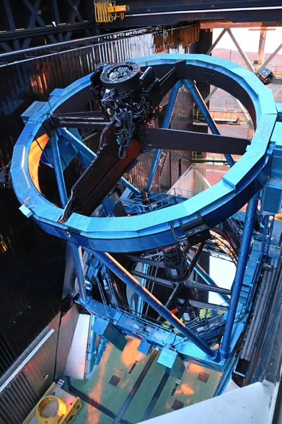
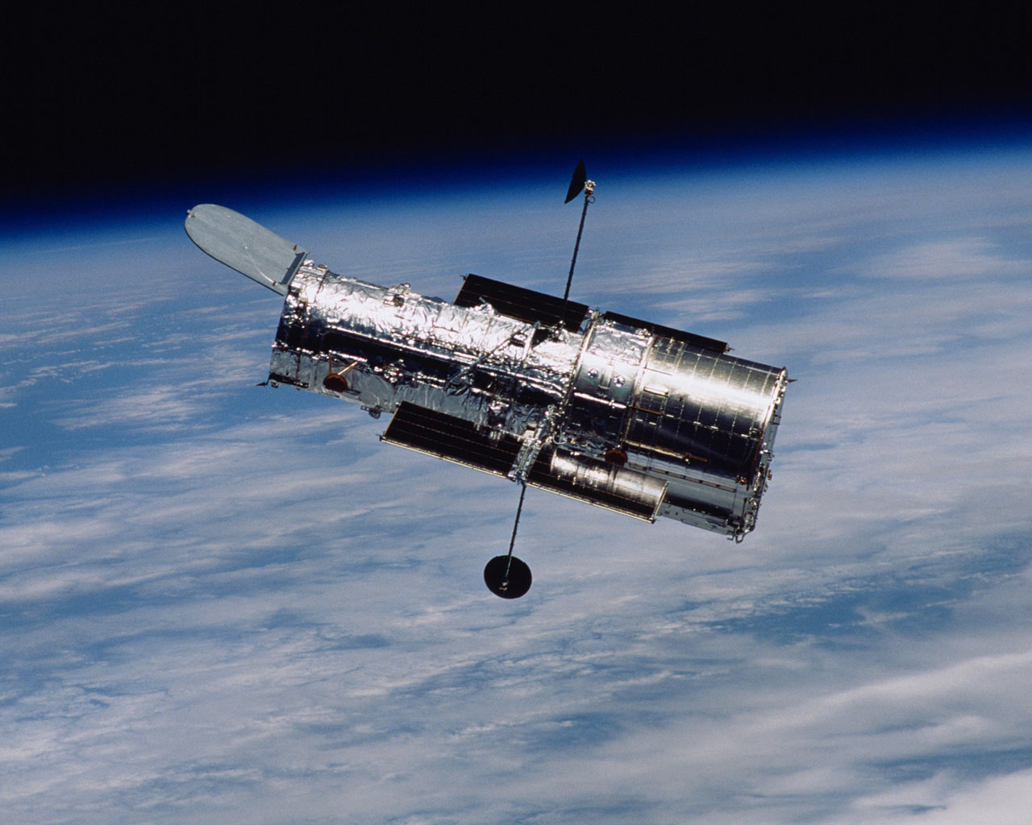
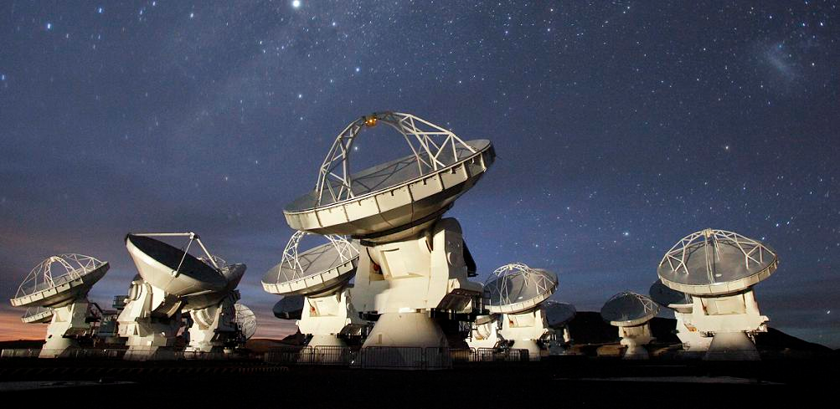
Project Status (2012-2018)
Two projects
1) Subaru Hyper Suprime-Cam (HSC) survey
HSC narrowband (NB) developments
HSC survey obs. started since 2014
2) Complementary multi-wavelength prog. including HST, Keck, and ALMA obs (+SDSS).
HSC
Hubble Space Telescope
(HST)
Atacama Large Mm/Submm Array (ALMA)

Slide 4
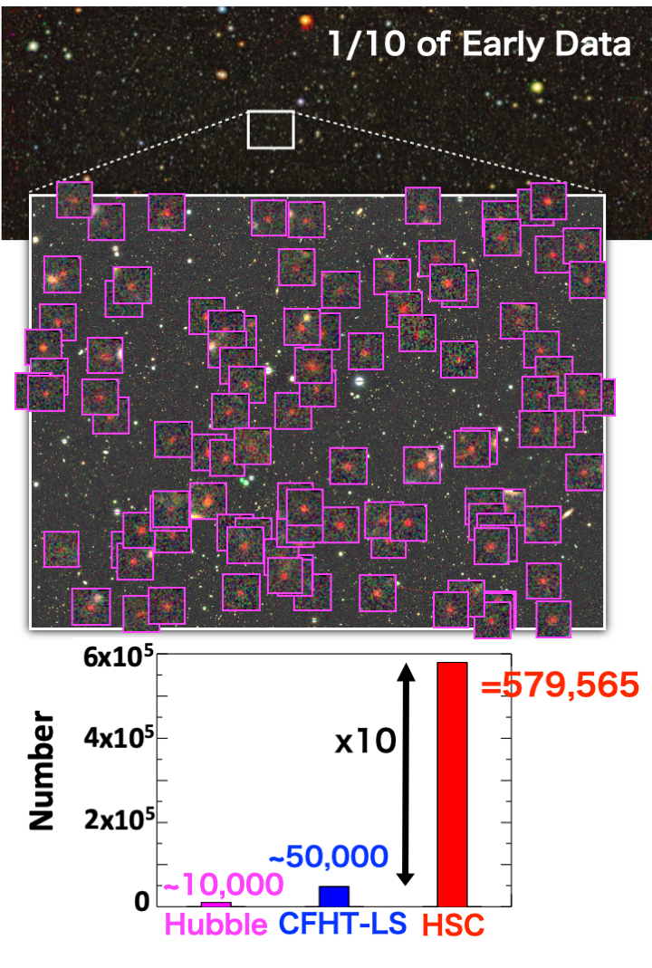
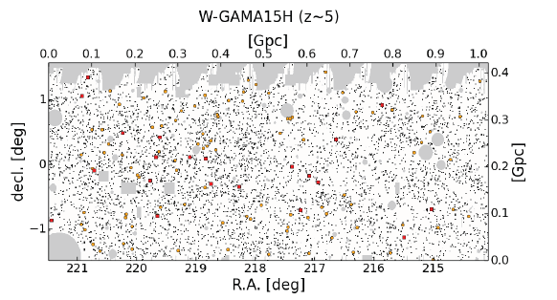
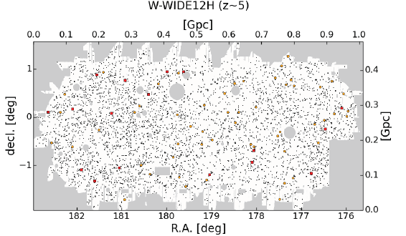
HSC Survey for High-z Galaxies
Examples
z=4
z=5
z=6
z=7
Ono et al. (2018)
〜10 times larger than prev. samples
First cosmological probe of z≳4 galaxies
Harikane et al. (2018)
579,565 galaxies (by dropout technique)
over 100 deg² → 1.4 Gpc³ (cosmology scale)

Slide 5
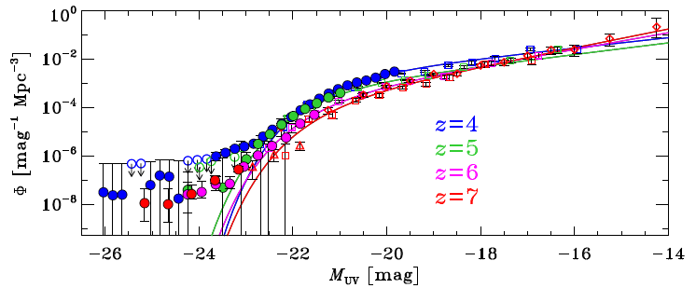
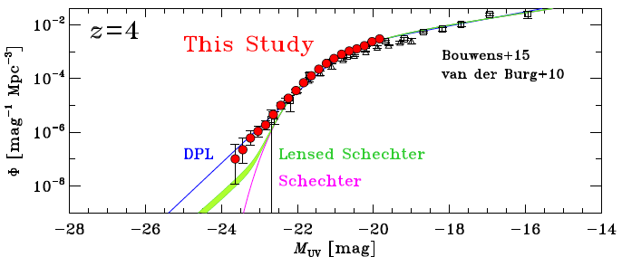
UV Luminosity Function (LF)
Ono et al. (2018)
Precision UV luminosity function (LF) → Bridging the LFs of galaxies and SDSS QSOs.
Rychard Bouwens (Leiden U.) e-mailed us, saying “Your figures showing the transition between the galaxy and quasar LF regimes will likely appear in many textbooks and reviews for many years to come.”
Subtraction of the AGN LFs
→ LF excess: Not Schechter+Lensing, but double powerlaw. (Bowler+15,+17)
Evidence of weak feedback?

Slide 6
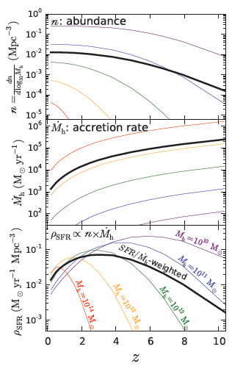
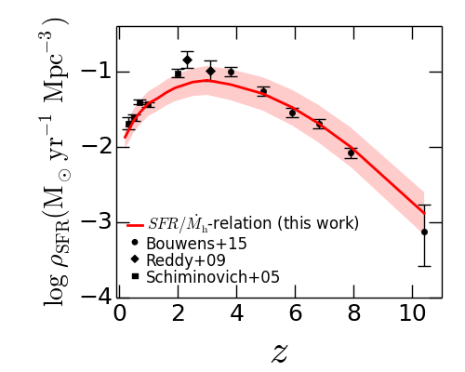
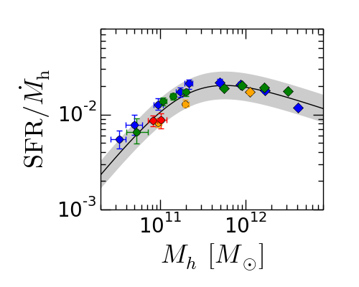
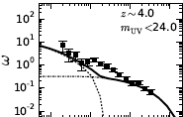
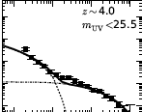
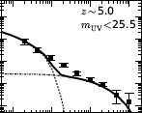
Clustering and Fundamental Relation
Cosmic SFRD Evolution
Direct observations
x
Non-linear effect
z=4
z=5
z=6
z=7
.
HSC results
x SFR/M_{h} =
Harikane et al. 2016, 2018
Precision angular correlation functions (cf. HOD model, ΛCDM)
→ Definitive identification of non-linear effect
HOD model fitting -> Halo mass (+mass accretion rate)
→ We find the fundamental relation of SFR/M_{h} vs. M_{h}
→ SF regulated by mass accretion (i.e. gas accretion from LSS
→ explaining the evolution of cosmic SF history
SFRD evolution = Structure Form. x Cosmic Ex.
.
Cosmic SFRD Evolution
--- Y. Harikane : U. Tokyo School of Science award in 2019 ---

Slide 7
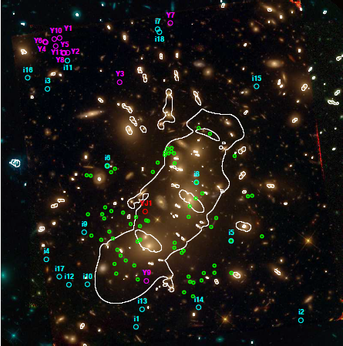
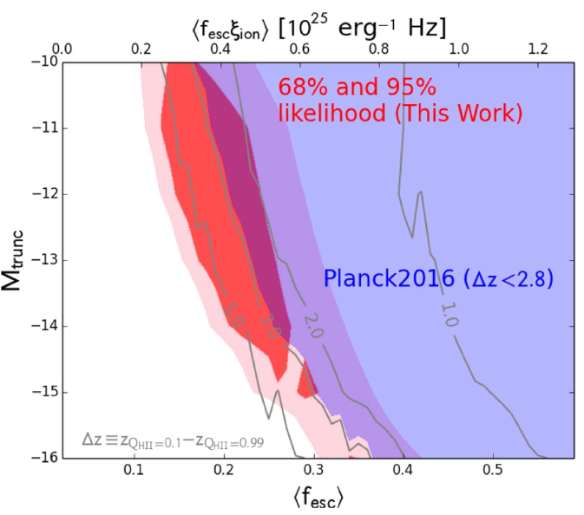
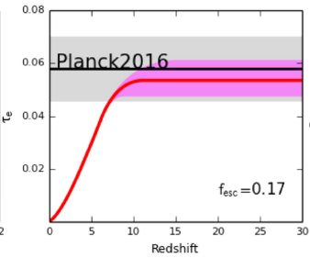
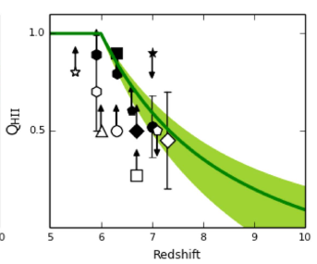
Cosmic Reionization
Ishigaki+18
For the simple 1-zone ionization model
Best fit
C_{HII} free case: <f_{esc}>~0.1-0.35
=(1-x_{HI})
Best-fit results
z〜6-7
z〜8
z〜9
(Consistent w Izotov/Vanzella+18)
All measurements are explained, if star-forming galaxies are major reionization sources
→ Δz=3.9 (-2.0/+1.6) [for Q_{HII}=10%-99%]: Consistent w kSZ res. of Planck2016 (Δz<2.8)
--- M. Ishigaki : U. Tokyo School of Science award in 2015 ---
402 galaxies at z=6-10 identified by dropout tech., ~30 out of which have μ≳10 (Ishigaki+18)

Slide 8
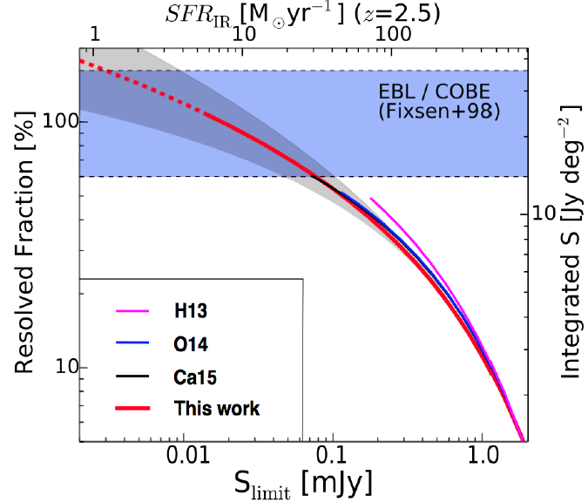
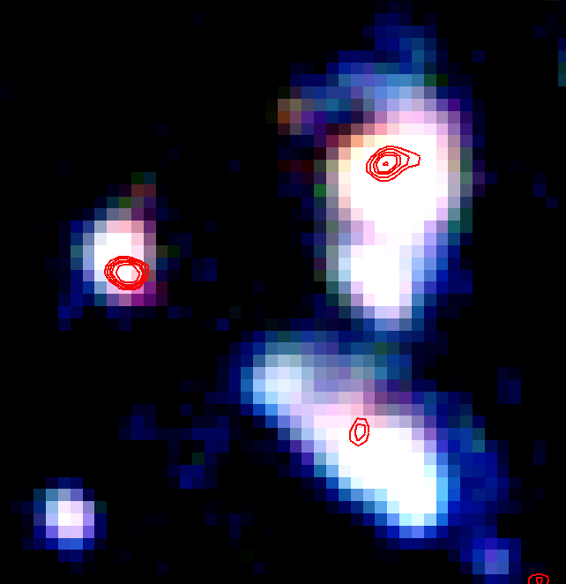
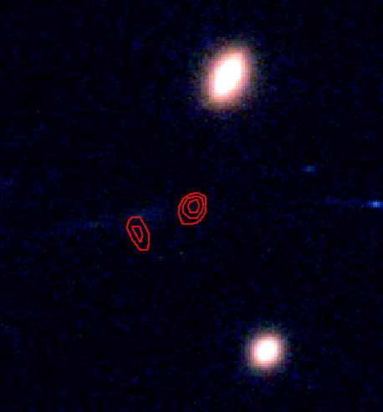
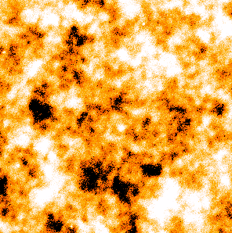
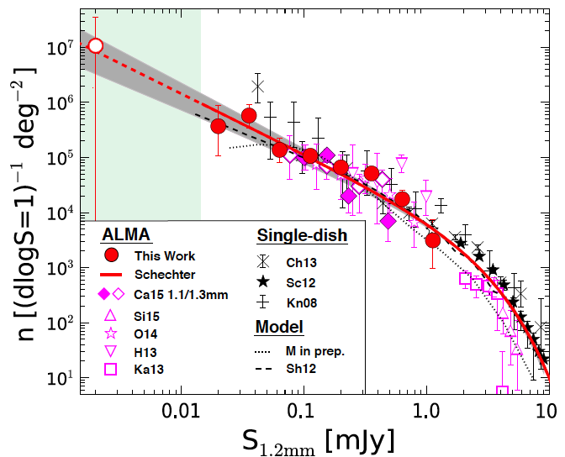
Origin of Cosmic Infrared Background (CIB)
CIB (100%)
COBE
This study
ALMA
Single Dish
Fujimoto+16
Intensive survey for mm sources: ~100% of CIB is resolved by ALMA obs (Fujimoto+16).
→ CIB is originated from dust in galaxies (no diffuse emission in the DM halos and IGM)
--- S. Fujimoto: U. Tokyo School of Science award in 2016 ---
~40% has no clear optical-NIR counterparts (down to ~27 mag)

Slide 9
Scientific Results (2012 Apr – 2018 Mar)
All papers (incl. collaboration papers)
A total of 120 refereed papers
A total of 5251 citations
ICRR-led papers
33 refereed papers, 1784 citations
Example,
Ouchi et al. (2018), “Systematic Identification of LAEs for Visible Exploration and Reionization Research Using Subaru HSC (SILVERRUSH). I. Program strategy and clustering properties of ˜2000 Lyα emitters at z = 6-7 over the 0.3-0.5 Gpc² survey area” (59 citations)
Citation counts as of May 2018
Notes:
A total of 66 refereed papers
52 from SDSS; 14 from HSC related studies
A total of 8622 citations
8087 citations from SDSS; 535 from HSC

Slide 10
Size of Group, and Manpower
Faculty
Masami Ouchi, Associate Professor, 2010 to the present
Yoshiaki Ono, Assistant Professor, 2012 to the present
Postdoctoral Fellows
Masao Hayashi, 2013-2014
Rieko Momose, 2012-2015
Suraphong Yuma, 2012-2015
Tomoki Saito, 2014-2015
Mariko Kubo, 2014-2016
Florent Duval, 2015-2016
Yi-Kuan Chiang, 2016-2016
Takatoshi Shibuya, 2013-2018
Jun Toshikawa, 2017 to the present
Ken Mawatari, 2018 to the present
Seiji Fujimoto, 2019 to the present

Slide 11
Education
Students
Resuming education activities after the arrival of Ouchi
Students from Physics/Astronomy departments of U. Tokyo
First 2 students in 2012
Accepting a total of 16 students incl. students in school (2012-2018)
13 (3) students have received master (Ph.D) degrees
Fellowships
8 students won JSPS DC fellowships:
Strong demands on our study subject from young students who are very active.

Slide 12
Award and Scholarship
Students
Masafumi Ishigaki: The School of Science Encouragement Award (M.S.) in 2015
Seiji Fujimoto: The School of Science Encouragement Award (M.S.) in 2016
Yuichi Harikane: The School of Science Encouragement Award (Ph.D.) in 2019
Seiji Fujimoto: The School of Science Encouragement Award (Ph.D.) in 2019
Post-docs
Takatoshi Shibuya: Astronomical Society of Japan Young Astronomer Award in 2019 (for 2014-2015 papers)
Staff
Yoshiaki Ono: Astronomical Society of Japan Young Astronomer Award in 2015
Masami Ouchi: Beatrice M. Tinsley Research Scholar in 2013
Masami Ouchi: The Young Scientists' Prize (Japan's Minister of Edu.) in 2014
Masami Ouchi: JSPS Prize in 2019
Masami Ouchi: Japan Academy Medal Prize in 2019

Slide 13
Funding and Budget
Grant for staff members
1) "Matter Exchange in the Cosmological Scale Probed with the Subaru/HSC and SDSS data", JSPS Grant-in-Aid for Scientific Research (A): 2015-2019
PI: M. Ouchi, \32,200,000
2) "Pionnering Cosmic Reionization and Magnetism Investigated \dotfill by Long Wavelength Radio Observations”, JSPS Grant-in-Aid for Scientific Research (A): 2017-2019
PI: N. Sugiyama (M. Ouchi as a CoI) \33,900,000 (\1,500,000)
3) "Cosmic Reionization Revealed by the Subaru/HSC NB Survey: CHORUS Project”, JSPS Grant-in-Aid for Scientific Research (A): 2017-2020
PI: A. Inoue (M. Ouchi as a CoI) \24,100,000 (\2,728,000)
4) "Cosmic Reionization Investigated by the Next Generation Observations and Simulations", JSPS Grant-in-Aid for Scientific Research (A): 2011-2014
PI: M. Ouchi, \39,960,000
5) "Determining the Physical Nature of a Unique Giant Lyman Alpha Emitter at z=6.595", Hubble Space Telescope Grant (AURA for NASA): 2010-2013
PI: M. Ouchi, $61,219
6) "Galaxy overdensities and their contribution to the cosmic reionization around distant QSOs based on the wide field millimeter and optical observations", Grant-in-Aid for Young Scientists: 2019-2022,
PI: Y. Ono, \3,300,000
7) "Cosmic Reionization Revealed by the Subaru/HSC NB Survey: CHORUS Project", JSPS Grant-in-Aid for Scientific Research (A): 2017-2020
PI: A. Inoue (Y. Ono as a CoI) \34,100,000 (\1,364,000)
8) "Observational study on galaxy formation history based on the Subaru HSC survey”, Grant-in-Aid for Young Scientists (B): 2015-2019
PI: Y. Ono, \2,900,000
9) "Properties of Galaxies in the Reionization Epoch Revealed by the 2012 Hubble Ultra Deep Field Campaign", Grant-in-Aid for Research Activity Start-up: 2012-2014
PI: Y. Ono, \2,000,000
*** ICRR joint usage/research center grant --- PI: M. Ouchi \500,000 (2012-2018)
Grant for students
JSPS DC fellowship grants for 8 students
Notes:
3,980,000 yen:
328,xx yen:

Slide 14
Relation with other universities/community
1) HSC program
HSC survey consortium ~>100 scientists (Opt-NIR obs. society in Japan, Princeton, Taiwanese institutes)
Narrow-band development w scientists from Tokyo, NAOJ, Ehime, Osaka-sangyo, Tsukuba etc.
2) HST, ALMA program
Hubble Ultra Deep Field 2012 (UDF12): Caltech, Arizona, Edinburgh etc.
HST/RELICS survey: STScI, UC Davis/Riverside, Michigan etc.
ALMA Lensing Cluster Survey (ALCS): NAOJ, Arizona, Lyon, LAM, UCL, Catolica etc.
Accepting (sending) post-docs from (to) Opt-NIR obs. and ALMA communities.
On-going and forthcoming program
Subaru Prime Focus Spectrograph (PFS) survey: Tokyo, NAOJ, Osaka, Princeton, LAM etc.
Murchison Widefield Array (MWA): Nagoya, Kumamoto, ANU, Curtin, MIT etc.
Subaru-NASA Wide Field Infrared Survey Telescope (WFIRST): NAOJ, Caltech/IPAC, JPL+
Notes:
14 from Japanese institutes

Slide 15
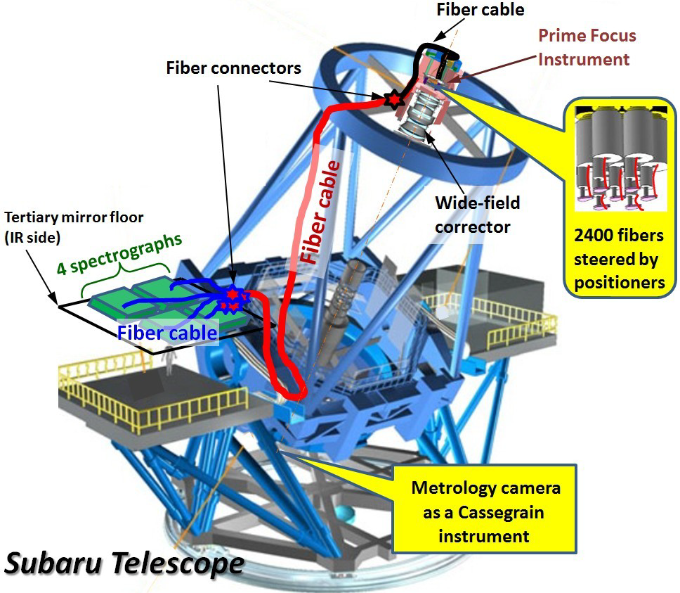
Future prospects
Prime Focus Spectrograph (PFS)
2400 fibers
FoV: Φ1.3deg
1) HSC survey observations: 2014-2020+
2) HST, ALMA program 2012-2020+
On-going and forthcoming programs in the 2020s
Subaru PFS (~2021-)
Subaru-NASA WFIRST program (~2025)
Thirty Meter Telescope (TMT; ~2028)

Slide 16
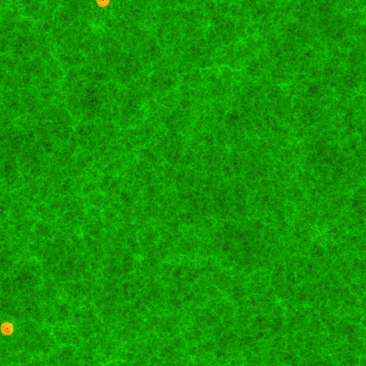
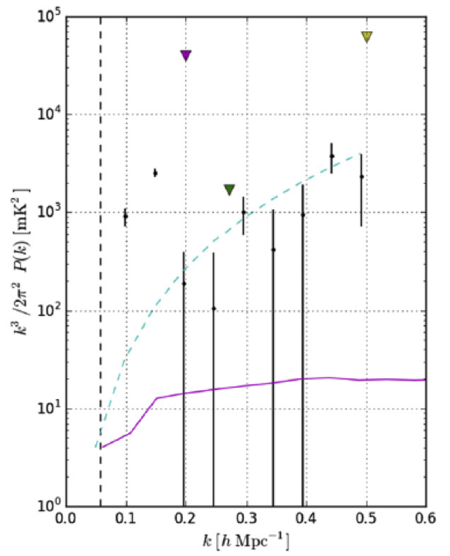
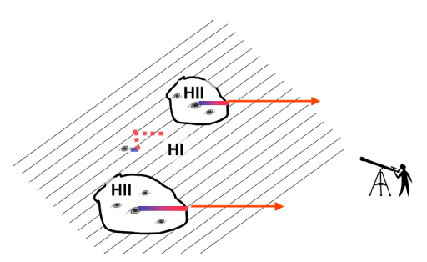
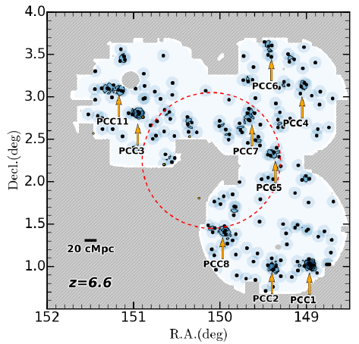
PFS Program for Reionization Physics
Simulation (prediction)
Epoch of Reionization (EoR) HI 21cm Auto Power Spectrum
No Detections (2 σ upper limits)
Galaxies (blue dots),ionized bubbles (orange) (Iliev+06)
Galaxy (LAE) Distibution (HSC obs)
Expected (Model) x_{HI}~50%
Dijkstra 2014
Ali+15 (see+Ali+18)
No detections, due to strong foreground systematics
Cross Correlation with real signal of HSC+PFS galaxies (LAEs)
Higuchi+19
Notes:
The IGM-Galaxy interplay is also important at the epoch of the reionization. The animation (left) presents cosmic reionization predicted by the radiative transfer simulation. The neutral IGM (green) is ionized by ionized photons from star-forming galaxies (blue dots), and ionized regions (a.k.a ionized bubbles) are made. The ionized bubbles grow, merge, and complete cosmic reionization. This simulation is based on the physical process of the reionization, so called, the inside-out scenario of reionization. In the inside-out scenario, galaxy overdensities produce ionized bubbles, and drive cosmic reionization. The right figure is the LAE distribution and overdensities on the sky obtained by the HSC imaging survey. The sky coverage is larger than the animation (left). The LAE distribution (overdensities) correspond to the distribution (overdensities) of ionizing sources.

Slide 17
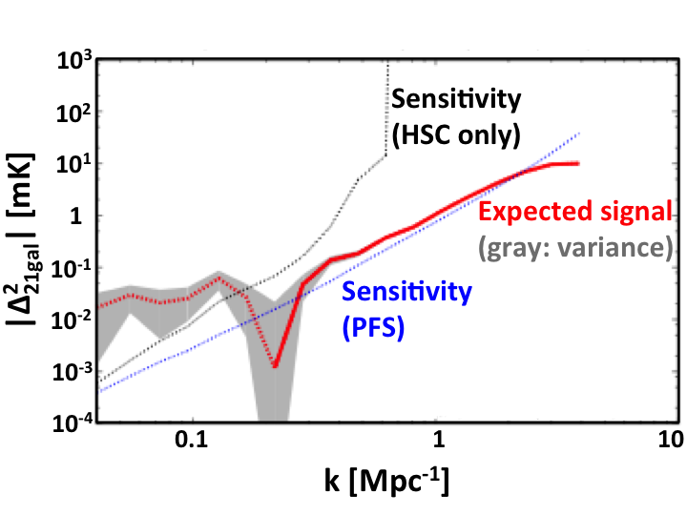
First Detection of EoR HI 21cm Signal by
LAE-21cm Cross Correlation
neg. signal
detections
21cm: MWA,SKA
Kubota+18. See similar predictions (Sobacchi&Mesigner+16, Hutter+18)
Goal-1: Detection of the cross-correlation signals -> Evidence of early cosmic HI struc.
Positive cross-correlation at k~0.4 Mpc⁻¹ at ~5 sigma
Negative cross-correlation at k~0.1 Mpc⁻¹ at ~3 sigma
Goal-2: Determination of the CPST scale at z=6.6 with Δk=~0.1 accuracy
First definitive evidence of cosmic ionized bubbles
Goal-3: Cross-correlation shape differences: galaxy and AGN contributions (TBD)
Hasegawa et al. are implementing AGN sources in simulations to evaluate (ongoing).
No competing studies exist in the existing/planned projects.
Notes:
Now we have the sky distribution of LAEs (galaxies) from the HSC survey. One needs the IGM data to understand the reionization process. On the HSC imaging footprint, Murchison Widefield Array (MWA) is taking deep HI 21cm radio data under the official participation of Japanese investigators in Kumamoto University, Nagoya University, University of Tokyo etc. This figure shows the cross-power spectrum of LAE - HI 21cm predicted by the simulation, assuming the on-going HSC and MWA data qualities. The red solid and dotted lines represent the cross-power spectrum expected from the simulation. Particularly, the red dotted line indicates the negative correlation signal. In the large scale (small in k), the simulation predicts the negative correlation between LAEs and the HI 21cm. This is because no HI exists around LAEs that are sitting in the ionized bubbles. In the small scale (large in k), there is a positive correlation that can be explained by the simple large-scale structures. There is a cross-power spectrum transition (CPST), where the cross-power changes from negative to positive correlation (at k~0.2 Mpc^-1 in this case). This corresponds to the scale of the typical ionized bubbles. The black dotted line is the sensitivities accomplished by the HSC imaging data. The imaging HSC data would identify the negative correlation. However, the HSC imaging data alone won’t detect the positive correlation and so as CPST. If you can include the PFS spectroscopy data for the Lya redshift determination, one can identify the positive correlation as well as CPST. This is because the PFS spectra will allow us to measure the small scale clustering that cannot be probed by the HSC imaging data alone. Here we have three scientific goals. (see the text in this slide from here.) Goal1 is …. Goal2 is ….

Slide 18
Summary
Science goal
Evolution of the universe (Structure/galaxy formation, Cosmic reionization)
Project status
HSC Survey (2014-) and multi-wavelength prog (+SDSS)
Scientific results
120 refereed papers, 33 out of which are led by ICRR
Size of Group, manpower, and education
2 faculty. 9 post-doc. 16 students (+in school). 13/3 degrees. 8 JSPS fellowships
Award and Scholarship
2 School of Science Awards, 1 ASJ Young Astronomer Award, 1 MEXT Prize
Funding and Budget
9 grants, 2 of which are ~30-40 million yen programs led by Ouchi
Future prospect
HST to PFS (for WFIRST/TMT). HI-galaxy corr. for reionization phys

