Slide 1

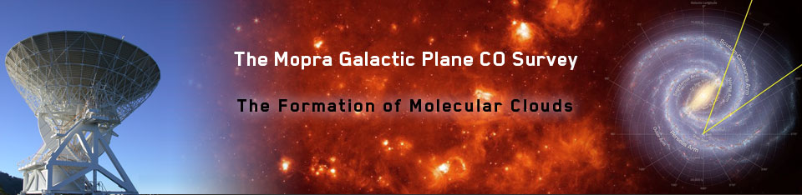

The Mopra Southern Galactic Plane CO Survey: why the CTA needs it!
PASA (Publications of the Astronomical Society of Australia),
2013, 30, e044 (Burton et al.) + 2015, 32, e020 (Braiding et al.) www.phys.unsw.edu.au/mopraco
Michael Burton
University of New South Wales
Gavin Rowell
University of Adelaide plus many, many collaborators…..
mopra.org

Slide 2
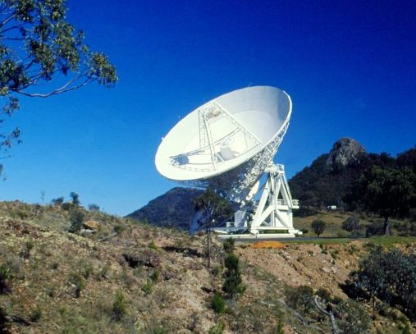
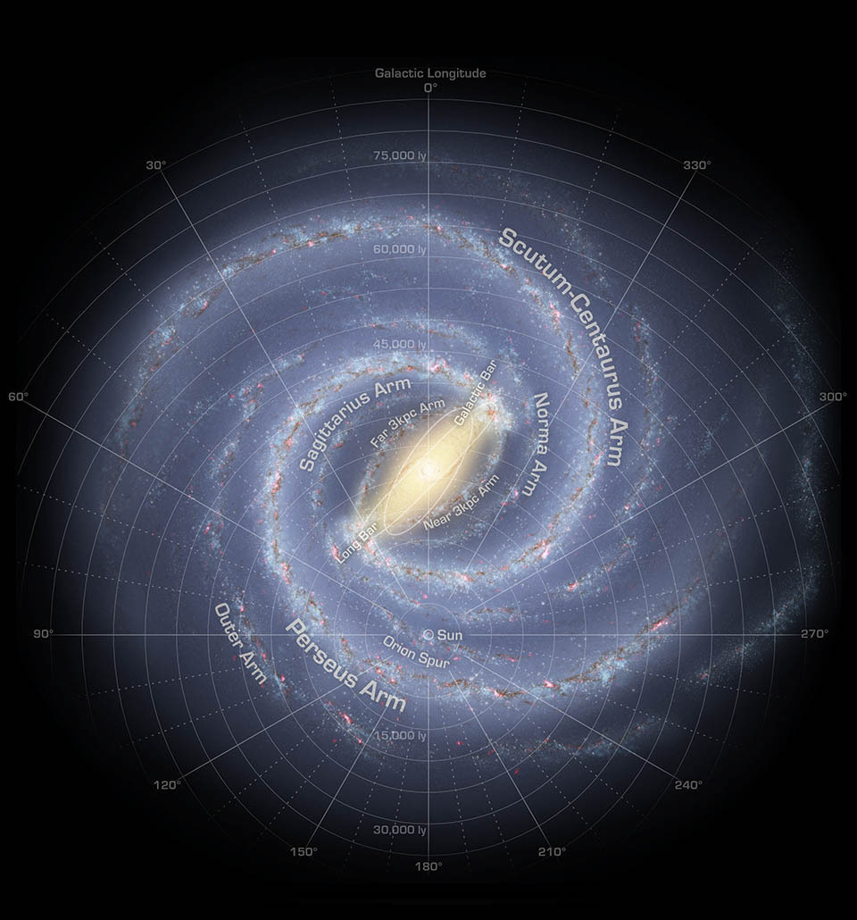
Outline
Molecules and TeV Gamma-rays
  What’s the connection?!
    The greatest column density of nuclei for cosmic-ray interactions
Radio telescopes and the interstellar gas
  Mopra + Nanten2 + HEAT + Parkes + ATCA + ASKAP + STO2 + ....
The Mopra Southern Galactic Plane CO Survey
  100° x 2° across the 4th Quadrant of the Galaxy
  0.6 arcmin, 0.1 km/s, 3 isotopologues
    Resolution commensurate with CTA’s needs

Slide 4
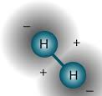

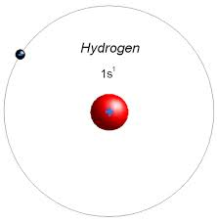
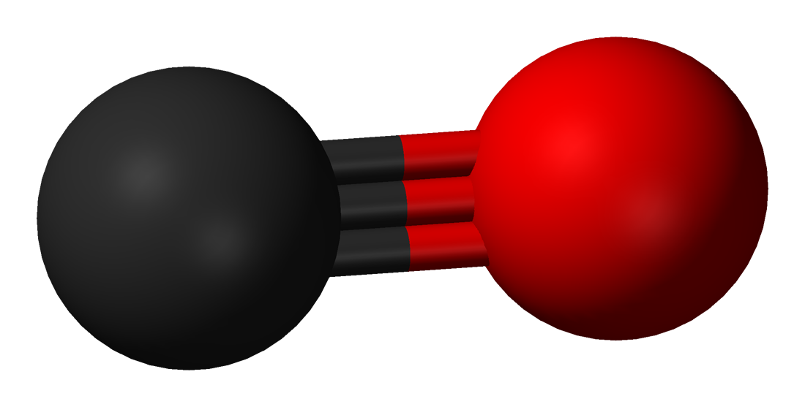
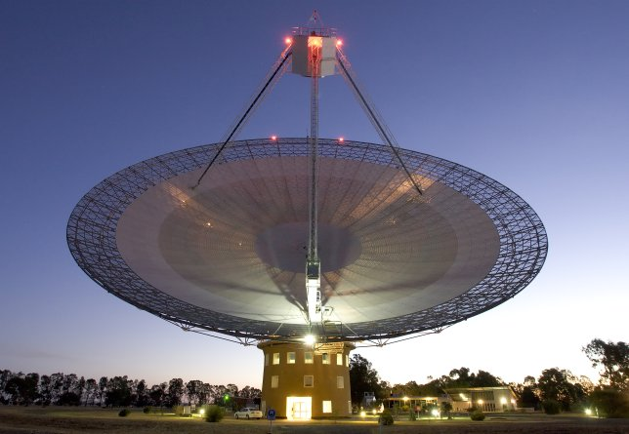
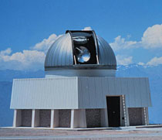
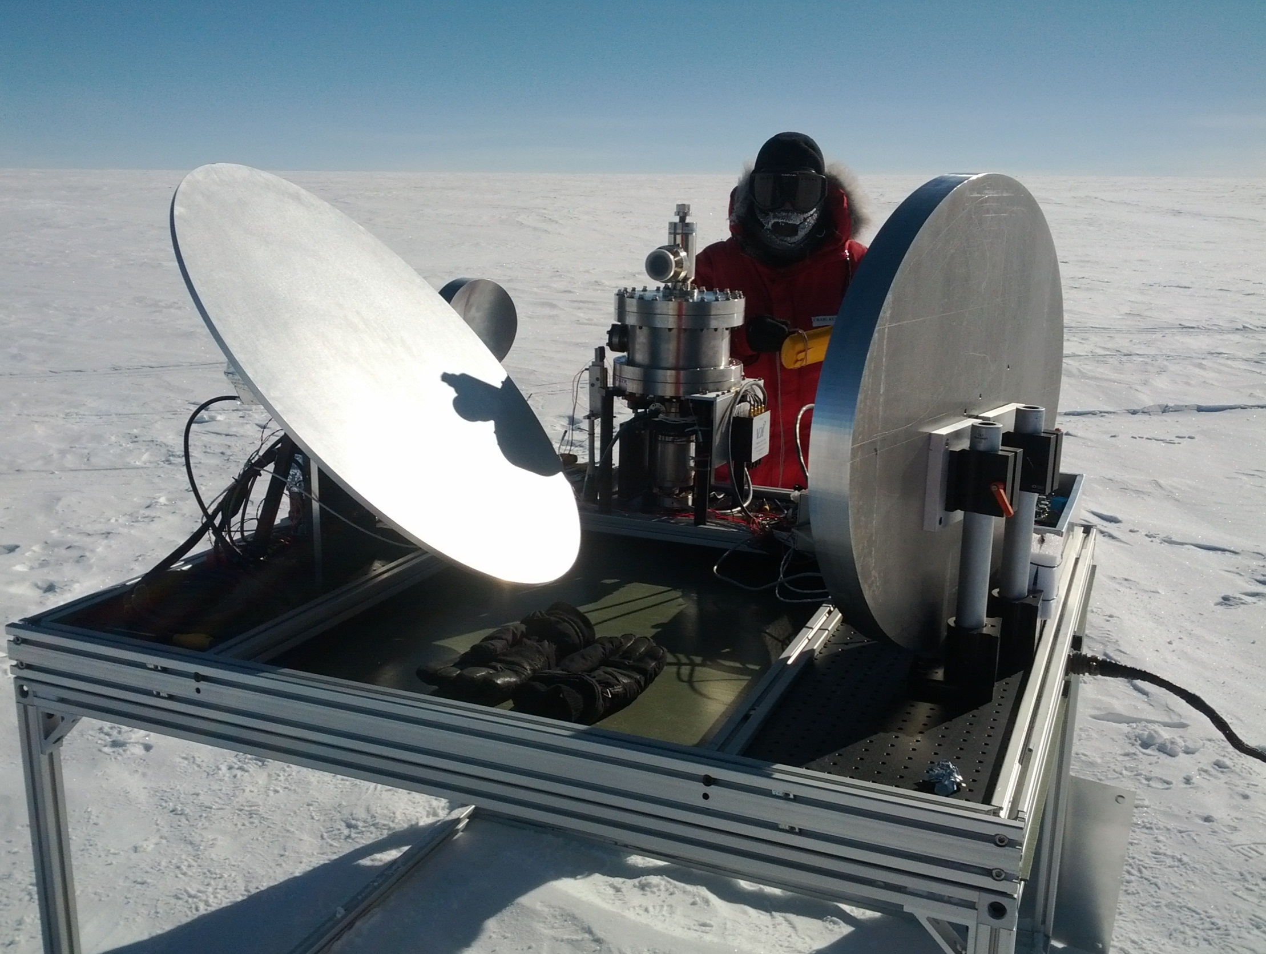
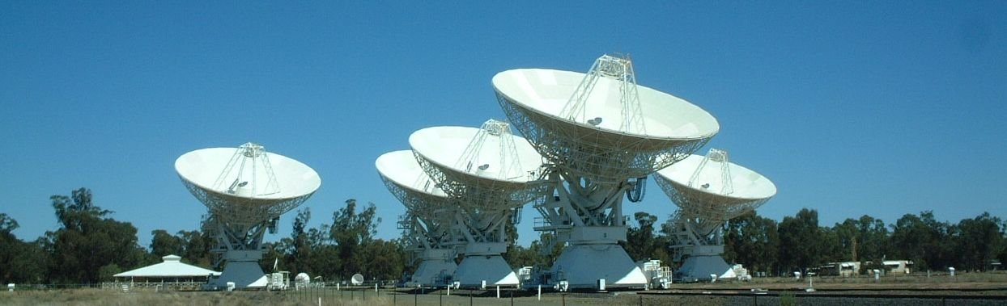
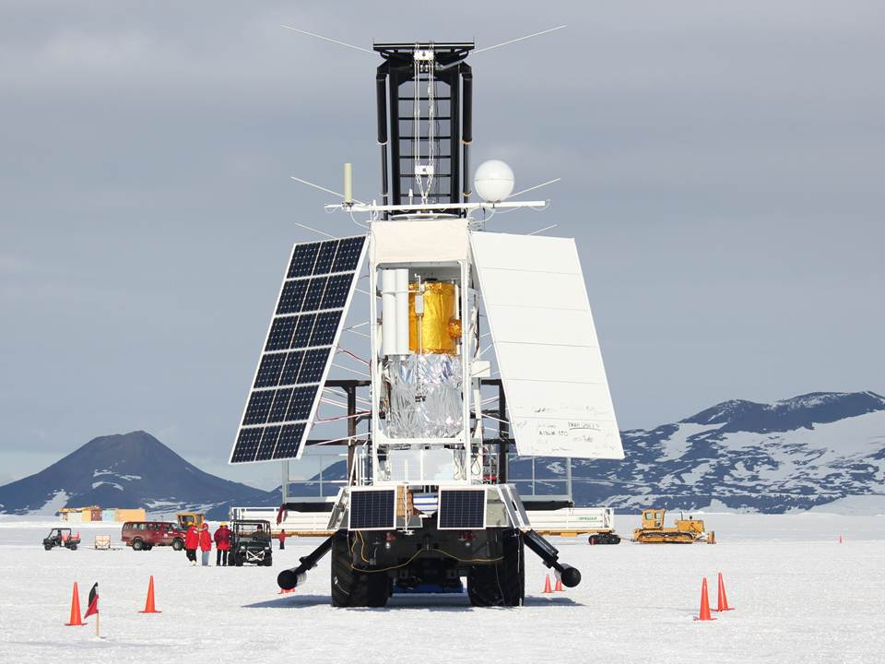
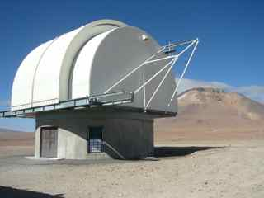
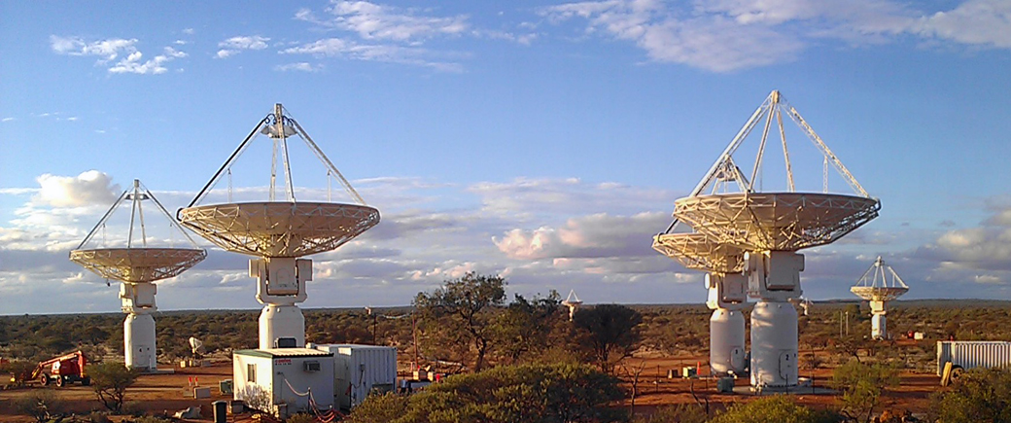
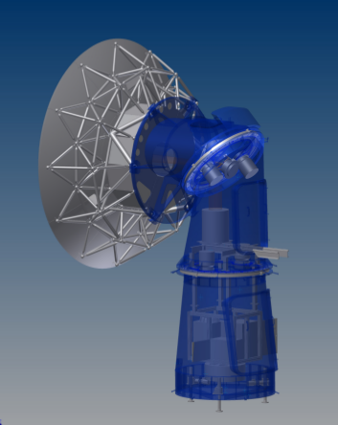
H H₂ ➔ CO Dark Gas ➔ C
1.2m Columbia
New York + Chile
Dame et al 2001.
CO J=1-0 2.6mm
60cm HEAT
Ridge A, Antarctica
[CI] : THz
Parkes + ATCA
SGPS – HI 21cm
McClure-Griffiths et al. 2005
22m Mopra
60cm STO-2
GASKAP
Dickey et al. 2013
4m Nanten2 (Nagoya)
5m DATE5

Slide 5
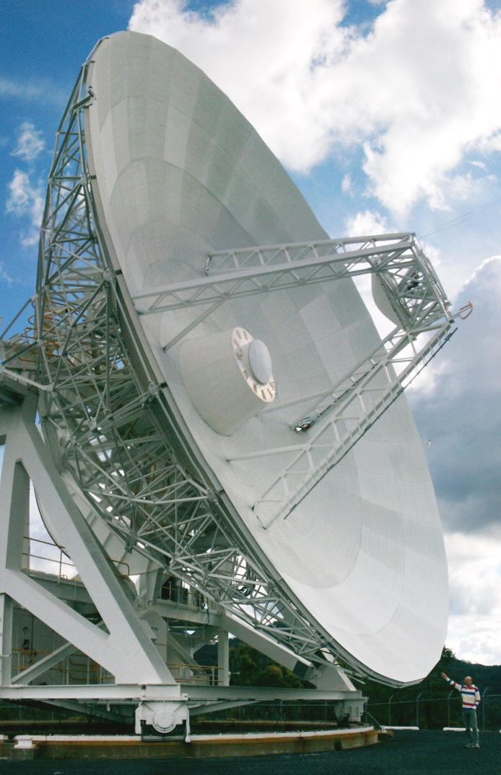
Mopra Telescope:
Millimetre-Wave Capabilities
22-m Telescope for long-wave mm astronomy
  Receiver 3mm + 7mm + 12mm
Bandwidth 8 GHz: UNSW-MOPS correlator
  Broad Band 32,000 channels, 0.8 km/s resn.
  16 Zooms modes over 137 MHz
    4096 channels/zoom, 0.1 km/s@3mm
“Fast-On-the-Fly” (FOTF ) Mapping
User-pays operation:
  UNSW/Adelaide + NAOJ 3-year contract
    2013-2015 (Just finished)
  What now???
    Crowdfunding campaign

Slide 6
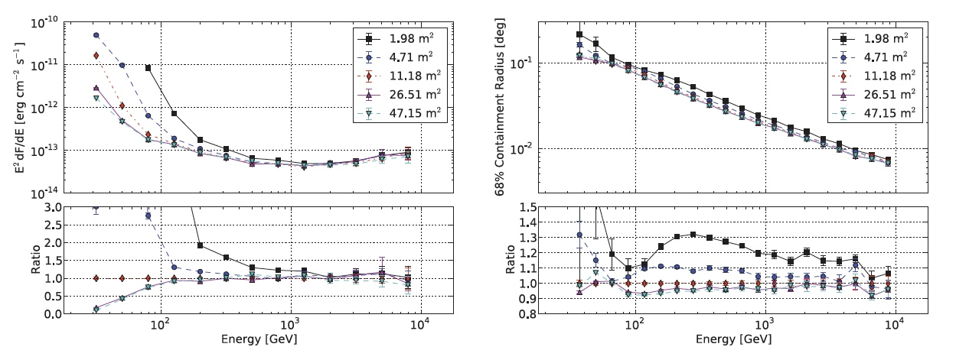
CTA’s need for better angular resolution in the ISM
Colombia CO Survey
Nanten2 CO
Mopra CS
Mopra CO
Energy (TeV) 0.1 1 10
Wood et al, 2016, Astroparticle Physics, 72,11

Slide 7
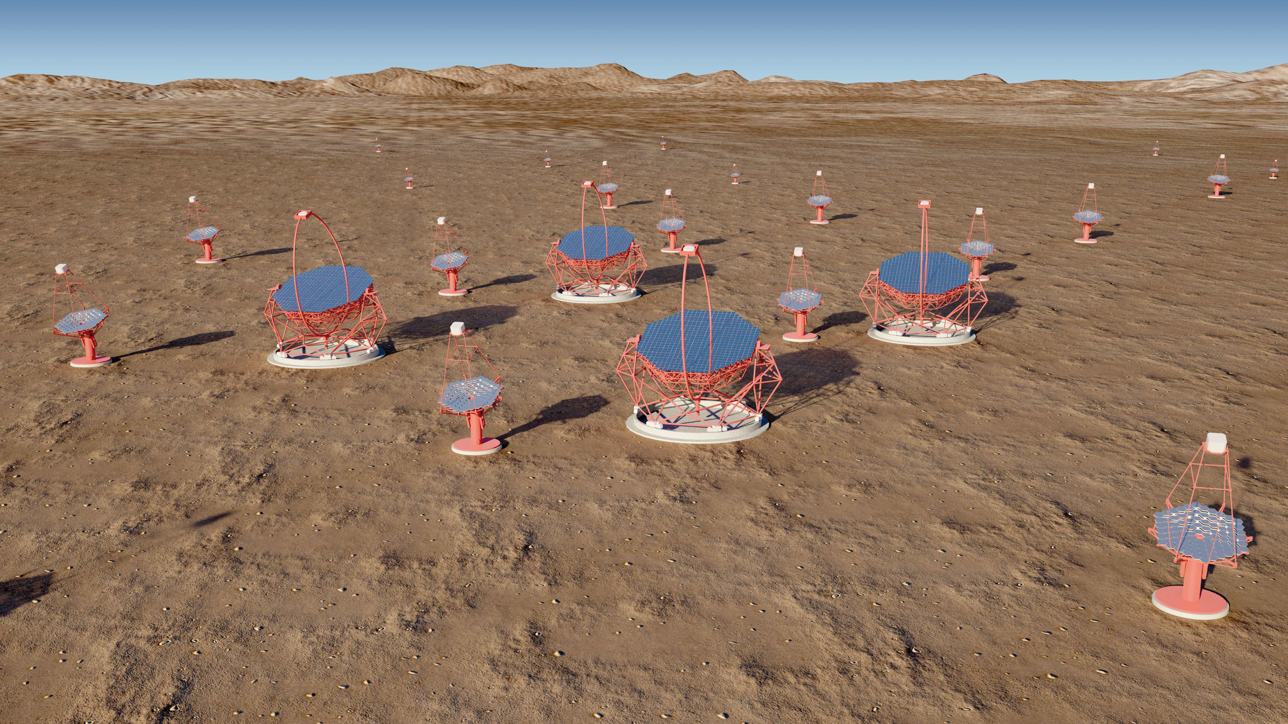
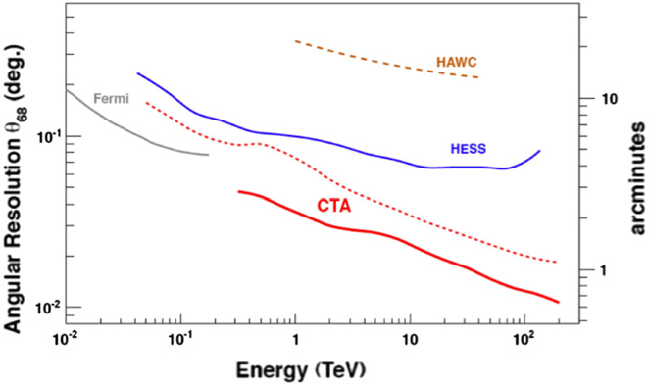
CTA’s need for better angular resolution in the ISM
Columbia CO Survey
Nanten2 CO
Mopra CS
Mopra CO
Acharyara et al. 2013

Slide 8
Fast Mapping with Mopra
Binning mode in 2.048s cycles
  8 x 256ms samples
i.e. 8 x faster for 1/3rd the sensitivity
  Only suitable for CO lines
Scan at 35”/s = 9” cell size
15” row spacing
30 hours/sq. deg. c.f. 350 hours
8 zoom modes, not 16
  ¹²CO, ¹³CO, C¹⁸O, C¹⁷O
60’
uniform
coverage
15’
5’
6’
Thanks also to Warwick Wilson, Dick Ferris, Balt Indermuehle

Slide 9
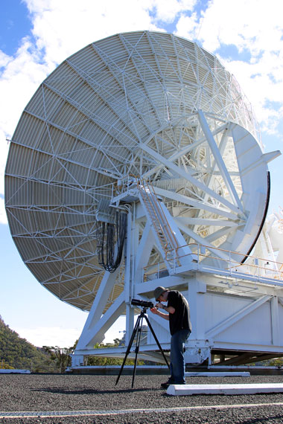
Line Parameters for CO Survey
IF | Frequency (GHz) | Isotopologue | V_{low} (km/s) | V_{high} (km/s)
1+2 | 110.1 | ¹³CO 1-0 | -475 | +270
3+4 | 109.7 | C¹⁸O 1-0 | -495 | +255
5 | 112.3 | C¹⁷O 1-0 | -235 | +130
6+7+8 | 115.2 | ¹²CO 1-0 | -550 | +525
0.6 arcmin Beam @ 0.1 km/s resolution
~4 shifts per 1°x1° block (|b|<0.5°)
An order of magnitude improvement in both
spatial and spectral resolution than previous
generation survey, and in three key lines, not one!

Slide 10
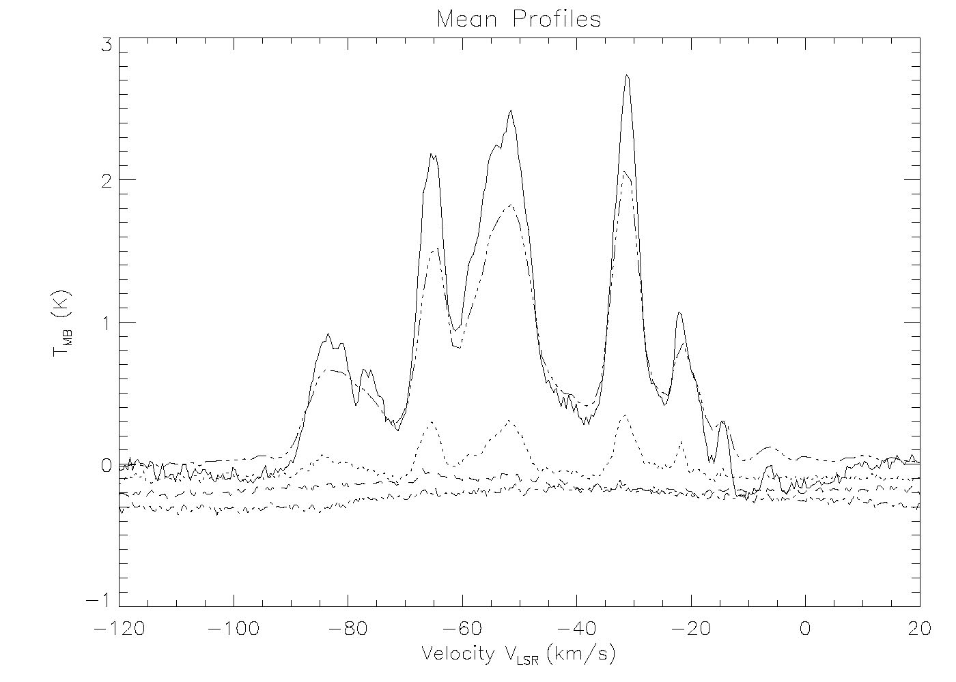
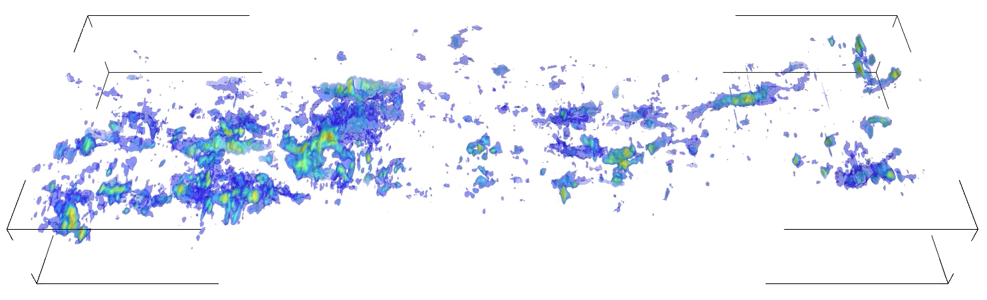
Sample Results
Mean ¹²CO & ¹³CO line profiles in G323
¹²CO & ¹³CO images + Columbia survey contours
¹²CO
Columbia survey
¹³CO
G320-330 ¹²CO Rendering: longitude-latitude-velocity
-100 km/s
+0.5°
0 km/s
330°
-0.5°
320°

Slide 11
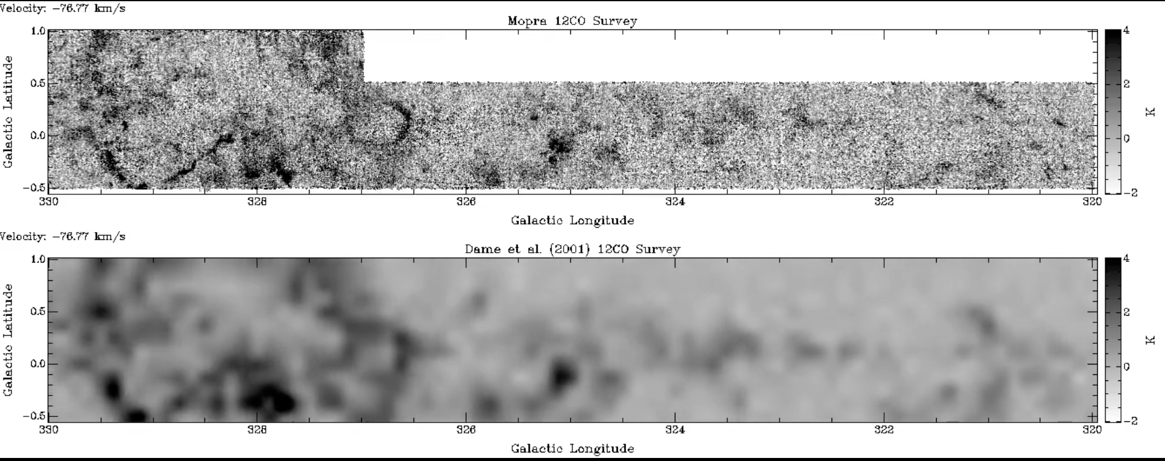
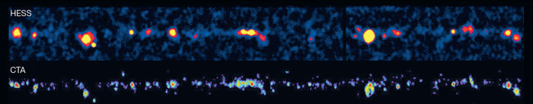
¹²CO: Mopra vs. Columbia
Resolution Gain:
0.6 vs. 9 arcmin and 0.1 vs. 1 km/s
Mopra 22m
Columbia 1.2m

Slide 12
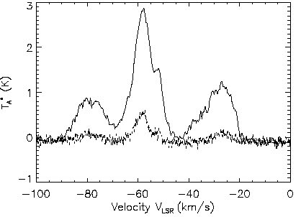
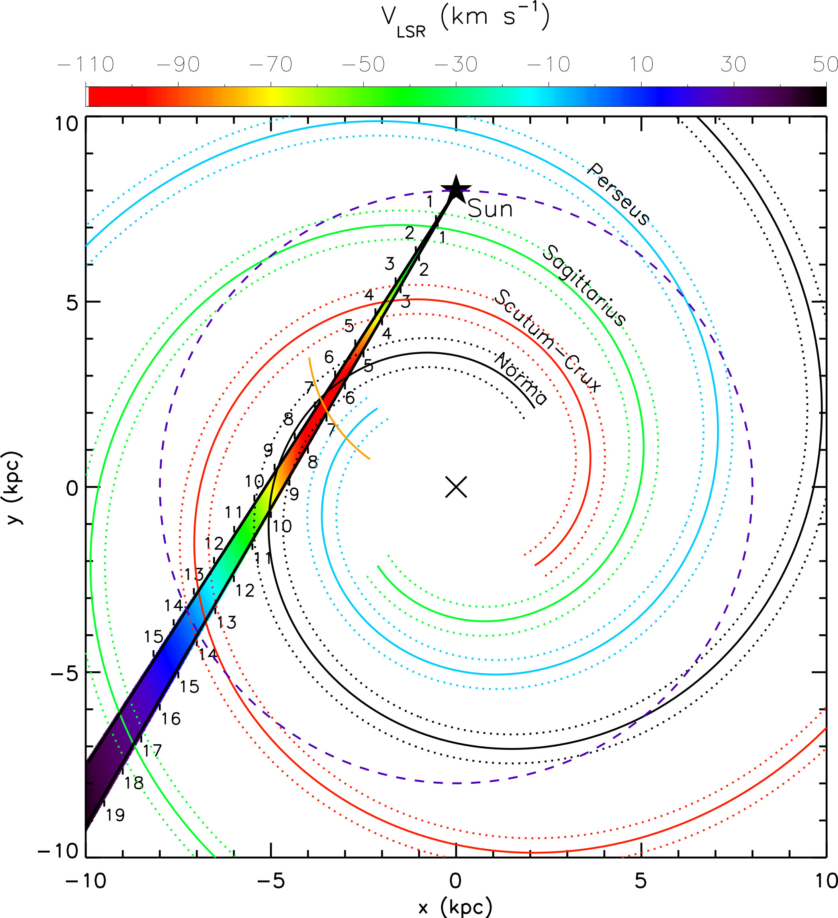
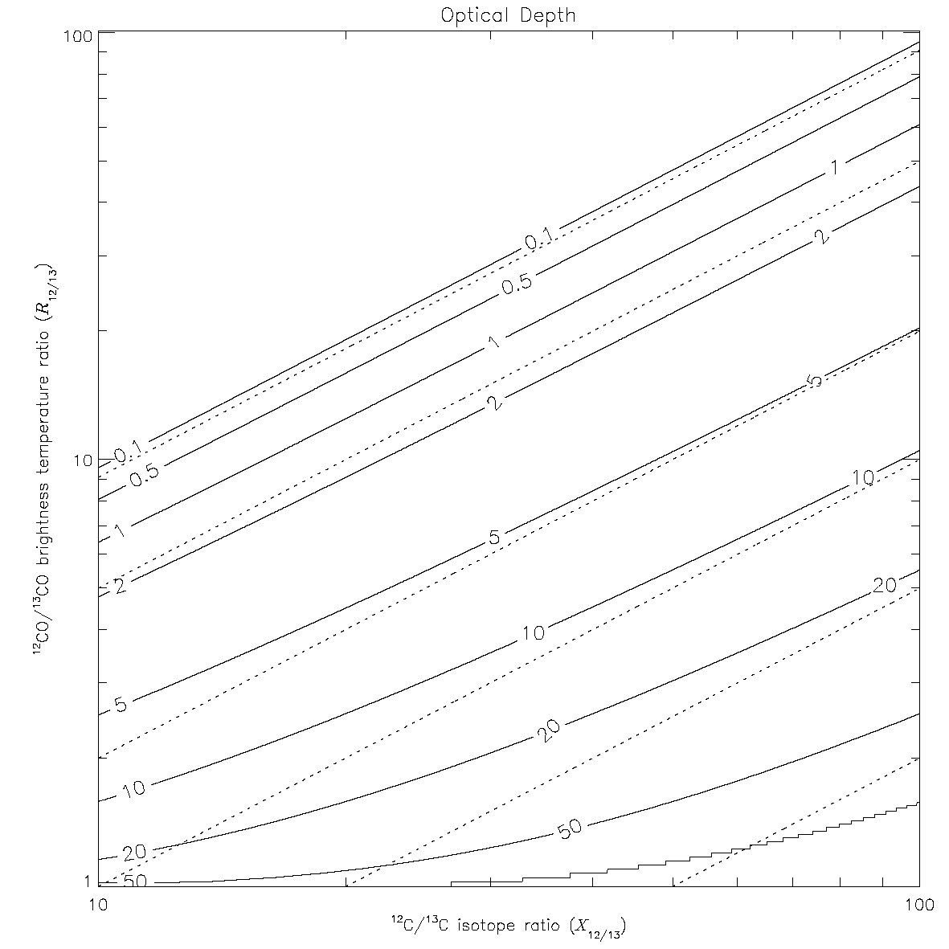
CO Lines yield:
Source Distance +
Column Density
¹²CO +¹³CO
Line Profiles
X
orbital
motion
Optical Depth
τ
¹²CO/¹³CO
Observed Line Ratio
[¹²C/¹³C]
Intrinsic Isotope Ratio

Slide 13
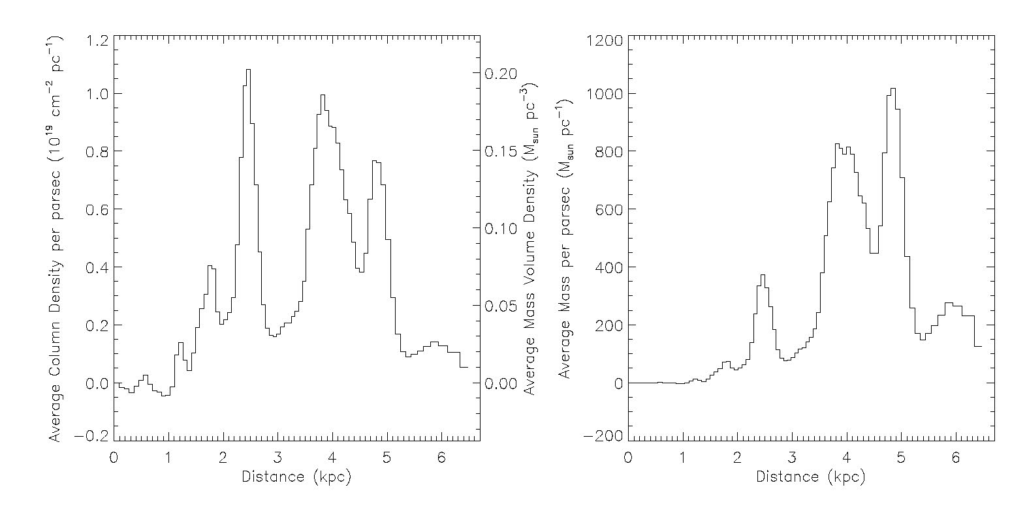
Molecular Mass Distribution at l=323°
Aim to produce a 3D galactic molecular mass distribution
M_{total} ~2 x 10⁶ M
ρ_{arm} ~0.1 M/pc³
M_{arm} ~5 x 10⁵ M

Slide 14
The ISM for G320° – 330°
12CO, 13CO, HI
Spiral arms clearly evident
[Scutum - Crux]
Sag -
Carina
Scutum -
Crux
Norma -
Cygnus

Slide 15
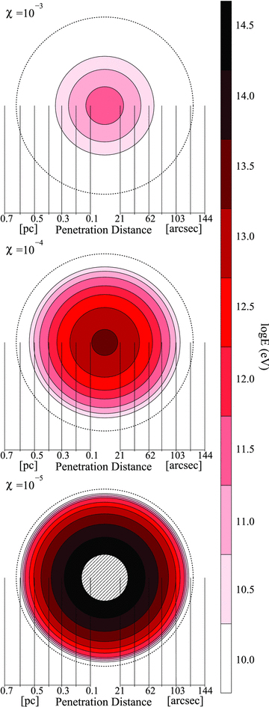
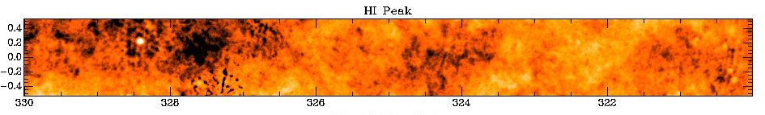
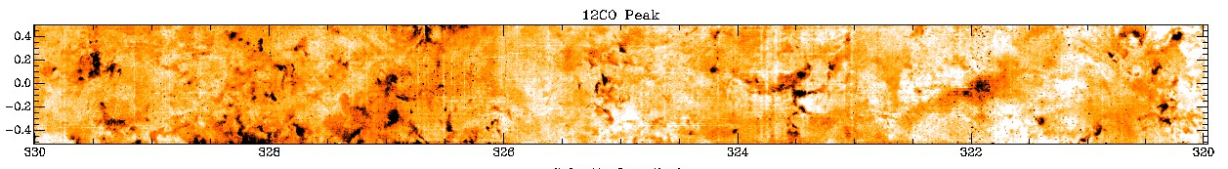
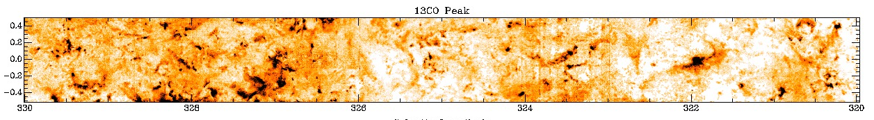
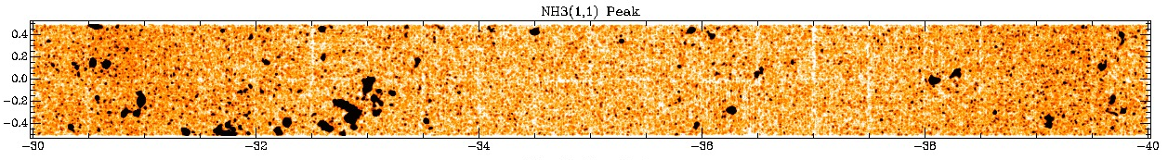
The Galaxy at Different Density: cosmic ray diffusion
Maxted et al. MNRAS 2012,422, 2230
HI
¹²CO
Density Increasing
¹³CO
Minimum Energy CR penetration with different diffusion suppression coeffs.
NH₃
Cosmic Ray diffusion
depends on both
the density
and the
column density
distribution

Slide 16
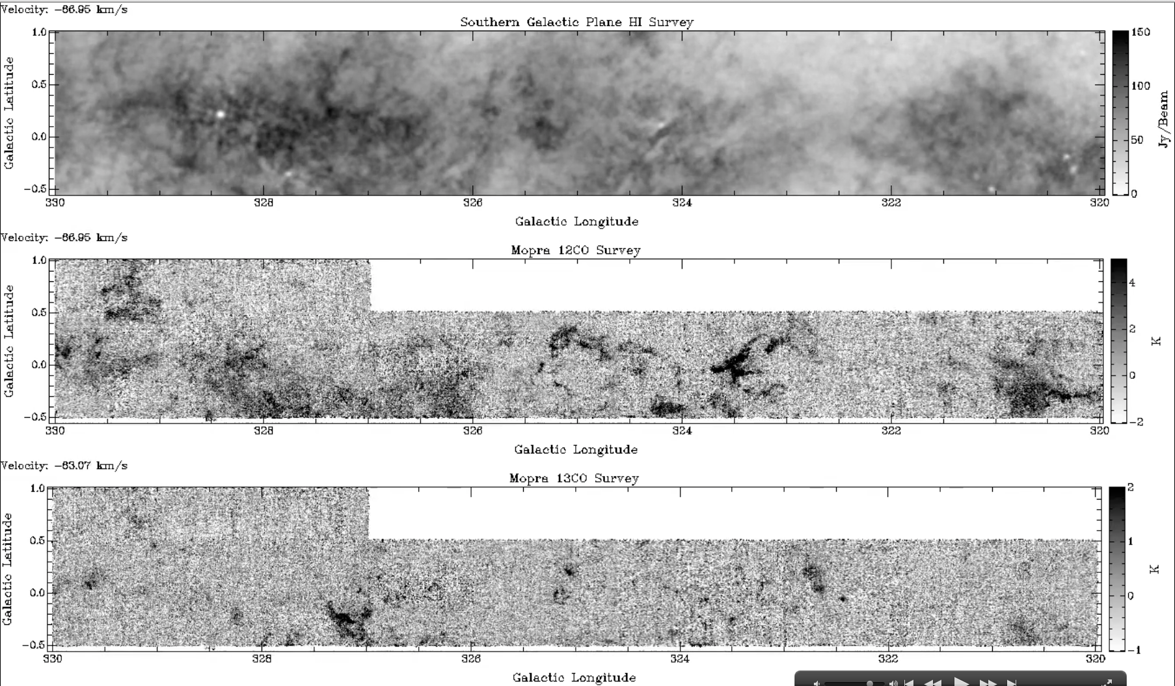
HI (SGPS), ¹²CO & ¹³CO (Mopra)

Slide 17
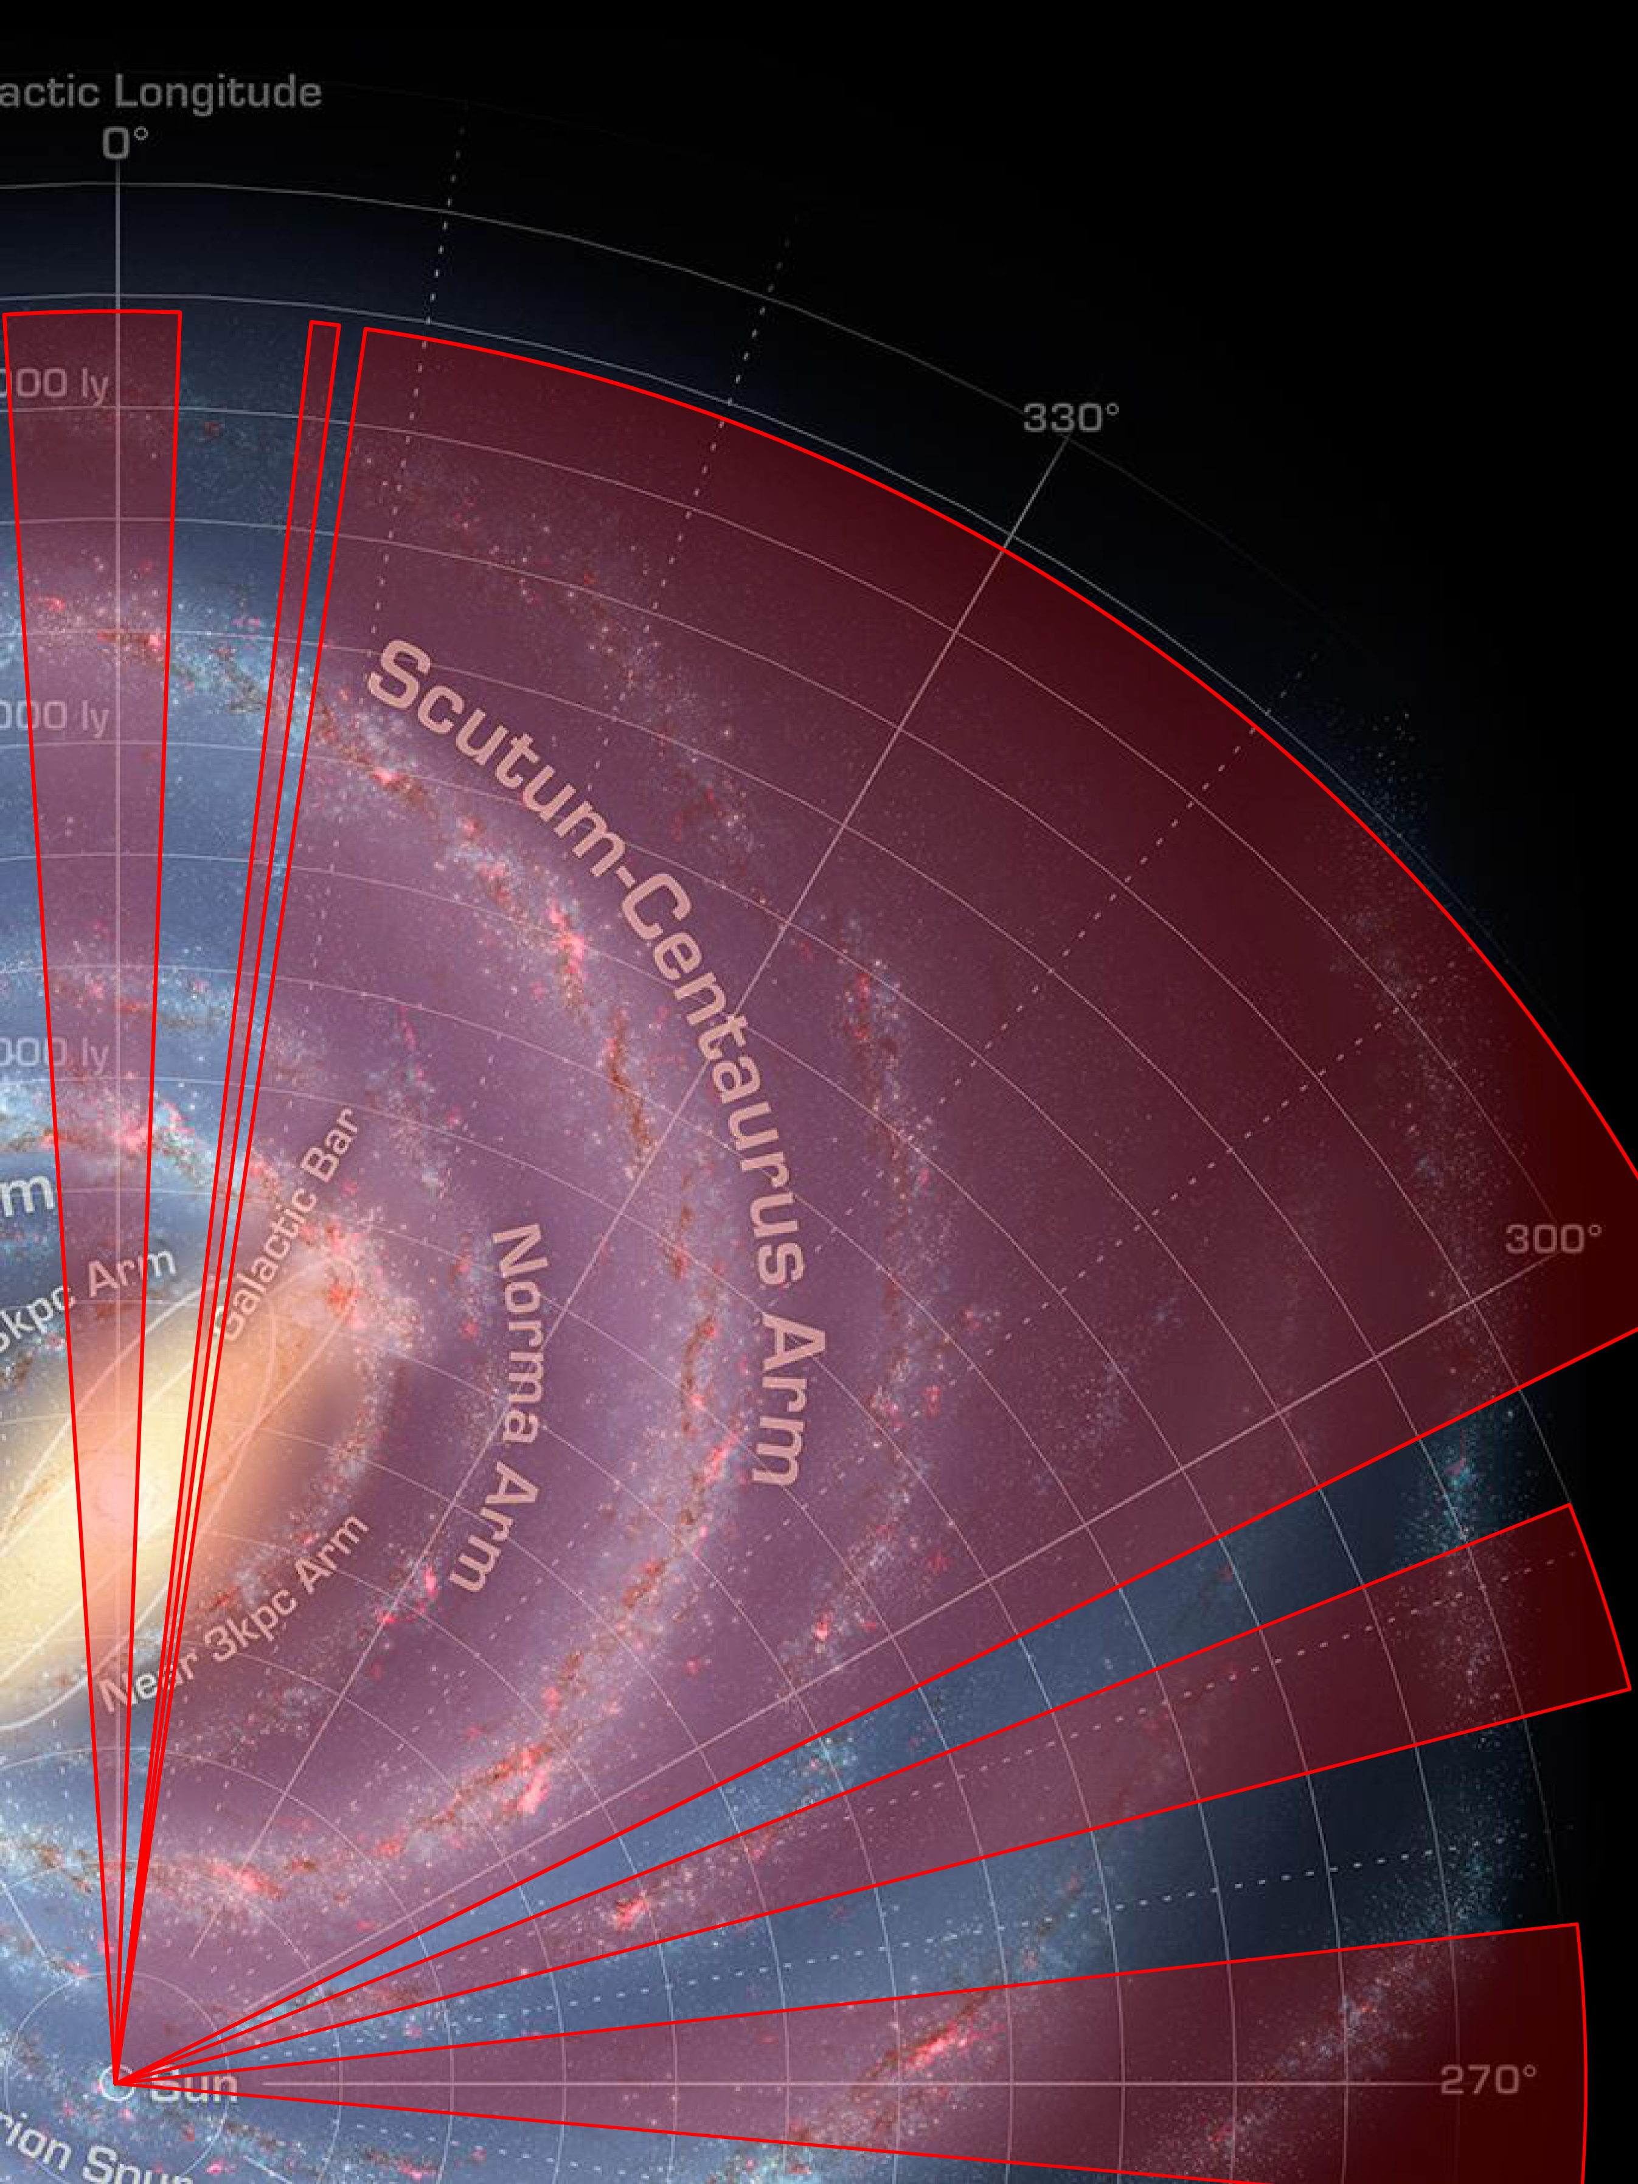
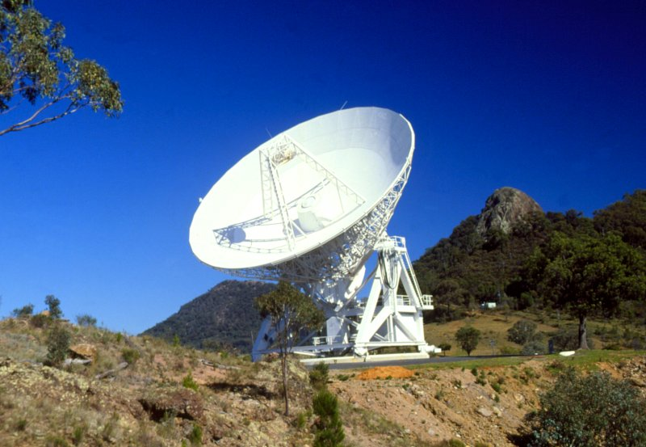
Survey Status
The 4th Quadrant of the Galaxy
l ~265° – +5°
Generally b=±0.5°
We aim to cover
b=±1.0°
~85 sq. deg covered so far.
Please contact us if interested in early access to the data for particular research projects.
CMZ
Carina
Vela Jnr
Data will be made available at
www.mopra.org

Slide 18
The Future of Mopra and the
Galactic Plane Survey?

