Slide 1

Overview on Thermal DM Models with emphasis on Electroweak Charges
Shigeki Matsumoto
(Kavli IPMU, U. Tokyo)
Dark matter (DM) problem is one of the most important problems in many fields of physics!
DM mass is, however, presently predicted to be in a range between 10^{–55}g and 10⁺⁴⁰g, namely uncertainty of a hundred orders of magnitude. Thus, we need diverse studies for the problem!
Among various DM candidates, a weak-charged thermal DM attracts many attentions. I try to briefly outline the above story and present some basics of the weak-charged thermal DM!
Notes:
30min. (6 or 7 slides in bulk)
0. タイトル
What we know DM & Various candidates.
Thermal Freeze-out DM.
WIMPy scenario + detection strategy and uncarted regions.
EWIMP (various possibilities and their properties).
Why they are not detected yet?
To detect the EWIMP. (Addressing J-factor estimation.)
Summary

Slide 2

Dark Matter Candidates
1/7
DM exists in form of halo associated w/ galaxy, etc.
I am (almost) stable, neutral, cold & weak interacting.
And, my weight must be in the following range!
m
10^{–22} eV
2π/mv < Gal. size
m < Gal. mass
10⁴⁰ g
Dark Matter
© Nintendo
What is DM?
10^{–22}eV < m < 10¹⁹GeV
Eg. PBH
Particle
λ = 2π/m > 2m/M_{pl}²
Non-particle
Motivation!
10^{–2}GeV < m < 10⁵GeV
Eg. Axion, ν_{R}, Fuzzy DM, …
Thermal
Non-thermal
…
Freeze-out
Asymmetric

Slide 3
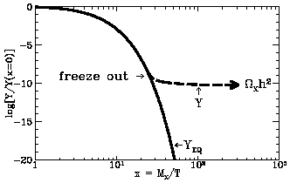
(Freeze-out) Thermal DM candidates
2/7
DM abundance was fixed by the so-called thermal freeze-out process.
Freeze-out： Abundance of a species is determined by the competition between the expansion rate of the universe and the reaction rate to maintain equilibrium between the species and others in the universe.
DM is in equilibrium with SM particles.
DM decouples from thermal bath (SMs).
Amount of DM does not change anymore.
Amount at → equilibrium
Freeze-out mechanism is known to describe BBN and CMB phenomena very successfully!
Motivation!
How dark matter abundance observed today is determined?
Freeze-out
WIMP-like
SIMP-like
Semi-ann.
…
DM DM ⇄ SM SM
3DM ⇄ DM DM
DM DM ⇄ DM SM

Slide 4

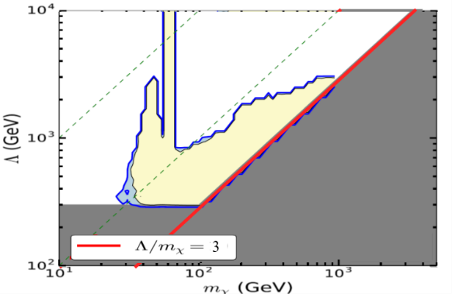
WIMP-like DM & its detection strategy
3/7
Collider D.
DM
SM
The process maintaining chemical equilibrium.
The same interaction offers the scattering
between SM & DM, guaranteeing kinematical
equilibrium during the freeze-out process.
Direct D.
DM
SM
The DM cand. most intensively studied so far.
All interesting parameter region excluded?
Indirect D.
Many types of WIMPy DM are uncharted yet because of its diversity!
Systematic & comprehensive studies tell us … [S.M., Y. S. Tsai, et. al.]
1. Classifying WIMP based on its quantum numbers (spin, weak isospin).
2. Constructing a renormalizable Lagrangian with minimal contents.
3. Put all constraints obtained so far and relic abundance condition.
[JHEP, 2019]
[PRD, 2016]
[JHEP, 2016]
Light WIMP, Leptophilic WIMP, (CPV) H-portal, Weak-charged WIMP.

Slide 5
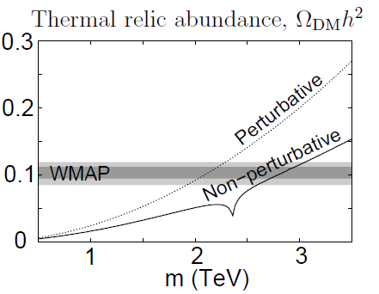
Weak-charged WIMP and its properties
4/7
SU(2)
Weak-charged WIMP dark matter
= The one described by a field of
a neutral component in a non-
trivial SM SU(2)_{L} multiplet!
The state of DM is close to a gauge eigenstate of the weak interaction.
A small mixing effect can be taken
into account by higher-dim. Ops.
1 2 3 4 5 …
0 (OK) OK OK
±1/2 OK OK
±1 OK OK
±3/2 OK
±2 OK
U(1)
…
The mass is predicted to be O(1)TeV!
Degeneracy among the component!
[J.Hisano, S.M., M.Nagai,
O.Saito, M.Senami, 2007]
[M. Ibe, S.M. R. Sato,
PLB721 2013]
NLO calculation needed. →Tobias’s talk
Difference is O(100)MeV! → ∃LLP

Slide 6

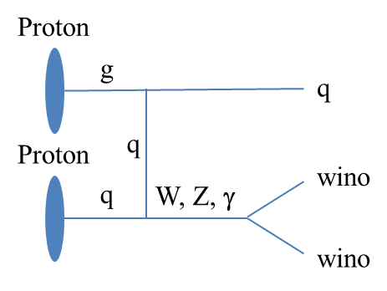
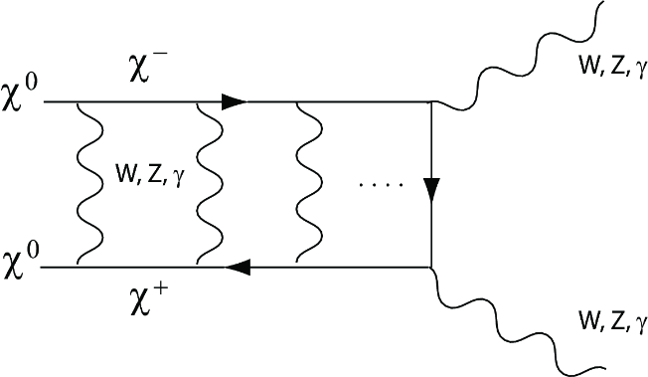
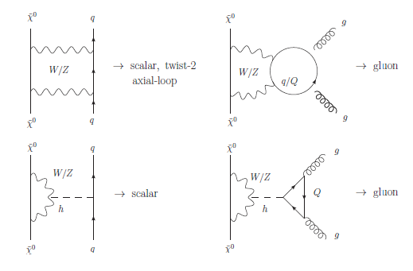
Why they are not detected so far?
5/7
[S. Asai, T. Moroi, K. Nishihara, T. T. Yanagida, 2007]
Collider D.
DM
SM
Direct D.
WIMP⁽’⁾
DM
SM
WIMP⁽’⁾
Indirect D.
Too heavy & too degenerate @ LHC.
Use of LLP (charged one) required.
[J. Hisano, S. M., M. M. Nojiri, 2004]
[J. Hisano, S. M., M. M. Nojiri, O. Saito, 2005]
Boosted by Sommerfeld effects.
Heavy and Uncertainty of astro.
LO contributions are suppressed.
Dedicated NLO calculation needed.

Slide 7
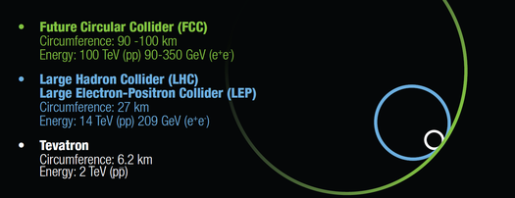
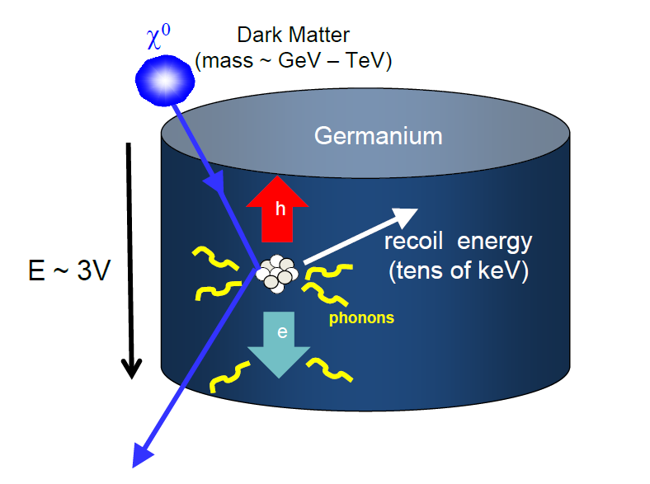
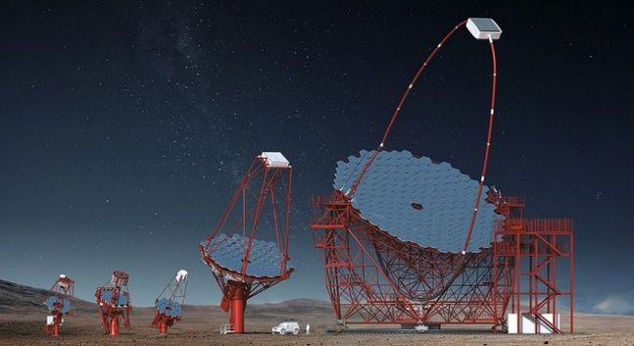
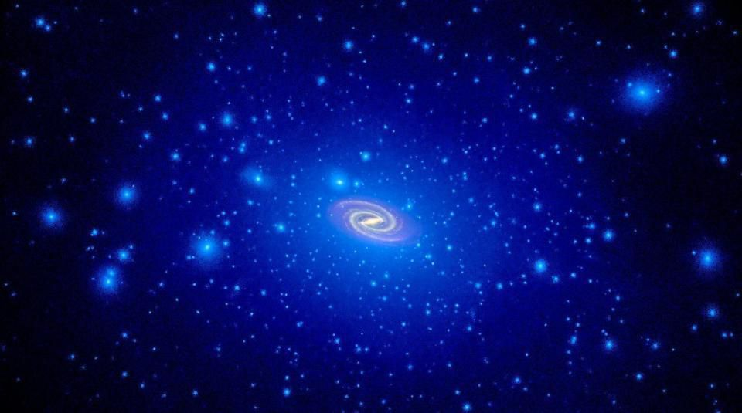
Toward the detection of weak-charged DMs
6/7
↶
↷
Colliders
Theory
Direct D.
SU(2)
1 2 3
0 (OK) OK
±1/2 OK
±1 OK
U(1)
How large s needed? What proc efficient?
Talks 12th morning!
What are Motivations?
Their phenomenology?
Takeo/Satoshi’s talks!
Future sensitivities?
Go beyond Nu floor?
Many Talks today!
Indirect D.
⤵
DM distributions
Prof. Salucci’s talk
Prof. Gelmini’s talk
Prof. Iocco’s talk
Shunichi’s poster
Dr. Hiroshima talk
What is the target? Observation time?
Talks 13th morning!
Local DM distribution at ☉.
DM distribution @ Gal. Cent.
DM distribution @ satellites.

Slide 8
Summary
7/7
We know little about microscopic nature of dark matter, e.g. its mass is merely predicted to be within range of 10^{–55}g to 10⁴⁰g. So, many dark matter candidates (such as particle/non-particle, thermal/non-thermal, etc.) are now being studied intensively,
Among various candidates, a thermal dark matter having a weak charge attracts attention, as it is well motivated from theories
of EW symmetry breaking, and has an inherent feature making it difficult to be observed at current dark matter detections.
I have briefly reviewed the dark matter focusing on a universal property that weak-charged dark matters have. More detailed property depending on each weak charge as well as theoretical motivation for each case will be discussed in following talks!

