Slide 1
Theory
Astro & Particle
Collider Experiment
Direct Detection
Indirect Detection
Masahiro Teshima
ICRR U.Tokyo / MPP

Slide 2
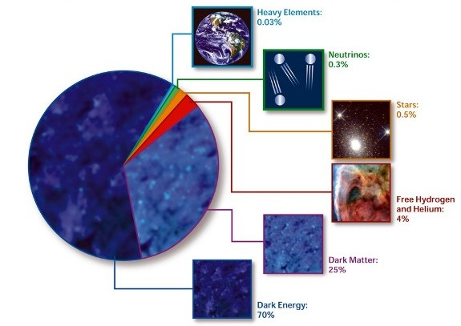
WIMPs as Dark Matters

Slide 3
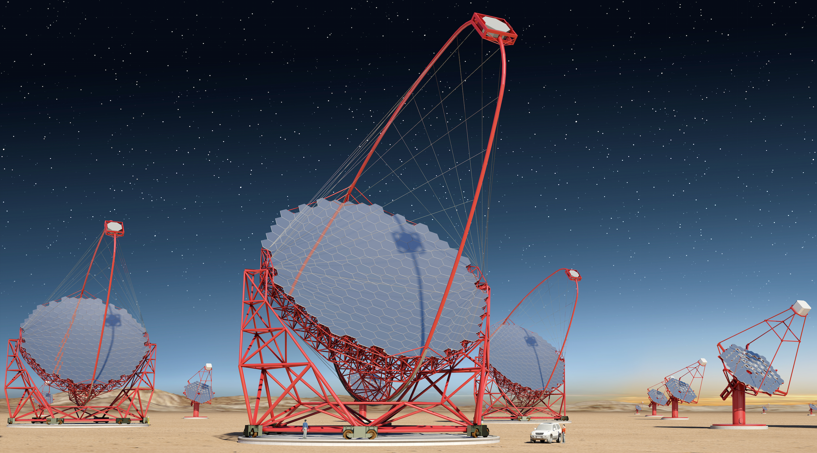
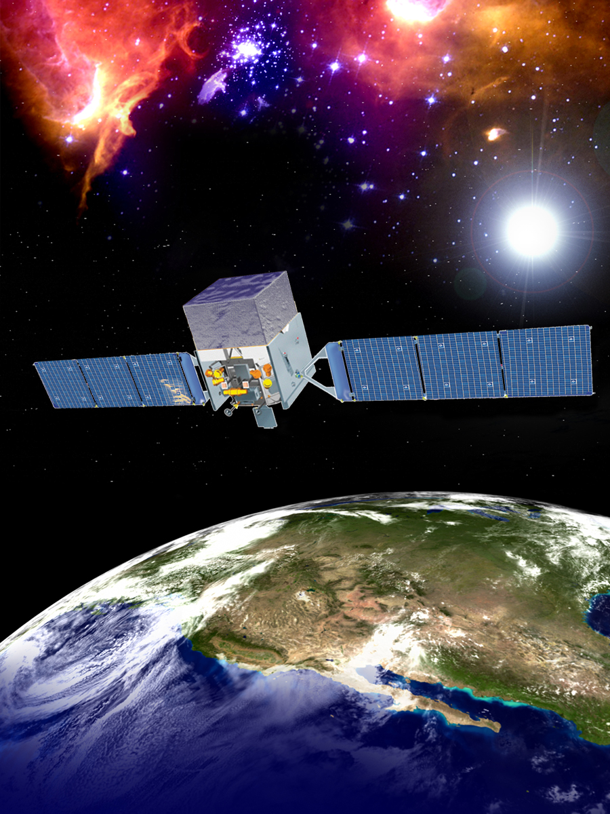
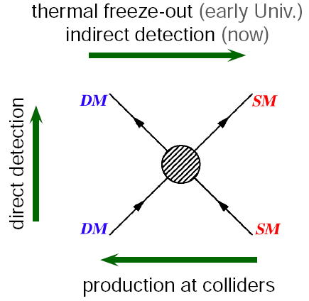
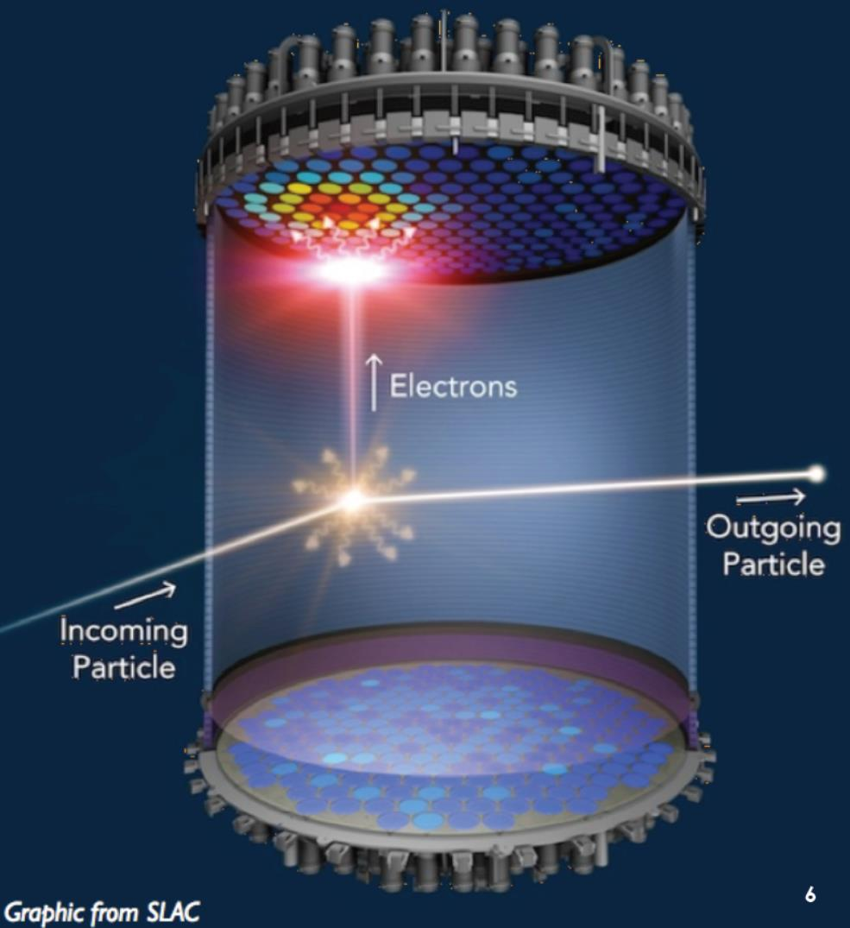

Toward the discovery of Dark Matter
Crossroads of the WIMP
CTA
Xenon 1ton
(Underground exp.)
CTA
(Gamma Rays)
Interaction probability
LHC
(Accelerator)
Xenon detector
Large Hadron Collider
Mass of DM

Slide 5
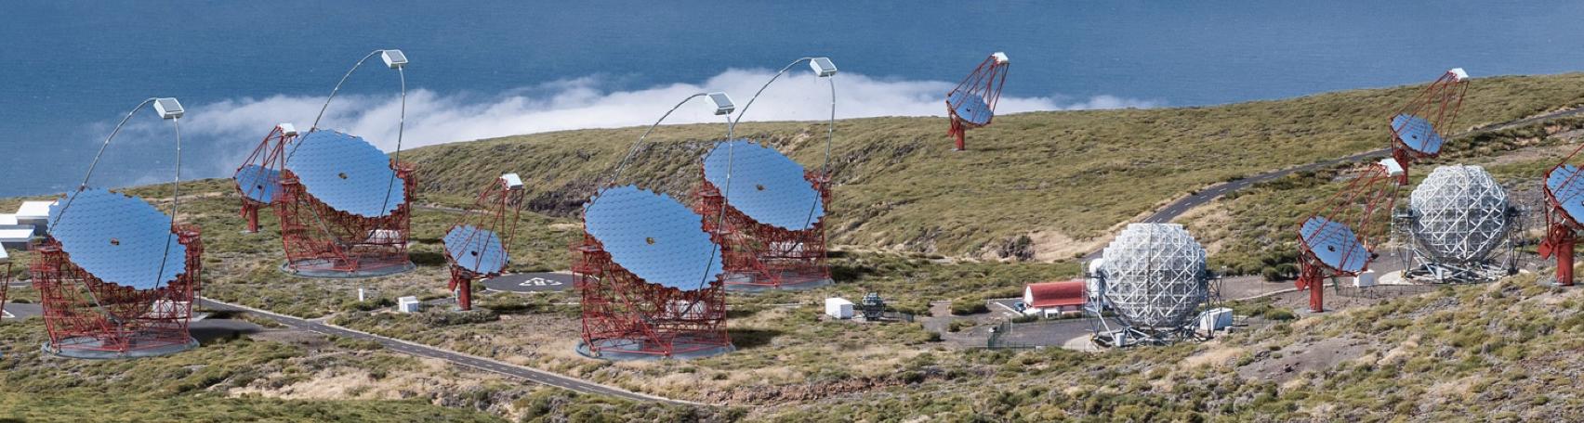
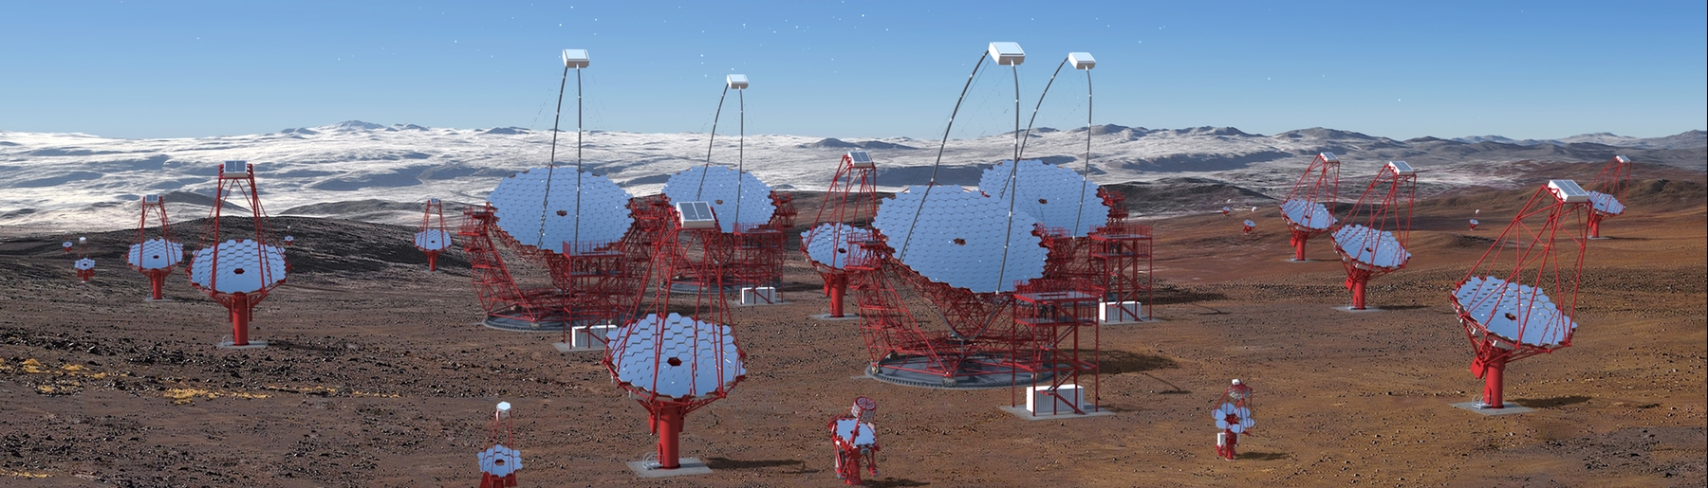
CTA Project
CTAN 2023~, CTAS 2026~

Slide 6
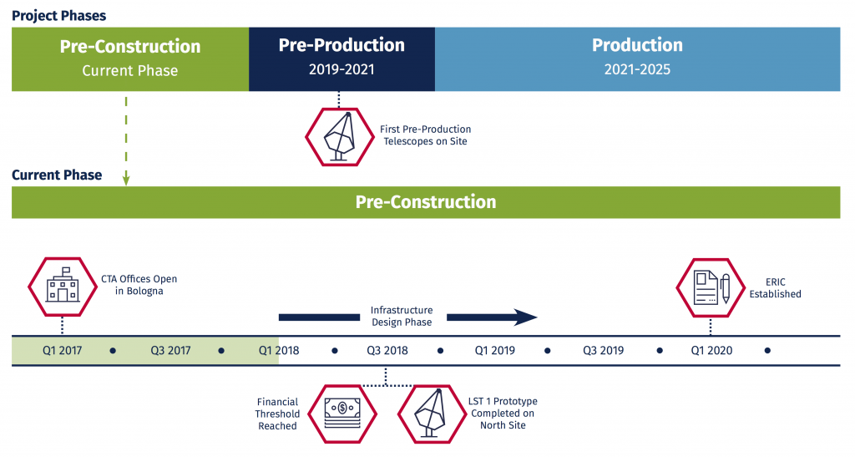

Time line for CTA and CTA-LSTs
2022: Completion of 4xLST North
2022: LST South (Phase 1.2), Erection in 23-26
LST-North
LST-South

Slide 7
Make the symposium fruitful and successful !!

