Slide 1
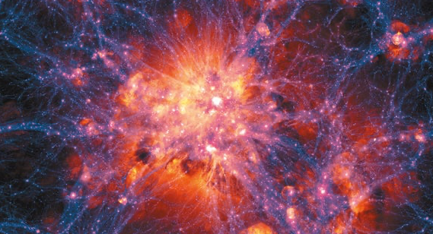
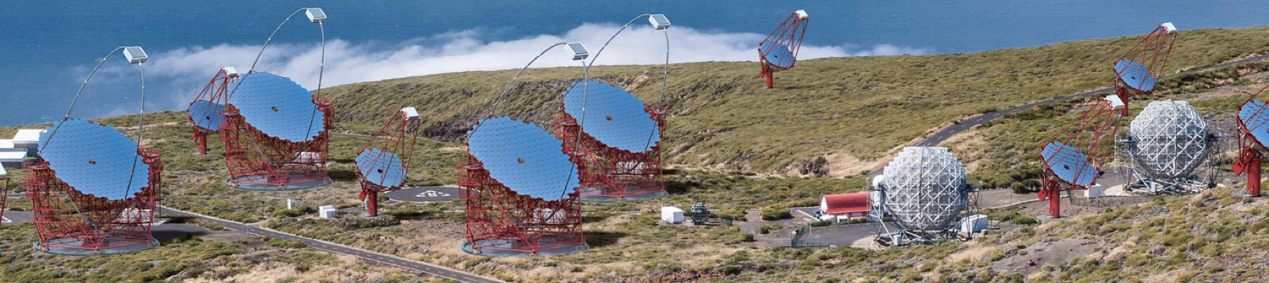
The Extreme Universe
Multi-Messenger Approach
Masahiro Teshima
Max Planck Institute for Physics
ICRR, The University of Tokyo
Credit: ILLUSTRIS COLLABORATION
Credit: CTA Observatory

Slide 2
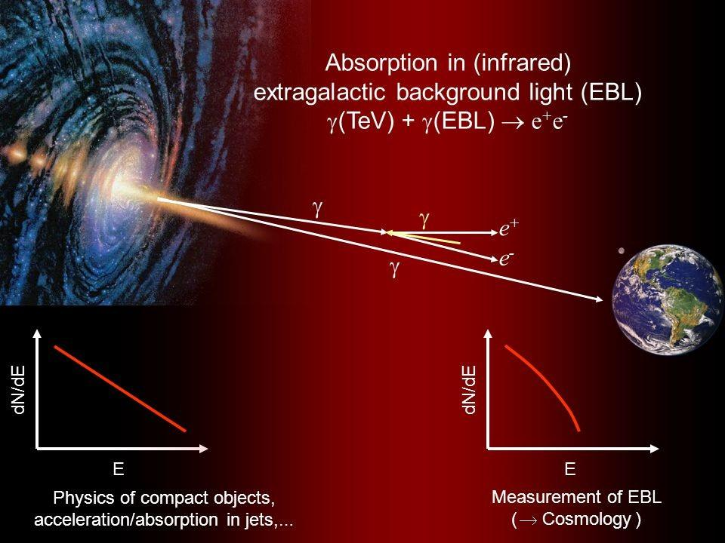
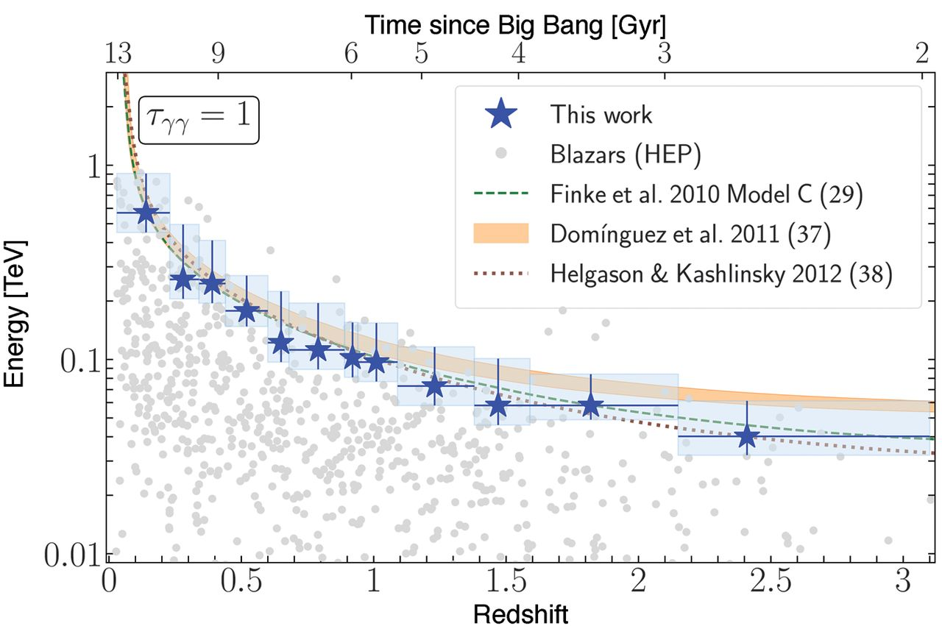
Expand Gamma Ray Horizon with LSTs Zmax = 1.0 ➔ Zmax = 3.0 and beyond
Fermi collab., Science 2018
LST@45º Eth 40GeV
LST@25º Eth 20GeV

Slide 3
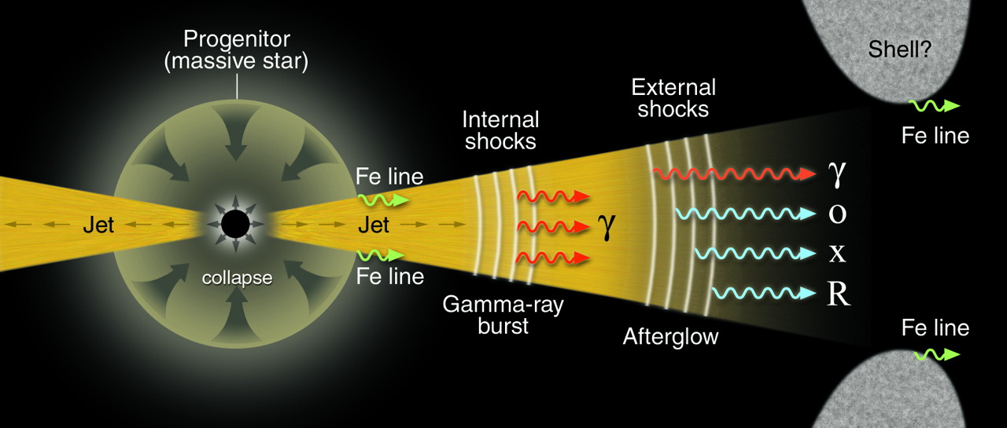
TeV-GRB 190114C observation with MAGIC Two Nature Papers 21. Nov. 2019
Synchrotron
Inverse Compton
Energy spectrum is extending to TeV energies
Significant energy released in TeV domain
Afterglow curve is parallel to X-Ray afterglow
LST will detect 10 times more events than MAGIC and HESS
TeV GRB190114C Skymap Bg. free

Slide 4
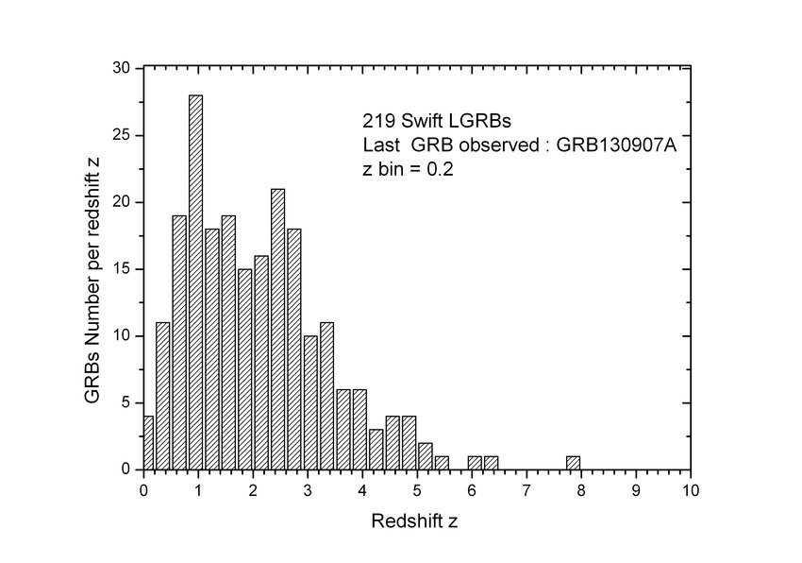
Redshift Distribution from SWIFT GRBs W. J. Azzam et al. 2014
LSTs
MAGIC, HESS
15 GRBs in z < 0.5
112 GRBs in z < 2.0
164 GRBs in z < 3.0
LST will increase
the detection probability x10

Slide 5
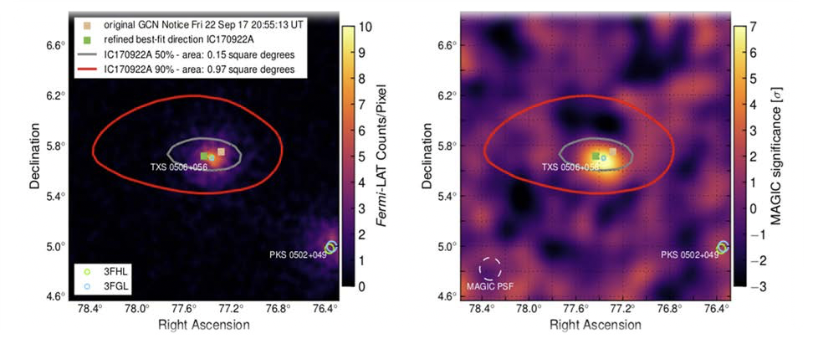
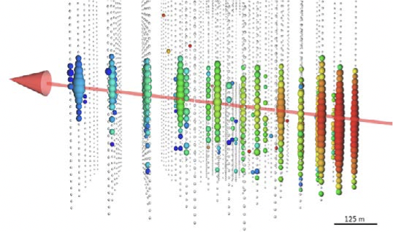
IC170922A / TXS 0506+056 PeV Neutrinos may come from distant UHECR sources The source density relates with the Star formation rate
Ice Cube Observation (~300TeV)
Fermi LAT
(>100 MeV)
Lepto-Hadronic Scenario
MAGIC
(>100GeV)
GTC Observation z = 0.3365
S. Paiano et. al 2018

Slide 6
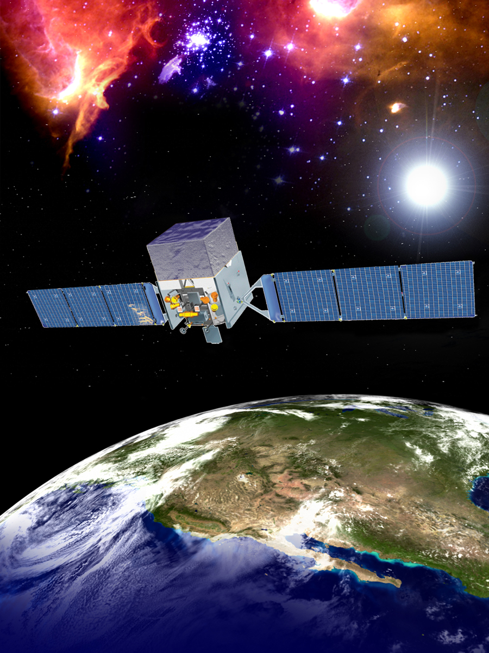
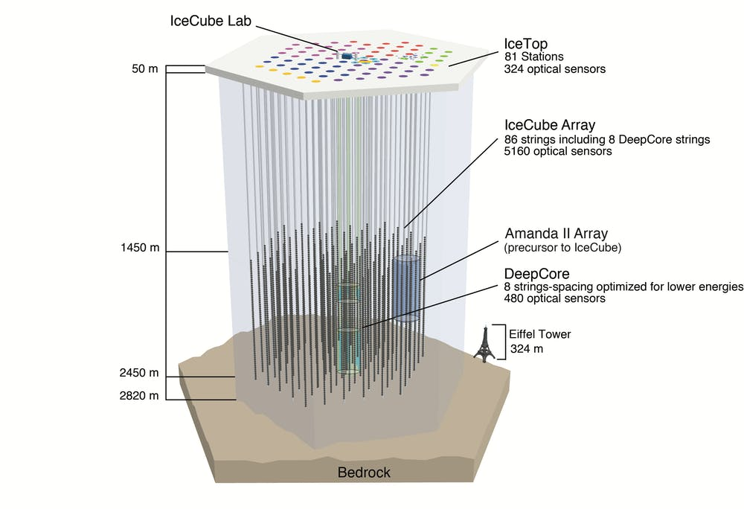
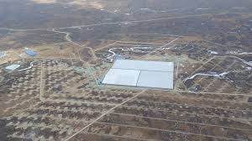
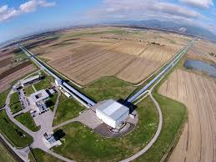
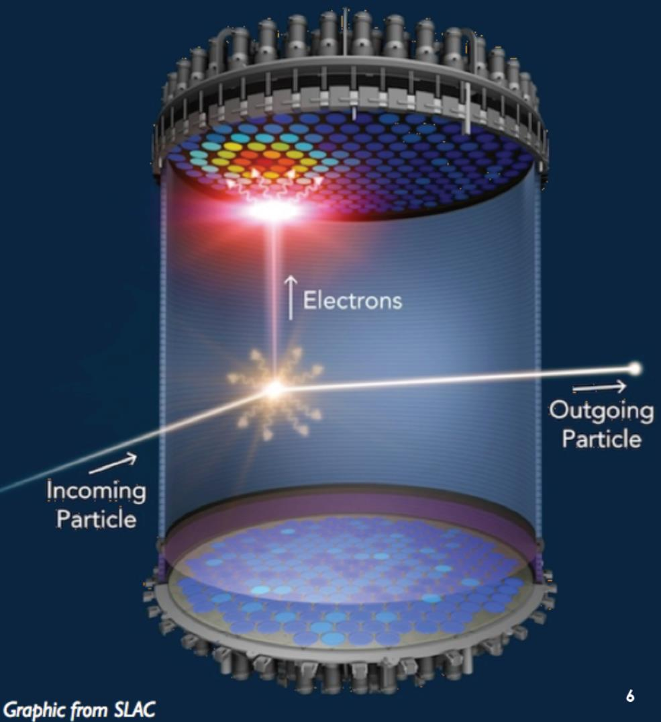
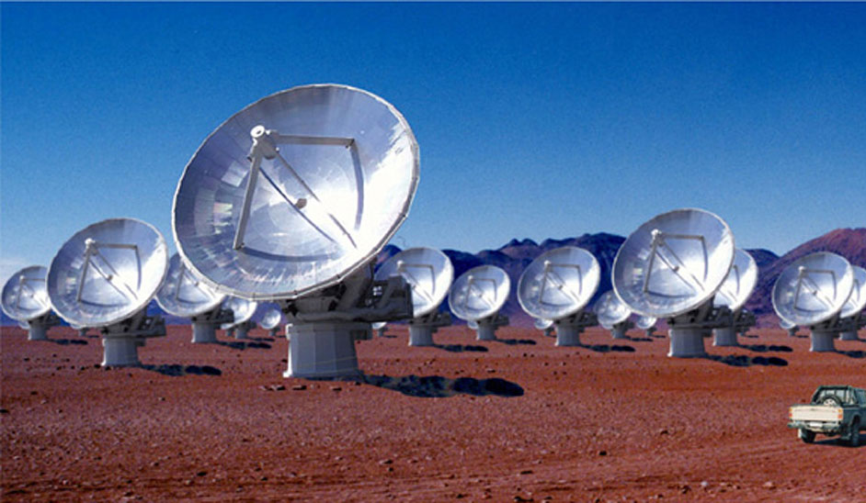
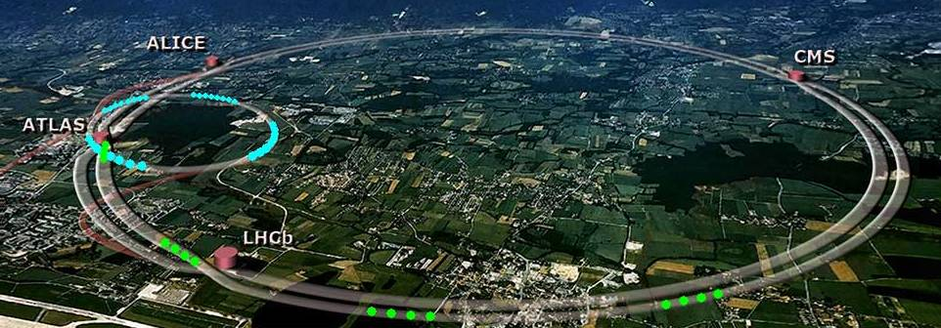
Multi-Messenger and Multi-WaveLength Astrophysics
Astrophysics
Particle Physics
ASTRO-PARTICLE PHYSICS
Cosmic Ray Physics
High Energy Astrophysics
ASTRO-PHYSICS
Gamma Ray Bursts, Black holes,
Neutron Stars, Space and Time
PARTICLE PHYSICS
Dark Matter, Neutrino
Energy Frontier

Slide 8
Concluding Remark
Thank you very much for participating in this workshop during the very difficult situation with the COVID-19 pandemic.
We have seen many interesting results from Fermi, LHAASO, IceCube, MAGIC, and NANTEN
EBL study from Fermi encouraging
Exciting new results from LHAASO
Multi-Messenger Astronomy with IceCube
Extreme Blazars and pulsars from MAGIC
RXJ 1713 detailed study by Fukui-san
etc. etc. etc.
These new results give us a strong pressure that we shall complete the construction of four LST array and join MM and MWL astronomy ASAP.
We appreciate your participation and contributions very much. I have seen the bright future in MM and MWL astronomy.
Thank Yoshida-San and other colleagues for organizing this workshop
See you again next year!

Slide 9
Dark Matter Search Sensitive M_{χ}: 200GeV - 10TeV
Particle Physics
Astrophysics
Canonical-σ
Gamma rays from Annihilation produce the bump around 1/10 -1/20 Mχ ➔ 20GeV-1TeV domain
CTA gives the stringent upper limit.
Stefan Funk 2015

