Slide 1
Recent results on γ-ray observations of Tibet ASγ group
&
Current status of ALPACA group
T. K. Sako
ICRR Young Researchers' Workshop
4-5 November 2021

Slide 2
ICRR Members
Member name | Position | Main work
Masato TAKITA | professor | supervisor
Takashi SAKO (older) | associate professor | supervisor
Munehiro OHNISHI | assistant professor | DAQ, data reduction, etc.
Kazumasa KAWATA | assistant professor | γ-ray analysis, Sun’s shadow, etc.
Takashi SAKO (younger) | project assistant professor | γ-ray analysis, CR anisotropy, etc.
Marcos ANZORENA | project researcher | ALPACA/ALPAQUITA MC, etc.
Sei KATO | D2 | ALPACA/ALPAQUITA MC, γ-ray analysis, etc.
Yoshichika YOKOE | D1 | ALPACA/ALPAQUITA MC, etc.
Teruyoshi KAWASHIMA | M1 | PMT test, etc.
Eduardo DE LA FUENTE | visiting professor (from Universidad de Guadalajara) | radio astronomy, etc.

Slide 3


The Tibet ASγ Collaboration
M. Amenomori(1), S. Asano(2), Y. W. Bao(3), X. J. Bi(4), D. Chen(5), T. L. Chen(6), W. Y. Chen(4), Xu Chen(4), Y. Chen(3), Cirennima(6),
S. W. Cui(7), Danzengluobu(6), L. K. Ding(4), J. H. Fang(4,8), K. Fang(4), C. F. Feng(9), Zhaoyang Feng(4), Z. Y. Feng(10), Qi Gao(6),
A. Gomi(11), Q. B. Gou(4), Y. Q. Guo(4), Y. Y. Guo(4), H. H. He(4), Z. T. He(7), K. Hibino(12), N. Hotta(13), Haibing Hu(6), H. B. Hu(4),
K. Y. Hu(4,8), J. Huang(4), H. Y. Jia(10), L. Jiang(4), P. Jiang(5), H. B. Jin(5), K. Kasahara(14), Y. Katayose(11), C. Kato(2), S. Kato(15),
T. Kawashima(15), K. Kawata(15), M. Kozai(16), D. Kurashige(11), Labaciren(6), G. M. Le(17), A. F. Li(18,9,4), H. J. Li(6), W. J. Li(4,10),
Y. Li(5), Y. H. Lin(4,8), B. Liu(19), C. Liu(4), J. S. Liu(4), L. Y. Liu(5), M. Y. Liu(6), W. Liu(4), X. L. Liu(5), Y.-Q. Lou(20, 21, 22), H.Lu(4),
X. R. Meng(6), Y. Meng(4,8), K. Munakata(2), K. Nagaya(11), Y. Nakamura(15), Y. Nakazawa(23), H. Nanjo(1), C. C. Ning(6),
M. Nishizawa(24), M. Ohnishi(15), S. Okukawa(11), S. Ozawa(25), L. Qian(5), X. Qian(5), X. L. Qian(26), X. B. Qu(27), T. Saito(28),
Y. Sakakibara(11), M. Sakata(29), T. Sako(15), T. K. Sako(15), J. Shao(4,9), M. Shibata(11), A. Shiomi(23), H. Sugimoto(30), W. Takano(12),
M. Takita(15), Y. H. Tan(4), N. Tateyama(12), S. Torii(31), H. Tsuchiya(32), S. Udo(12), H. Wang(4), Y. P. Wang(6), Wangdui(6), H. R. Wu(4),
Q. Wu(6), J. L. Xu(5), L. Xue(9), Z. Yang(4), Y. Q. Yao(5), J. Yin(5), Y. Yokoe(15), N. P. Yu(5), A. F. Yuan(6), L. M. Zhai(5), C. P. Zhang(5),
H. M. Zhang(4), J. L. Zhang(4), X. Zhang(3), X. Y. Zhang(9), Y. Zhang(4), Yi Zhang(33), Ying Zhang(4), S. P. Zhao(4), Zhaxisangzhu(6)
and X. X. Zhou(10)
(1) Department of Physics, Hirosaki University, Hirosaki 036-8561, Japan (2) Department of Physics, Shinshu University, Matsumoto 390-8621, Japan
(3) School of Astronomy and Space Science, Nanjing University, Nanjing 210093, China (4) Key Laboratory of Particle Astrophysics, Institute of High Energy Physics, Chinese Academy of Sciences, Beijing 100049, China (5) National Astronomical Observatories, Chinese Academy of Sciences, Beijing 100012, China (6) Department of Mathematics and Physics, Tibet University, Lhasa 850000, China (7) Department of Physics, Hebei Normal University, Shijiazhuang 050016, China (8) University of Chinese Academy of Sciences, Beijing 100049, China (9) Institute of Frontier and Interdisciplinary Science and Key Laboratory of Particle Physics and Particle Irradiation (MOE), Shandong University, Qingdao 266237, China (10) Institute of Modern Physics, SouthWest Jiaotong University, Chengdu 610031, China (11) Faculty of Engineering, Yokohama National University, Yokohama 240-8501, Japan (12) Faculty of Engineering, Kanagawa University, Yokohama 221-8686, Japan (13) Faculty of Education, Utsunomiya University, Utsunomiya 321-8505, Japan (14) Faculty of Systems Engineering, Shibaura Institute of Technology, Omiya 330-8570, Japan (15) Institute for Cosmic Ray Research, University of Tokyo, Kashiwa 277-8582, Japan (16) Institute of Space and Astronautical Science, Japan Aerospace Exploration Agency (ISAS/JAXA), Sagamihara 252-5210, Japan (17) National Center for Space Weather, China Meteorological Administration, Beijing 100081, China (18) School of Information Science and Engineering, Shandong Agriculture University, Taian 271018, China (19) Department of Astronomy, School of Physical Sciences, University of Science and Technology of China, Hefei, Anhui 230026, China (20) Department of Physics and Tsinghua Centre for Astrophysics (THCA), Tsinghua University, Beijing 100084, China (21) Tsinghua University-National Astronomical Observatories of China (NAOC) Joint Research Center for Astrophysics, Tsinghua University, Beijing 100084, China (22) Department of Astronomy, Tsinghua University, Beijing 100084, China (23) College of Industrial Technology, Nihon University, Narashino 275-8575, Japan (24) National Institute of Informatics, Tokyo 101-8430, Japan (25) National Institute of Information and Communications Technology, Tokyo 184-8795, Japan (26) Department of Mechanical and Electrical Engineering, Shangdong Management University, Jinan 250357, China (27) College of Science, China University of Petroleum, Qingdao 266555, China (28) Tokyo Metropolitan College of Industrial Technology, Tokyo 116-8523, Japan (29) Department of Physics, Konan University, Kobe 658-8501, Japan (30) Shonan Institute of Technology, Fujisawa 251-8511, Japan (31) Research Institute for Science and Engineering, Waseda University, Tokyo 169-8555, Japan (32) Japan Atomic Energy Agency, Tokai-mura 319-1195, Japan (33) Key Laboratory of Dark Matter and Space Astronomy, Purple Mountain Observatory, Chinese Academy of Sciences, Nanjing 210034, China

Slide 4
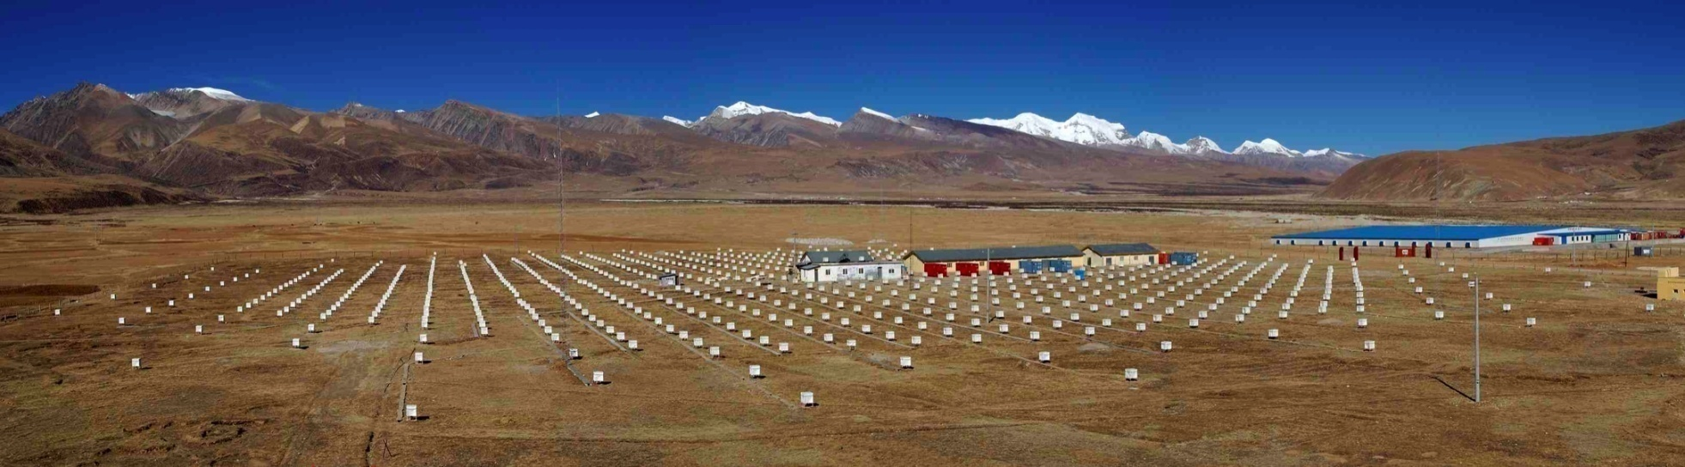
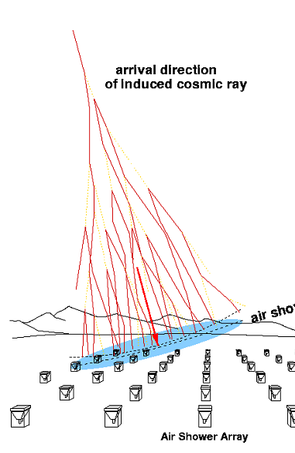
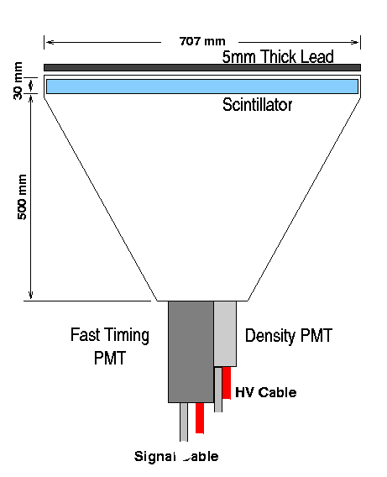
Tibet Air Shower Array
Tibet, China (90.522ºE, 30.102ºN) 4,300 m a.s.l.
scintillation counters 0.5 m² x 597
area ~65,700 m²
angular resolution ~0.5°@10TeV
~0.2°@100TeV
energy resolution ~40%@10TeV
~20%@100TeV
2nd particles timing ➡︎ arrival direction
2nd particles energy deposit ➡︎ primary energy

Slide 5
Water Cherenkov Muon Detector Array
2.4m underground (515g/cm² ~19X₀)
7.35m x 7.35m x 1.5m-deep water cell x 64
20”ΦPMT (HAMAMATSU R3600)
Concrete pools + Tyvek sheets
MD ~3400m²
Measurement of number of muons in air showers
➡︎ γ／CR discrimination

Slide 6
Event selection by MD
Optimization of muon cut
γ : MC sample (Crab orbit & Crab flux）
CR：Data (excluding Crab & Galactic Plane)
log (ΣΝμ) from MD
10TeV
100TeV
γ MC
~99.9% CR rejection
~90% γ efficiency
@ 100 TeV
ΣNμ=0
log (Σρ) from AS
Survival ratio
CR MC
Data
log (ΣΝμ) from MD
Σρ
(Sum of particle densities by all AS counters)
ΣNμ=0
log (Σρ) from AS
M. Amenomori et al., PRL, 123, 051101 (2019)

Slide 7
Gamma-ray observations of point-like/extended sources
Crab Nebula
SNR G106.3+2.7
TASG J2032+414 (in Cygnus OB2)
TASG J2019+368 (in Cygnus OB1)
M. Amenomori et al., PRL, 123, 051101 (2019)
M. Amenomori et al., Nature Astronomy Letters, 5, 460 (2021)
M. Amenomori et al., PRL, 127, 031102 (2021)

Slide 8
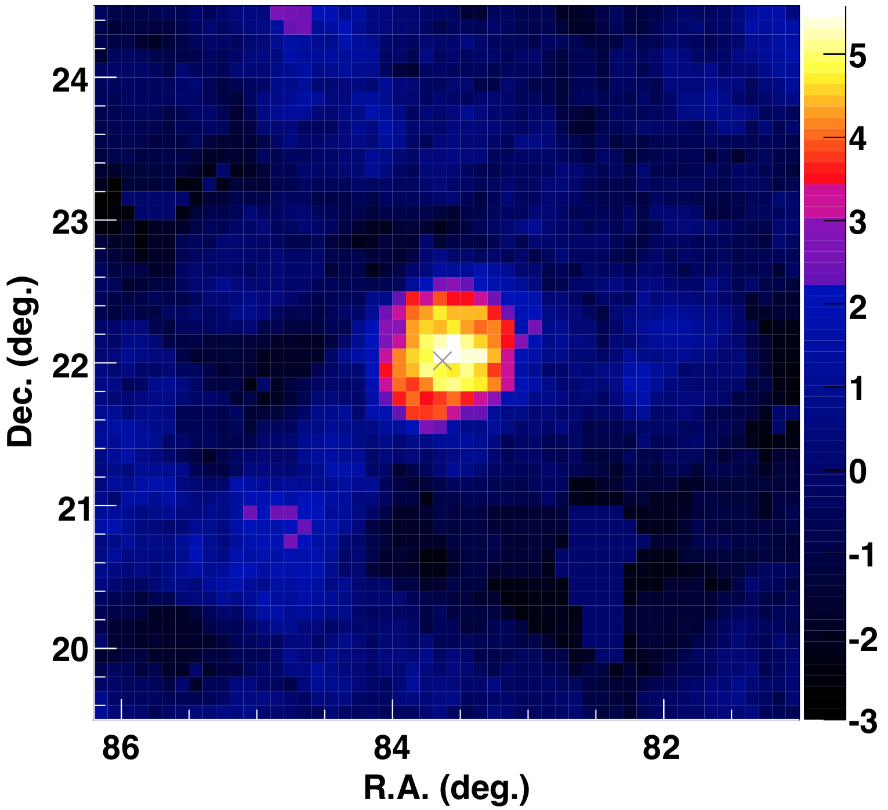
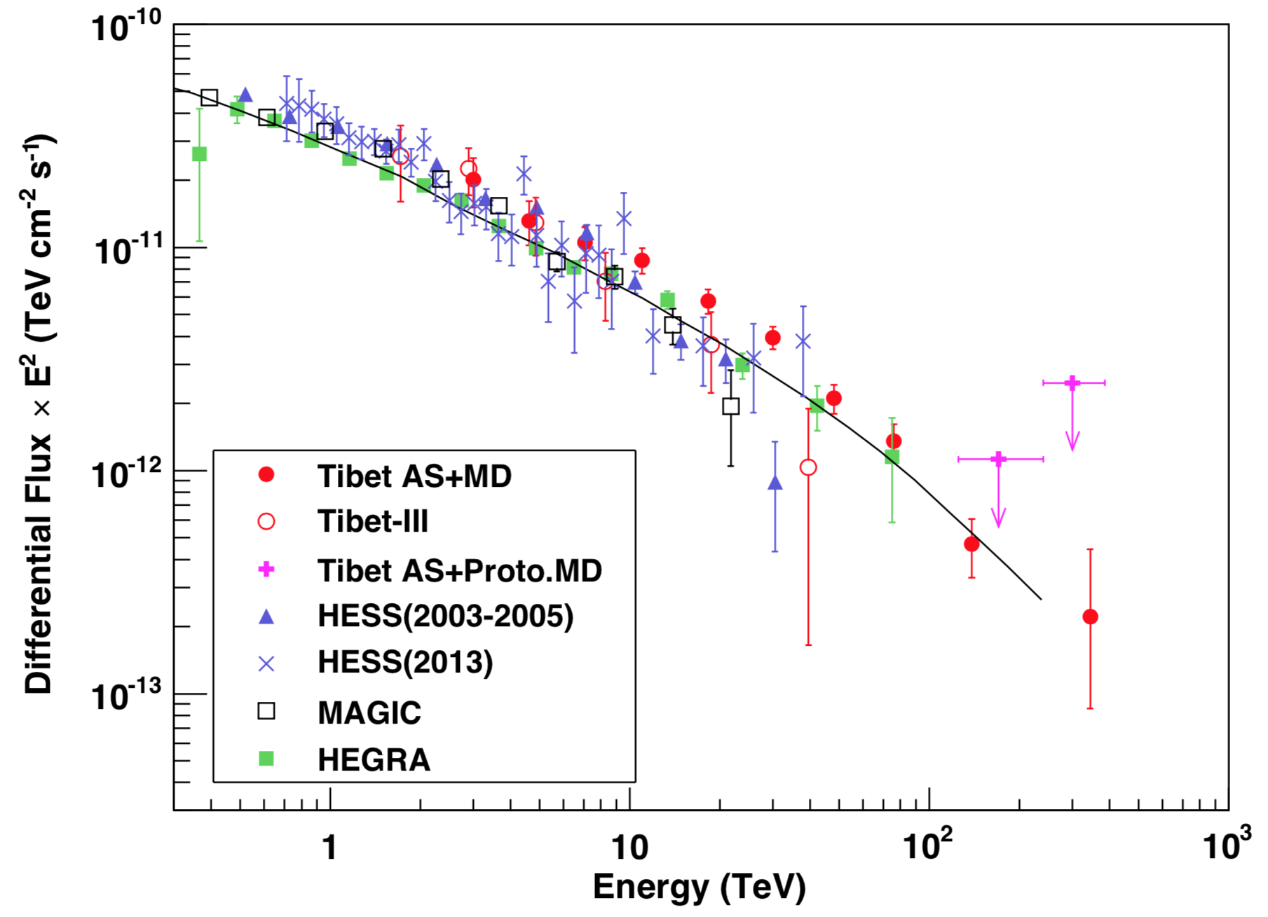
Crab Nebula
M. Amenomori et al., PRL, 123, 051101 (2019)
Significance map > 100 TeV
Energy spectrum
>100TeV
IC model
normalized to HEGRA
Aharonian+, ApJ, 614, 897 (2004)
Significance (σ)
Tibet AS+MD
24 events against 5.5 BG events > 100 TeV ➡︎ 5.6σ
First Detection of sub-PeV γ

Slide 9
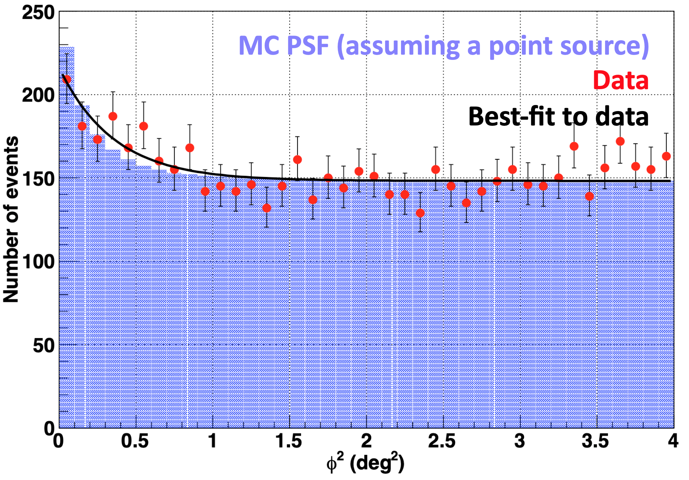
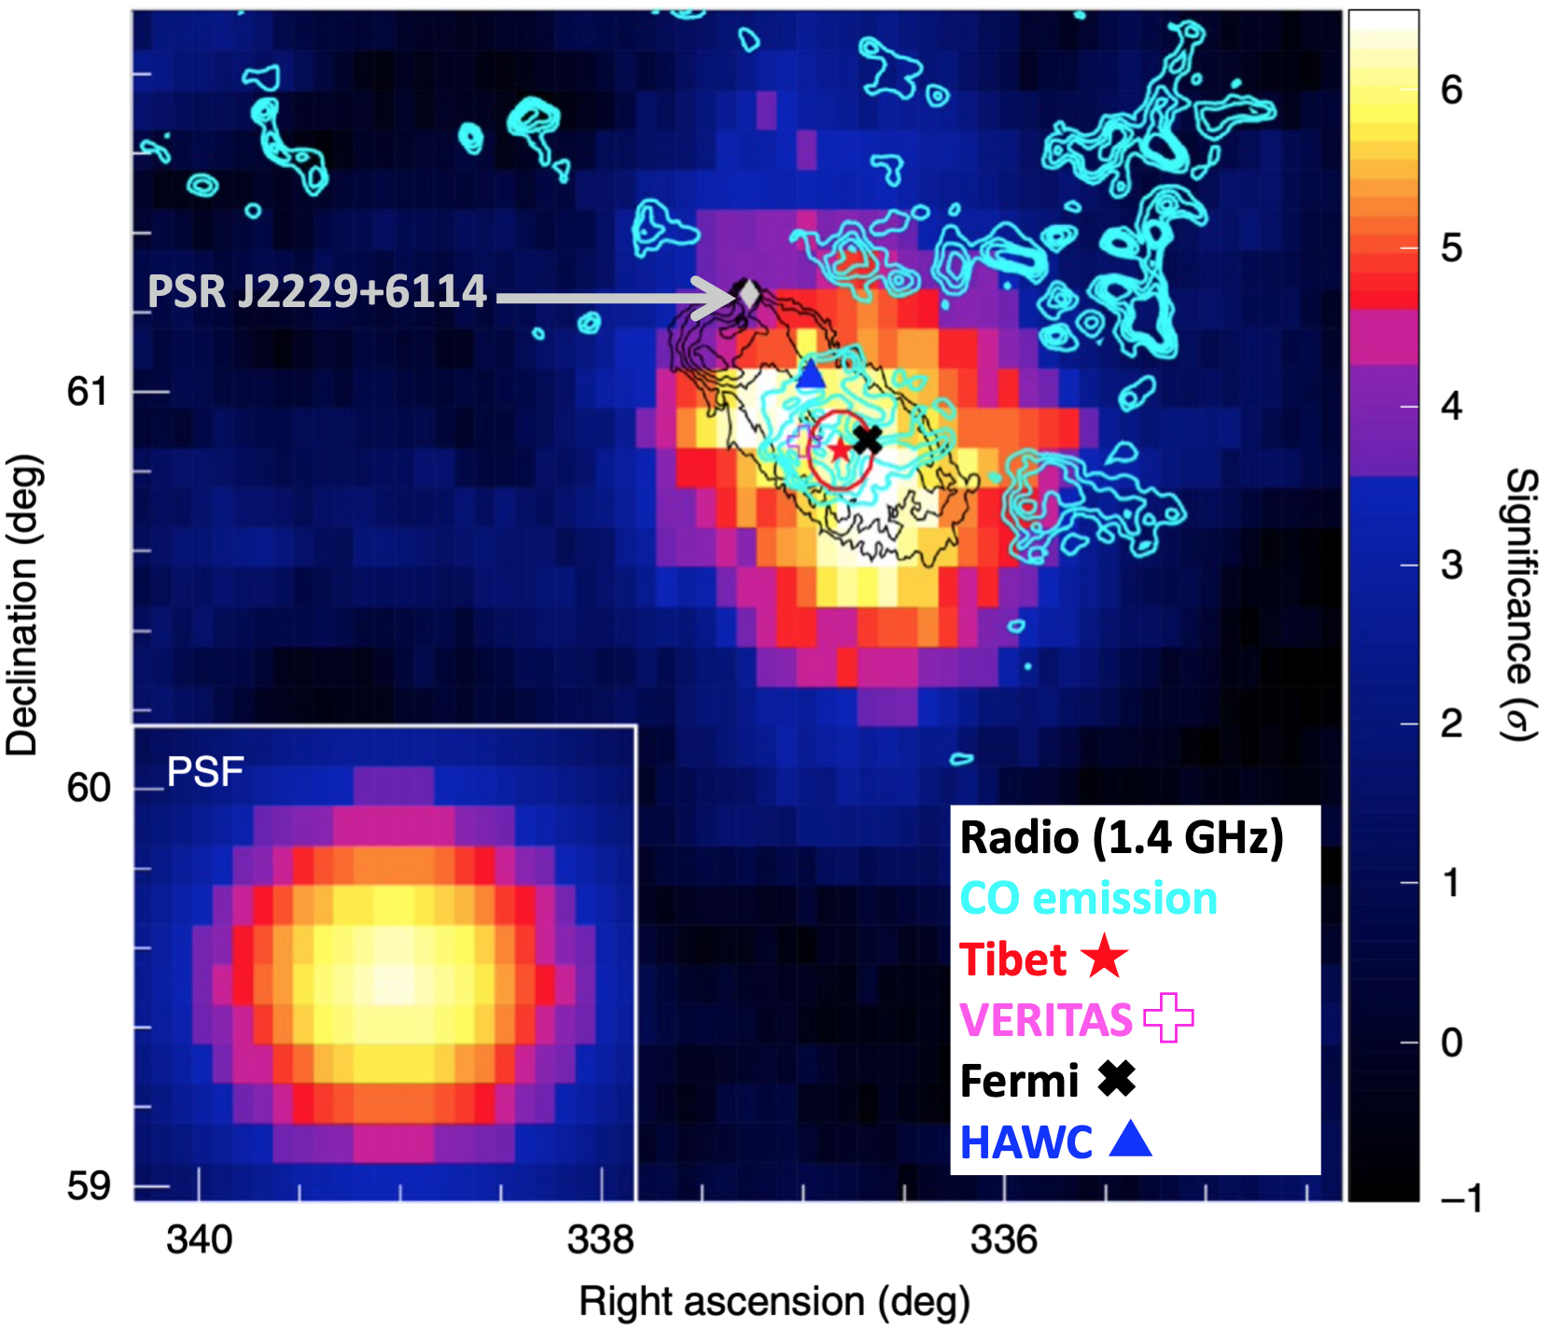
SNR G106.3+2.7
M. Amenomori et al., Nature Astronomy Letters, 5, 460 (2021)
Angular distribution > 10 TeV
Significance map > 10 TeV
Fitting with Gaussian:
σ_{PSF} = 0.35° from MC simulation
σ_{EXT}: source extension
➡︎ σ_{EXT} = 0.24°±0.10°
Tibet source position: R.A. = 336.82°±0.16°
Dec = 60.85°±0.10°
  ●coincident with the molecular cloud location
  ●distant from PSR J2229+6114 by 0.44°
  at 3.1σ level (syst. pointing error taken into account)
※ consistent with previous results
VERITAS: σ₁ = 0.27°±0.05°, σ₂ = 0.18°±0.03°
Fermi: 0.25°-radius disk
HAWC: <0.23° (90% C.L.)

Slide 10
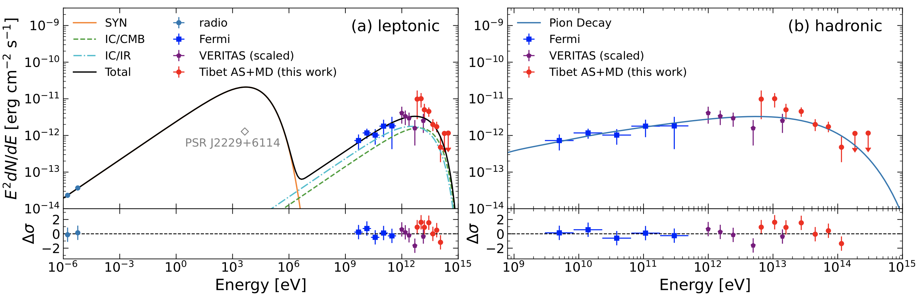
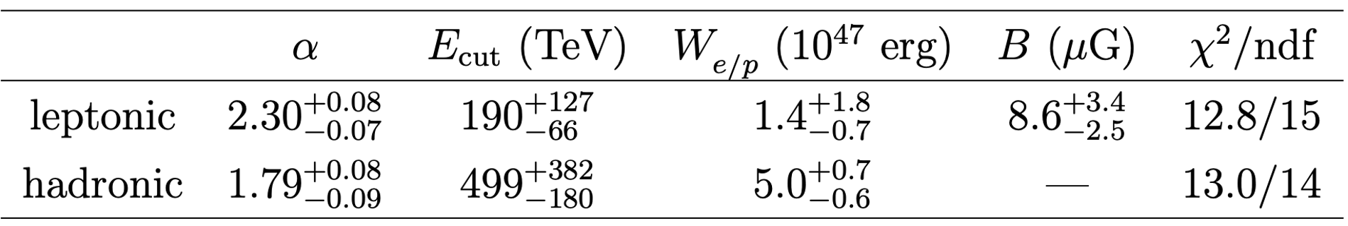
SNR G106.3+2.7
M. Amenomori et al., Nature Astronomy Letters, 5, 460 (2021)
Leptonic model
Hadronic model
Fermi
VERITAS
Tibet
Abdo et al., ApJL, 700, L127 (2009)
Xin et al., ApJ, 885, 162 (2019)
Pineault & Joncas, AJ, 120, 3218 (2000)
Estimate parent particles’ spectrum ∝ E^{−α} exp(−E/E_{cut})
using naima package (Zabalza, arXiv:1509.03319)
(※ assuming target gas density = 10 / cm³)
(※ W_{e/p}: total electron/proton energy > 10 MeV/> 1 GeV)
γ-ray morphology and energy budget indicate the hadronic model is favored

Slide 11
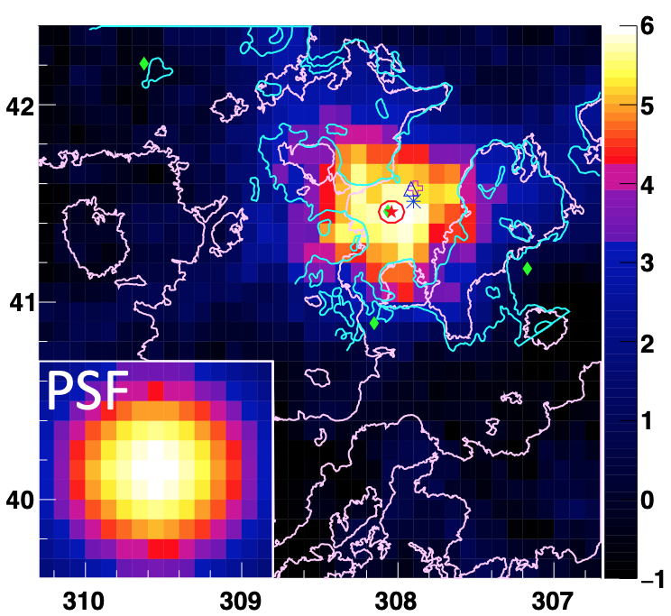
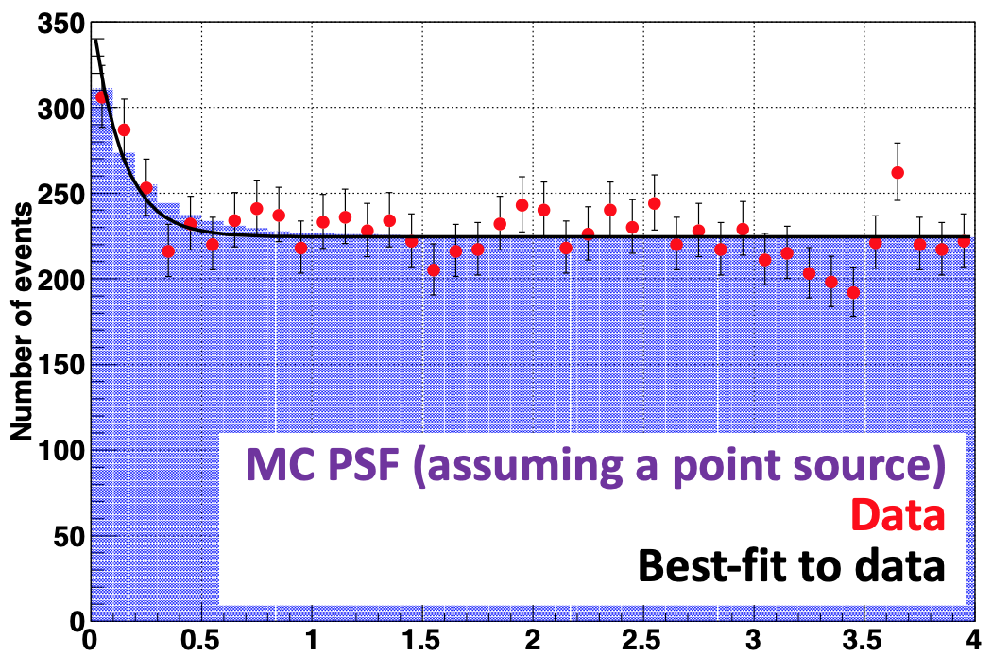

TASG J2032+414 (Cygnus OB2)
Significance map > 10 TeV
Angular distribution > 10 TeV
PSR J2032+4127
Declination (deg.)
Significance (σ)
MIPSGAL (24 μm)
CGPS (1420 MHz)
Fitting with Gaussian:
σ_{PSF} = 0.36° from MC simulation
σ_{EXT}: source extension
➡︎ σ_{EXT} = 0.00°±0.14°
Right Ascension (deg.)
this work
+
+
Consistent with previous results (σ_{EXT} ≈ 0.2°)
Fermi
VERITAS
HAWC
MAGIC
Abeysekara+, ApJL, 867, L19 (2018)
Abeysekara+, Nat. Astron. Let. (2021)
Abdollahi+, ApJ, Suppl. Ser., 247, 33 (2020)
Taylor+, Astron. J. 125, 3145 (2003)
Beerer+, ApJ, 720, 679 (2010)
Kraemer+, Astron. J., 139, 2319 (2010)
Detection significance 5.3σ > 10 TeV
Source position coincident with PSR J2032+4127

Slide 12
TASG J2032+414 (Cygnus OB2)
γ-ray energy spectrum
This work can be fitted by
a simple power law:
this work
95% C.L.
Gamma rays likely due to IC scattering by electrons produced
by PSR J2032+4127
Abeysekara+, ApJ, 861, 134 (2018)
Aliu+, ApJ, 783, 16 (2014)
Albert+, ApJL, 675, L25 (2008)
Aharonian+, A&A, 431, 197 (2005)
Abeysekara+, Nat. Astron. Let. (2021)
Bartoli+, ApJL, 745, L22 (2012)

Slide 13
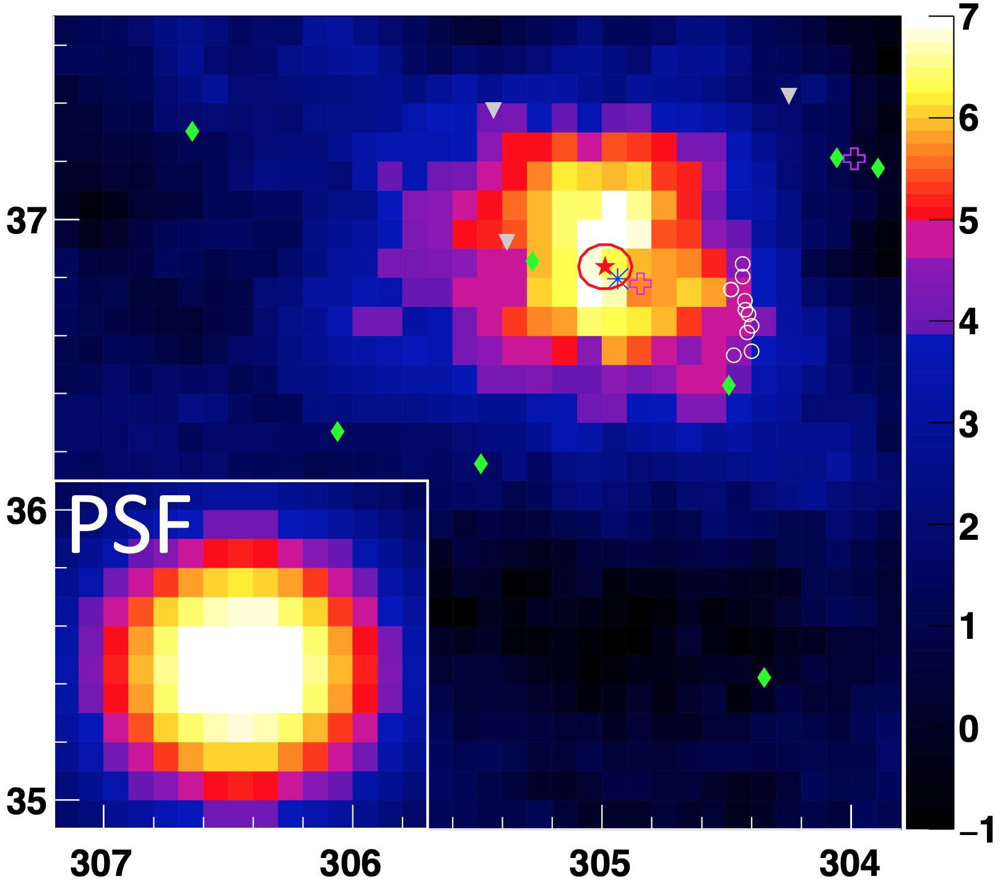
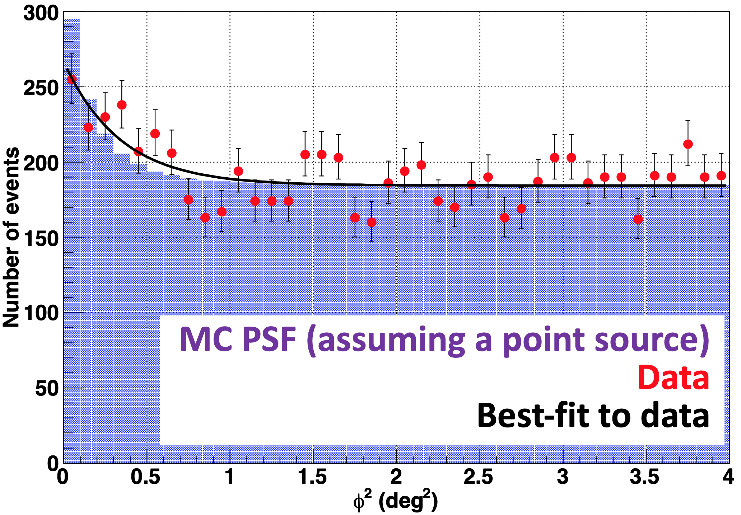
TASG J2019+368 (Cygnus OB1)
Significance map > 10 TeV
Angular distribution > 10 TeV
Wolf-Rayet stars
0.23°
PSR J2021+3651
Declination (deg.)
Significance (σ)
NuSTAR
sources
Fitting with Gaussian:
σ_{PSF} = 0.30° from MC simulation
σ_{EXT}: source extension
➡︎ σ_{EXT} = 0.28°±0.07°
Right Ascension (deg.)
this work
+
+
Fermi
VERITAS
HAWC
Consistent with previous results (σ_{EXT} ≈ 0.2° - 0.3°)
Detection significance 6.7σ > 10 TeV
Source position coincident with PWN G75.2+0.1
0.23° west of PSR J2021+3651
Abdollahi+, ApJ, Suppl. Ser., 247, 33 (2020)
Van der Hucht, New Astron. Rev. 45, 135 (2001)
Abeysekara+, ApJ, 861, 134 (2018)
Albert+, ApJ, 905, 76 (2020)
Gotthelf+, ApJ, 826, 25 (2016)

Slide 14
TASG J2019+368 (Cygnus OB1)
γ-ray energy spectrum
This work can be fitted by
this work
95% C.L.
Gamma rays likely produced in
PWN G75.2+0.1 via IC scattering
by electrons

Slide 15
Sub-PeV diffuse γ rays
from the Milky Way galaxy
M. Amenomori et al., PRL, 126, 141101 (2021)

Slide 16
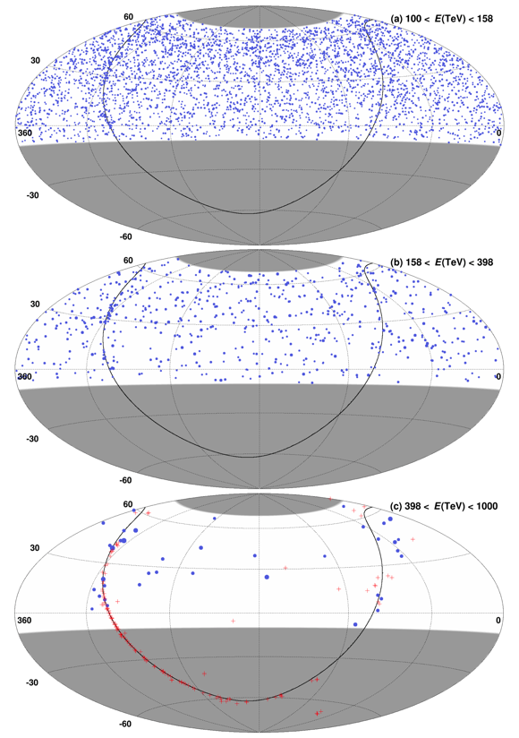
Event Distribution
Equatorial coordinates
Blue points:
Tibet AS +MD
(Circle size ∝ Energy)
100 – 158 TeV
Red plus marks:
TeV sources
(TeVCat catalog)
>0.398 PeV (10^{2.6} TeV)
38 events in our FoV
158 – 398 TeV
→Not from known TeV sources!
& No signal > 10 TeV around them
398 – 1000 TeV
M. Amenomori et al., PRL, 126, 141101 (2021)

Slide 17
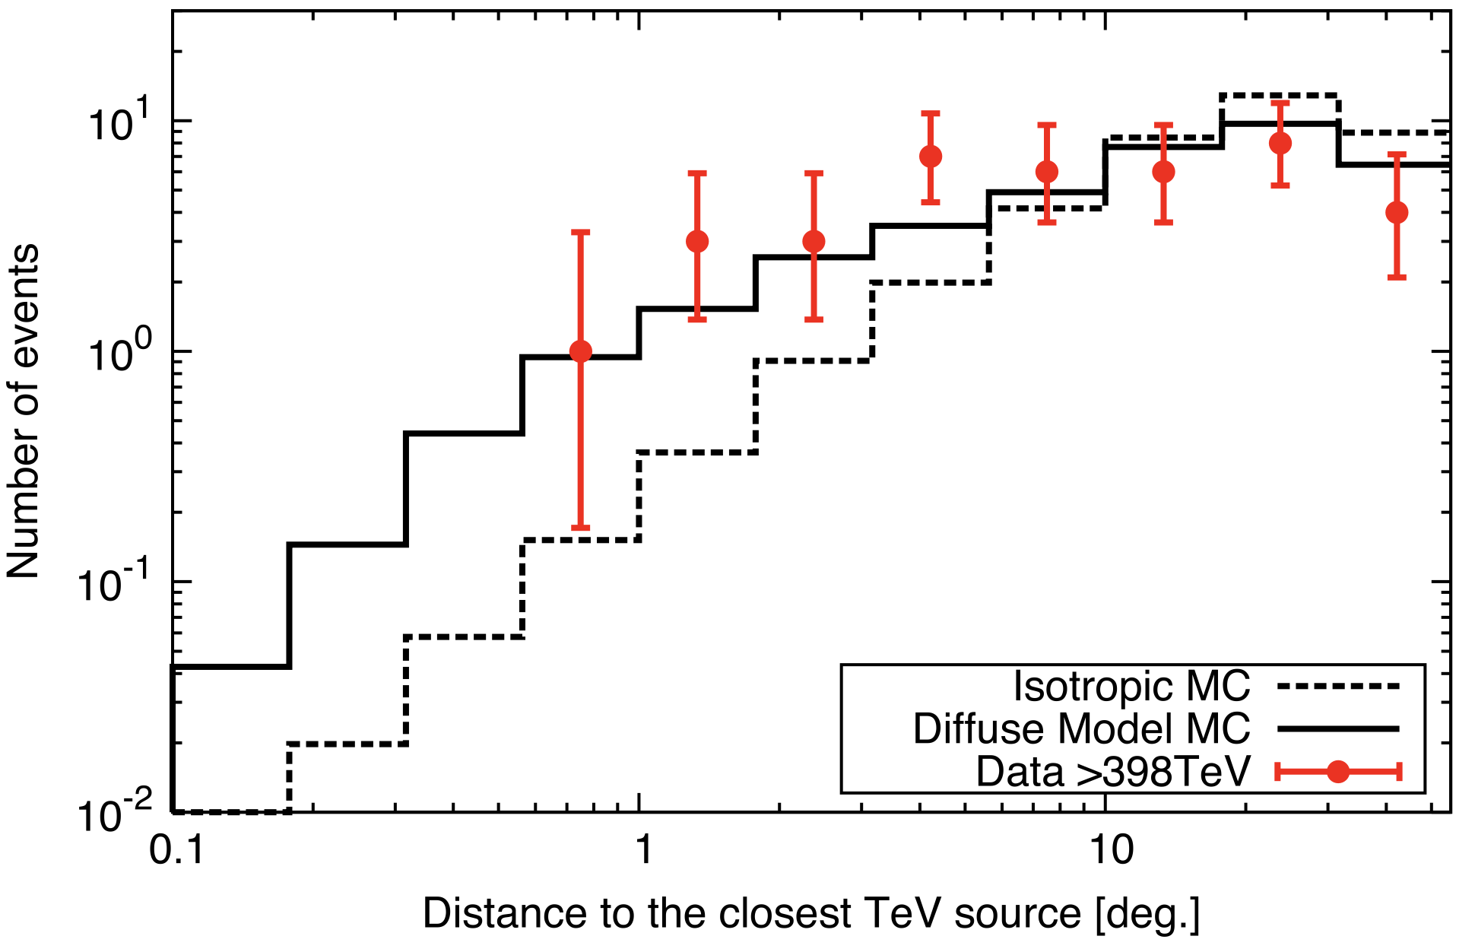
Distribution of distance to the closest TeV source for events > 0.398 PeV
M. Amenomori et al., PRL, 126, 141101 (2021)
no peak around 0 -> no correlation with known TeV sources
Diffuse Model: Lipari & Vernetto, PRD 98, 143003, (2018)

Slide 18
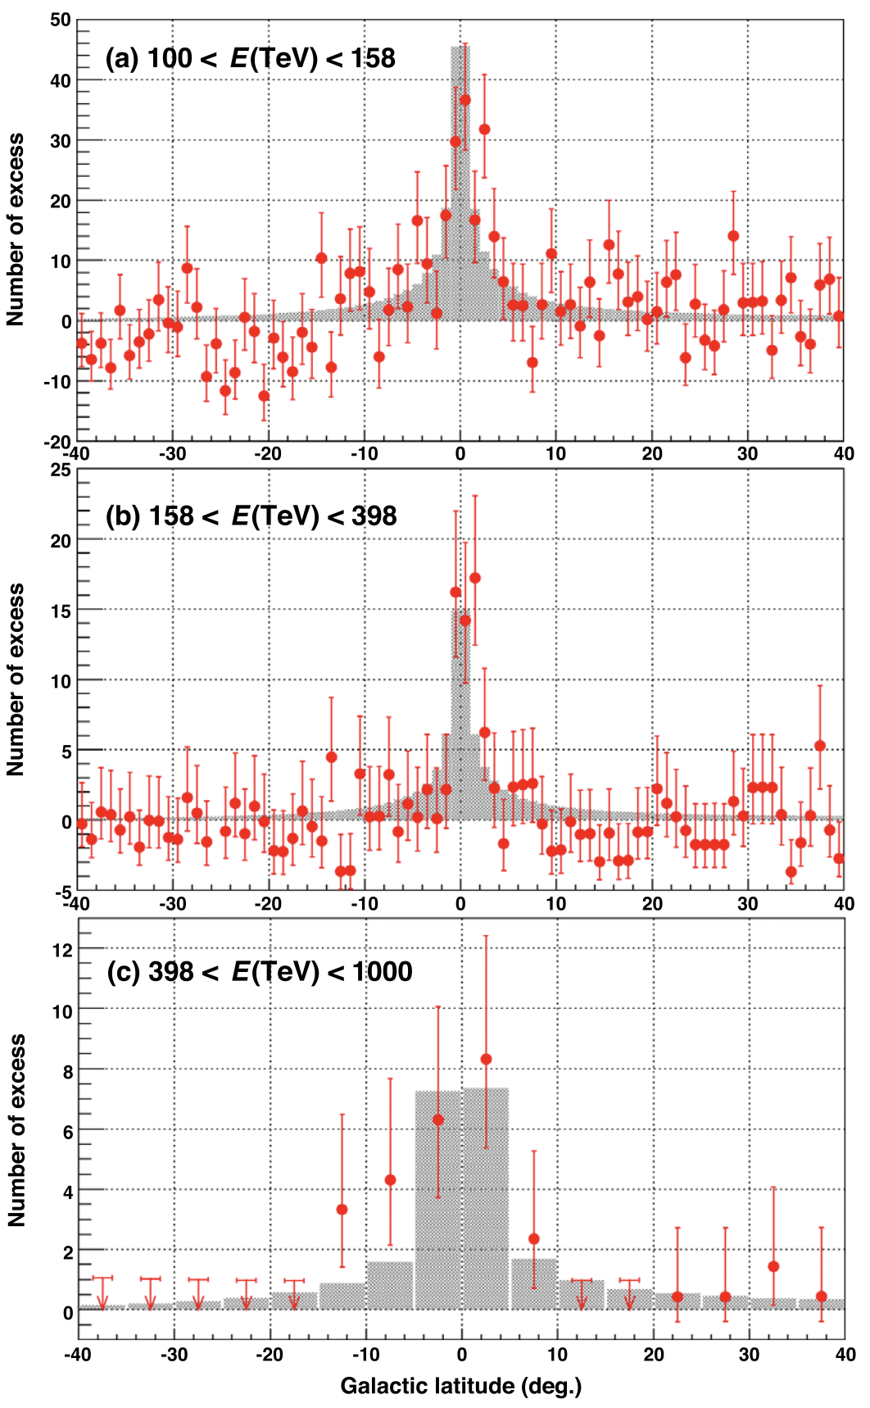
Galactic latitude distributions
M. Amenomori et al., PRL, 126, 141101 (2021)
100 – 158 TeV
158 – 398 TeV
Shaded Histograms: Model shape normalized to DATA (|b|<5º)
Model: Lipari & Vernetto,
PRD 98, 143003, (2018)
398 – 1000 TeV

Slide 19
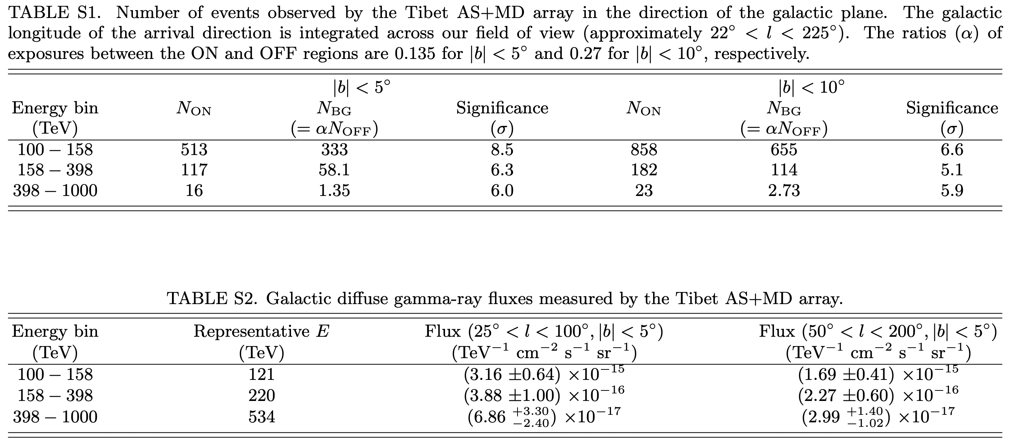
Number of sub-PeV events in the direction of galactic plane
observed by Tibet AS+MD array
M. Amenomori et al., PRL, 126, 141101 (2021)
Highest gamma-ray energy = 0.957 (+ 0.166 - 0.141) PeV
(Eres ~ 10 % around 400 TeV & energy scale uncertainty ~13% in quadrature)

Slide 20
Energy Spectrum
Models: Lipari & Vernetto, PRD 98, 143003, (2018)
4 ev / 10 ev from Cygnus cocoon (< 4º)
After excluding the contribution from the known TeV sources (within 0.5º in radius) listed in the TeVCat catalog
(~13% to the diffuse flux, but no contamination to events > 0.398 PeV)
Inner Galaxy
The measured fluxes are reasonably consistent with Lipari’s galactic diffuse gamma-ray model assuming the hadronic cosmic-ray origin.
Outer Galaxy
Amenomori+., PRL 126, 141101,(2021)

Slide 21
Electron origin? vs Proton origin?
Galactic coordinates
0.398 – 0.957 PeV
gamma rays
Observed gamma rays are isolated, not coming from known gamma-ray sources.
→ Electrons lose their energy quickly, so they should stay near the source.
→ Protons don't lose energy and can escape farther from the source.
Strong evidence for sub-PeV γ rays induced by cosmic rays
This is the first evidence for existence of PeVatrons, in the past and/or present Galaxy, which accelerate protons up to the Peta electron volt (PeV) region.

Slide 22
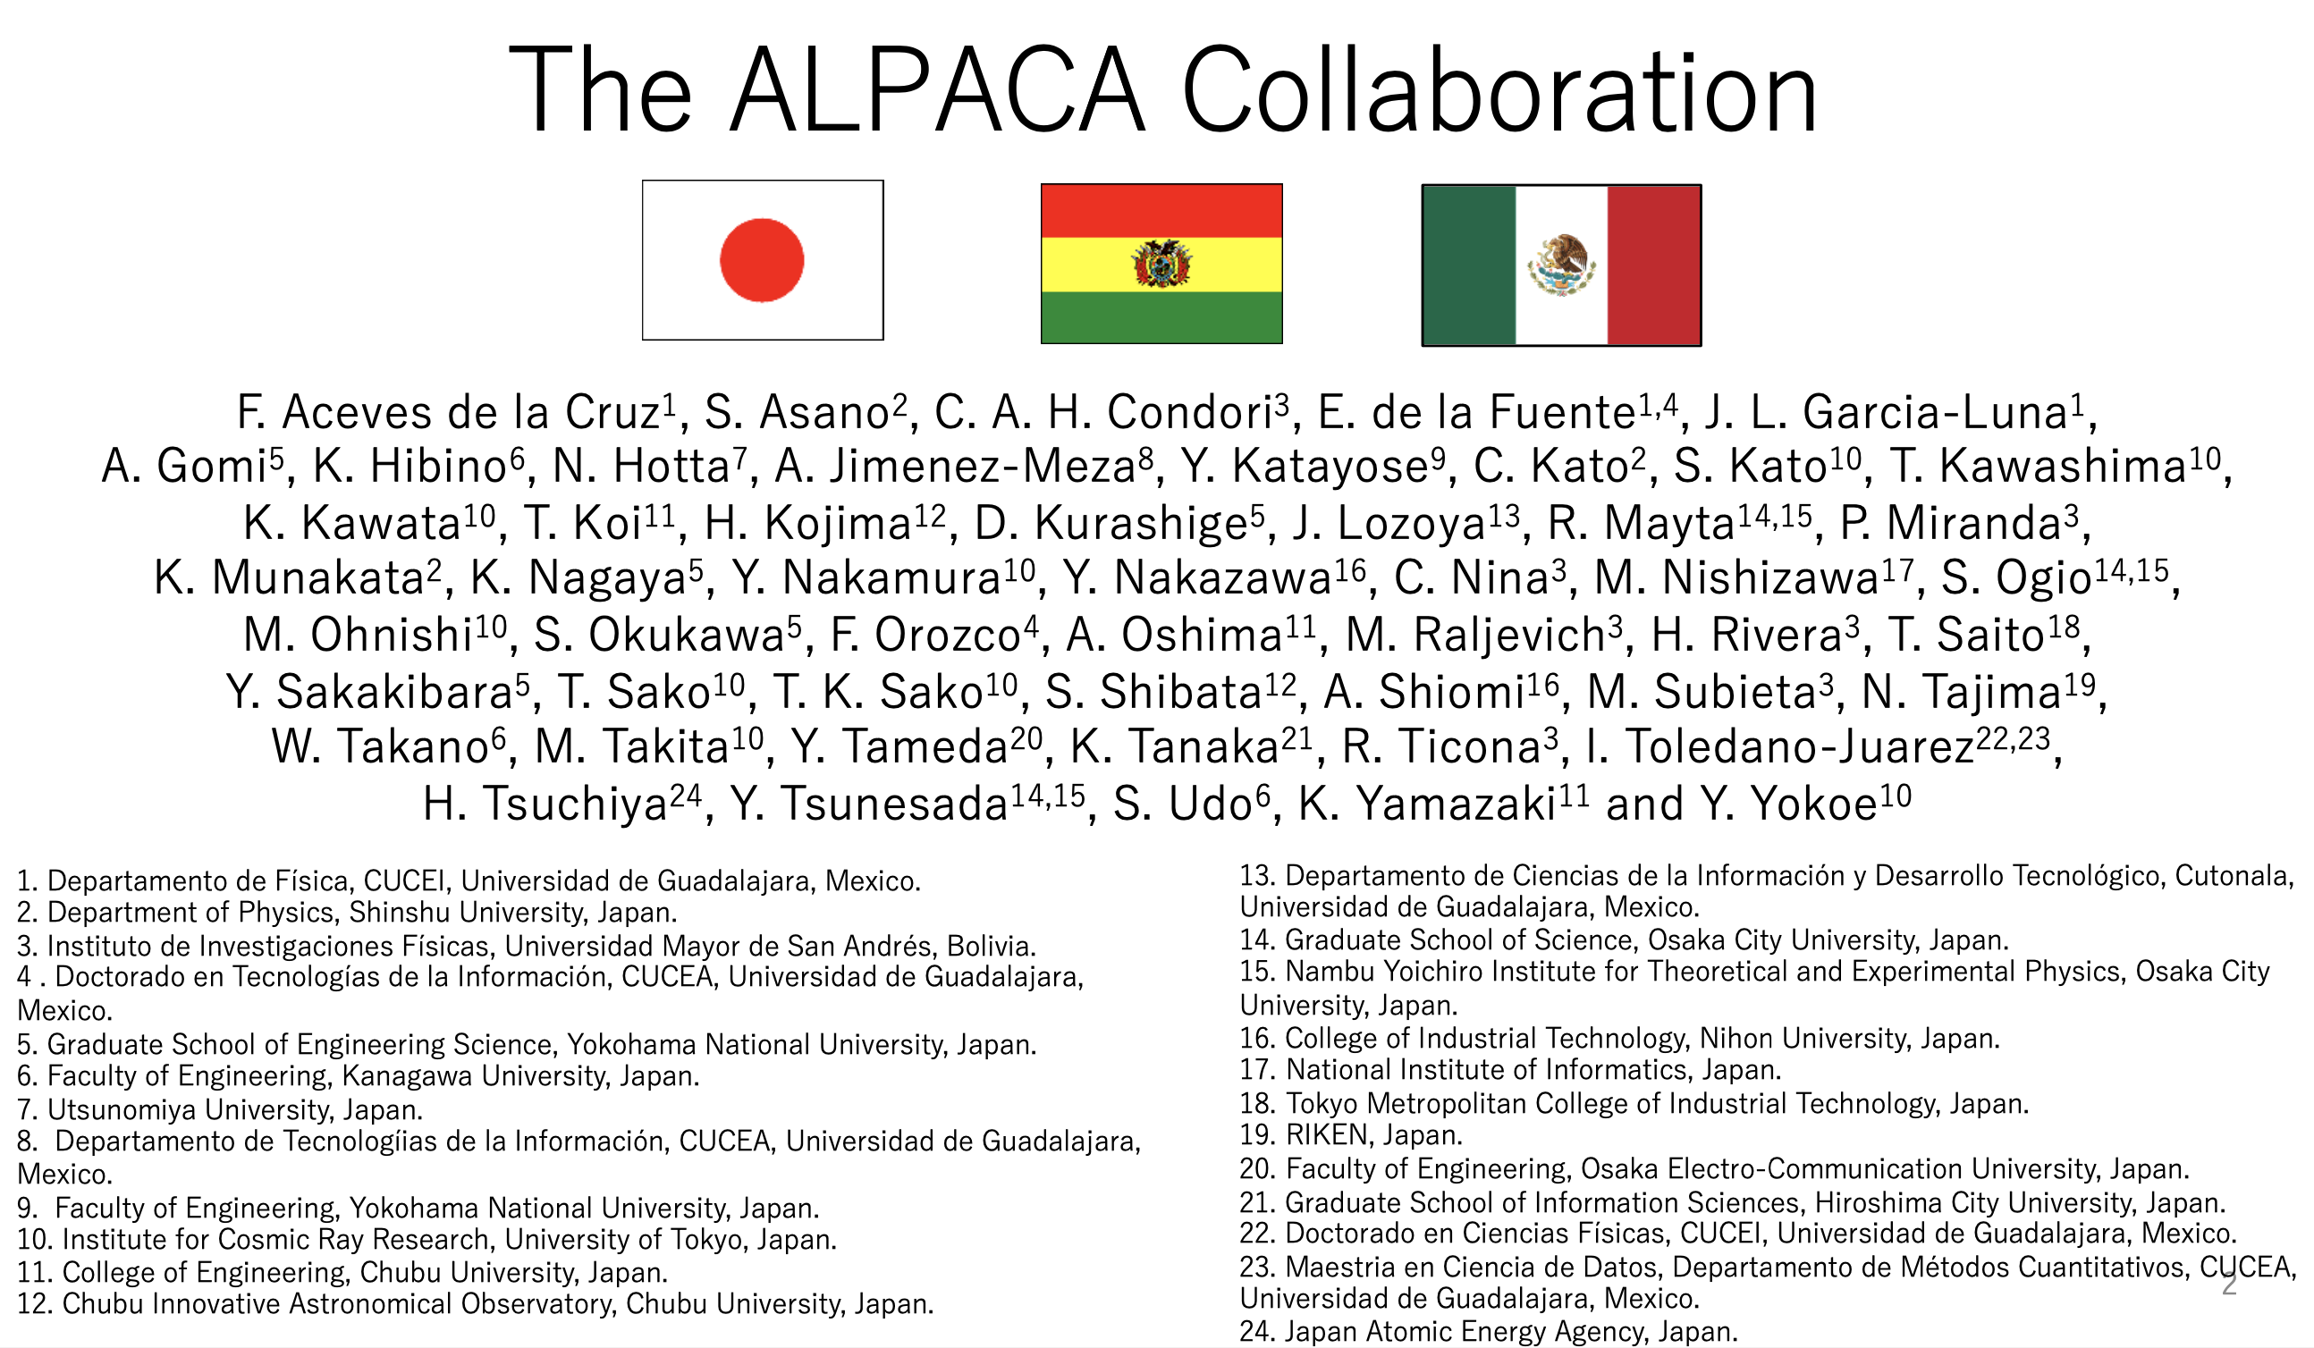

Slide 23
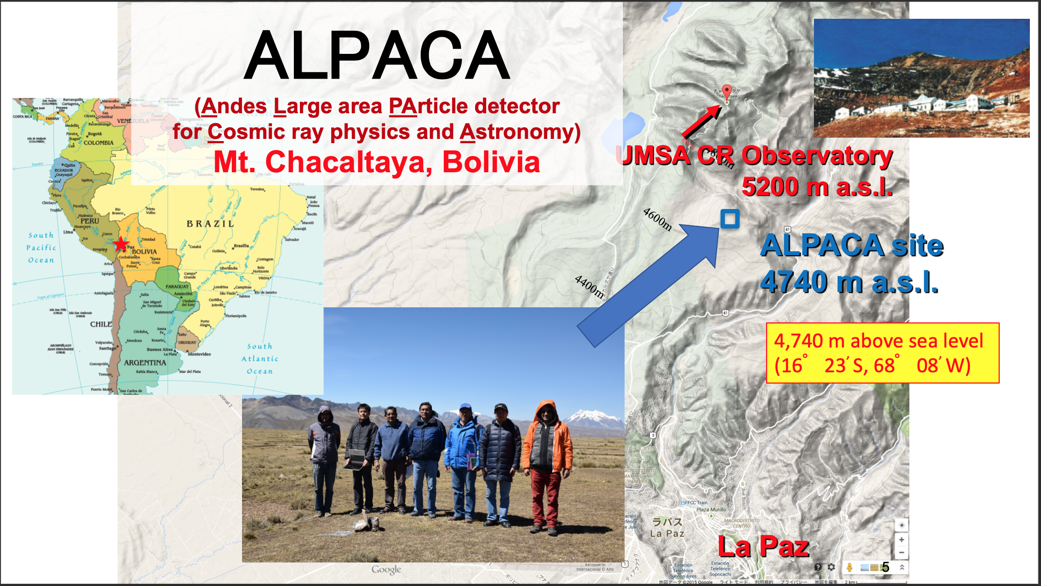

Slide 24
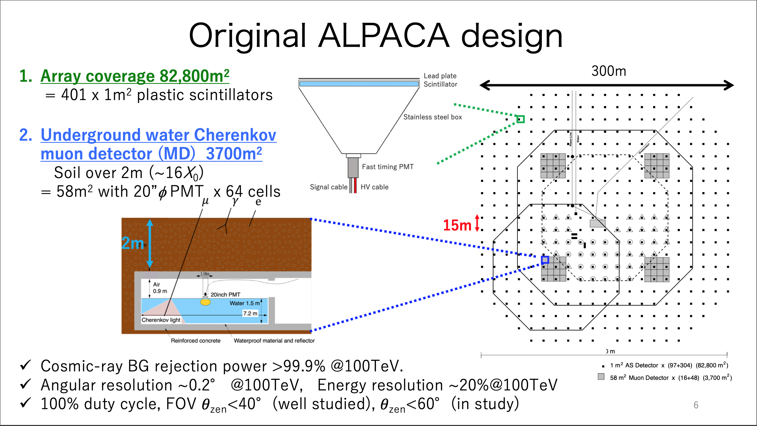

Slide 25
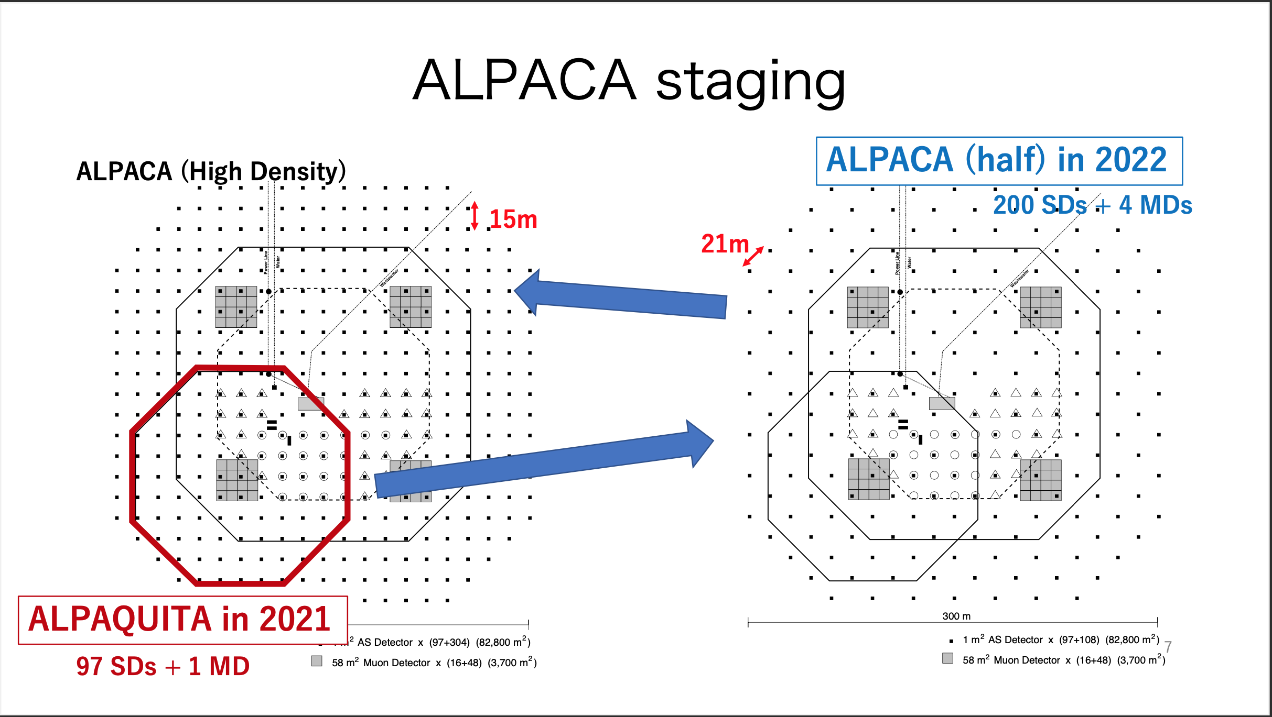

Slide 26
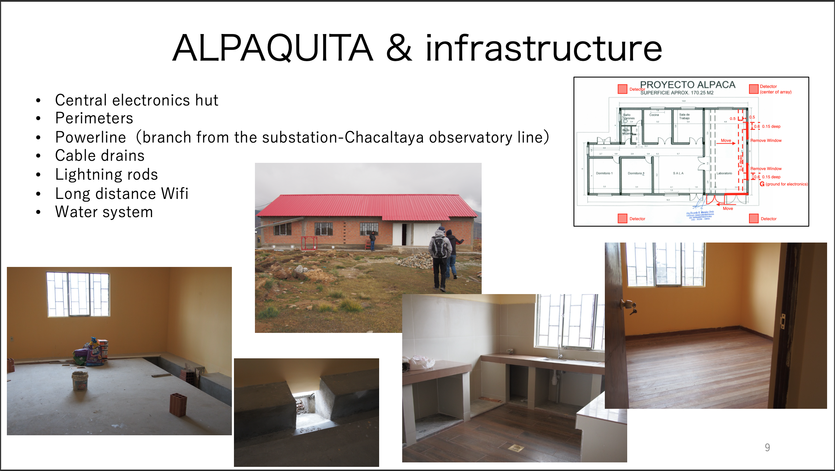

Slide 27
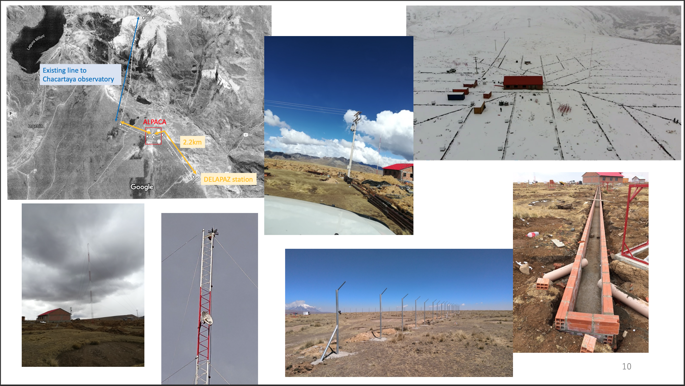

Slide 28
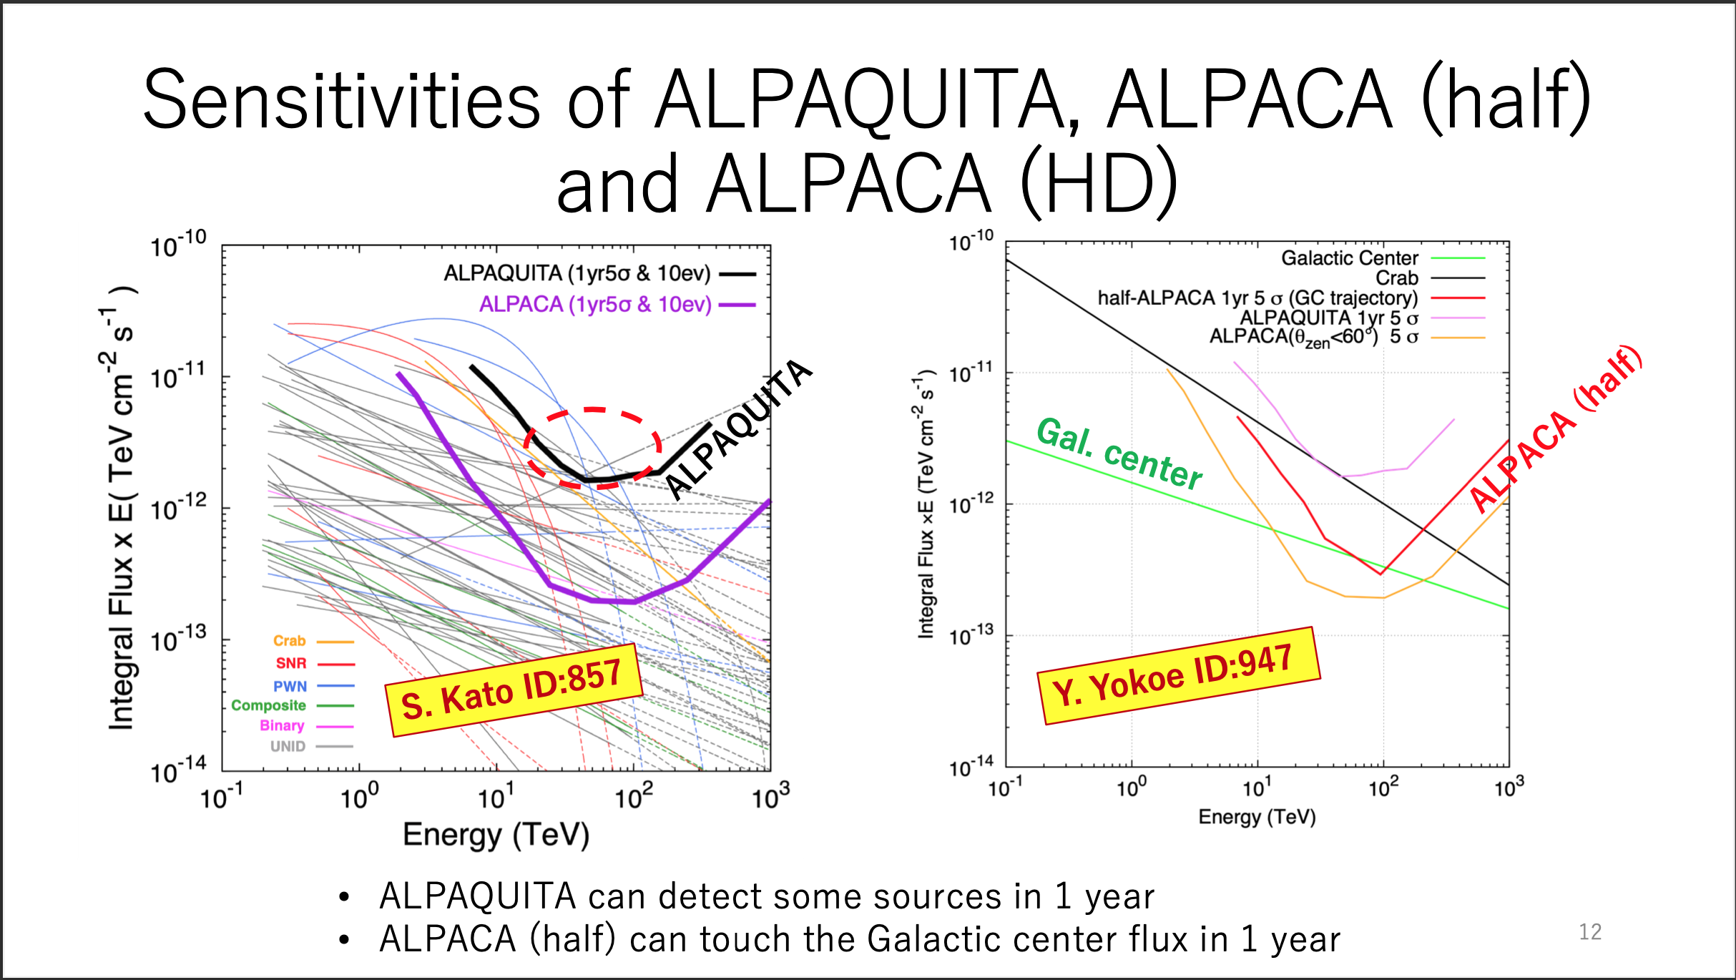
from ICRC 2021
from ICRC 2021
S. Kato et al., Experimental Astronomy, 52, 85 (2021)

Slide 29
Summary
Tibet ASγ group
Recent results of gamma-ray observations:
Crab Nebula -> First detection of sub-PeV gamma rays
G106.3+2.7 -> Potential PeVatron candidate
Cygnus OB 1 & 2
Galactic diffuse sub-PeV gamma rays
-> Evidence for existence of past and/or present PeVatrons in our Galaxy
M. Amenomori et al., PRL, 123, 051101 (2019)
M. Amenomori et al., Nature Astronomy Letters, 5, 460 (2021)
M. Amenomori et al., PRL, 127, 031102 (2021)
M. Amenomori et al., PRL, 126, 141101 (2021)
ALPACA group
Current status:
Infrastructure completed, ALPAQUITA (18,500 m²) construction under way
Thank you for your attention!

Slide 30
END

Slide 31
Diffuse γ-ray Model
Interstellar gas density
Cosmic-ray spectrum
Knee
Lipari & Vernetto,
PRD (2018)
Electron/Positron
Bremss.
Hadronic
Steep spectrum
in TeV region
IC
Photon fields
Diffuse e origin: negligible!

Slide 32
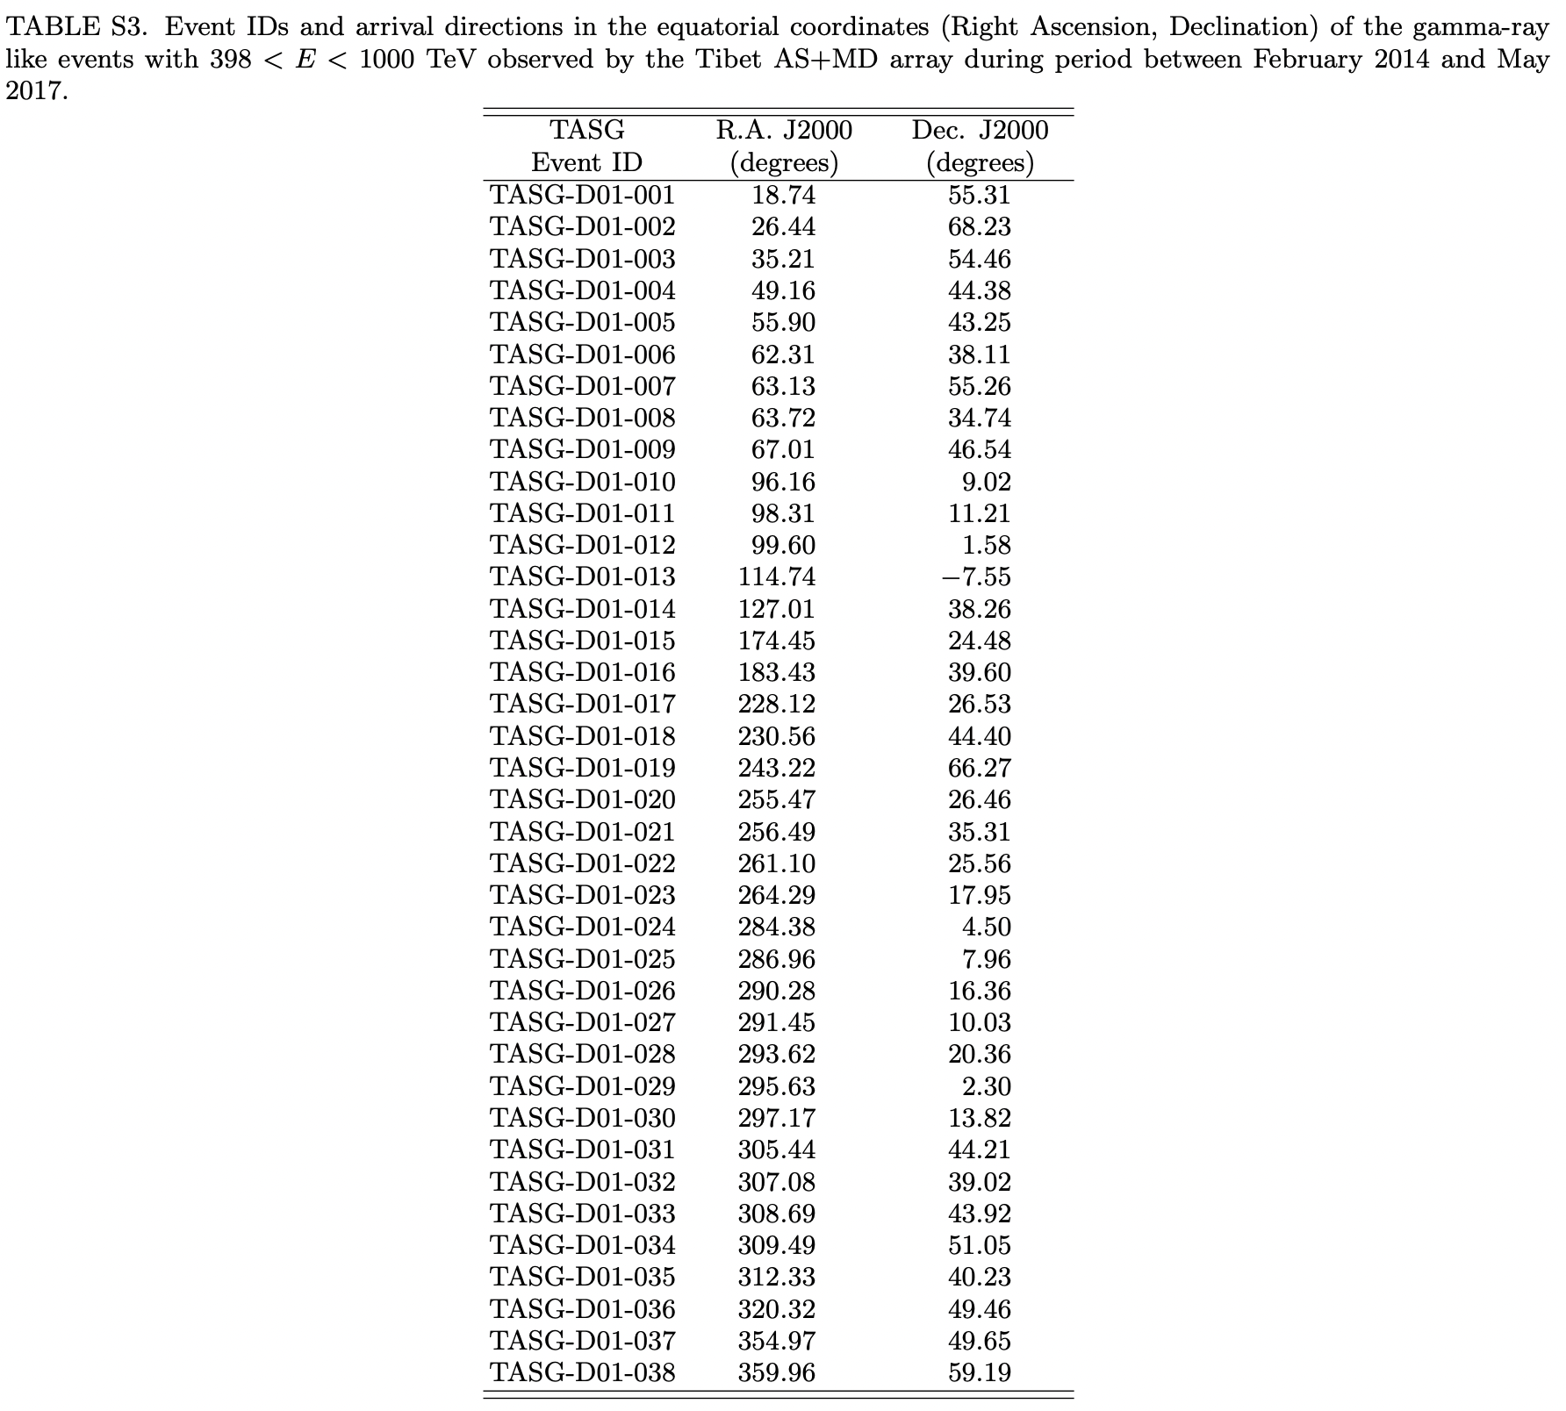
Arrival Directions of the 38 events (> 0.398 PeV)
See PRL supplemental materials
Amenomori+., PRL 126, 141101,(2021)

Slide 33
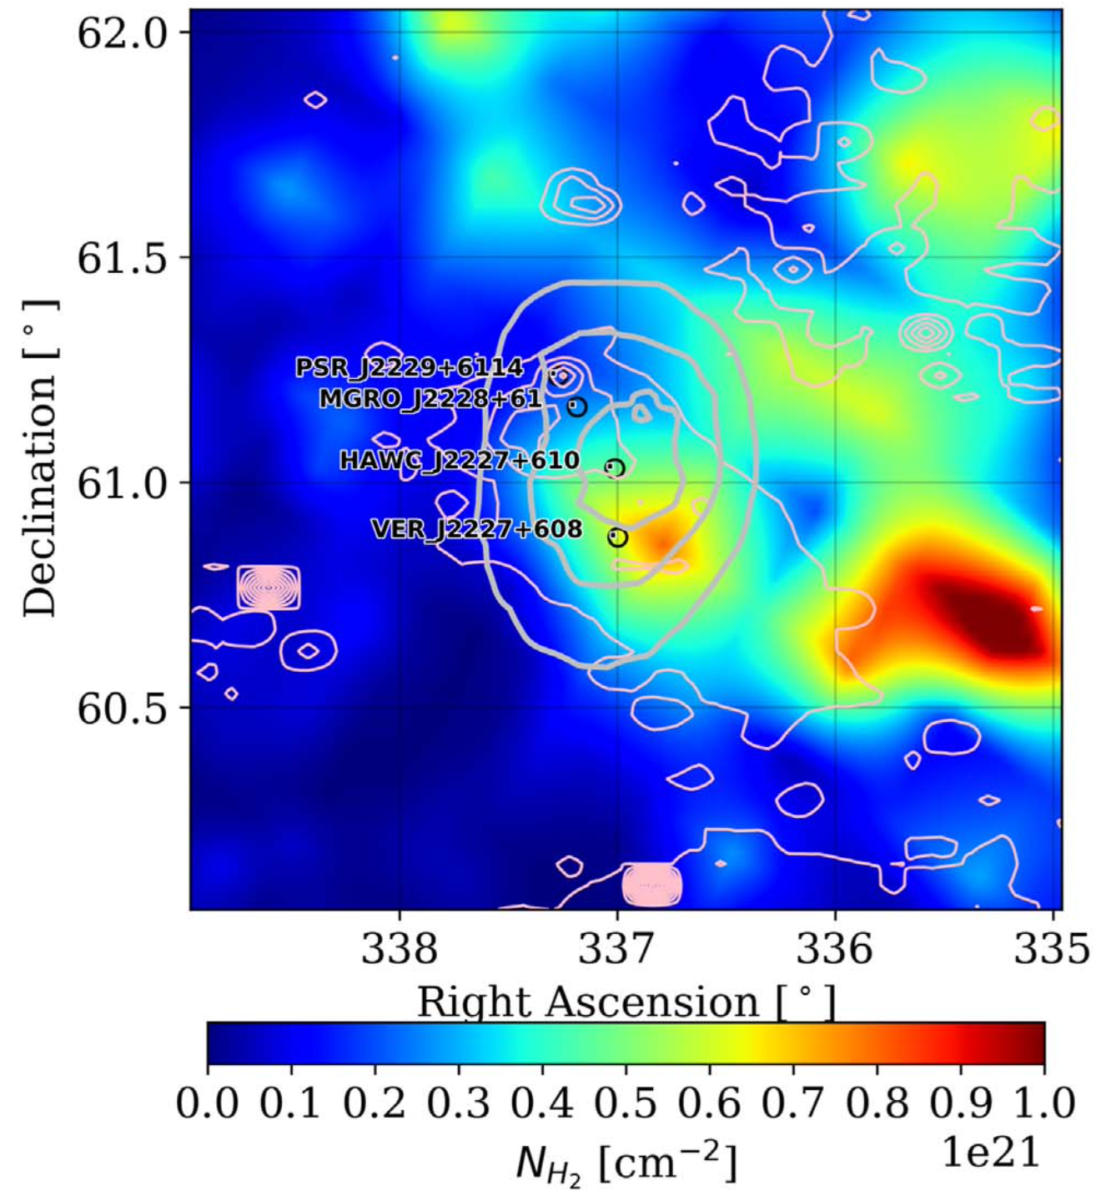
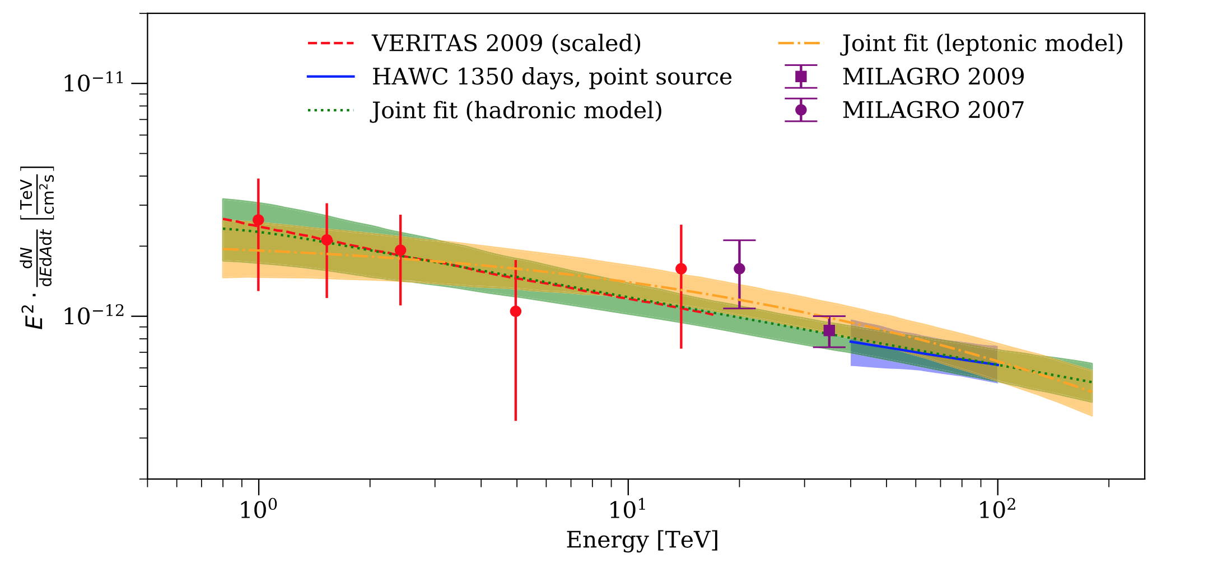
SNR G106.3+2.7 observed by HAWC
Albert et al., ApJL, 896, L29 (2020)
Radio (1.4 GHz)
Significance contour
PSR J2229+6114
Energy spectrum
VERITAS
Milagro
HAWC
HAWC
VERITAS
1 TeV
100 TeV
Source location consistent with the location of PSR J2229+6114
as well as the molecular cloud
Measured the γ-ray spectrum from 40 TeV up to 100 TeV

Slide 34
Discussion
Hadronic model
Protons accelerated by SNR shock interact with molecular cloud gas π⁰ 2γ
E_{cut} ∼ 0.5 PeV
Leptonic model
Inverse Compton scattering of ambient photons by electrons injected by PSR J2229+6114
E_{cut} ∼ 190 TeV, B ∼ 9 μG
W_{e} ∼ 1.4 x 10⁴⁷ erg: only 2% of energy released by PSR J2229+6114 during its age of 10 kyr
98% used for B amplification B should be much stronger than 9 μG
— What if pulsar age is 1 kyr?
Diffusion length of 1 TeV electrons ∼ 1.7 pc = 0.12° during 1 kyr
inconsistent with the location of the 10 GeV γ-ray emission
observed by Fermi
Hadronic model is favored

Slide 35
Aharonian+, A&A, 309, 917 (1996)
Gabici+, MNRAS, 396, 1629 (2009)
Leptonic model
Diffusion length:
E_{cut} ∼ 190 TeV, α ∼ 2.3, B ∼ 9 μG
Diffusion coefficient:
190 TeV electrons diffuse away by 0.44°
(= diffusion length 6 pc @ distance from the Earth 0.8 kpc)
during its synchrotron cooling time of 0.9 kyr
➡︎ reduction factor of diffusion coefficient χ ∼ 0.004
➡︎ if the true age of the pulsar is 1 kyr, 1 TeV electrons diffuse away only by ∼1.7 pc = 0.12°
➡︎ inconsistent with the location of the 10 GeV γ-ray emission observed by Fermi
Hadronic model
E_{cut} ∼ 0.5 PeV, α ∼ 1.8
Proton spectrum remains hard (α ∼ 1.8) even after diffusion time of 10 kyr (SNR age)
➡︎ Diffusion could be suppressed due to the trapping of protons inside the molecular cloud

Slide 36
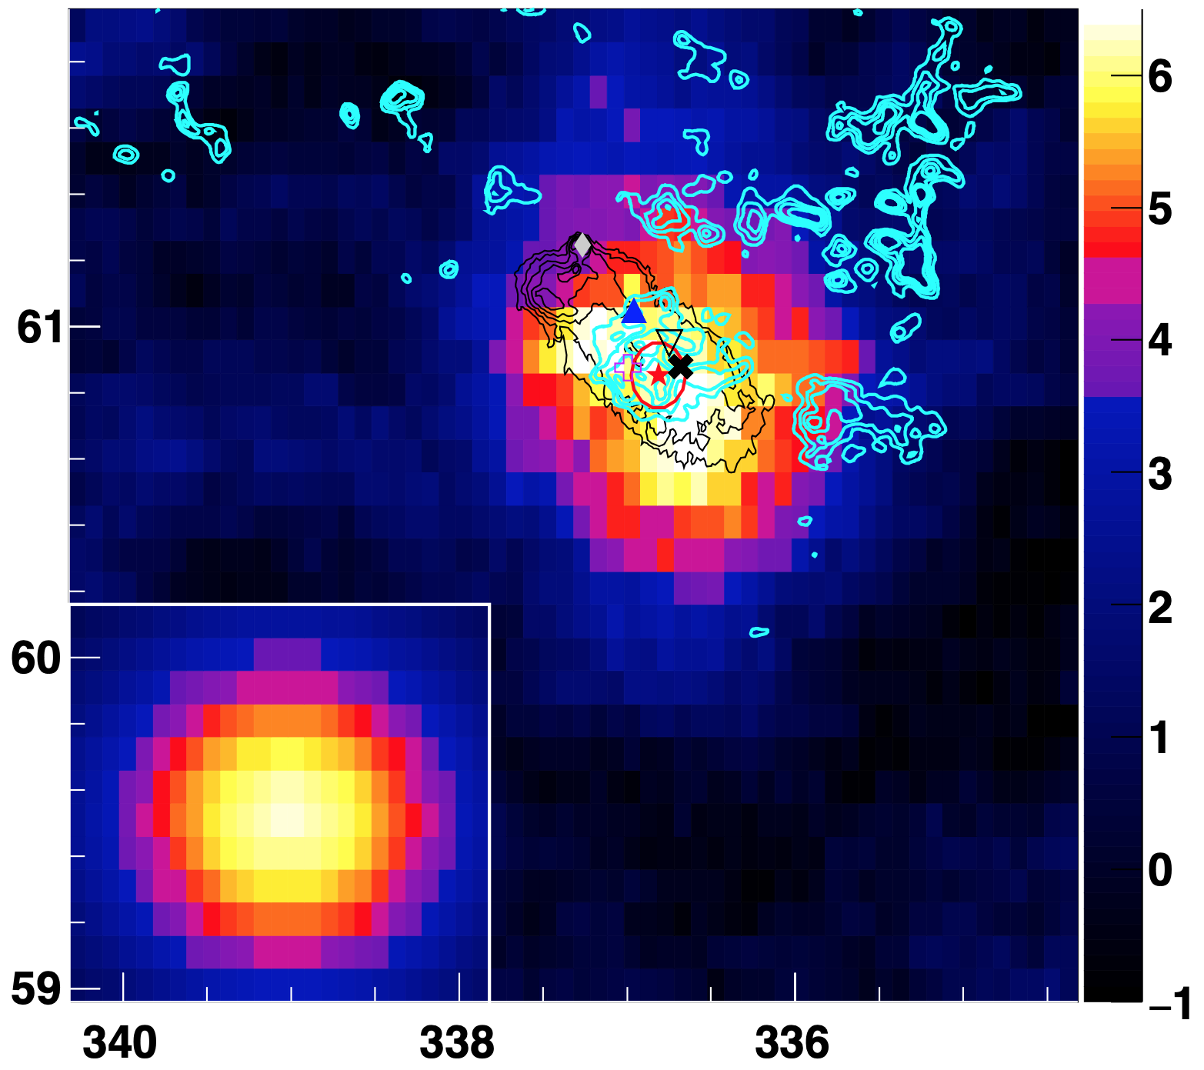
PSR J2229+6114
Declination (deg.)
Radio (1.4 GHz)
CO emission
Tibet ★
VERITAS
Fermi ✖︎
HAWC ▲
LHAASO ▽
Right Ascension (deg.)

Slide 38
Number of events
Integral
Differential
E_{Rec}(TeV) | after Nμ cut
 | ON/BG | σ
>10.0 | 671 / 522.6 | 6.1
>15.8 | 466 / 351.9 | 5.6
>25.1 | 187 /110.5 | 6.4
>39.8 | 64 / 26.9 | 5.9
>63.1 | 26 / 7.3 | 5.1
>100.0 | 6 / 2.5 | 1.8
>158 | 1 / 1.0 | -
>251 | 0 / 0.2 | -
E_{Rec}(TeV) | after Nμ cut | σ
 | ON/BG
10-16 | 205 / 170.6 | 2.5
16-25 | 279 / 241.4 | 2.3
25-40 | 123 / 83.6 | 3.9
40-63 | 38 / 19.6 | 3.6
63-100 | 20 / 4.8 | 4.9
100-158 | 5 / 1.4 | 2.2
158-251 | 1 / 0.9 | -
251-398 | 0 / 0.2 | -

Slide 39
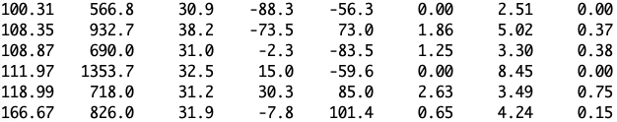
ON-source event list > 100 TeV
ON = 6
BG = 2.5
Erec (TeV) Σρ zen(°) core X(m) core Y(m) Nμ cut Nμ Nμ/ cut
1
2
3
4
5
6

Slide 40

on-source events > 100 TeV
+ Tibet best-fit position > 10 TeV
Search window (radius 0.5°)
events with Nm < 0.2
events with Nm >= 0.2
6
2
3
1
4
5

Slide 41
Relative muon distribution
E > 63.1 TeV
Number of events
after Nμ cut
total 26
BG 7.3
excess 18.7
BG
γ MC

Slide 42
Bin Purity
Erec (TeV) | purity | contamination
 |  | from lower energies | from higher energies
10-16 | 33.9 % | 38.6 % | 27.5 %
16-25 | 34.6 % | 42.5 % | 22.9 %
25-40 | 40.3 % | 36.9 % | 22.9 %
40-63 | 44.6 % | 34.1 % | 21.3 %
63-100 | 49.4 % | 31.9 % | 18.7 %
100-158 | 54.8 % | 29.8 % | 15.3 %
158-251 | 61.0 % | 26.2 % | 12.8 %
※ 100-251 75.3 % 20.2 % 4.4 %
(cf. 83 % 14 % 3 % for Crab)

Slide 43
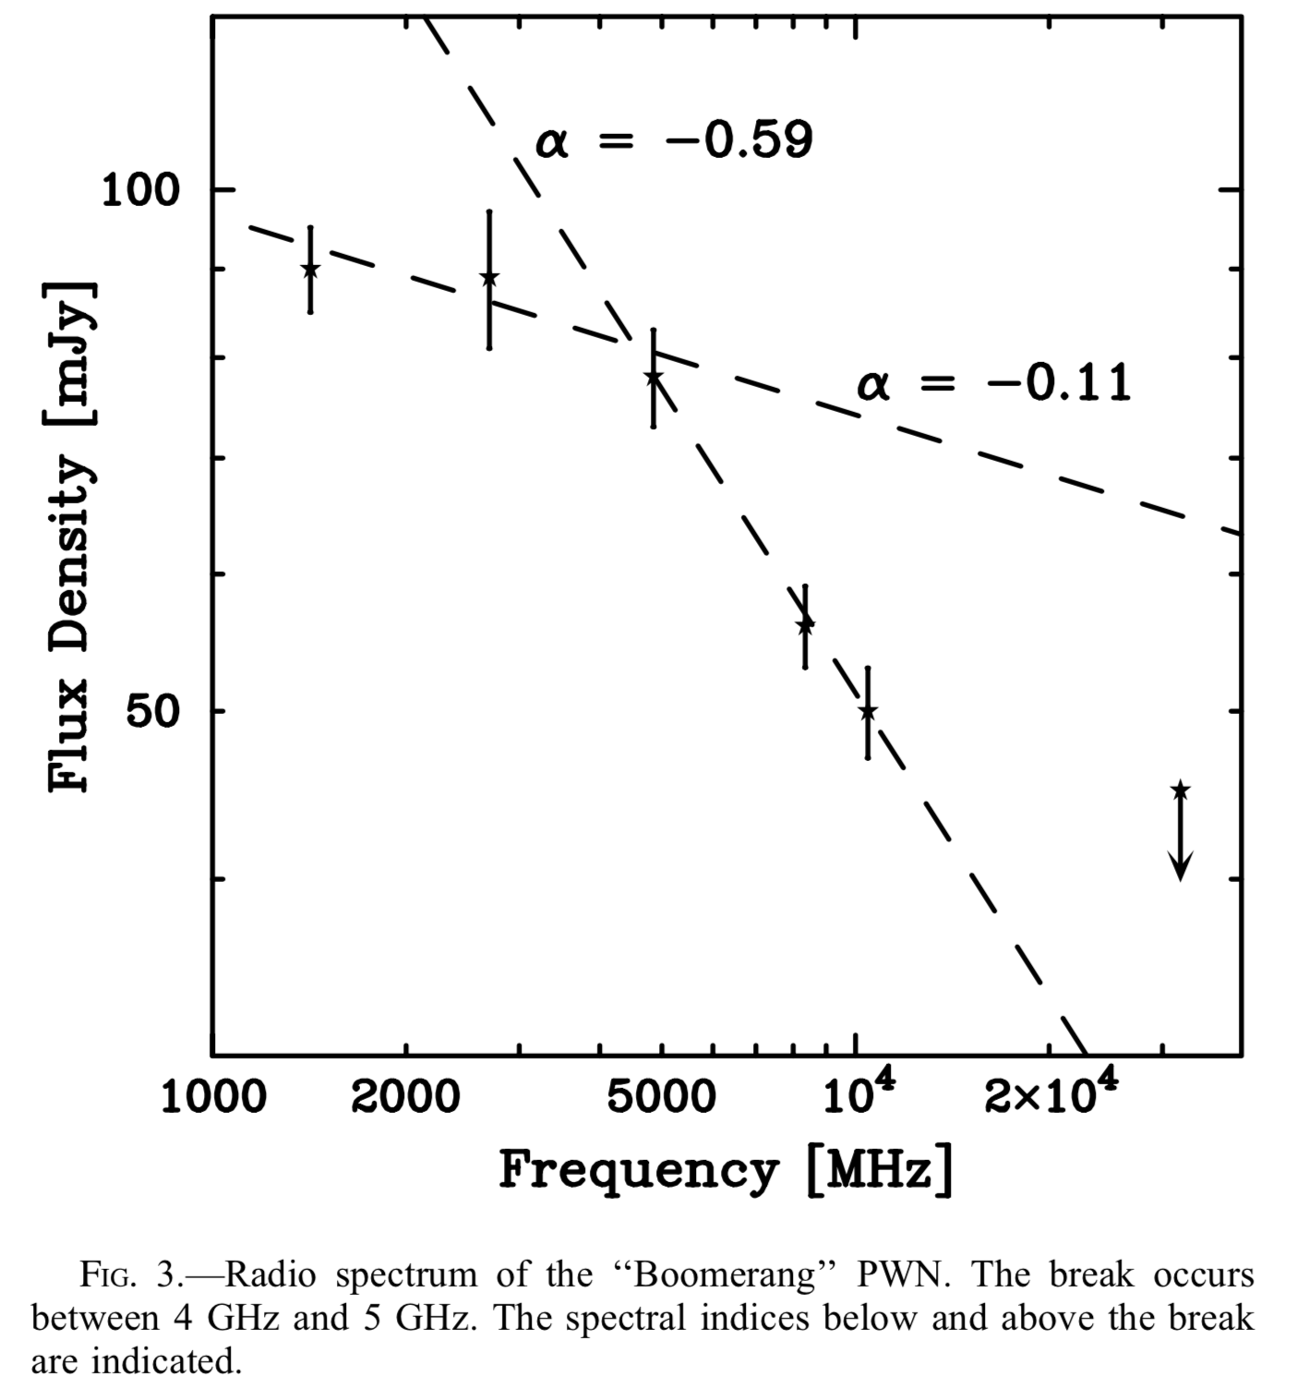
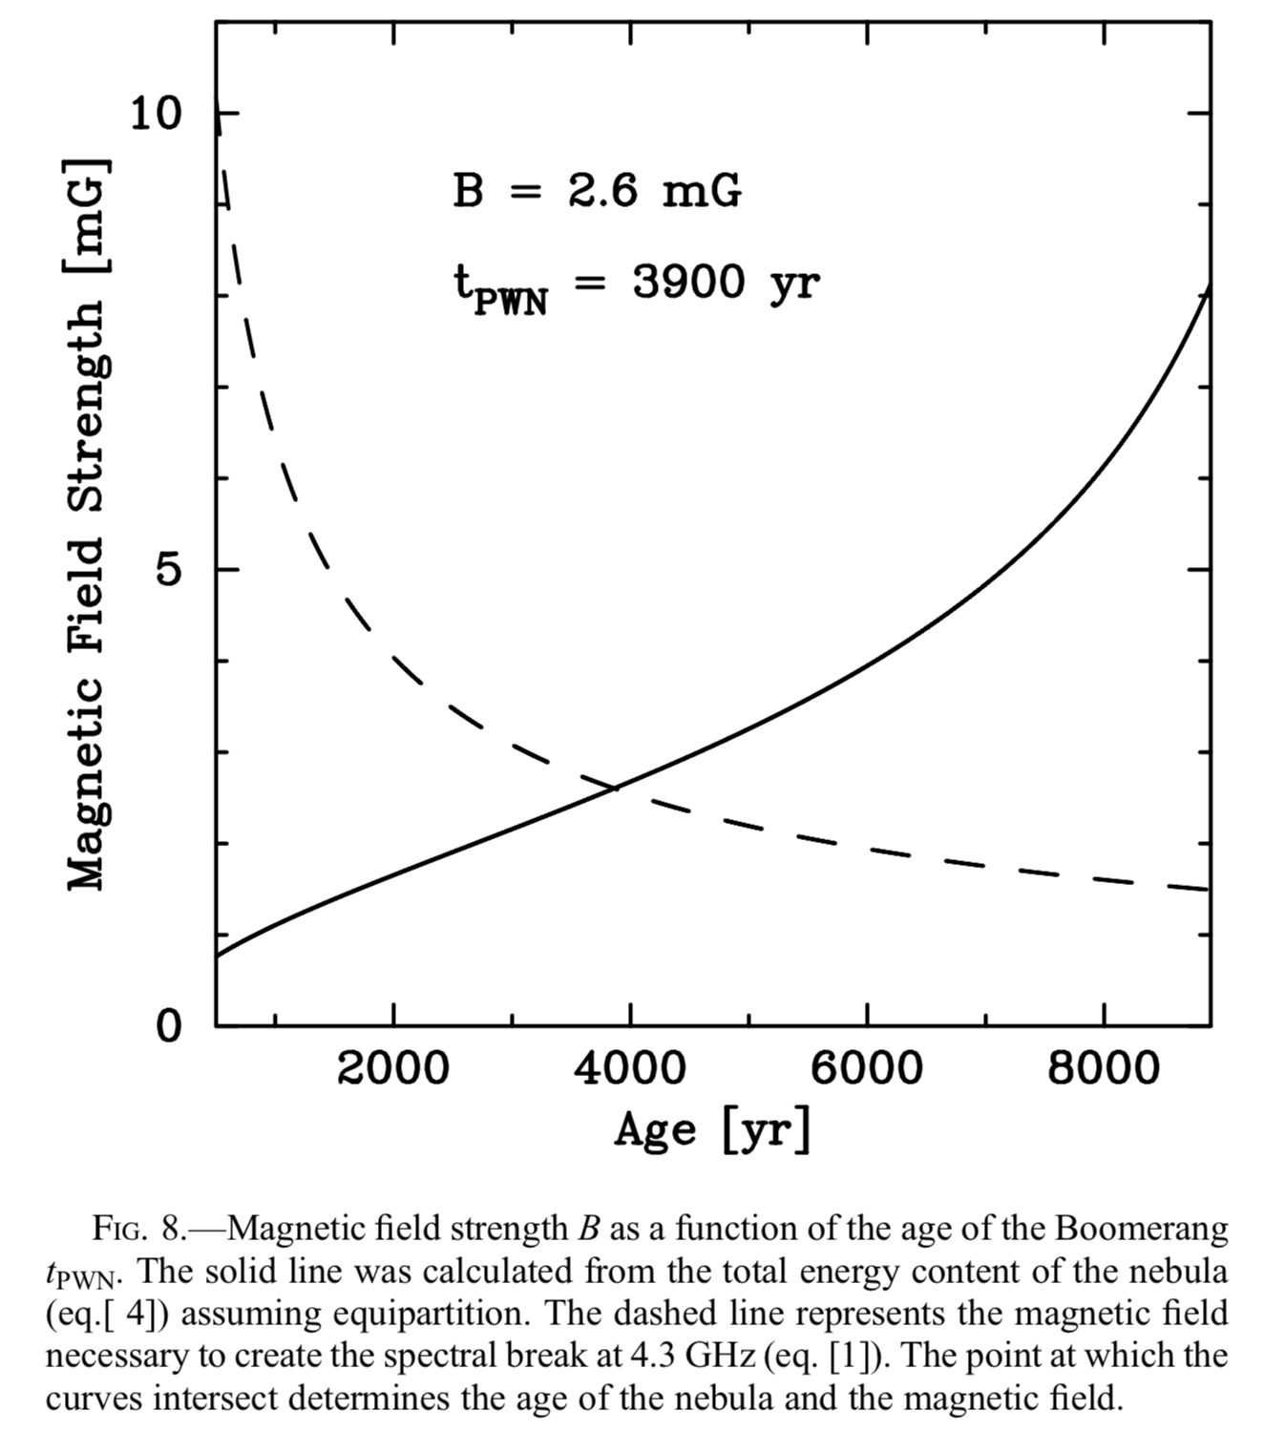
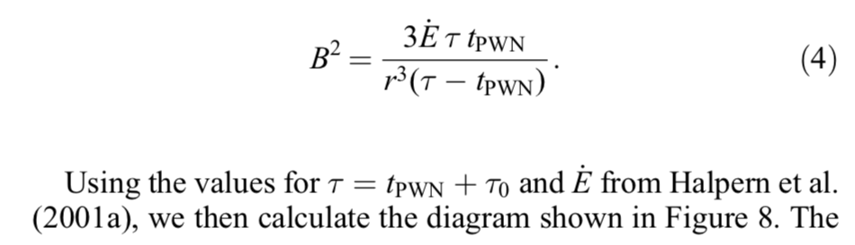
Boomerang PWN properties
Kothes et al, ApJ, 638, 225 (2006)
pulsar PSR J2229+6114： P = 51.6 ms
Ė = 2.2 x 10³⁷ erg/s
τ = = 10,460 yr

Slide 44
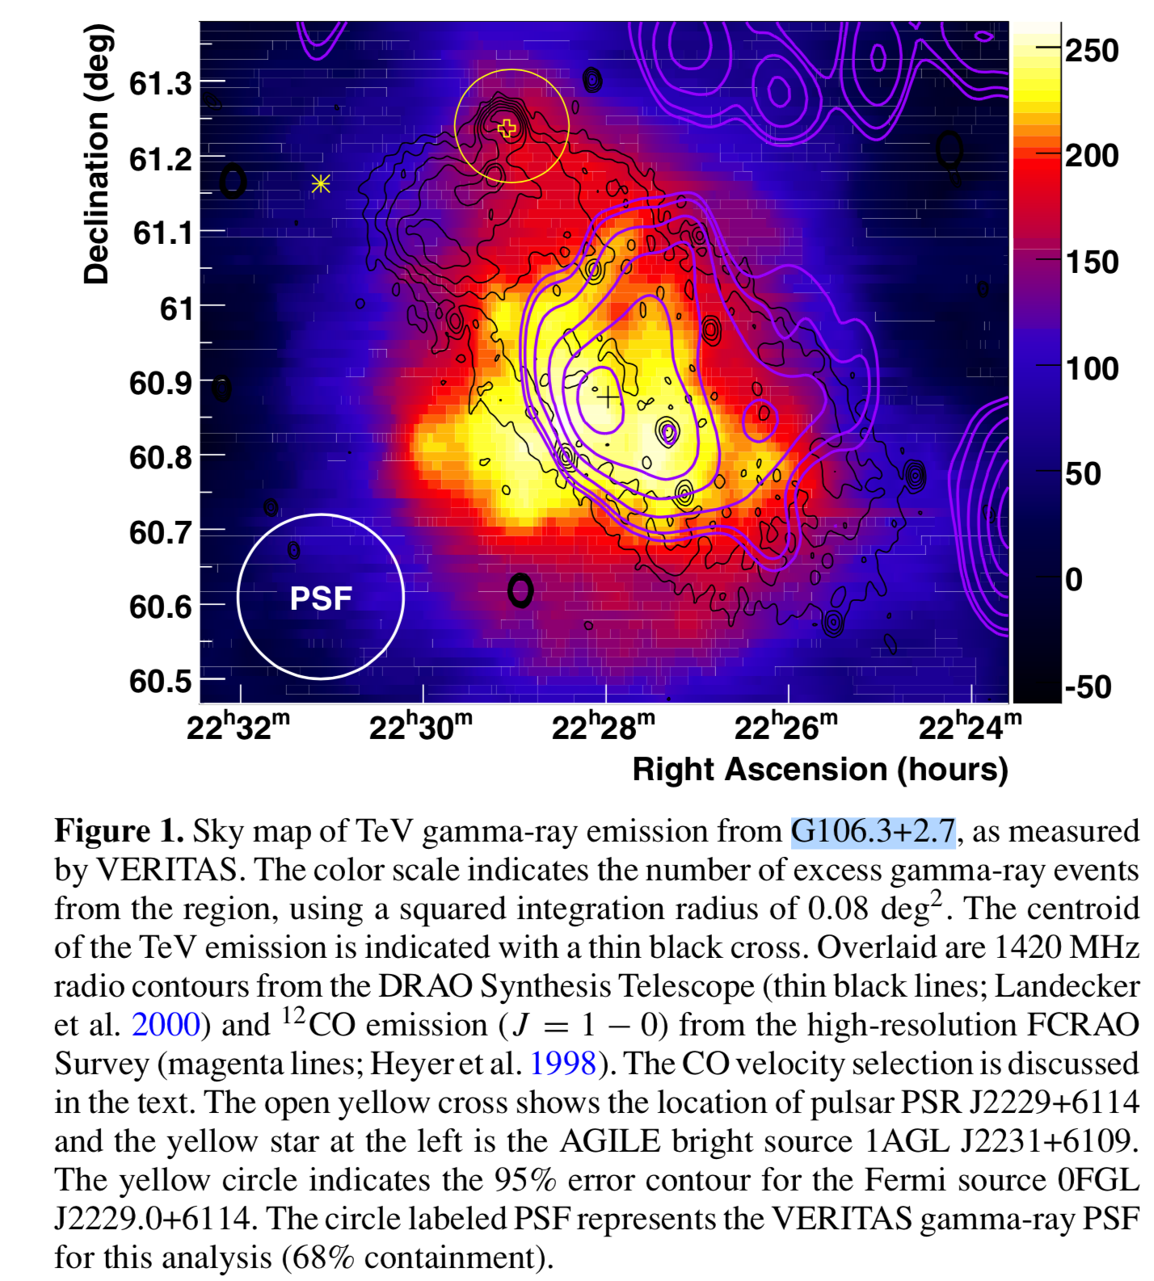
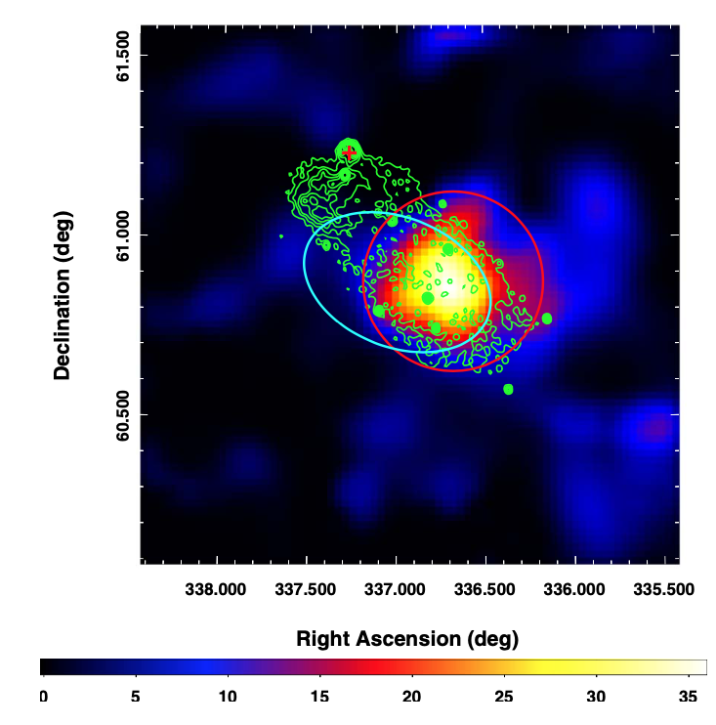
SNR G106.3+2.7 observed by VERITAS & Fermi
Acciari et al., ApJL, 703, L6 (2009)
Abdo et al., ApJL, 700, L127 (2009)
VERITAS
Fermi
Boomerang PWN
PSR J2229+6114
PSR J2229+6114
Radio (1.4 GHz)
CO emission
Fermi
VERITAS
Radio (1.4 GHz)
TS
Distance 0.8 kpc ➡︎ SNR size 14 pc x 6 pc
PSR J2229+6114： Ė = 2.2 x 10³⁷ erg/s, age 10 kyr
Centroid of GeV & TeV γ emission coincident with the molecular cloud location
Kothes et al, ApJ, 560, 236 (2001)
Halpern et al., ApJL, 552, L125 (2001)

Slide 45
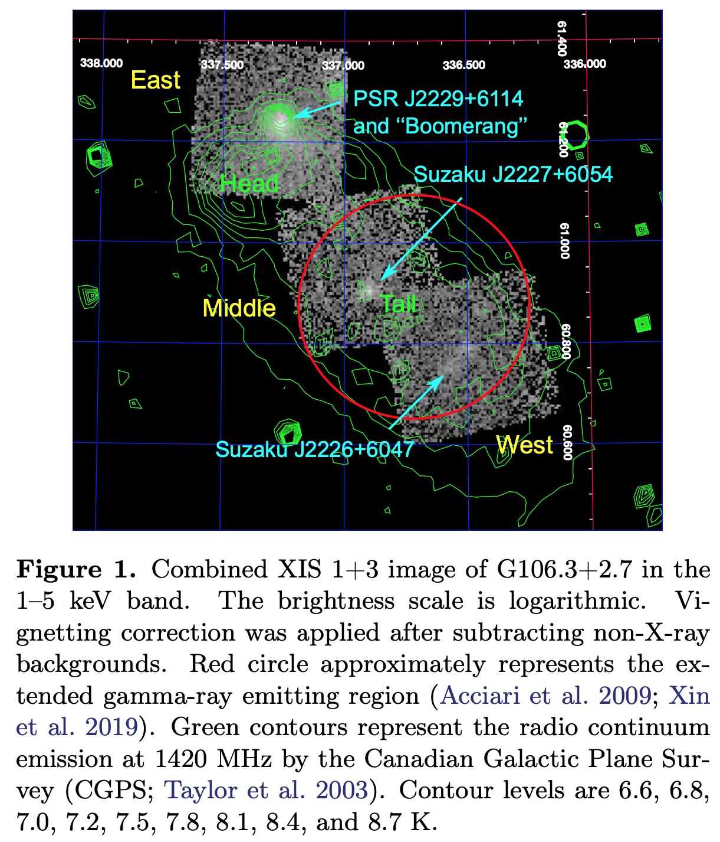
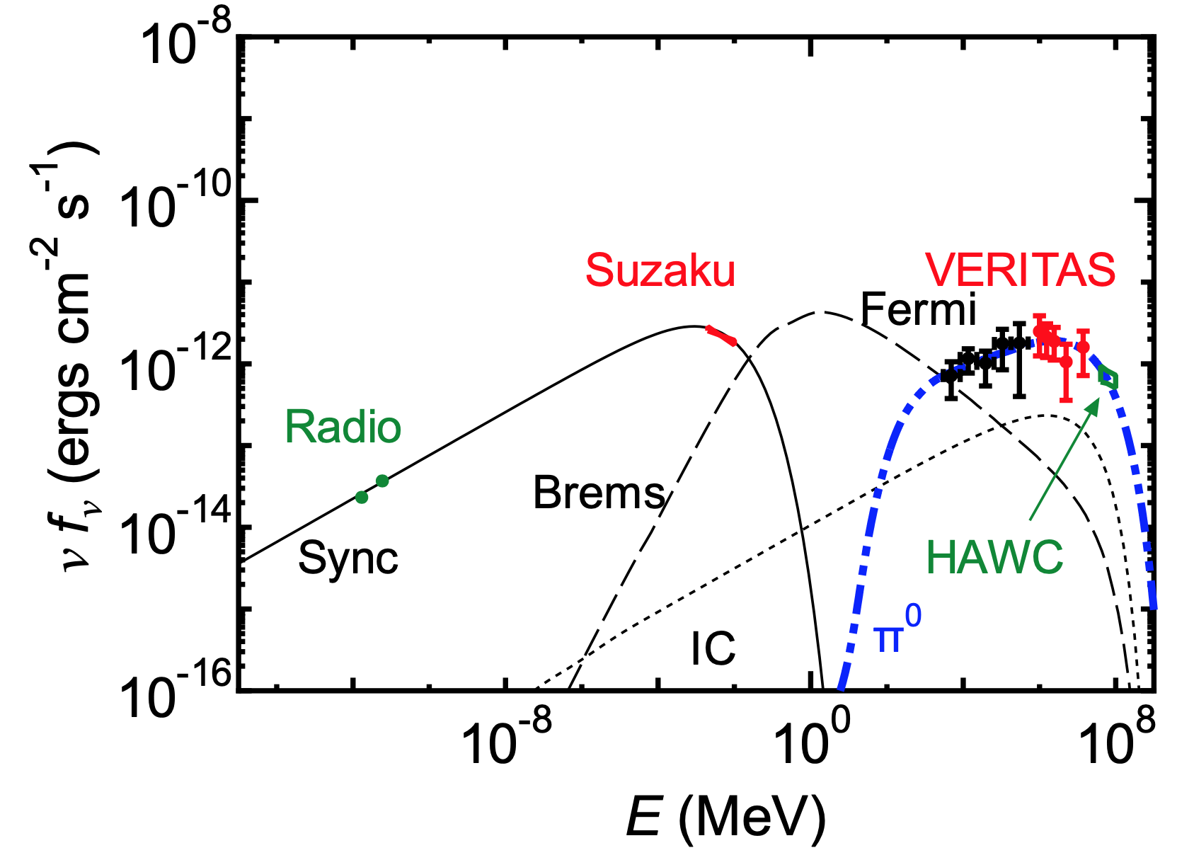
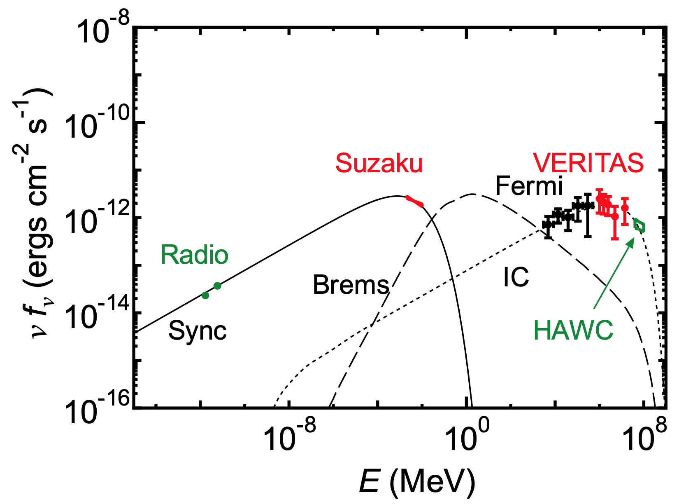
Suzaku observation
Fujita et al., arXiv:2101.10329 (2021)
Hadronic+Leptonic
パルサーや点源を除いた
Diffuse 成分のフラックス
1—5 keV
Pure Leptonic
Radio & X: intensity increases toward pulsar
➡︎ likely by electrons from pulsar
γ-ray: emission region coincident with molecular cloud
➡︎ likely by protons trapped inside the molecular cloud

Slide 46
Optimization of Nμ cut
maximize figrure-of-merit
Nμ cut for:
Crab
85%Crab@10TeV, Γ=−2.8
11%Crab@10TeV, Γ=−2.3
Cut used in this work
cut value of ΣNμ

Slide 47
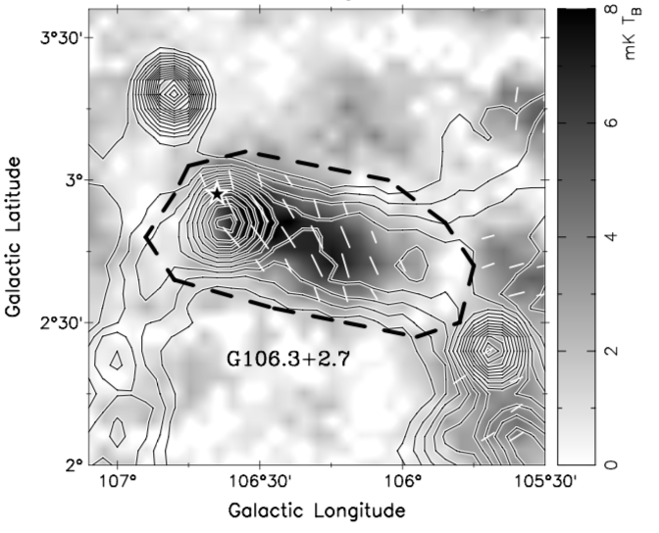
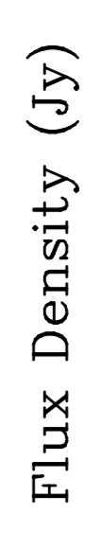
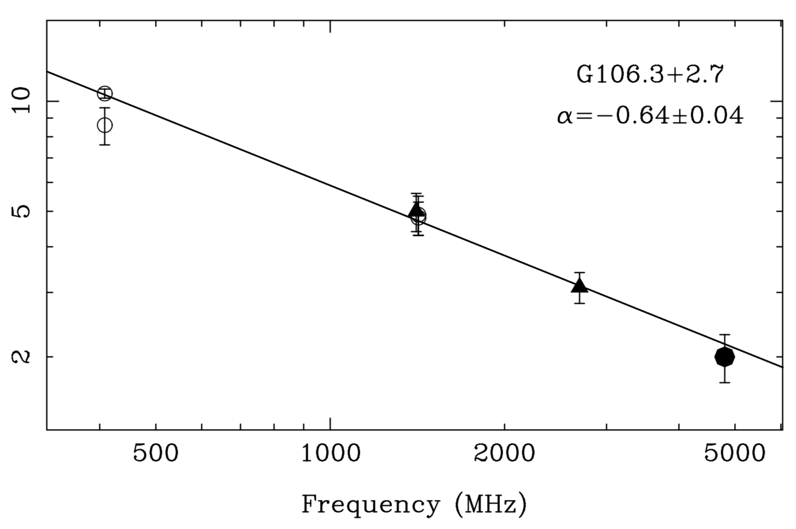
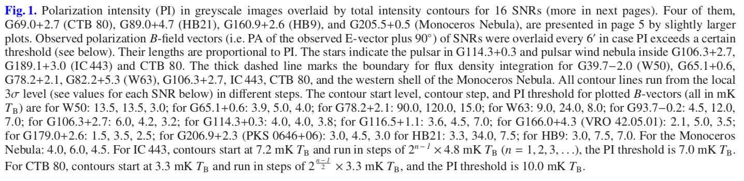
X. Y. Gao et al., A&A, 529, A159 (2011)
radio observation
boundary for flux integration

Slide 48
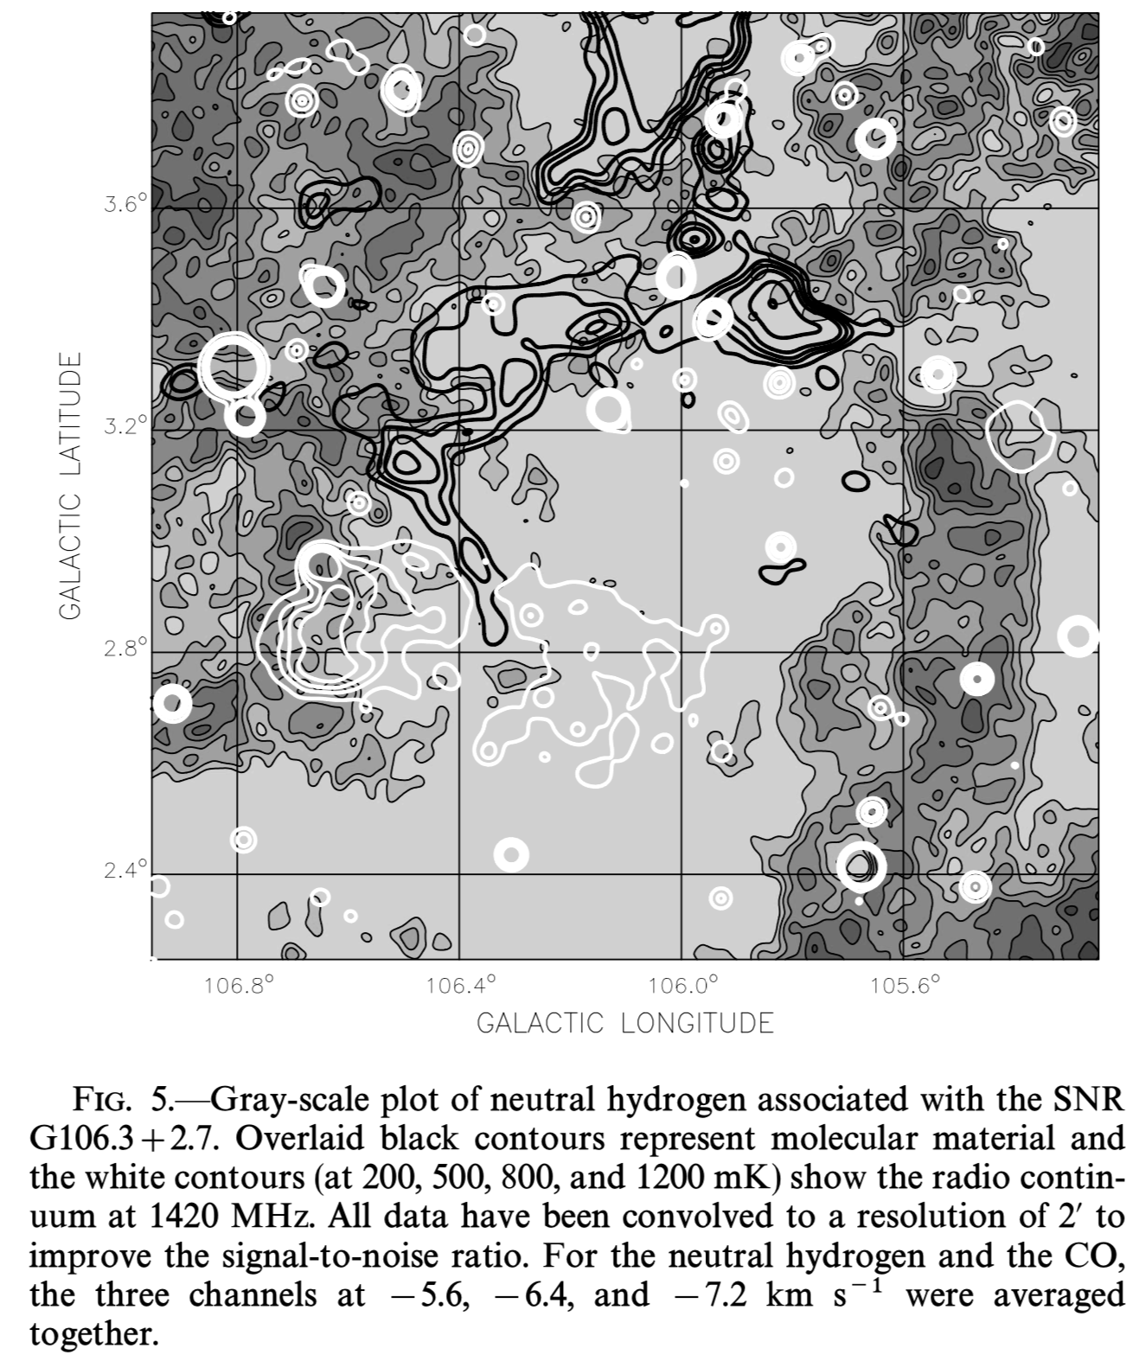
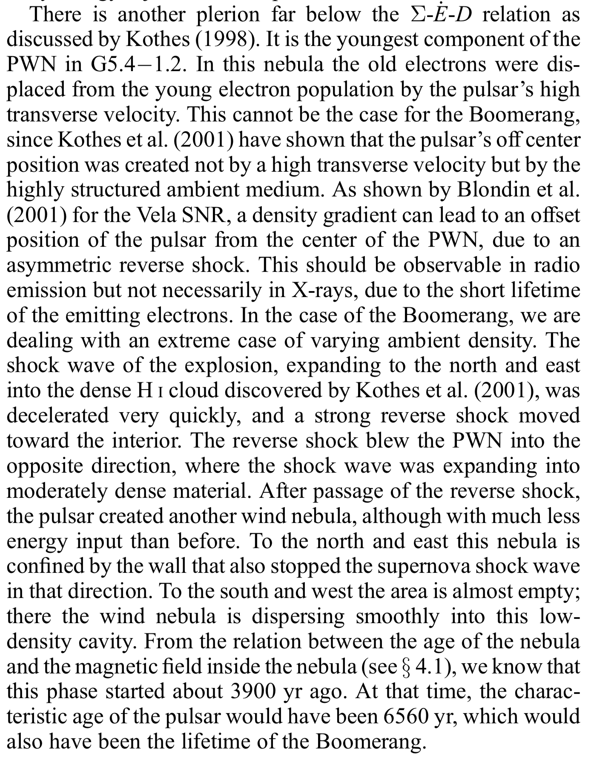
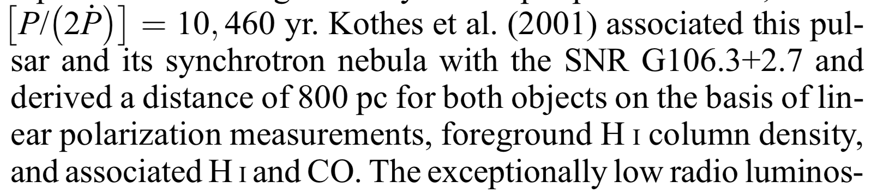
SNR G106.3+2.7 & Boomerang PWN
Kothes et al., ApJ 560, 236 (2001)
Kothes et al, ApJ, 638, 225 (2006)
Dense
material
Boomerang
PWN
SNR G106.3+2.7

Slide 49
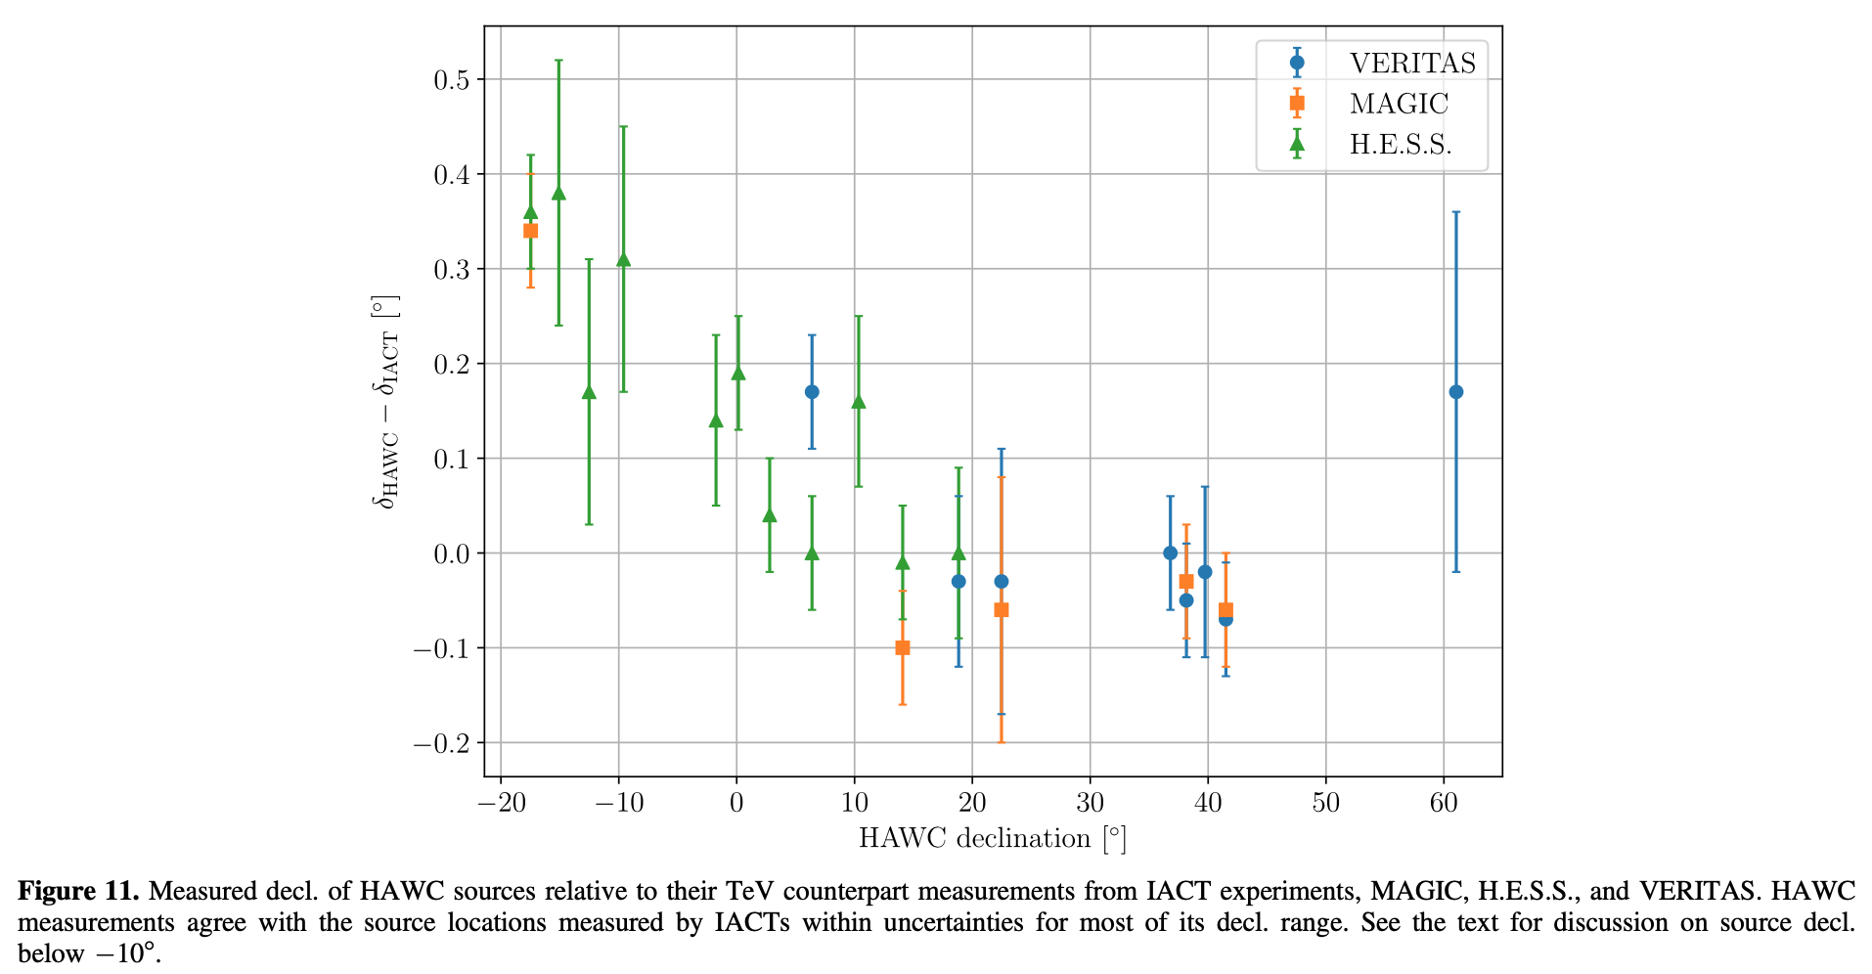
HAWC pointing error
Albert et al., ApJ, 905, 76 (2020)

Slide 50
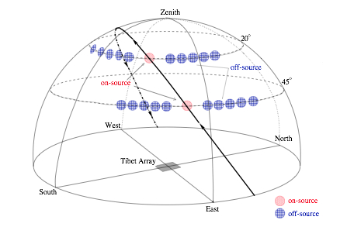
Excess count estimation
OFF regions
ON source
Live time: 720 days
Data： Feb. 2014 ー May 2017
Standard event selection conditions for AS analysis & muon cut by MD
Equi-Zenith-Angle Method
  — Search window radius
  — : number of events observed in ON-source window
  — : average of numbers of events in 20 OFF regions
  — Excess =
(variable from ∼0.7° to lower limit 0.5°)

Slide 51
パルサーの年齢 10 kyr、距離 6 pc を仮定
パルサーが放出した総エネルギー 69 x 10⁴⁷ erg
98 % が磁場の増幅に使われた -> 67.6 x 10⁴⁷ erg
このエネルギーが半径 6 pc の体積に含まれる場合、磁場強度はどうなるか？
B がフラットな場合: 80 μG
B ∝ r⁻¹ の場合：46 μG @ 6 pc <- 9 μG より 5 倍程度大きい

Slide 52
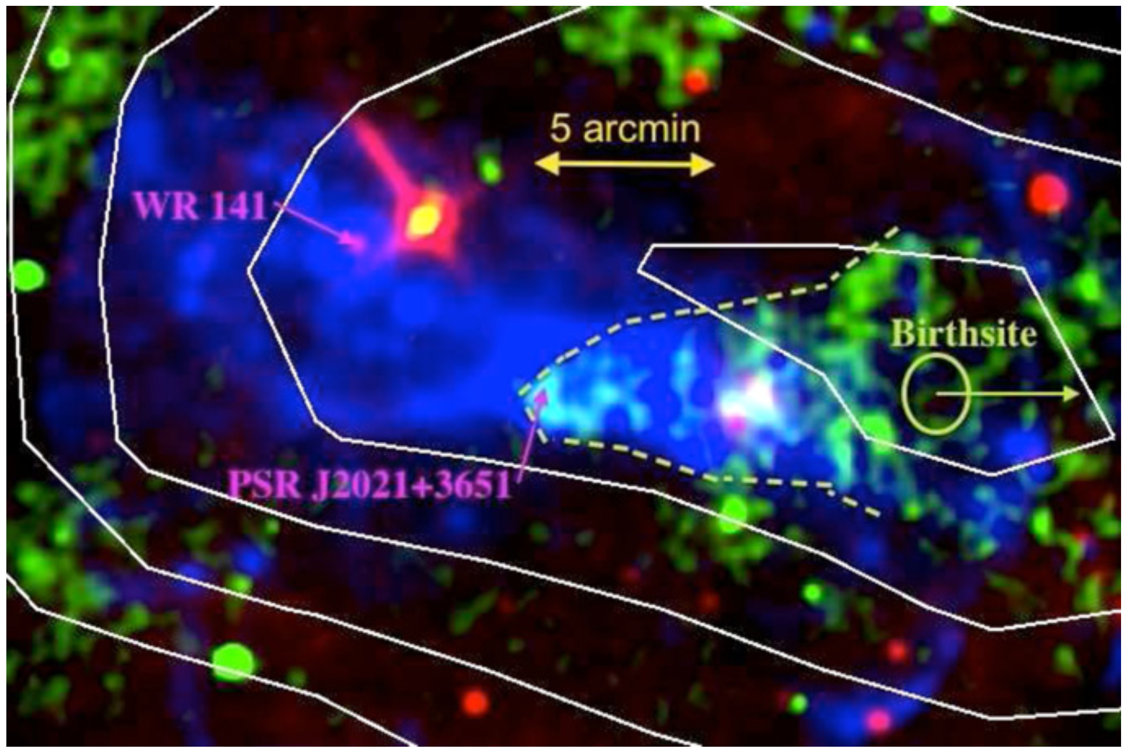
TASG J2019+368 (Cygnus OB1)
PWN G75.2+0.1: Main possible contributor to gamma-ray emission
Aliu+, ApJ, 788, 78 (2014)
PSR J2021+3651
$\dot{E}$ = 3.4 x 10³⁶ erg/s
age τ ∼ 17 kyr
d = 1.8 kpc
v = 420 (d/1.8 kpc)
*(τ / 17 kyr)⁻¹
km/s
PWN G75.2+0.1
Roberts+, ApJ, 577, L19 (2002)
+1.7
−1.4
Kirichenko+, ApJ, 802, 17 (2015)
0.2°
MSX 8.3 μm
VLA 20 cm
XMM 1 – 8 keV
VERITAS sig. contours

