Slide 1
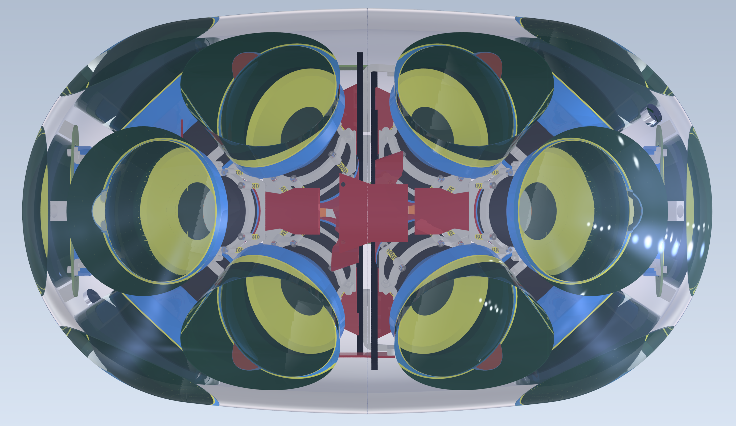
Development of the optical modules for IceCube-Gen2 Nobuhiro Shimizu (Chiba University) Shingakujutsu workshop A03 2022 March 7th

Slide 2
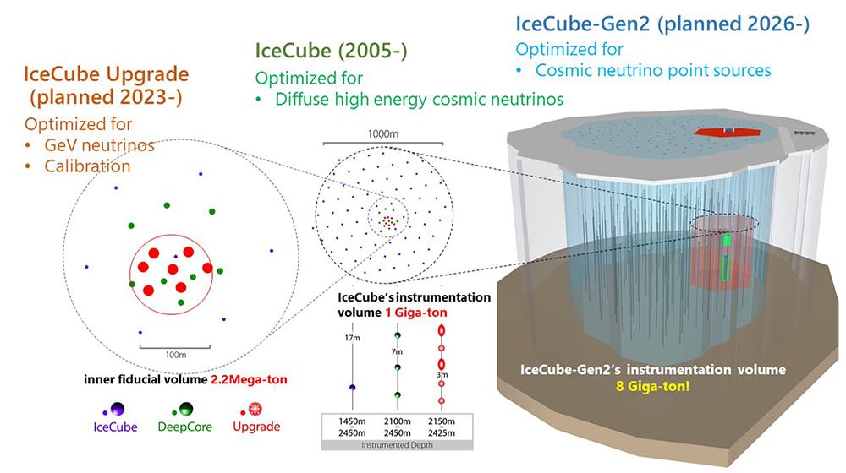
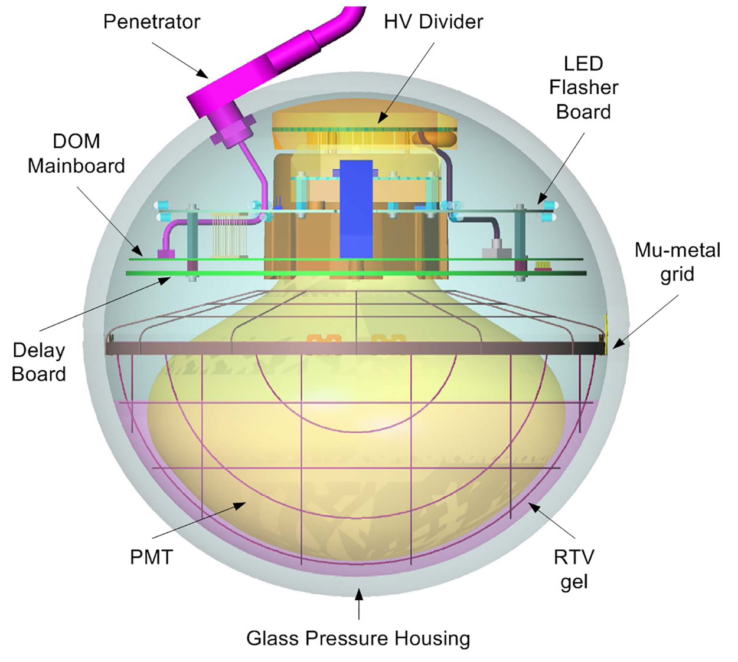
The IceCube and future upgrades
Digital Optical Module (DOM)
for Gen-1
IceCube Gen-1
a cubic kilometer neutrino telescope deployed in Antarctica
5160 Digital Optical module (DOM) to detect Cherenkov photons produced by secondary particles from neutrino interaction
IceCube Upgrade
Deploy $∼$700 new optical modules from 2023
IceCube Gen-2
Deploy $O$(10,000) new optical modules from 2027

Slide 3
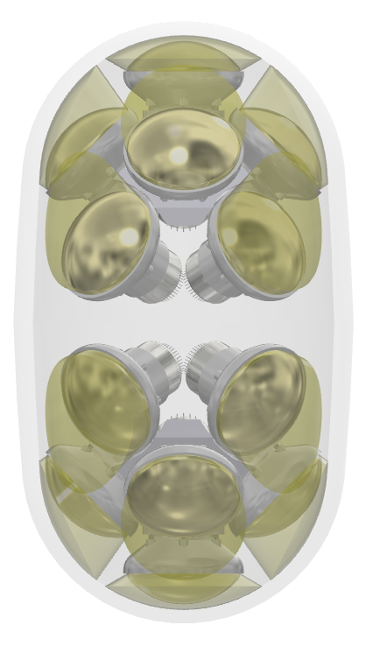
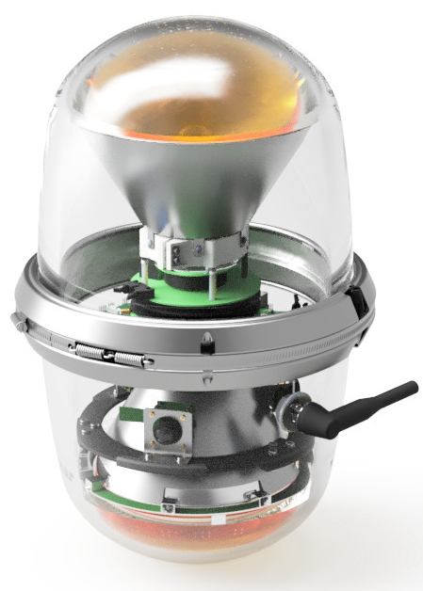
New optical modules for Gen2
Requirements of new optical modules
Volume of Gen2 → x 8
Sparse layout: 125 m → 240 m
low cost per optical sensitivity
Reduce a diameter to save cost of drilling
House as many PMTs as possible
2023
2027
Long optical module (LOM)
① Use a low noise elongated glass vessel.
② House 18 four inch PMTs. ③ Adopt “gel pads” to efficiently lead photons to PMTs
33 cm
30 cm
30.5 cm
Gen1 DOM
D-Egg
LOM

Slide 4
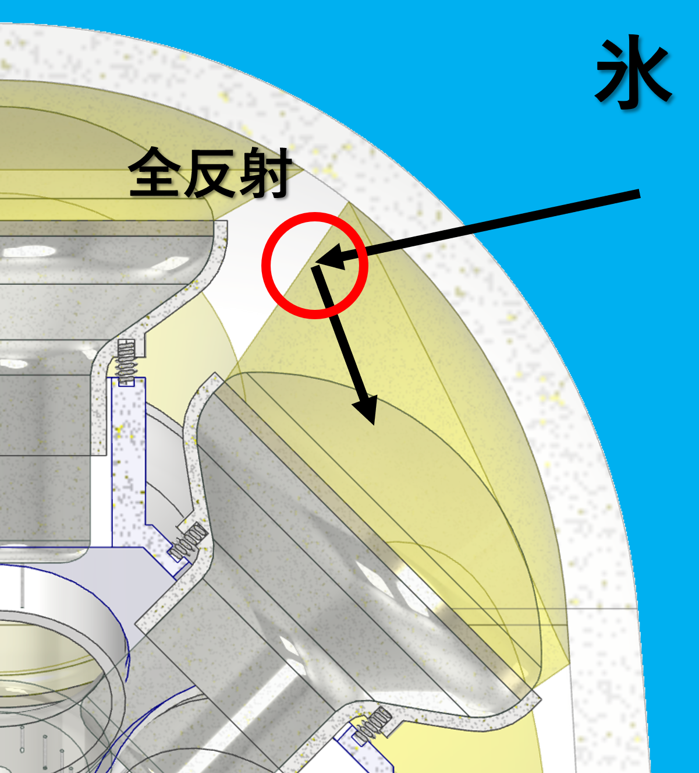
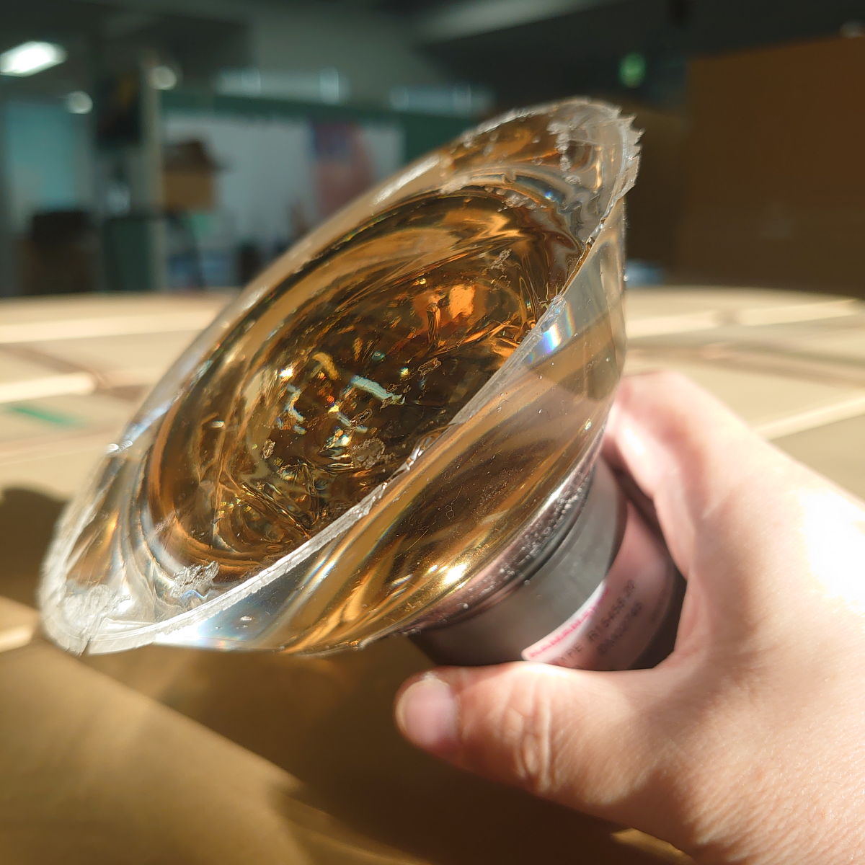
Concept of the design of LOM gel pad scheme
A gel pad
Inspired by HK’s multi-PMT module. The UV-transparent silicone elastomer is casted to a conical shape.
Works as
1. an optical interface and
2. a photon collector thanks to internal reflection.
A golden color of the photocathode
→ implies the enhancement of effective area

Slide 5
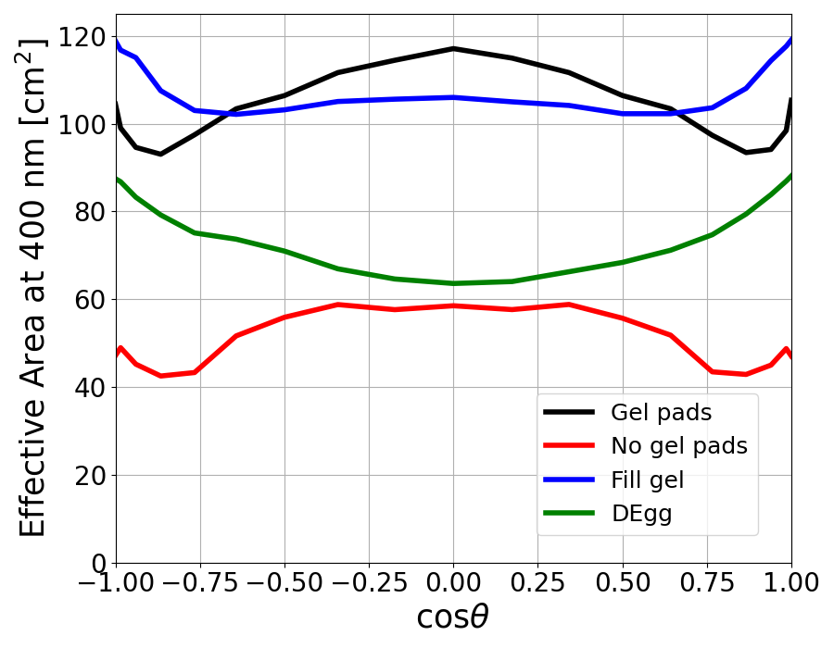
Improvement of sensitivity
photons
② No optical interface
③ Fill gel
④ Gel pads
① D-Egg
③
The D-Egg already has x2.8 higher sensitivity than IceCube-Gen1 DOM.
Optical interface is necessary
To fill UV-transparent gel may be good but increases the cost and weight.
With the gel pad approach, we further expect x1.5 improvement of sensitivity compared to D-Egg with cost-effective way.
④
①
②

Slide 6
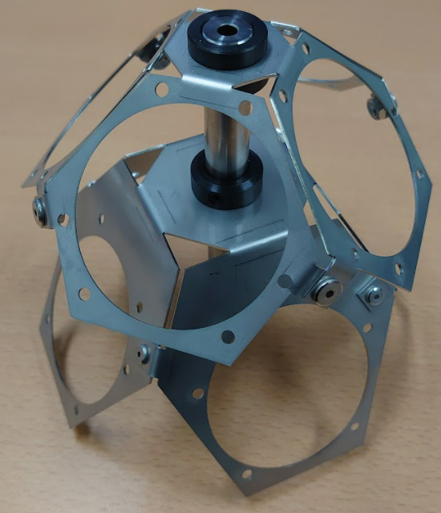
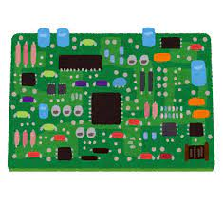
Development of the components

Slide 7
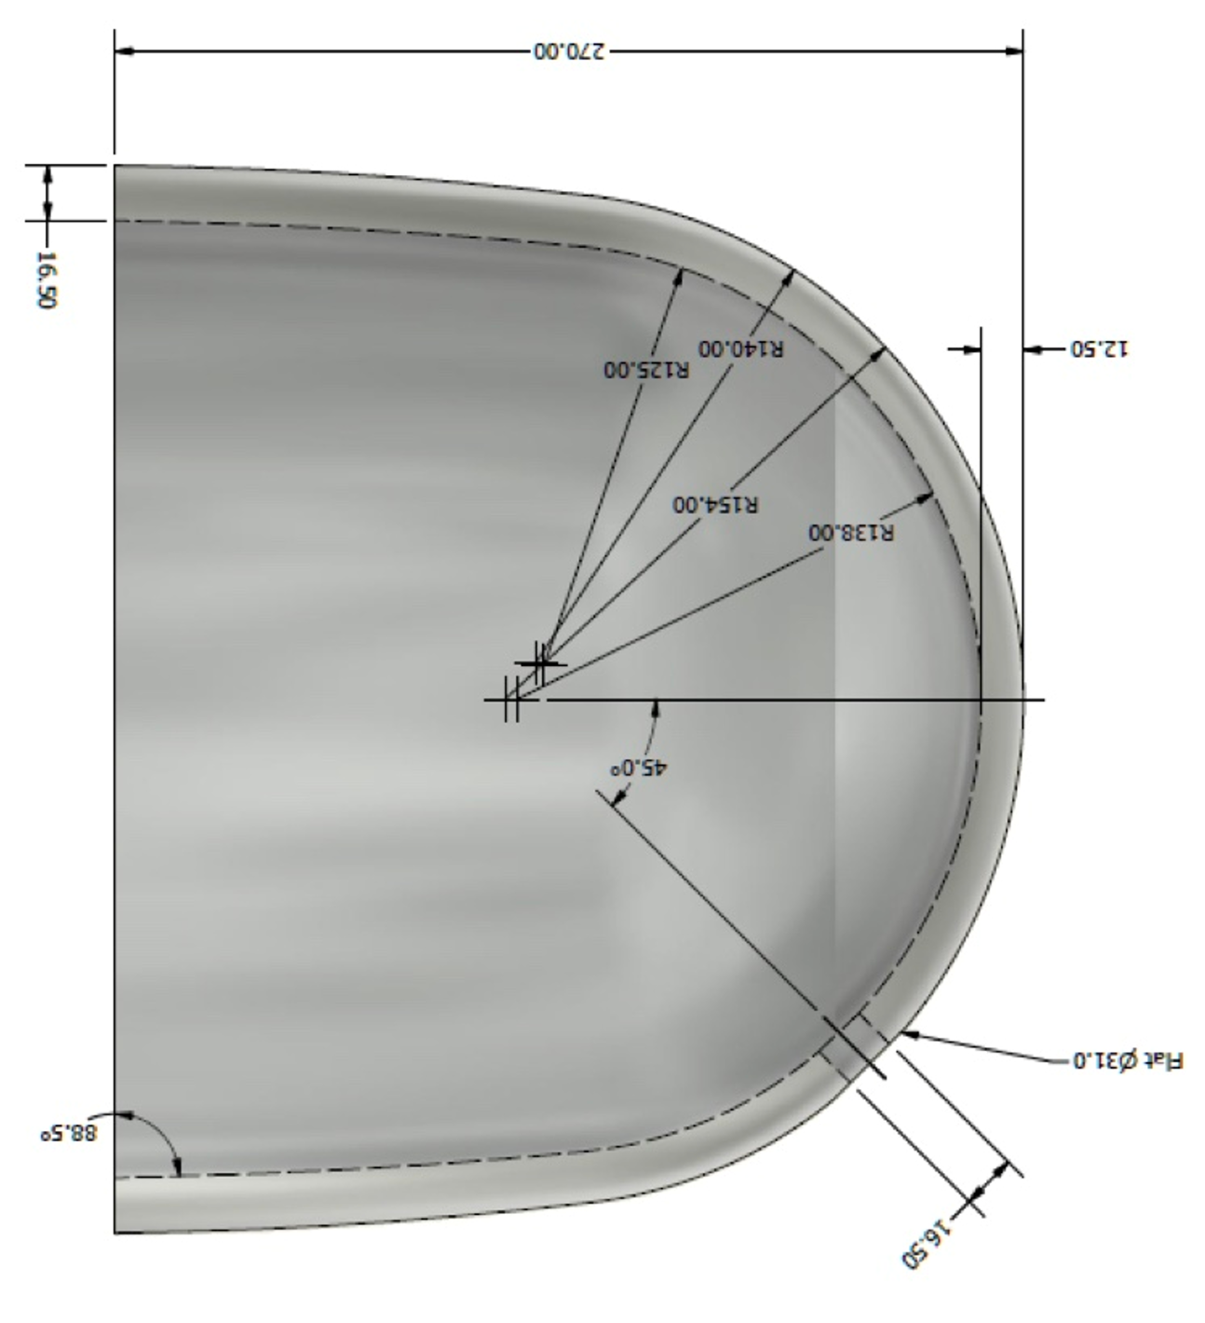
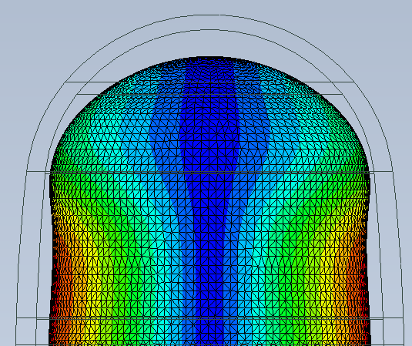
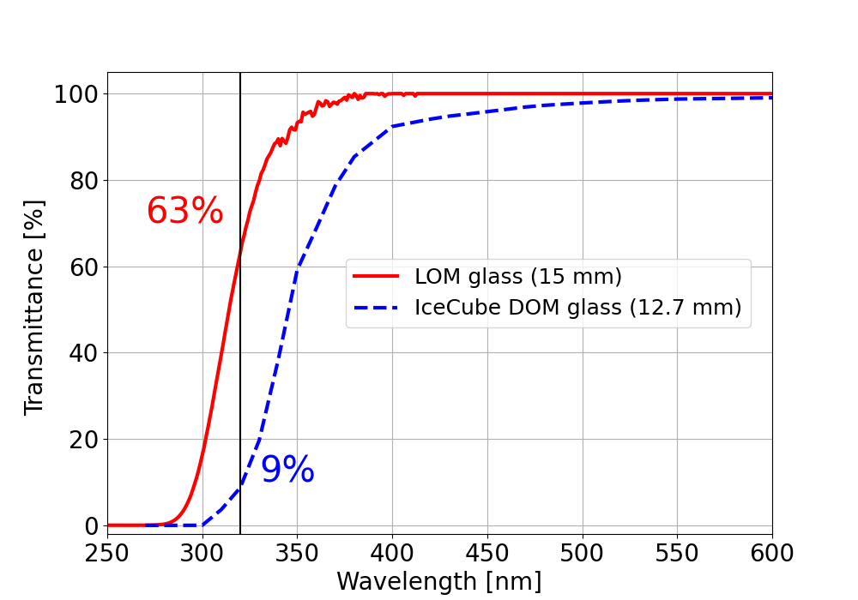
Pressure-resistant glass of LOM
Requirements on the glass
Pressure-resistant up to 70 MPa while small material to reduce price
Transparency to UV photons
Low noise due to RI sources
Thickness:
20 mm (D-Egg) → 16.5 (LOM)
Transparency of glass
Bq/kg
Horizontal variation in 70 MPa
RI decays in the glass
0.7 mm
1.4 mm

Slide 8
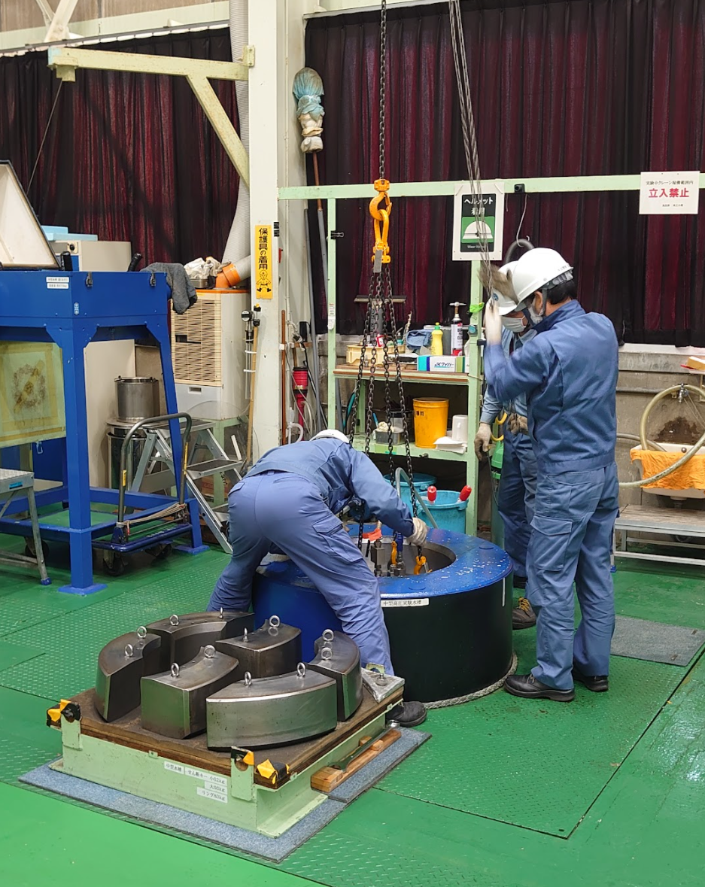
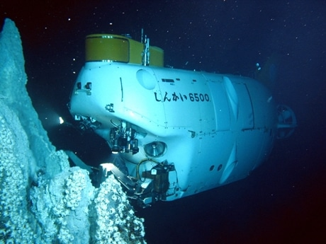
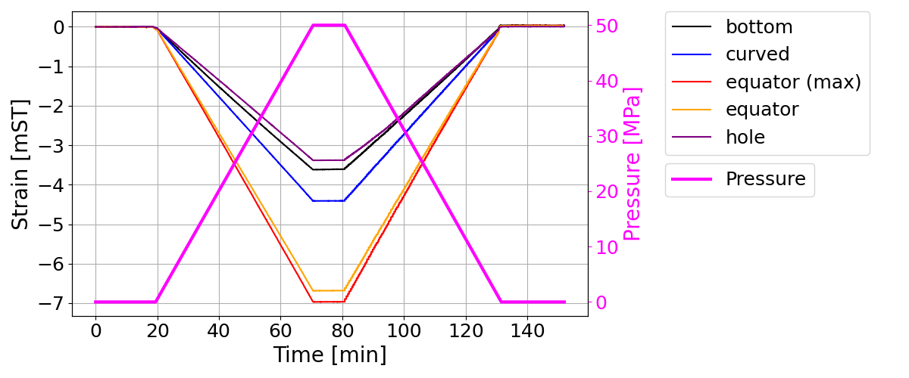
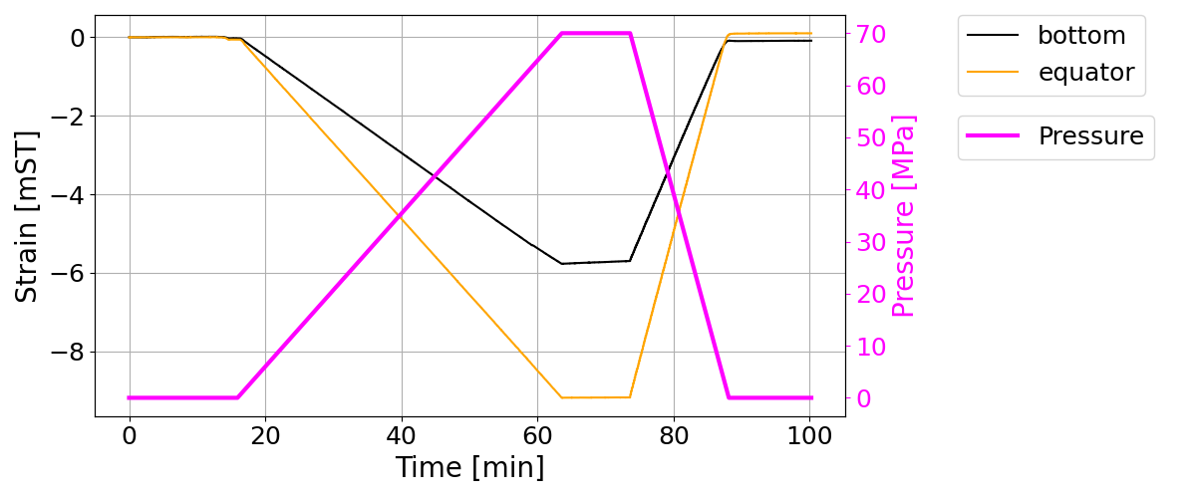
Pressure test
JAMSTEC (2020 March 3rd)
Attach strain sensors inside the glass and measured the strain of glass
Test: 50 MPa and 70 MPa runs
No notable change observed in the glass
hole
equator
equator (max)
curved
bottom
Sample 1 (50 MPa run)
Location of sensor | Measured strain at 70 MPa (mST) | Simulated strain at 70 MPa (mST)
Bottom | 5.0 | 5.8
Curved | 6.2 | 5.8
Equator | 9.2 | 9.3
Equator (max) | 9.7 | 9.6
Hole | 4.8 | 4.3
Sample 2 (70 MPa run)
→ Reasonable agreement between the measured and simulated strains.

Slide 9
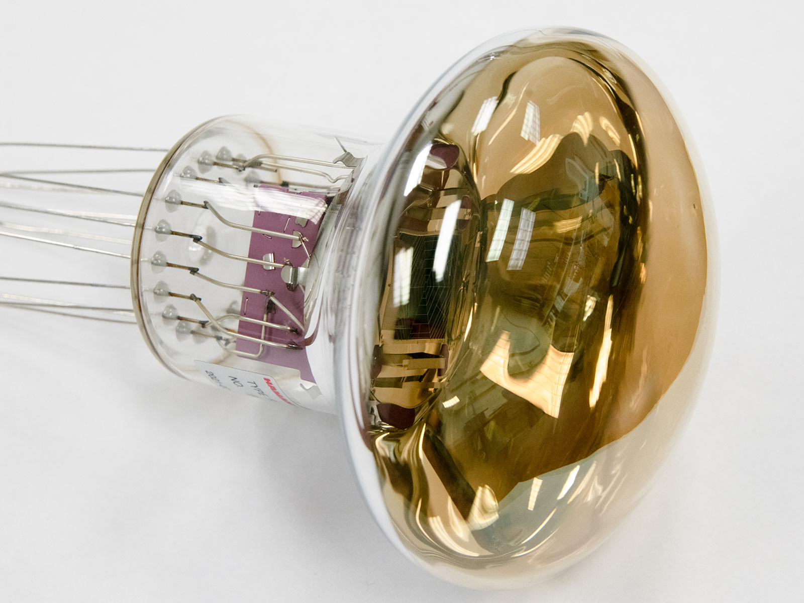
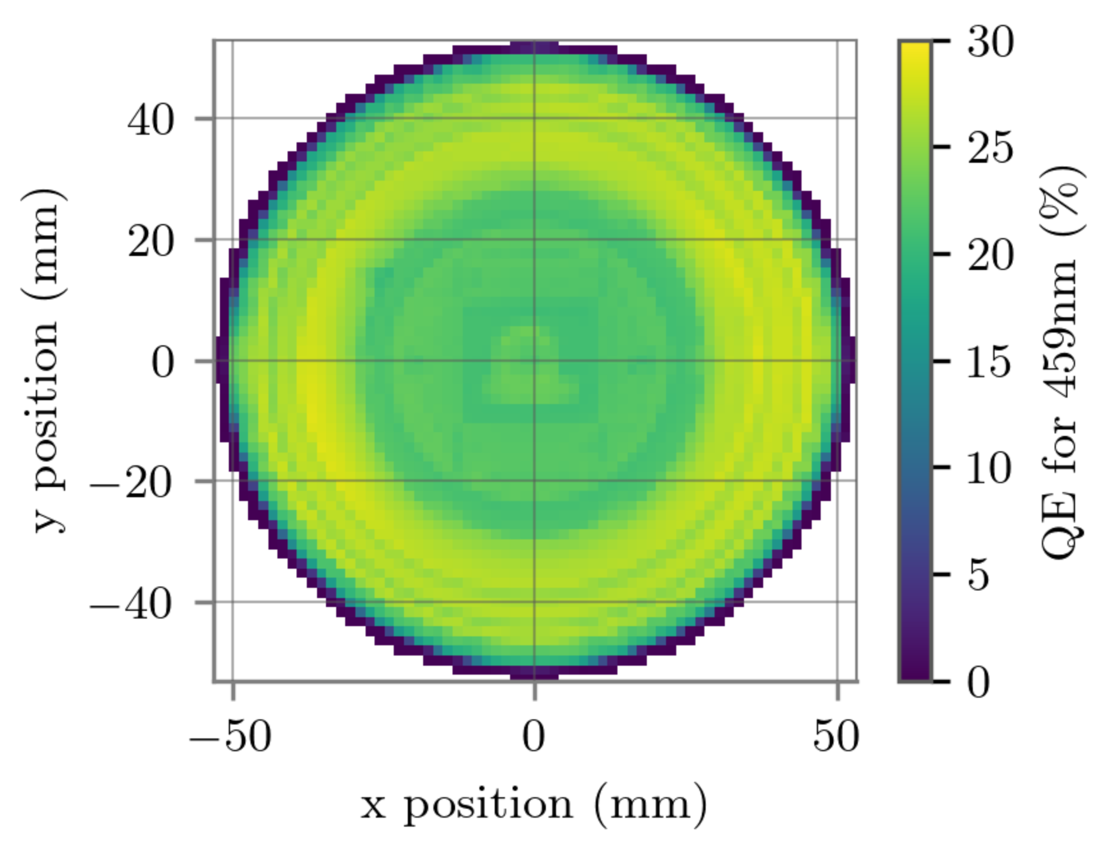
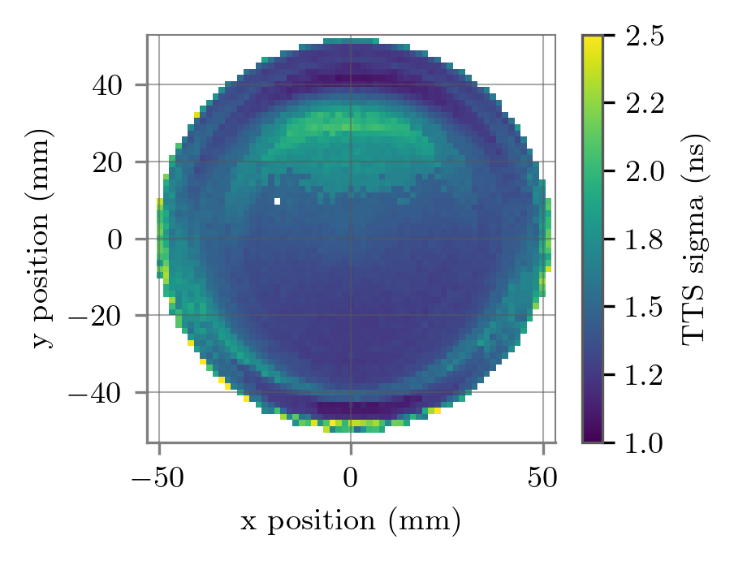
New 4 inch PMT
4 inch PMTs were not in the existing lineup of Hamamatsu
Requirements for the new PMTs
as high QE as possible (typically better than 25%)
TTS $<$ 6 ns
height → shorter than 106 mm
diameter → larger than 102 mm
Start the development from autumn in 2020
1st version arrived at summer in 2021
> 102 mm
< 106 mm
The new Hamamatsu PMT satisfied our basic requirements.
$$\overline{QE}∼25\%$$
$σ_{T} \sim 1.5$ ns

Slide 10
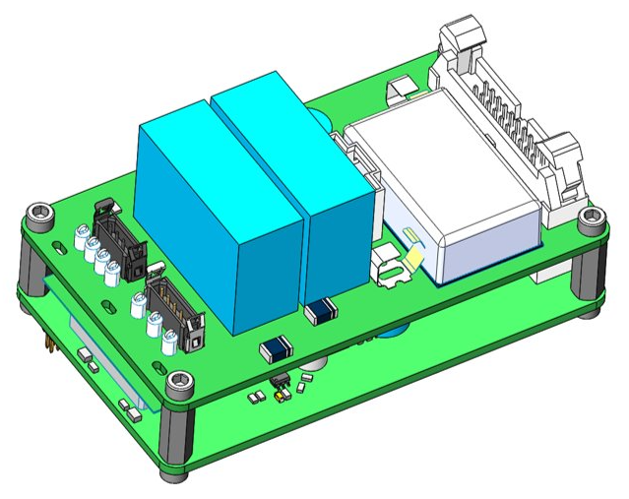
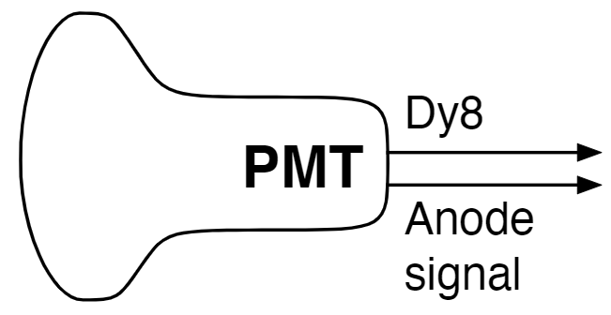
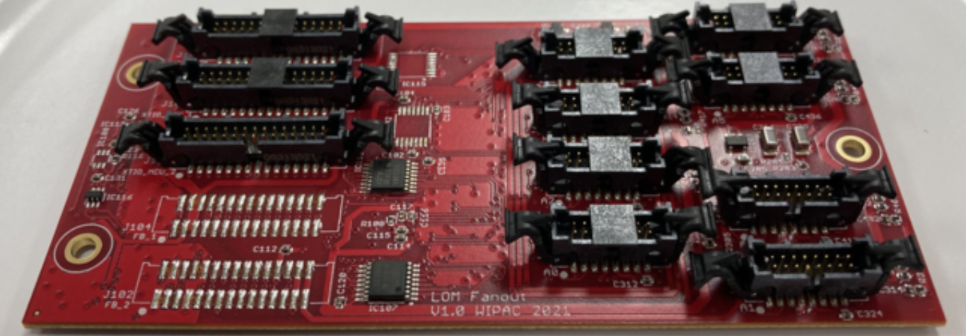
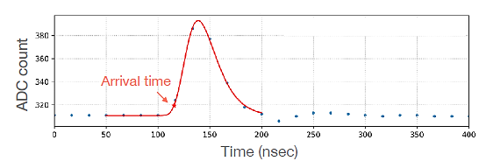
Readout of signals
surface
DAQ
x18
x2 (upper
and lower)
digitization
(wuBase)
“mini”
main
board
MUX
board
$$⋯$$
MUX board
”fanout” of 9 PMT signals
programable coincidence of multi-PMT hits
mini main board
communicate with surface DAQ
power management ($±$ 48 V → low voltages)
storage of hit data until trigger signal comes
Digitized waveform
wuBase
HV generation with Cockcroft-Walton circuit
Digitize the waveform of signal with 60 MSPS (high and low gain channels)
Super low power consumption (145 mW/PMT)

Slide 11
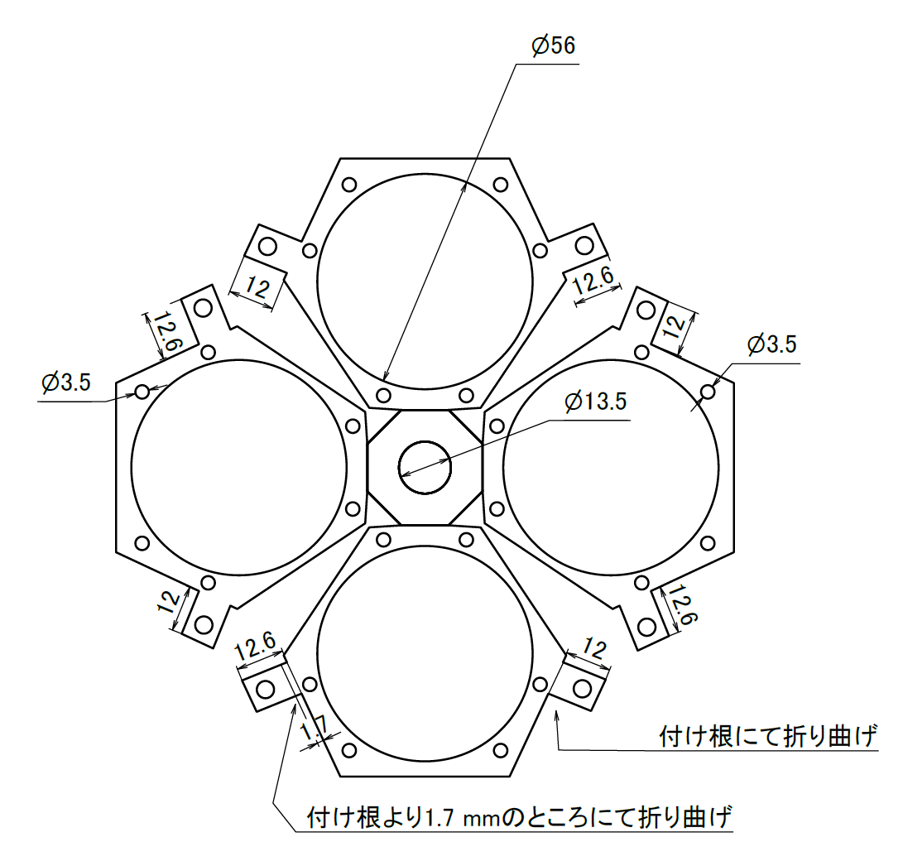
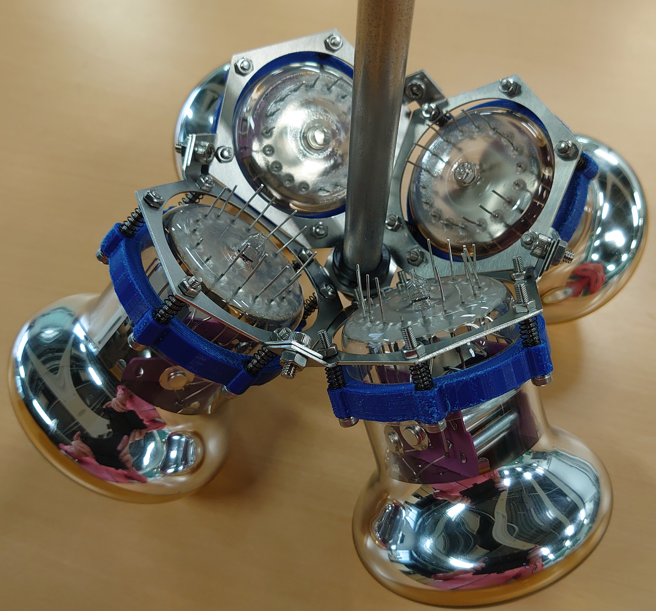
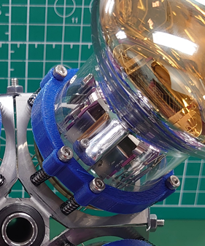
Internal design of LOM
Structure
SUS plates to hold PMTs
center shaft to fix SUS plate
springs to push PMTs outwards

Slide 12
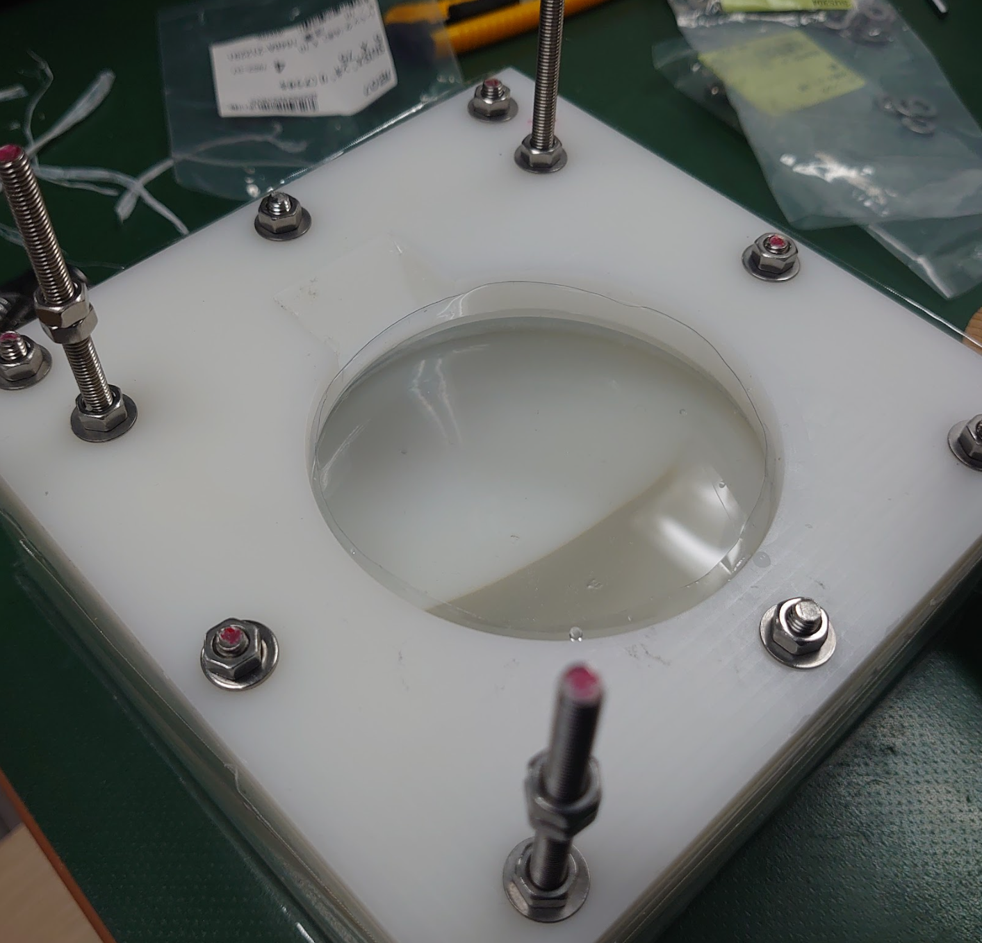
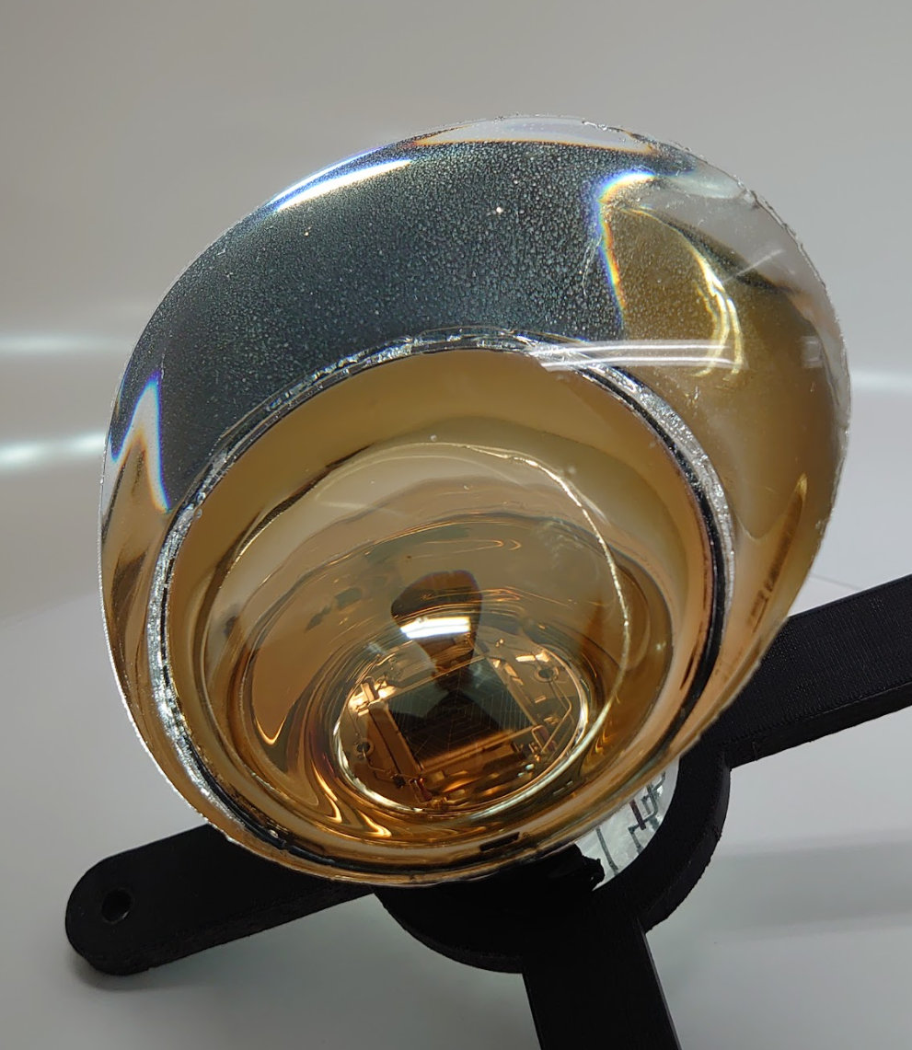
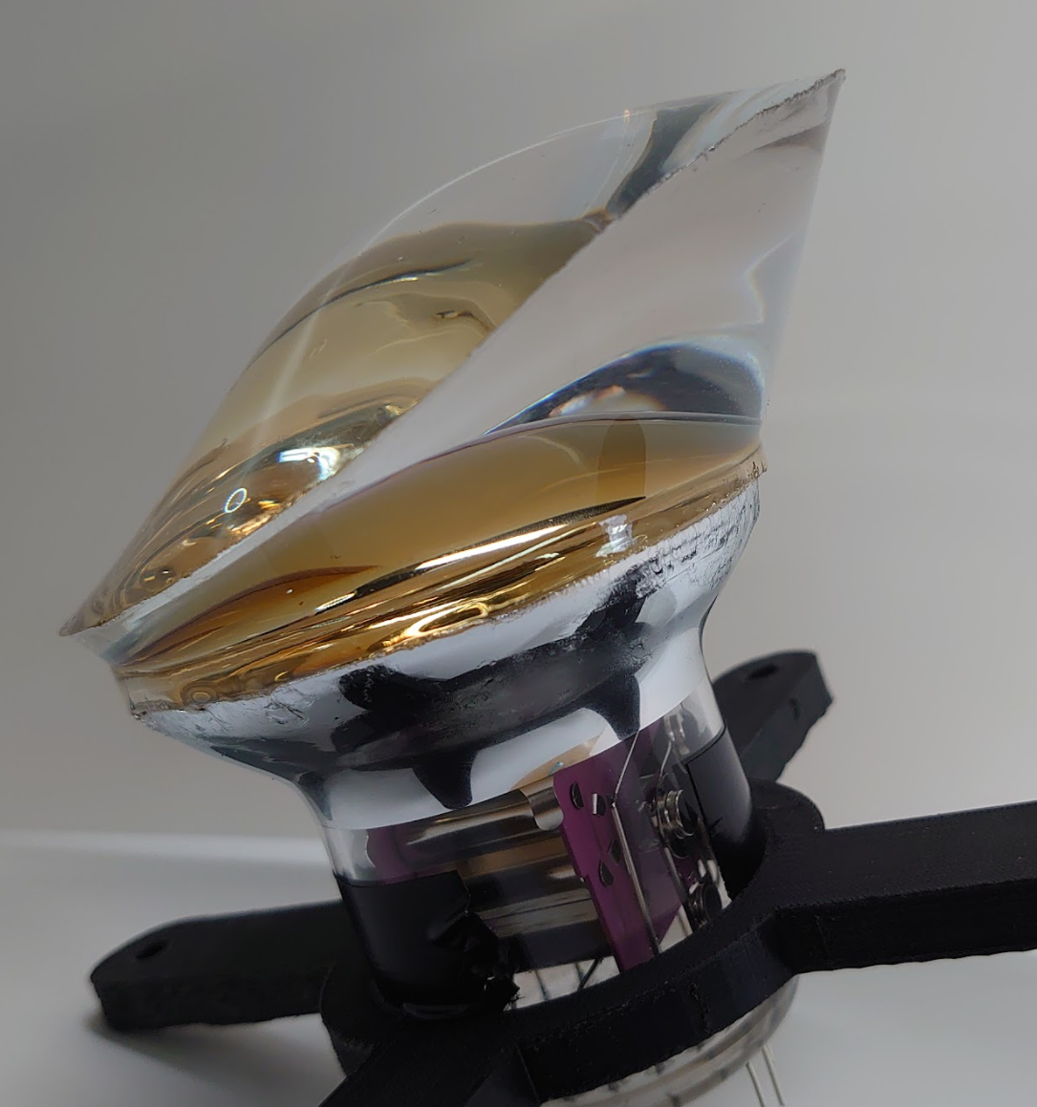
Casting of gel pads
A vacuum forming technique to make a plastic disposable mold.
After mixing two component silicone, pour liquid gel into the mold.
After waiting a few days to cure
We have almost established a method to cast a beautiful gel pad on a PMT.
→ Further study needed to make the procedure efficient/systematic.

Slide 13
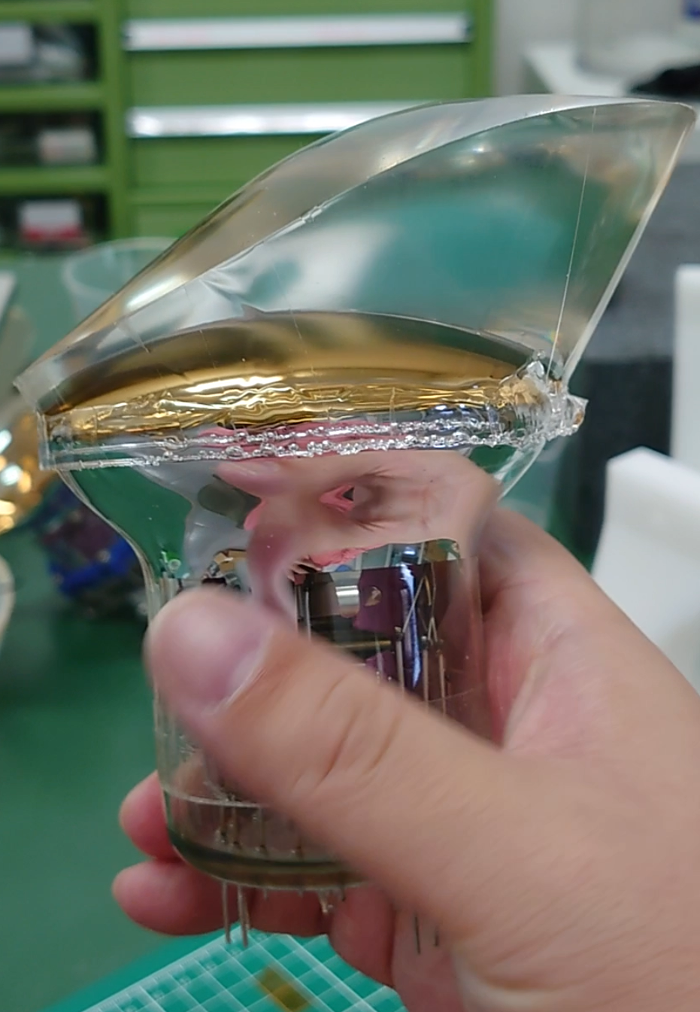
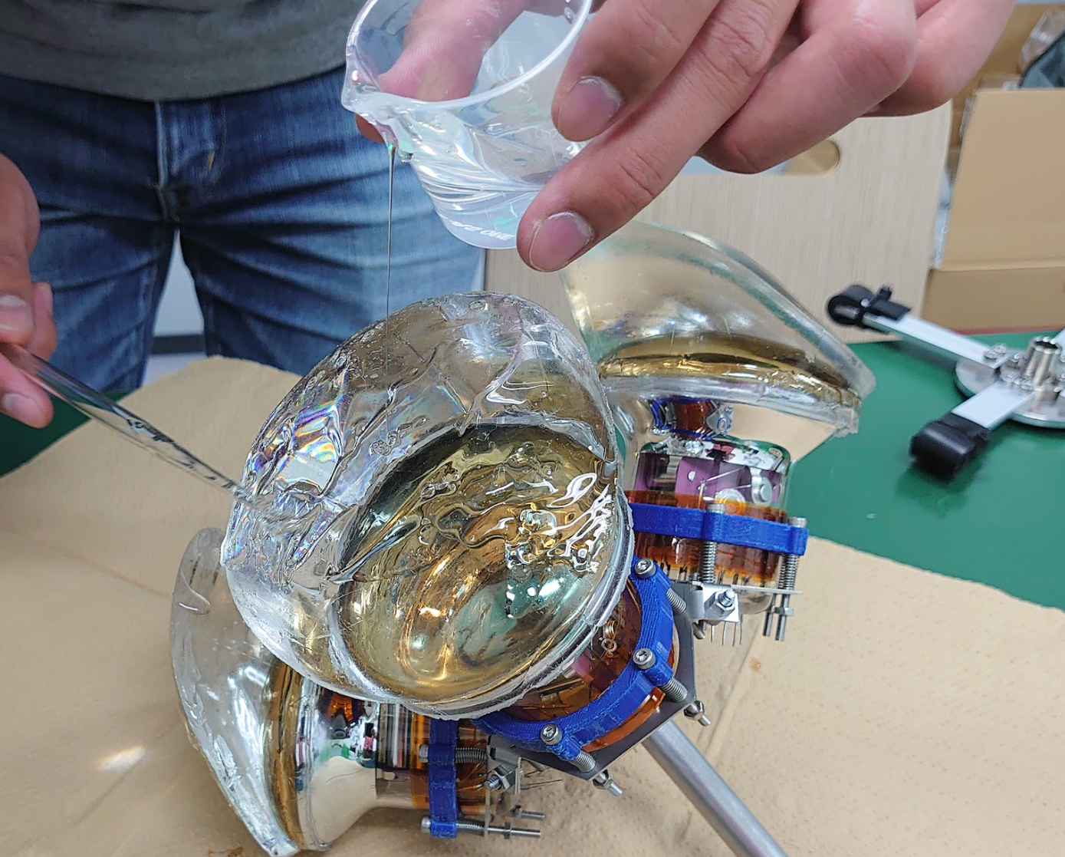
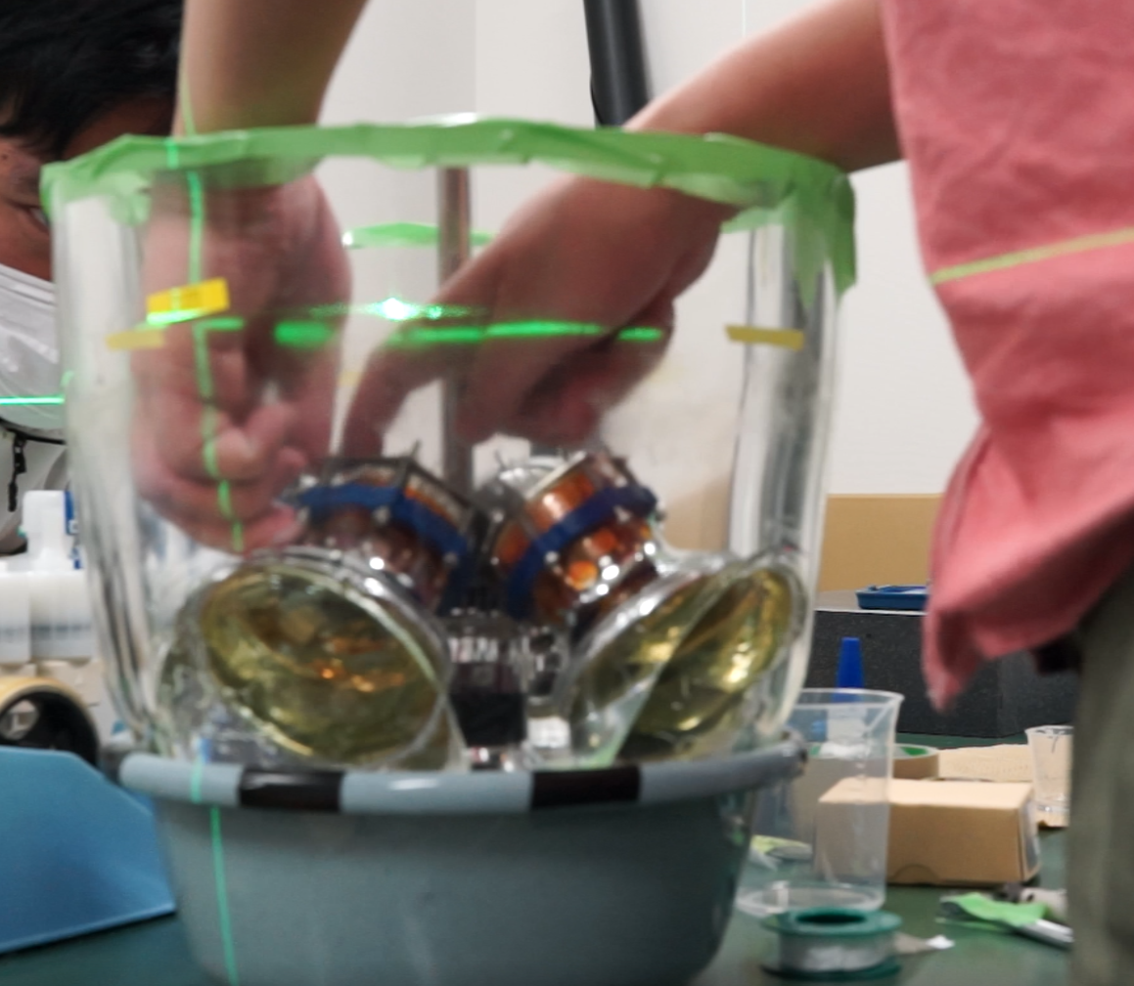
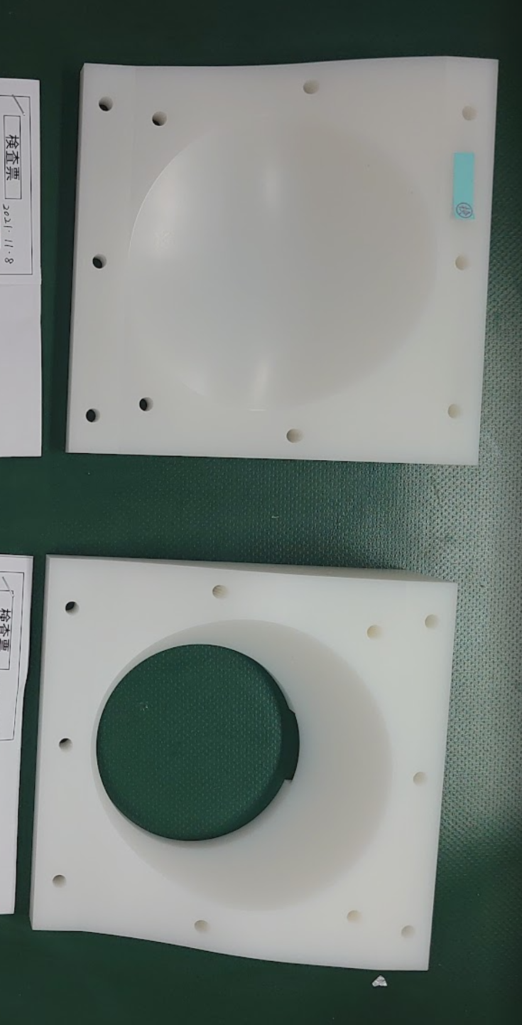
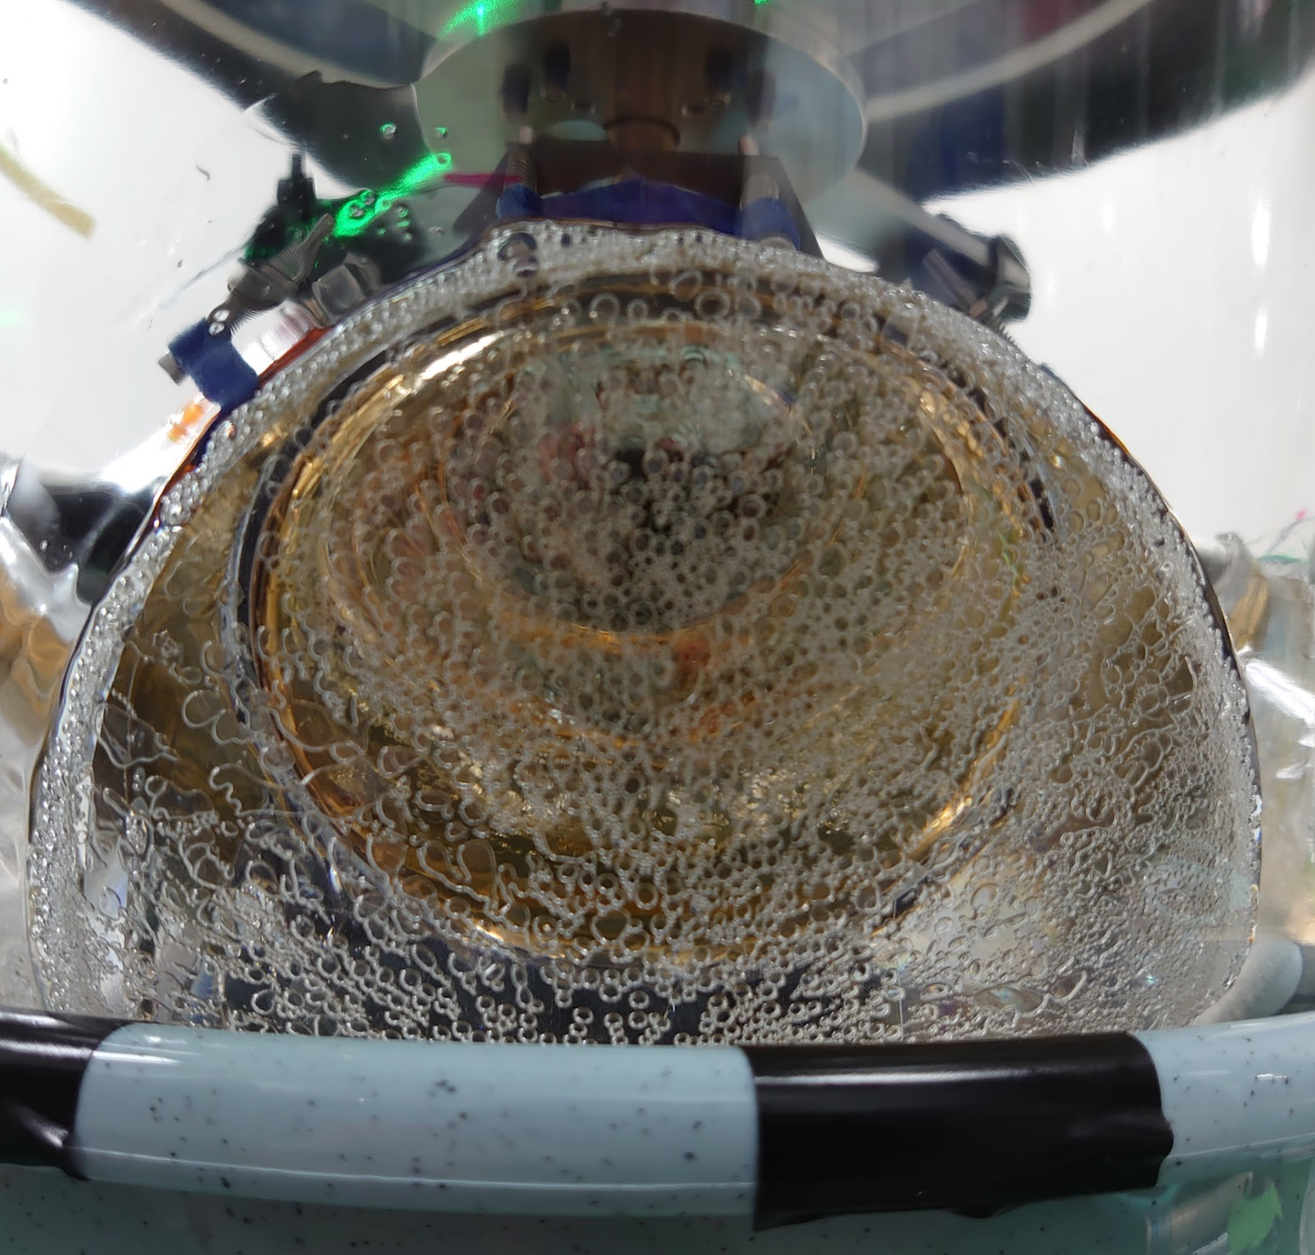
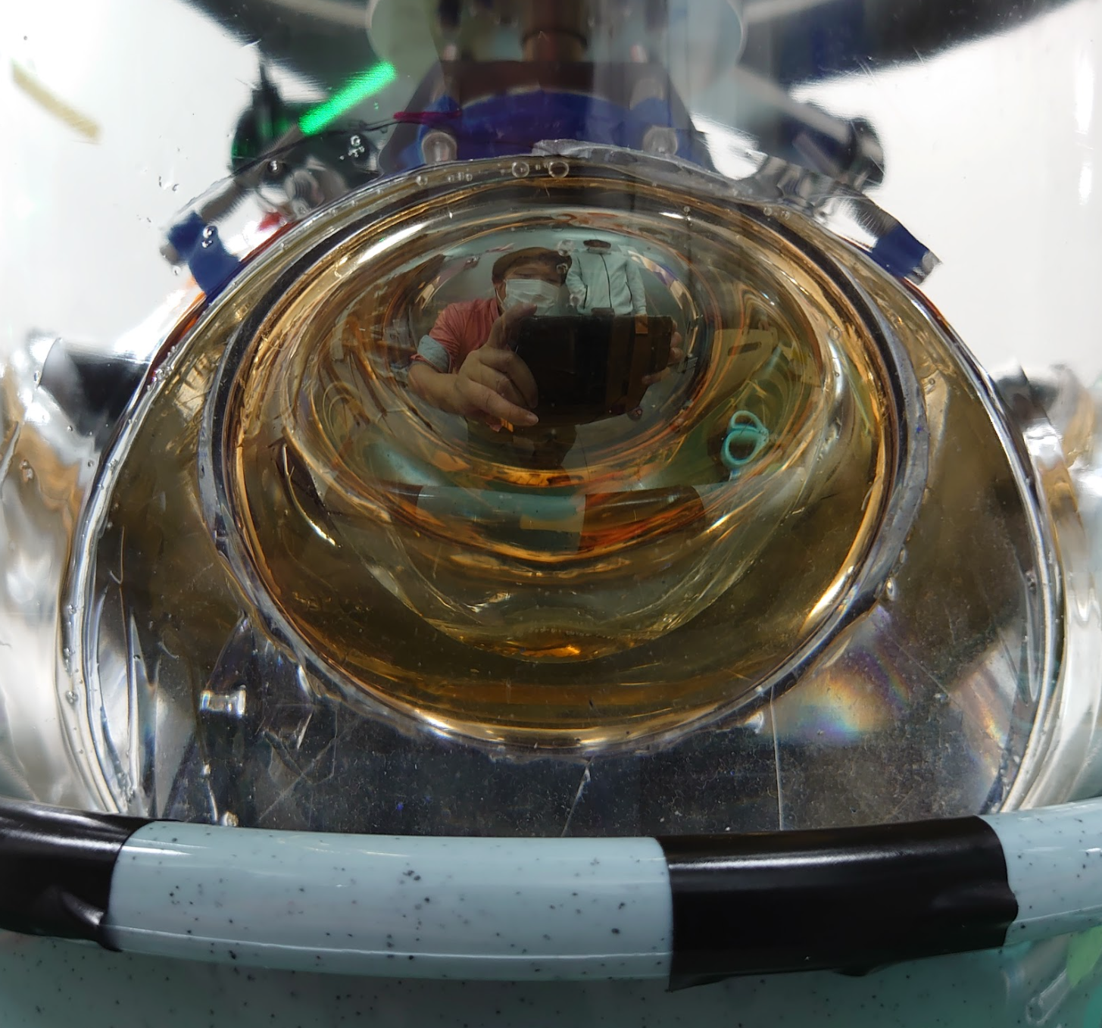
Installation procedure of the gel pads
①
②
③
Preparation of a premade gel pad casted on a PMT
Dispense liquid gel
Install a layer (four PMTs)
④
⑤
Remove bubbles in vacuum
Release vacuum and wait for curing
⑥

Slide 14
Summary
IceCube Gen-2 plans to deploy O(10,000) new optical sensors. To accommodate the larger volume, the sensors are required to have higher sensitivity.
A new sensor LOM houses 18 four-inch PMTs in the glass, and expected to improve the sensitivity by a factor of 1.5 compared to D-Egg.
Development of each component is under way
Pressure resistant glass tolerated up to 70 MPa
New 4 inch PMTs were developed and satisfied our basic requirements
Electronics are finalized
Establish of the assembly procedure is now ongoing.
Efficient and systematic casting of gel pads on PMTs
A prototype assembly using 3 inch PMTs + D-Egg glass was performed.

Slide 15
Backup

Slide 16
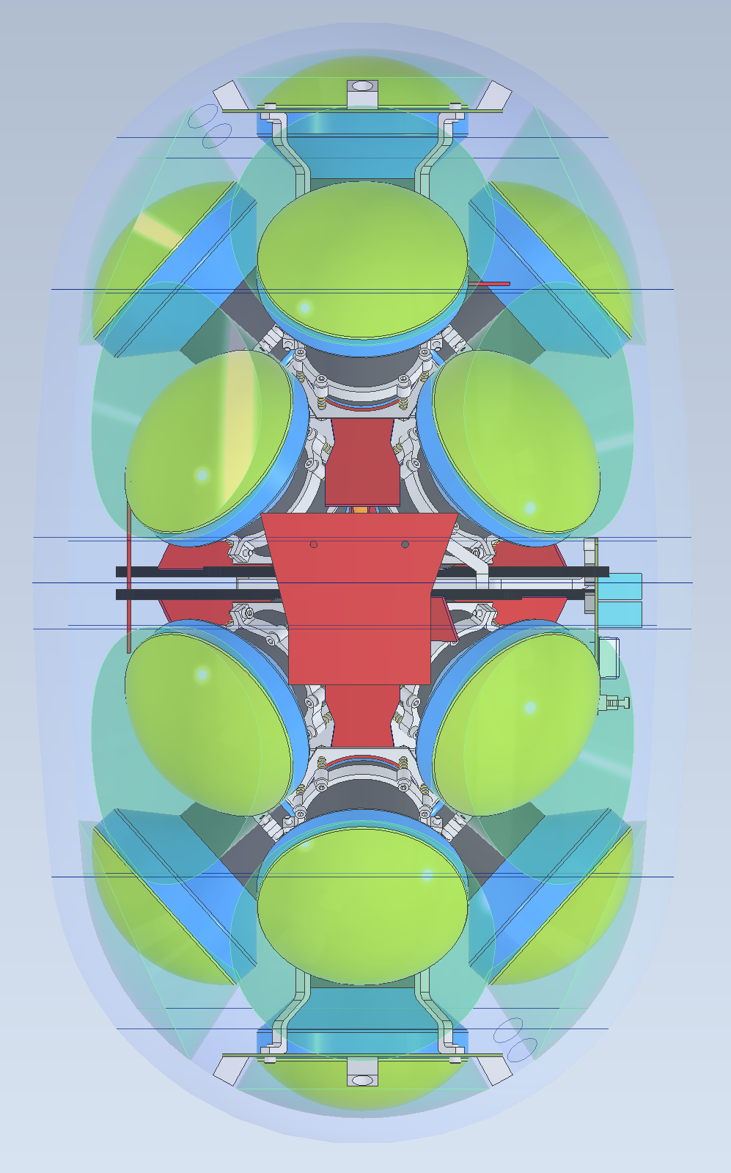

Slide 17
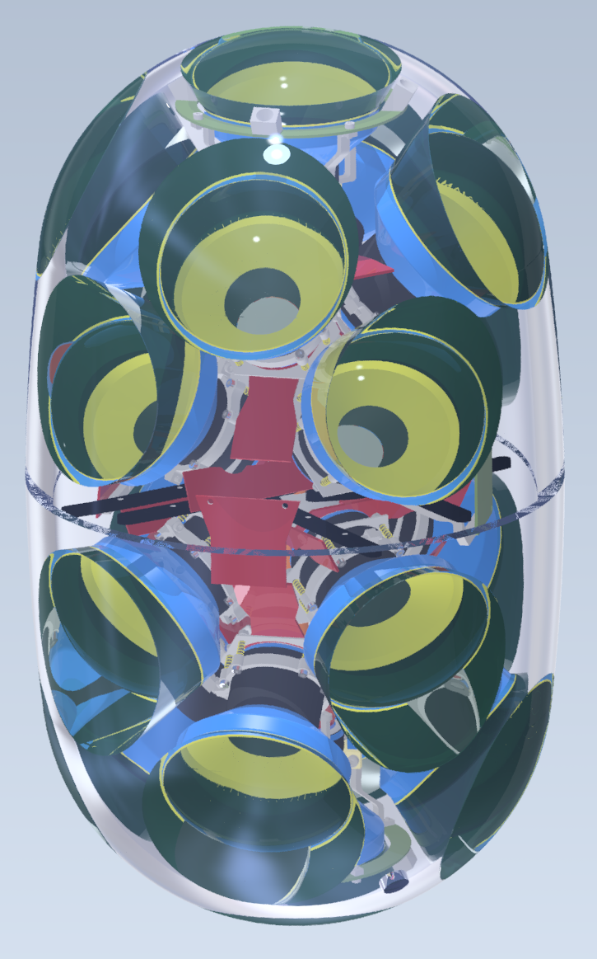
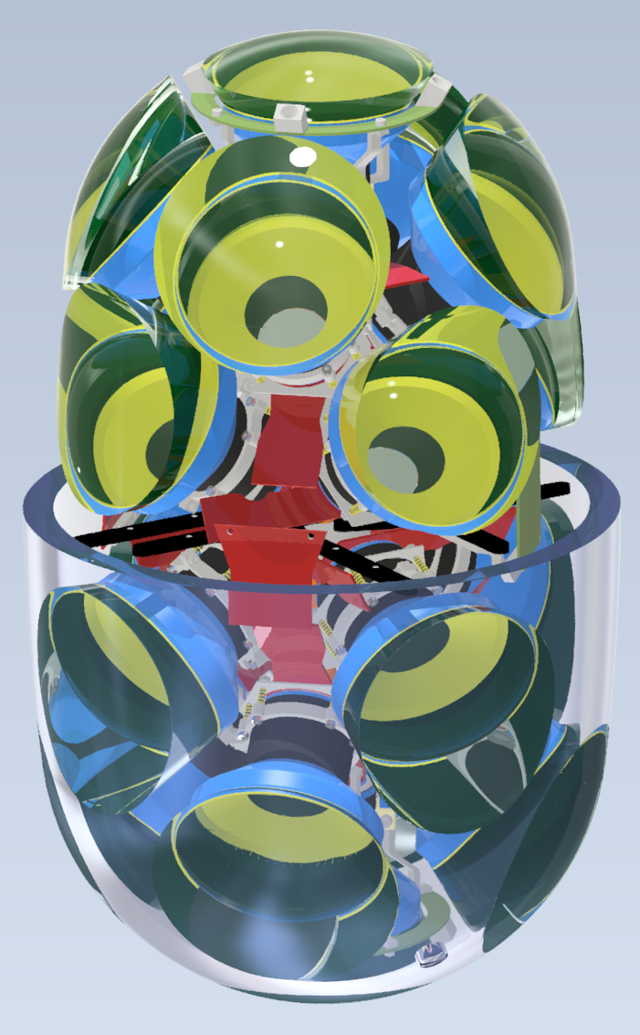
Realistic 3D model

Slide 18
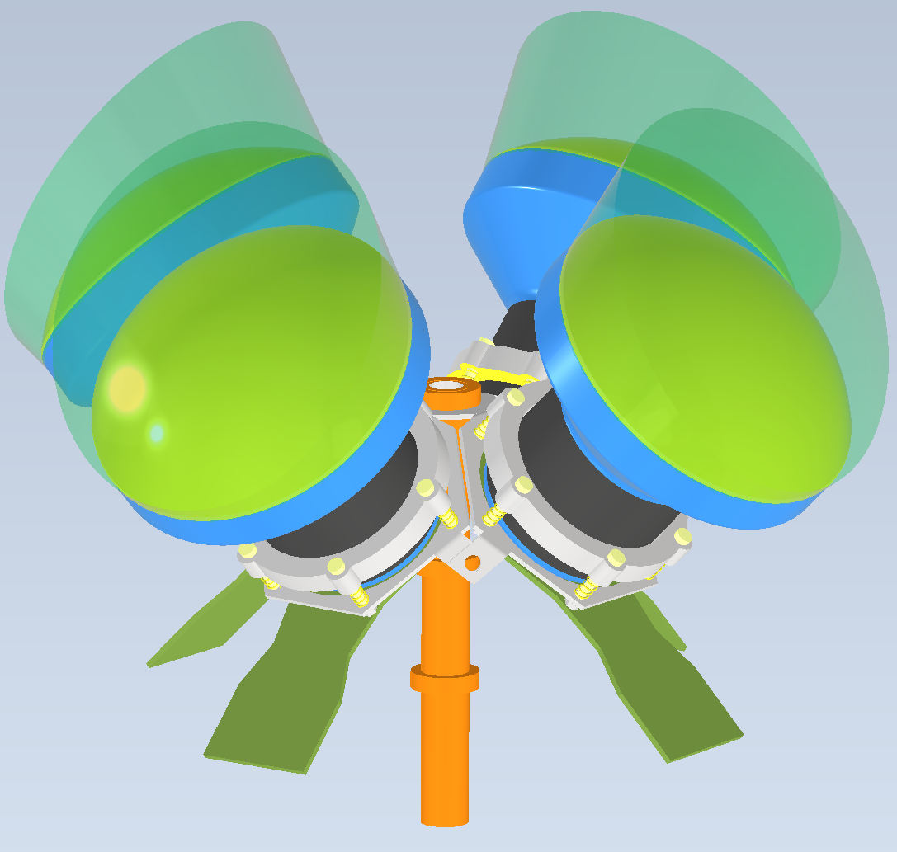
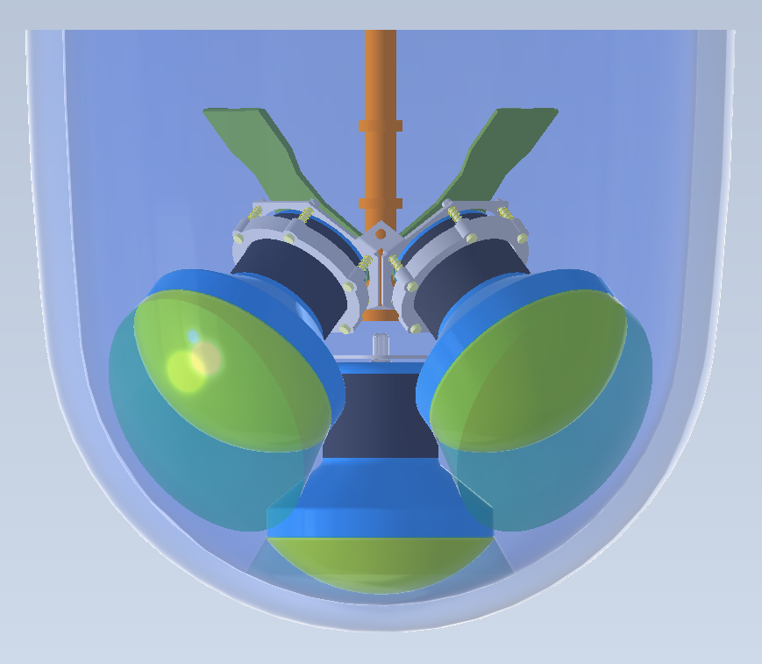
Installation procedure
① Glue the 1st layer
② Assembly of the
2nd layer module
③ Install the 2nd layer module
pump
④ Firmly fix the center shaft
⑤ degassing
⑥ release vacuum

Slide 19
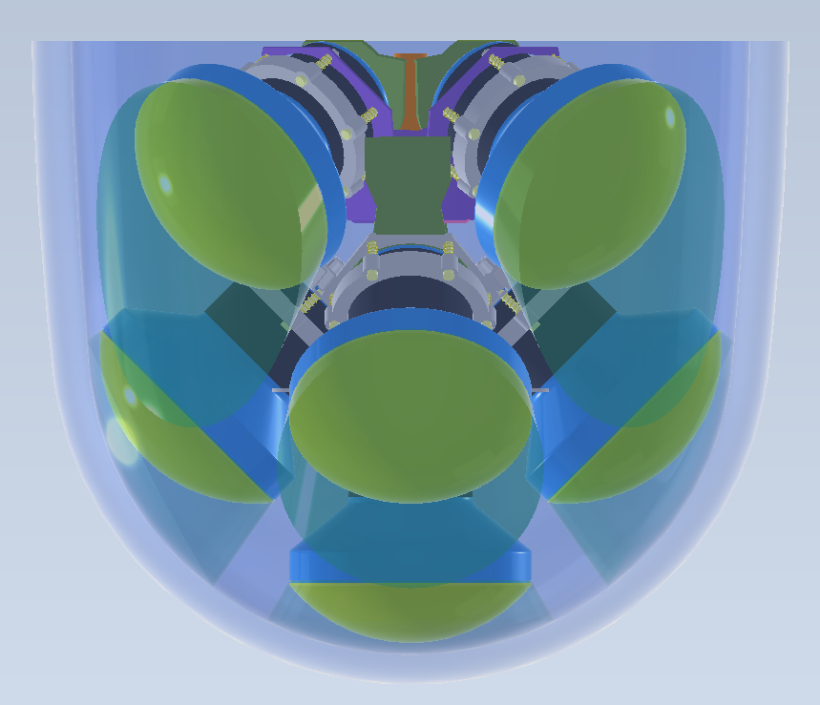
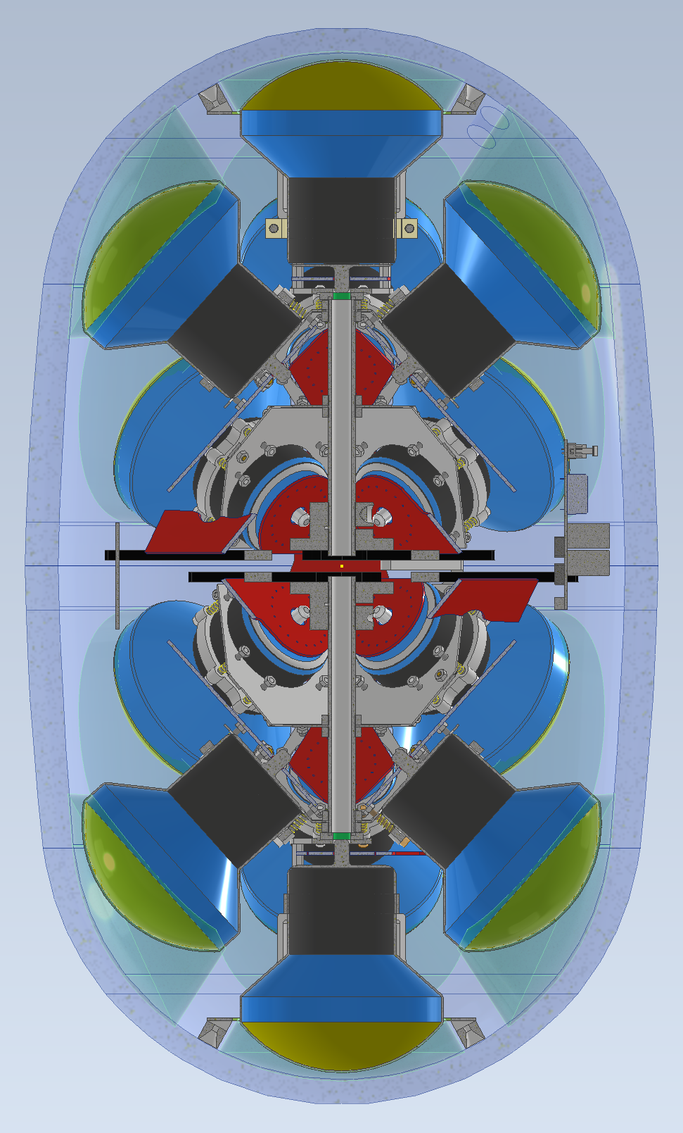
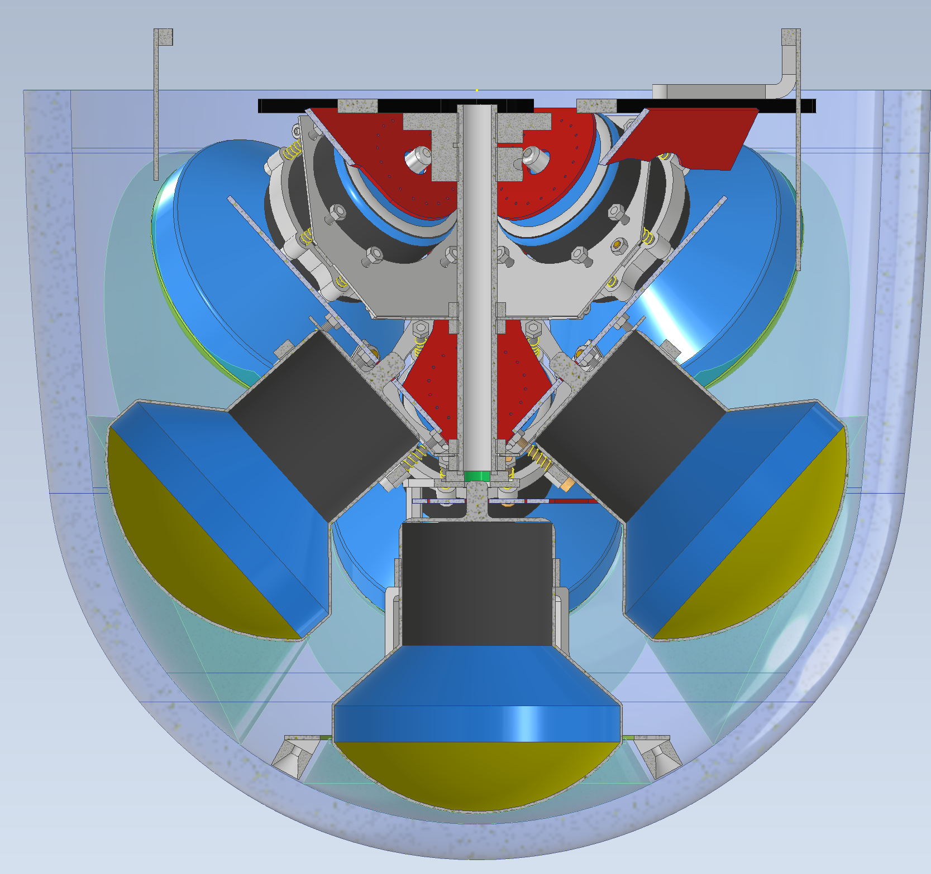
Installation 2
⑦ Assembly of the
3rd layer half modules
⑧ the shaft is released
⑨ Install the 3rd layer
pump
⑩ degassing
⑪ release vacuum and
add ribs/MBs
⑫ Sealing

Slide 20
Internal cut view

