Slide 1
High energy Astrophysics
Tomoki Wada
Notes:
Hi, I’m Tomoki Wada in High energy astrophysics group.
I will talk about the review of High energy astrophysics group.

Slide 2
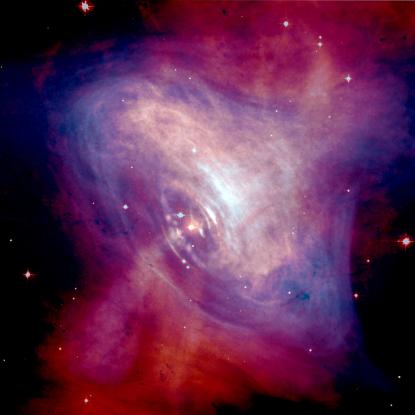
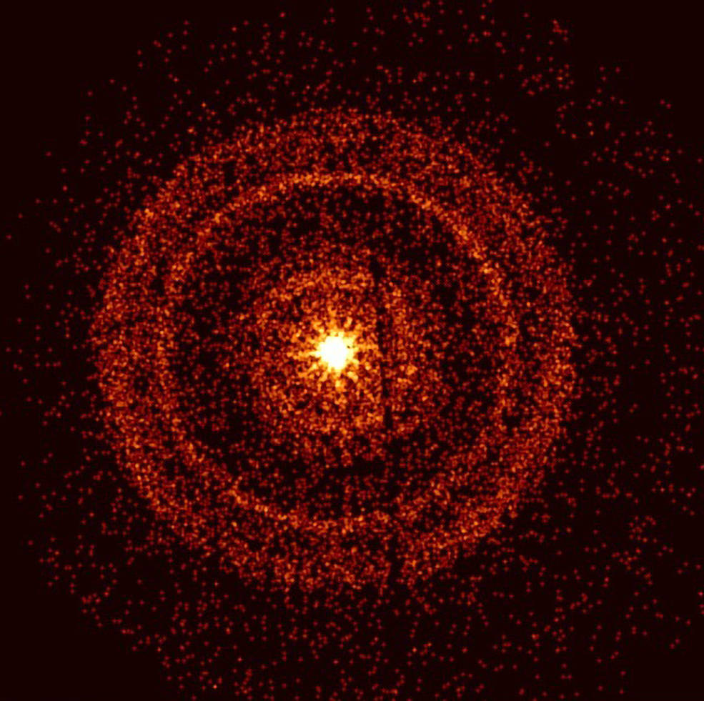
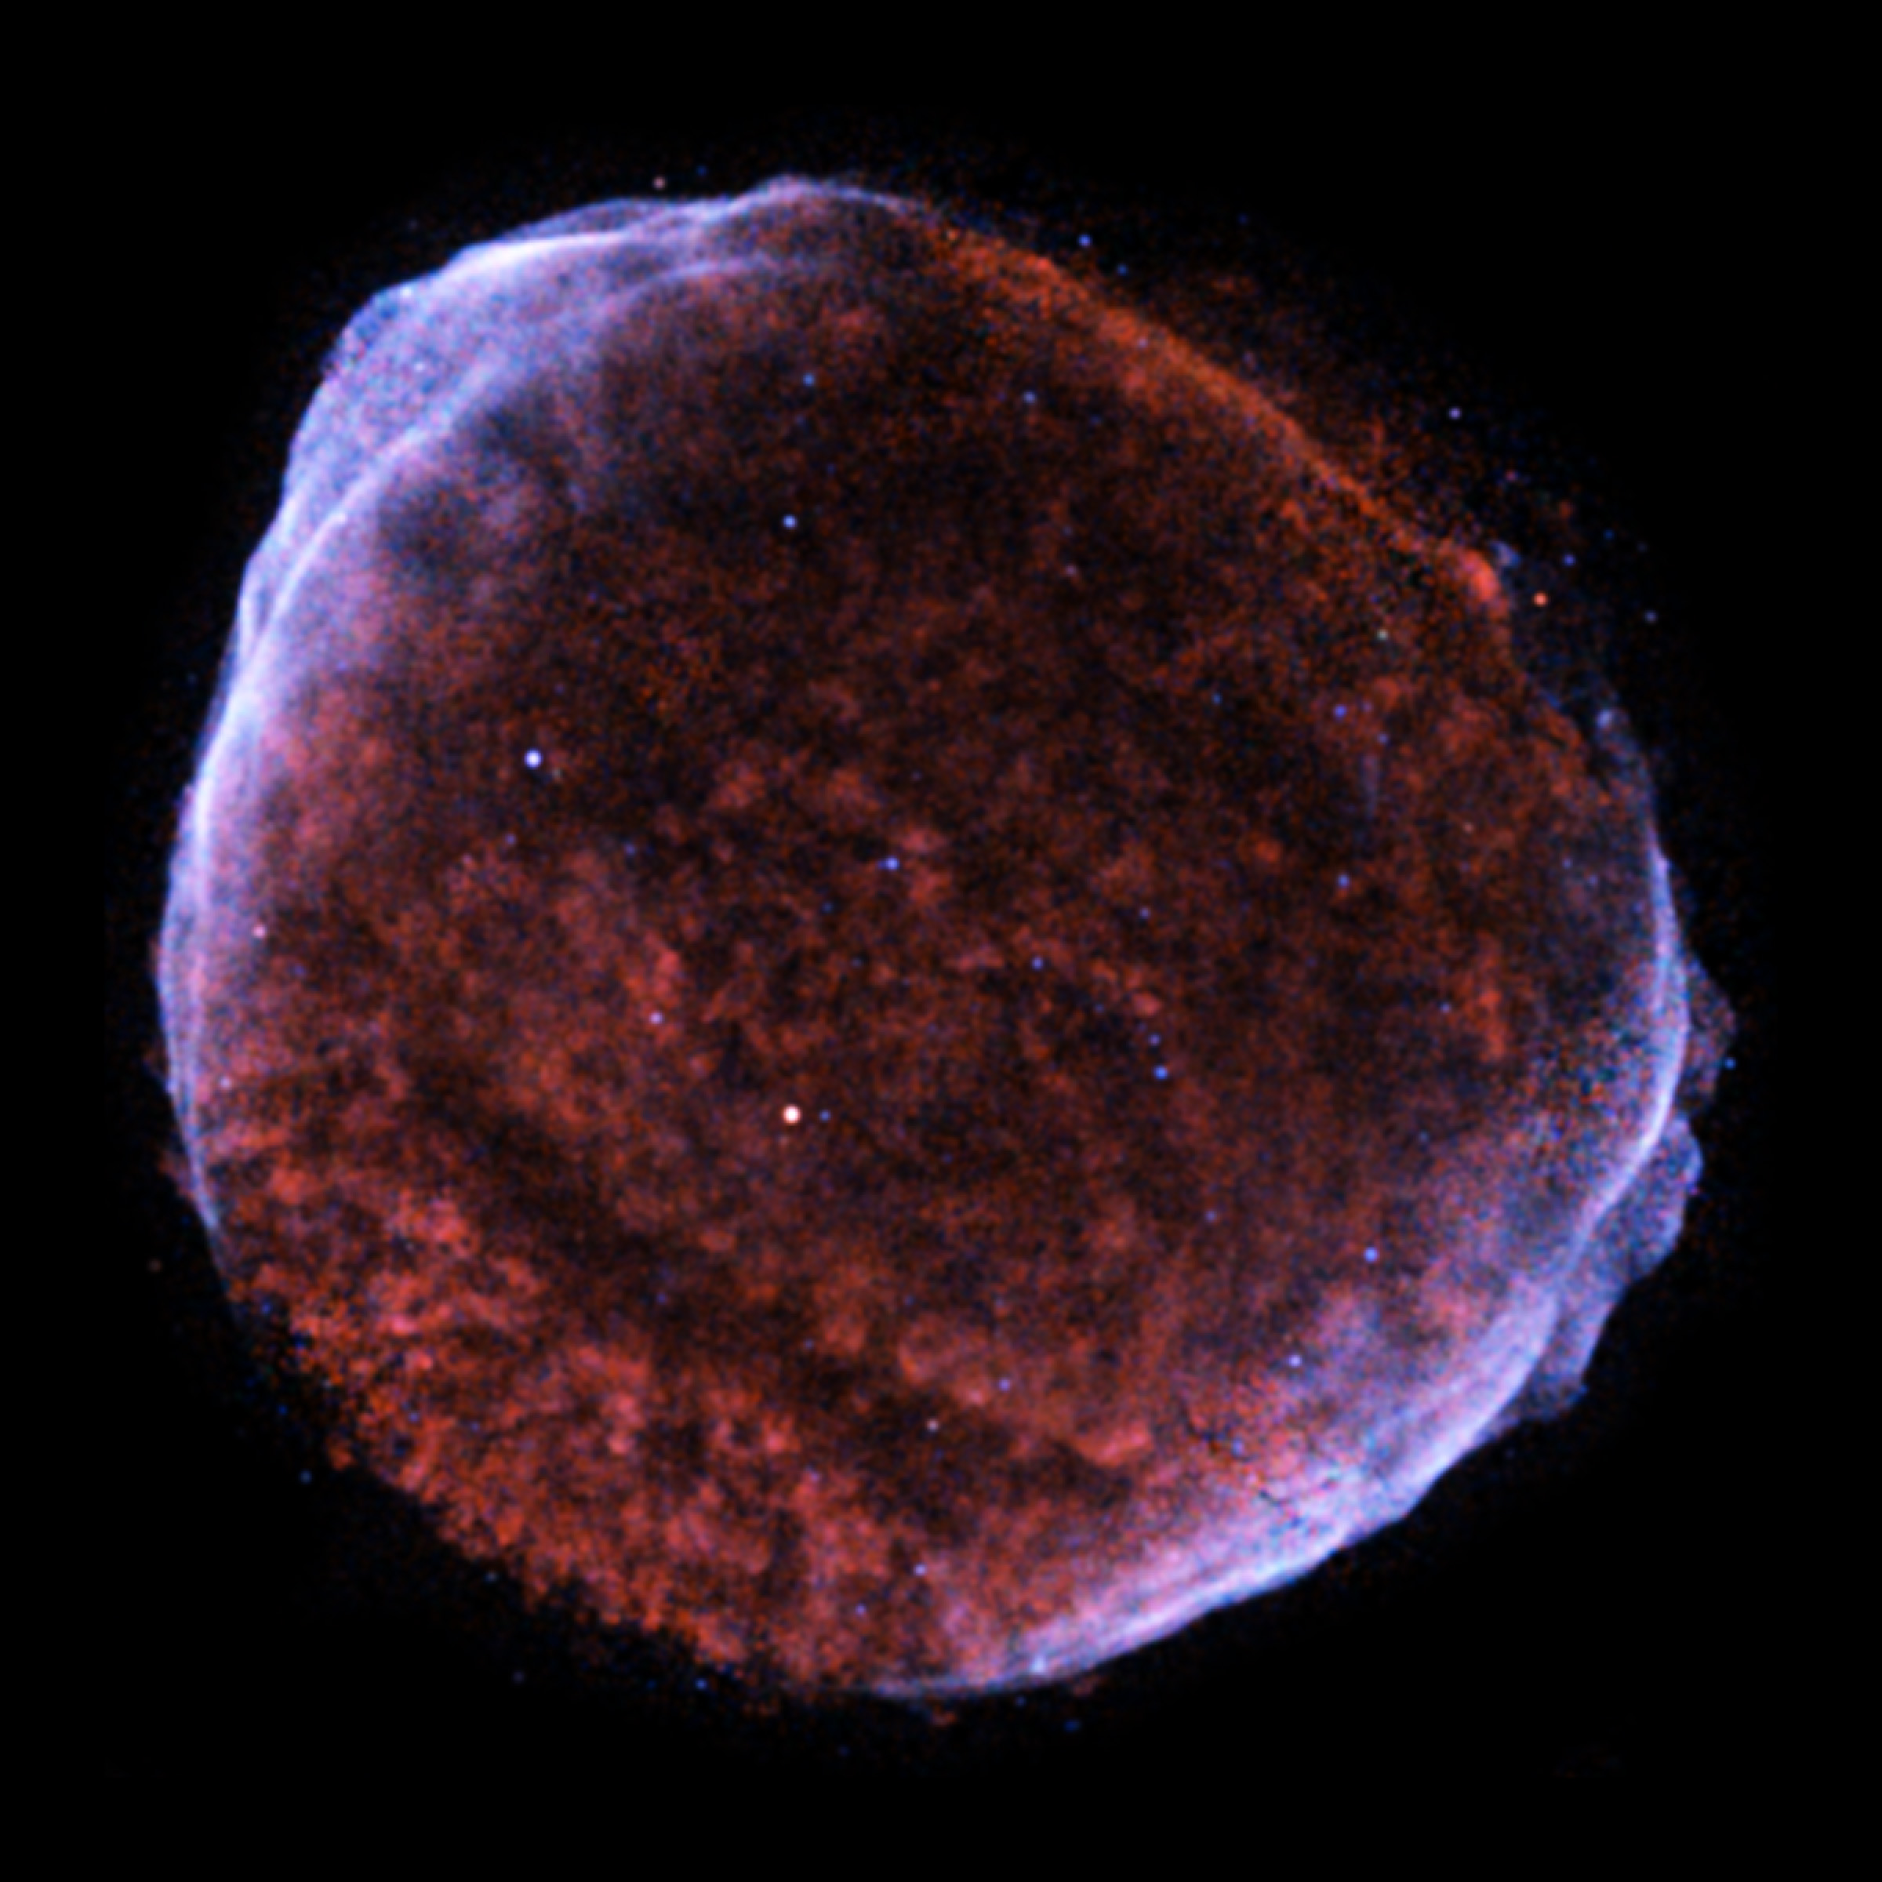
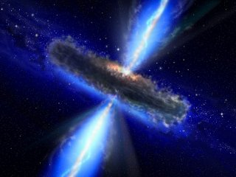
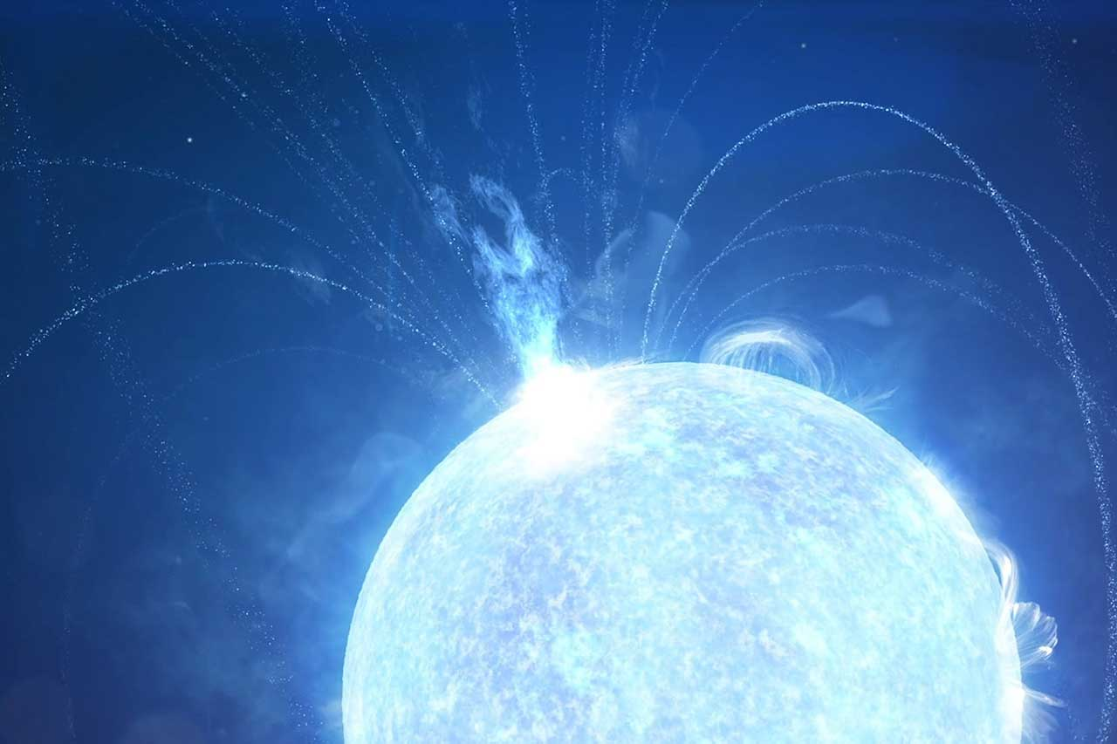
High-Energy Astrophysical Objects
Notes:
We research the high-energy astrophysical objects theoretically.
Examples of high-energy astrophysical phenomena are supernovae, pulsars, giant flares from magnetars, jets launched from supermassive black holes, gamma-ray bursts, and brbrbr.
Our research subjects are physical mechanisms of these object.
For example, jet formation, acceleration of relativistic particles, photon (radio, optical, X and gamma-ray) and neutrino emissions and so on.
Multi-messenger astronomy will be drastically developed in this century.
Therefore, interpretation of observed data and prediction of new astrophysical
phenomena from various perspectives are also important themes in our study.

Slide 3
Member
Staff | Assoc. Prof. | Katsuaki Asano
 | Project Assis. Prof. | Jiro Shimoda
PDs | ICRR PostDoc | Tomohisa Kawashima Tomoki Wada (Takumi Ohmura)
Students | Doctor | Kosuke Nishiwaki (D3) Ryota Goto (D2) Yo Kusafuka (D1)
 | Master | Theo Abounnasr (M2) Yuto Ichinose (M1)
Notes:
This is the member list of our group.
There are twop staffs. Associate Prof. Asano-san, and Project Assistant prof. Shimoda-san
Two Postdocs, Kawashima-san, and me.
Five great students, Nishiwaki-kun, Goto-kun, Kusahuka-kun, Theo, and Ichinose-kun.

Slide 4
Research fields of Young researchers
Black hole
Cosmic ray
Milky way (all)
Kawashima
Nishiwaki
Shimoda
Goto
Kusafuka
（Ohmura）
Wada
Jet/GRB
FRB
Notes:
Each young researcher study different research fields like this figure.
I will introduce the research of each young researcher.

Slide 5
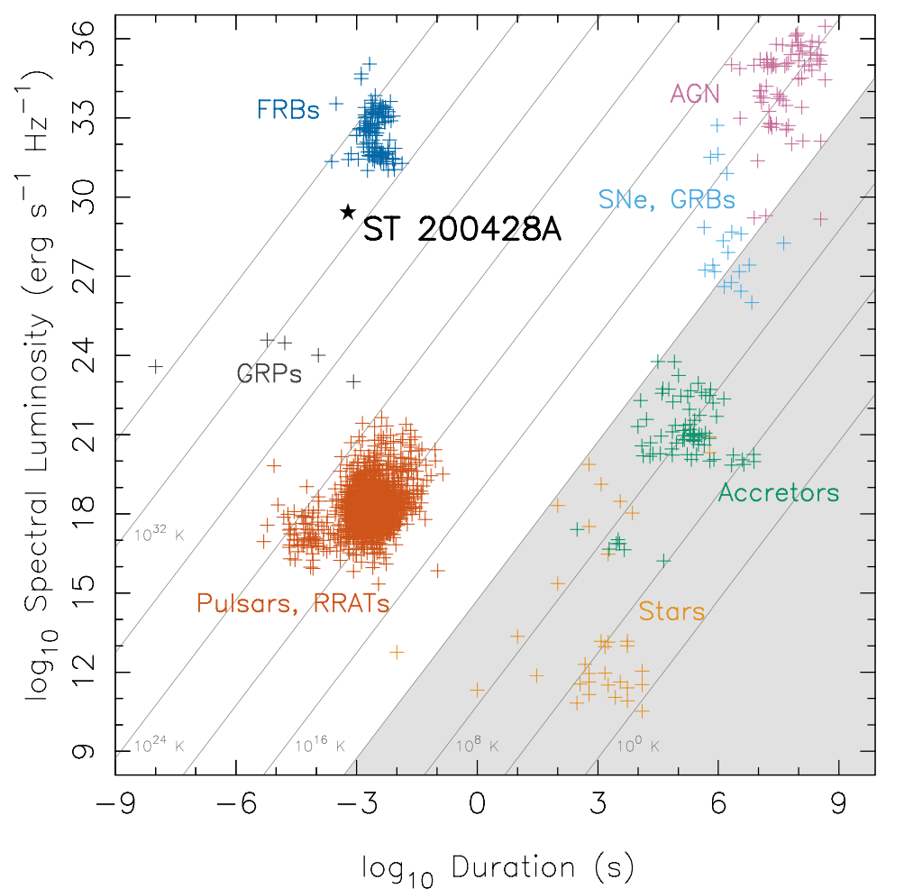
Fast Radio Burst
Brightest radio transient in the universe!
Short Duration
Radio Band
Bright
Cosmological
Short
Bright
Q. What is the origin of these bursts?
Magnetars?, BH?, ULX?, etc..
Q. How are they emitted?
Bunch of charged particle?,
Maser instability in shock?, etc..
(Bochenek et al. 2020)
Notes:
First, I’d like to talk about my studies.
Fast radio burst is the brightest radio transient in the universe.
Its duration is about millisecond, it is emitted in radio band with very high luminosity, and it comes from cosmological distances.
As the right panel shows, it is bright in the millisecond timescale, and extremely short inn the similar luminosity.
This means that extremely large number of photons are in the same state in phase space.
There are two questions.
First, what is the origin?
Second, how are they emitted?

Slide 6
Galactic FRB/ X-ray burst/ Periodicity
Galactic FRB from a magnetar
X-ray burst association
-> Expanding fireball with baryon
explain the observed X-ray & energy of FRB
Neutrino?
X-ray
FRB
Baryon from
magnetar
Magnetar
Velocity of outflow from fireball
Notes:
One FRB comes from a galactic magnetar and X-ray burst is associated with the FRB.
As the source, we consider an expanding fireball with baryons loaded from the magnetar.
If some amount of baryon is loaded, the observed X-ray spectrum and observed FRB luminosity would be explained.
Using these modeling, I investigate the origin of FRBs.

Slide 7
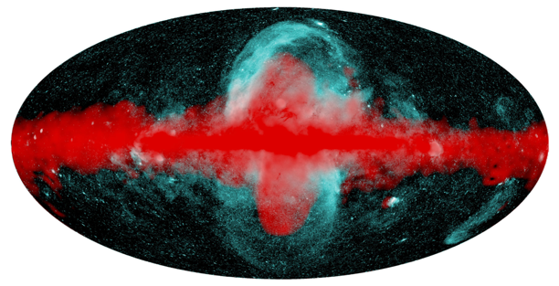
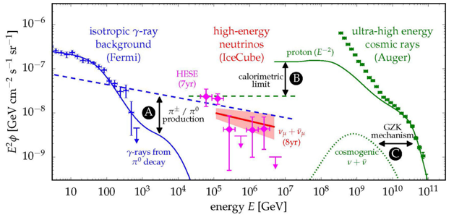
Roles of Cosmic-Rays in Astrophysics:
The History of Our Galaxy (arXiv:2306.16887)
Jiro Shimoda
Predehl+20
X-ray (eROSITA)
γ-ray (Fermi)
Notes:
Shimoda-san study the roles of cosmic-rays in Astrophysics.
The Galactic cosmic rays are thought to play a key role in many topics,
for example, the lifetime of protoplanetary disk, star formation in the galactic disk, bra-bra-bra.
Recently, he construct the long-term evolution model of the Milky Way that successfully explains the long-term evolution of star formation history, cosmic ray energy density, metallicity, and stellar dynamics.
Also, the nonthermal bubble like structures known as the Fermi-bubble and eROSITA bubble can be reproduced by his model -> next slide.

Slide 8
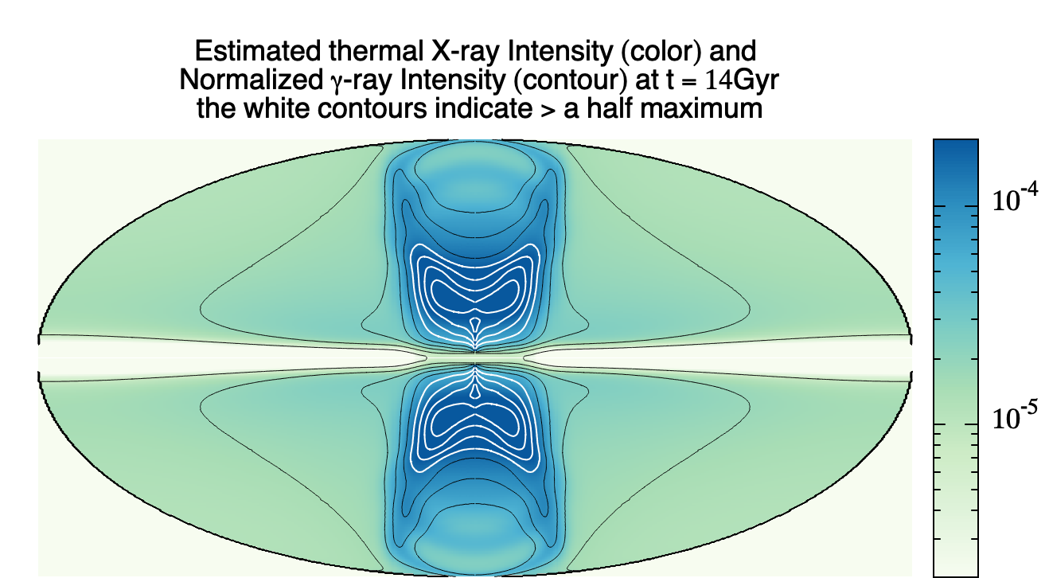

One of the Model Predictions
*Hadronic γ-ray
Our model reproduces the Fermi & eROSITA bubbles?
We are preparing quantitative comparison (coming soon)…
Predehl+20
Notes:
wow, it looks very simillar.
He is preparing the quantitative comparison for these X-ray and gamma-ray structures, and the neutrino emissions from the Galactic system.

Slide 9
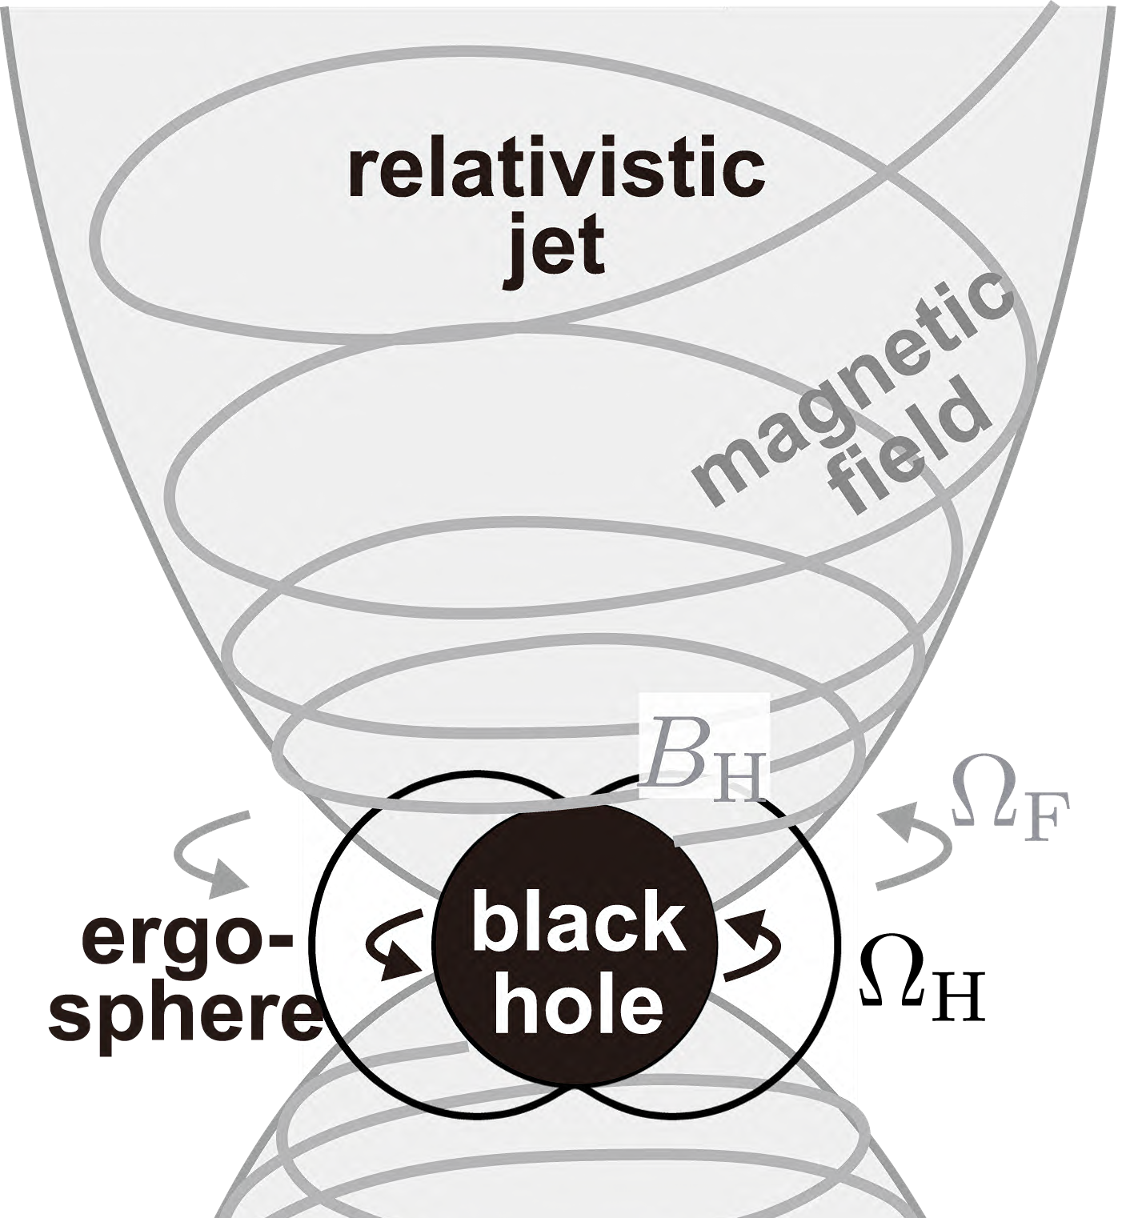
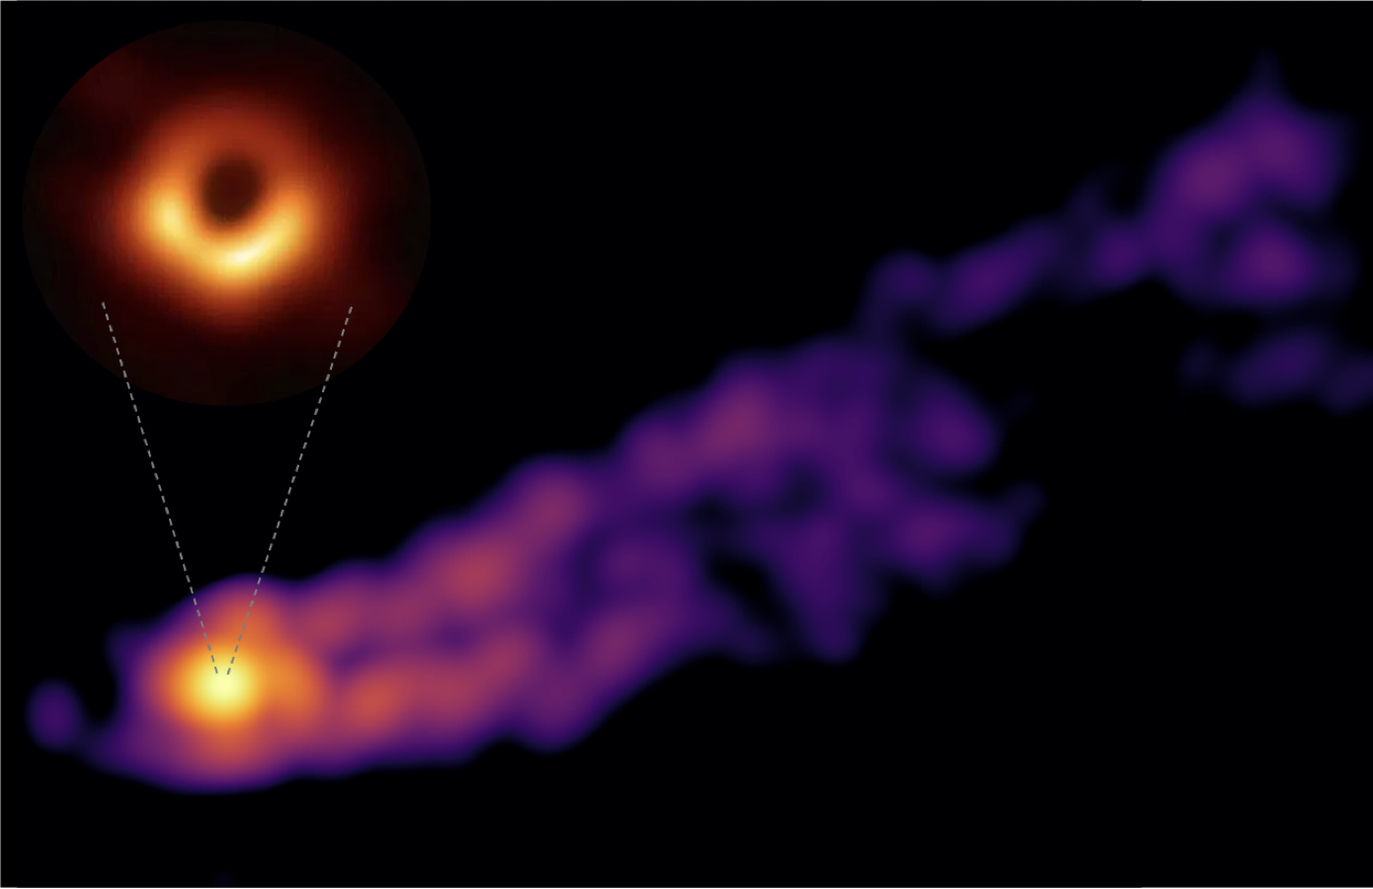
BIG QUESTION:
What is the formation mechanism of relativistic jets?
Blandford-Znajek (BZ)process?
To be BZ or not to be BZ, that is the question☺
black hole (shadow)
relastivistic jet
black hole spin + B-field
+ accelerated particles!
Credit: EHT collaboration, EAVN collaboration
Notes:
There exists a big question in astrophysics: “What is the formation mechanism of relativistic jets”.
Right figure displays the black hole shadow and the relativistic jet in M87.
Blandford-Znajek process, shortly, BZ process is one of the most plausible mechanism.
The black-hole-spin energy extraction is expected via the magnetic field as shown in the left figure.
However, we are not sure this is the mechanism of the jet formation.
So, BZ or not BZ, that is the question.
The key points to test the BZ process is black hole spin, B-field, and the injection of the plasma triggered by the particle acceleration.

Slide 10
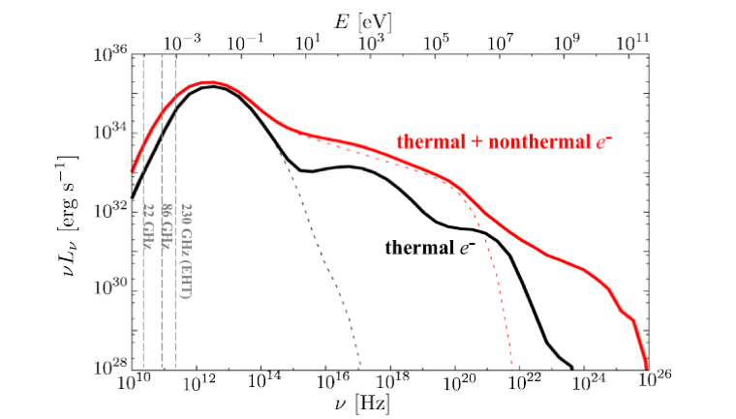
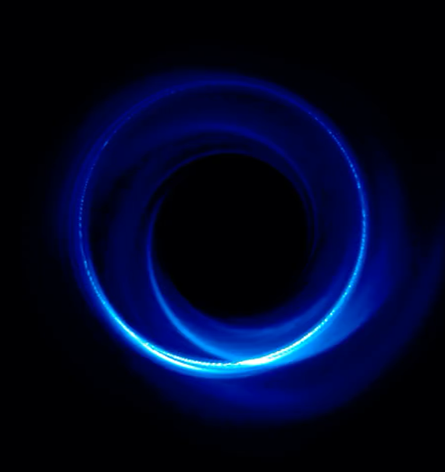

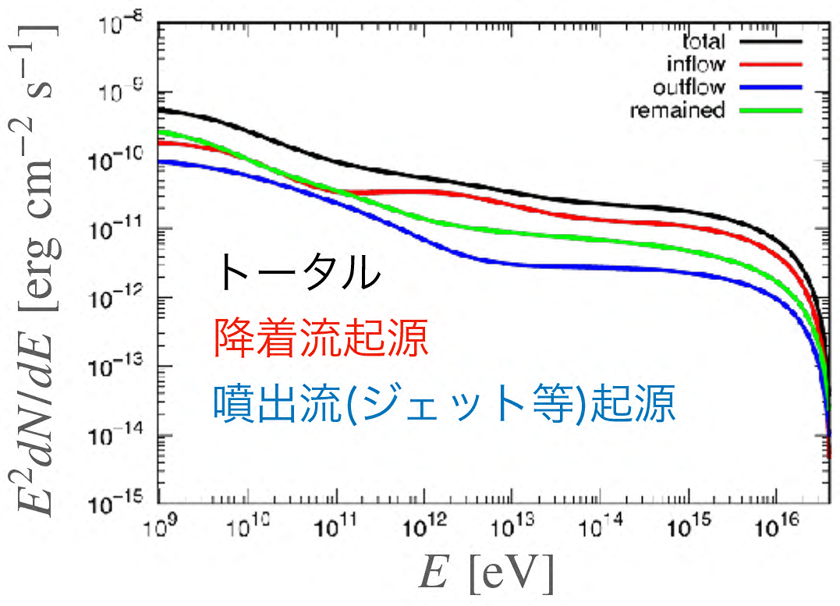
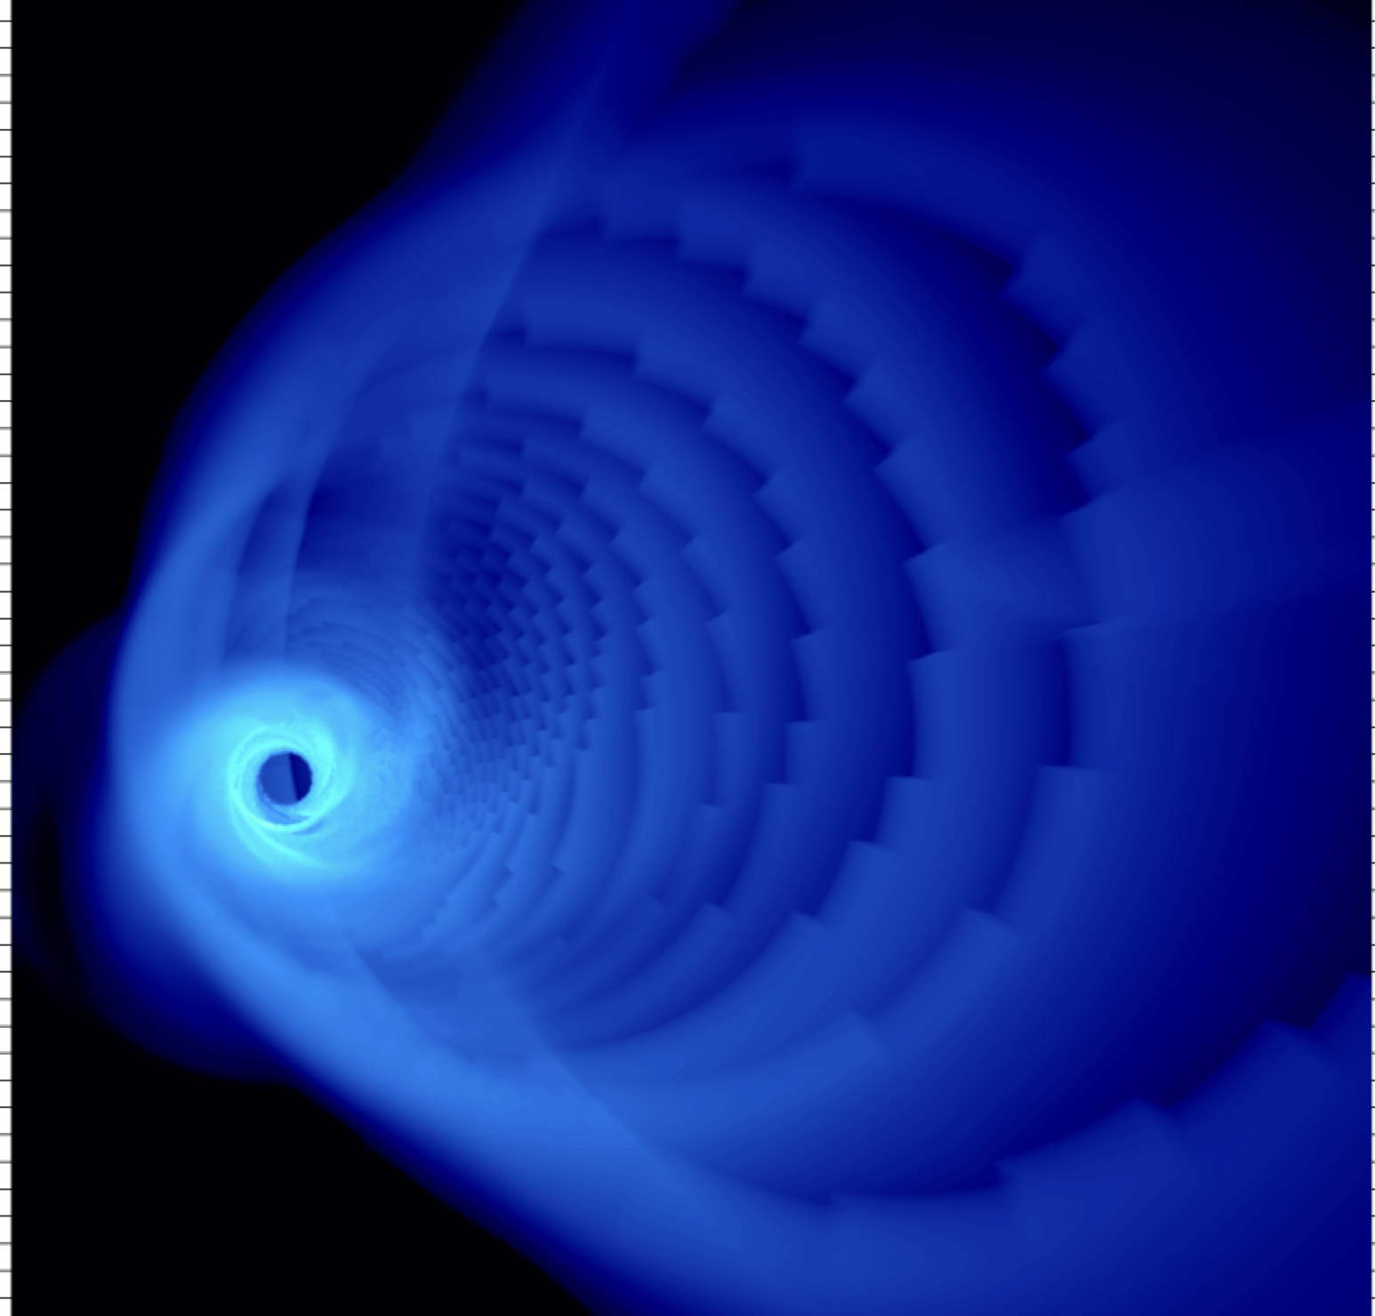



I would like to develop a new research field:
“Event Horizon Scale Multi-messenger Astrophysics”
Towards future comparison w/ next-generation EHT + CTA + IceCube gen2
Kawashima and Asano in prep.
↓
↑
Kawashima + 2023
Characters from Higgstan.com
General Relativistic (GR) MHD + Multiwavelength GR radiative transfer w/ RAIKOU code
+ Hadronic Process (CR acceleration + neutrino emission) w/ ν-RAIKOU code
Notes:
In order to address the formation mechanism of relativistic jets, he would like to
develop a new research field ”Event Horizon Scale Multi-messenger Astrophysics” .
These are examples of the calculation of the horizon scale images, multiwavelength photon spectrum, and high-energy neutrino spectrum.
He is planning to establish the way to constrain the black hole spin, B-field, and the amount of accelerated particles.
Near future, he would like to constrain these ones via the comparison with the future observation of next-generation EHT, CTA, and IceCube gen2, and address the formation mechanism of relativistic jts.

Slide 11
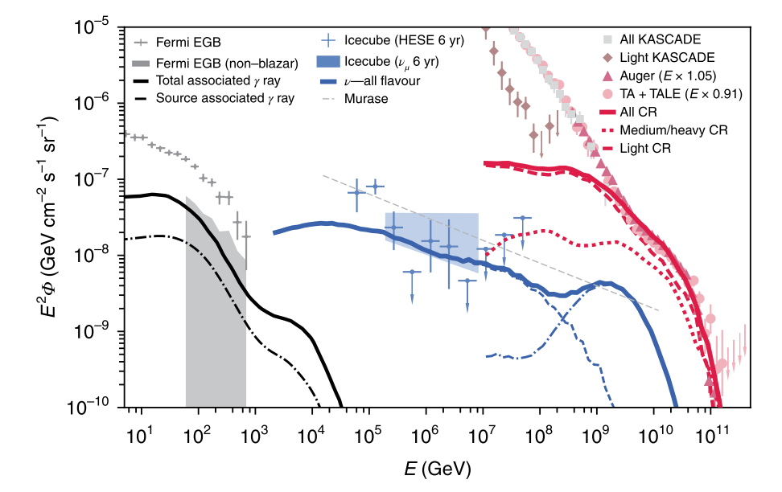
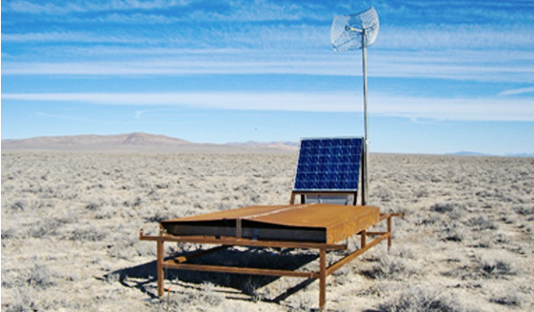
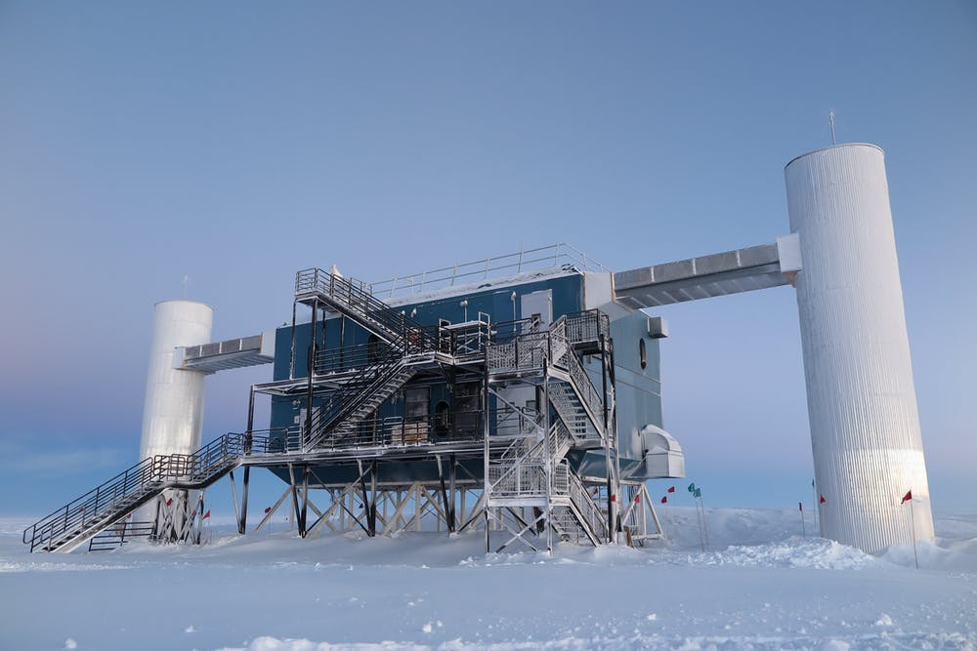
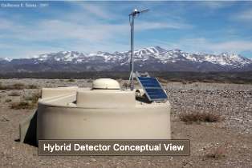
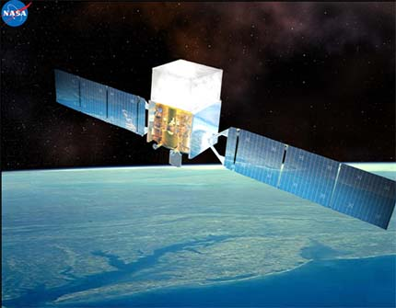
High-energy Multi-messenger Astrophysics
High-energy cosmic ray
Neutrino
What is the origin of the ultra-high energy cosmic-rays (UHECRs)?
Intriguing coincidence: energy fluxes of
UHECRs, PeV neutrino, sub-TeV gamma-ray
are comparable
Gamma-ray
Notes:
Script
1. The origin of high-energy cosmic-ray is a long-standing big problem.
IceCube neutrino observatory has opened up a brand new path for cosmic-ray research.
The energy fluxes of extragalactic gamma-ray, neutrino and cosmic-rays are comparable, there must be some correlations between them, maybe from the same origin.
It is important to study with multi-messenger observations including photons, neutrinos and cosmic-ray.

Slide 12
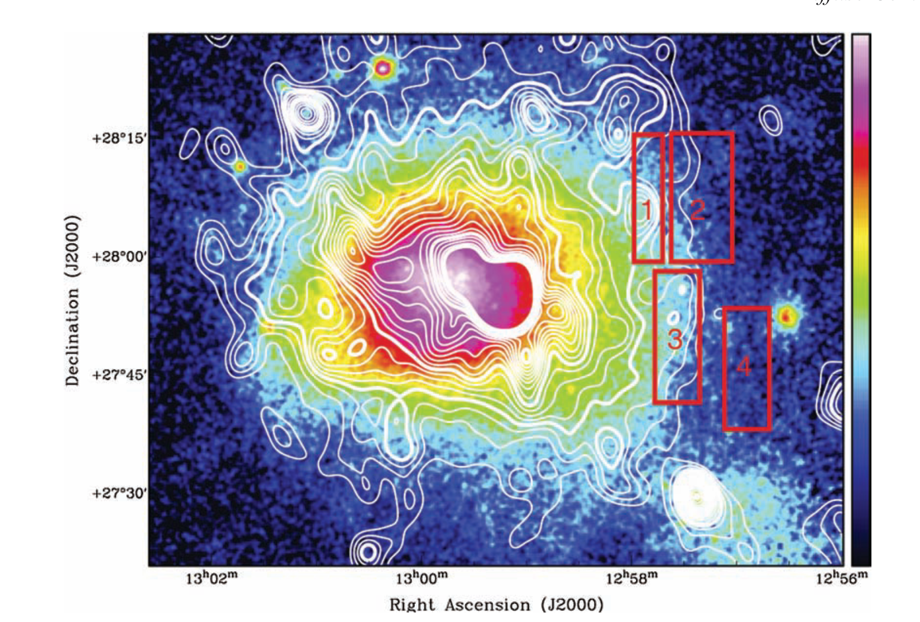
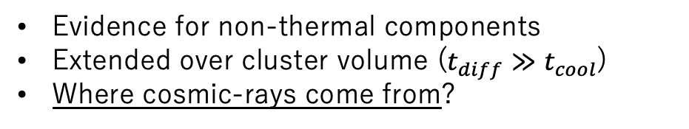
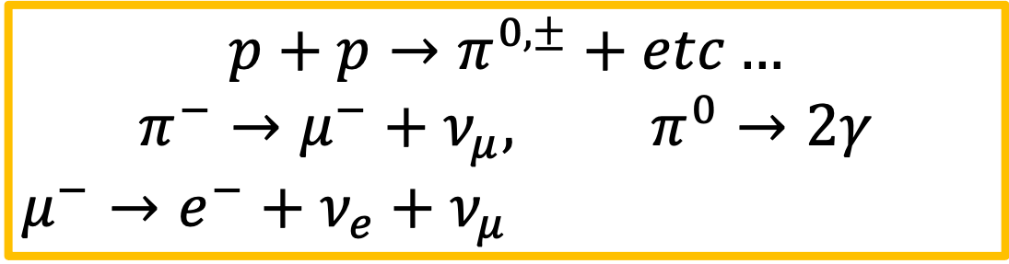
Galaxy Clusters as Comic-ray ‘Reservoir’
$$p+p→π^{0,±}+etc…$$
$$π^{−}→μ^{−}+ν_{μ}, π^{0}→2γ$$
$$μ^{−}→e^{−}+ν_{e}+ν_{μ}$$
Giant Radio Halo
of Coma cluster
[Brown & Rudnick 2011]
neutrino
gamma
IC
radio
Evidence for non-thermal components
Extended over cluster volume ($t_{diff}≫t_{cool}$)
Where cosmic-rays come from?
Currently, no direct clues for cosmic-ray protons
Are clusters responsible for IceCube flux ??
Notes:
Script
One possible candidate for the origin of IceCube neutrino is “cluster of galaxies”
With its large volume, galaxy cluster works as a cosmic-ray reservoir, and produce gamma-ray and neutrinos
(left figure) Radio observation proves the existence of cosmic-ray electrons inside the cluster
he is studying where cosmic rays come from ?
(right)Thiis is the calculated spectrum,
Can galaxy clusters be the origin of high-energy radiations??

Slide 13
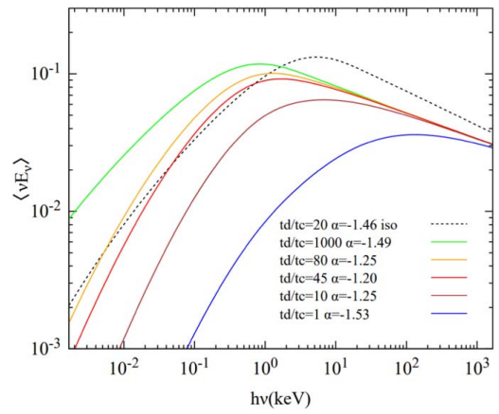
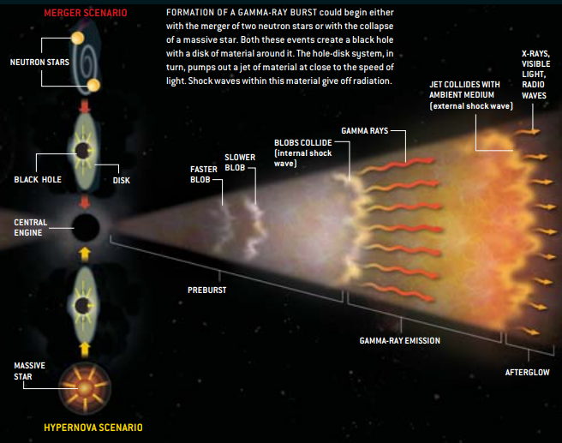
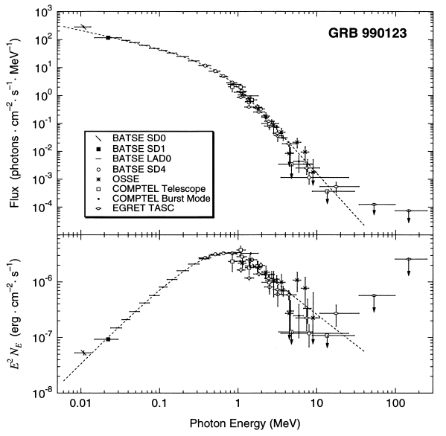
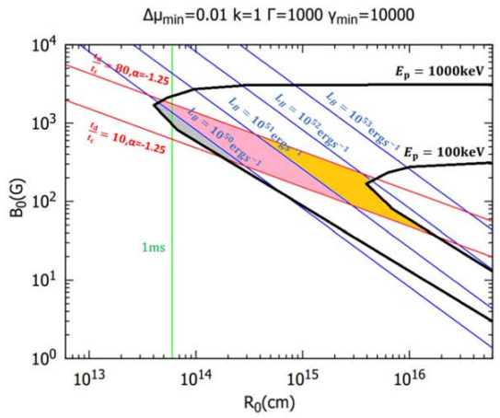

Ryota Goto
Gamma Ray Burst(GRB)
GRB spectrum
$$N_{E}∝E^{−1}$$
JUAN VELASCO
The most luminous explosion
in the universe.
Briggs et al. 1999
Goto & Asano 2022
Notes:
Gamma Ray Bursts, GRBs, are the most luminous explosion in the universe.
Gamma rays are emitted from relativistic jets,
the jet is ejected after deaths of massive stars or neutron star mergers.
What radiation process can explain GRB spectra is still unknown problem.
In the simple model in Goto & Asano 2022, He showed that it was difficult to reproduce both photon index around -1 and observed luminousity by synchrotron radiation.

Slide 14
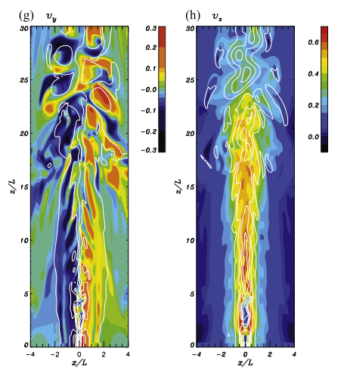
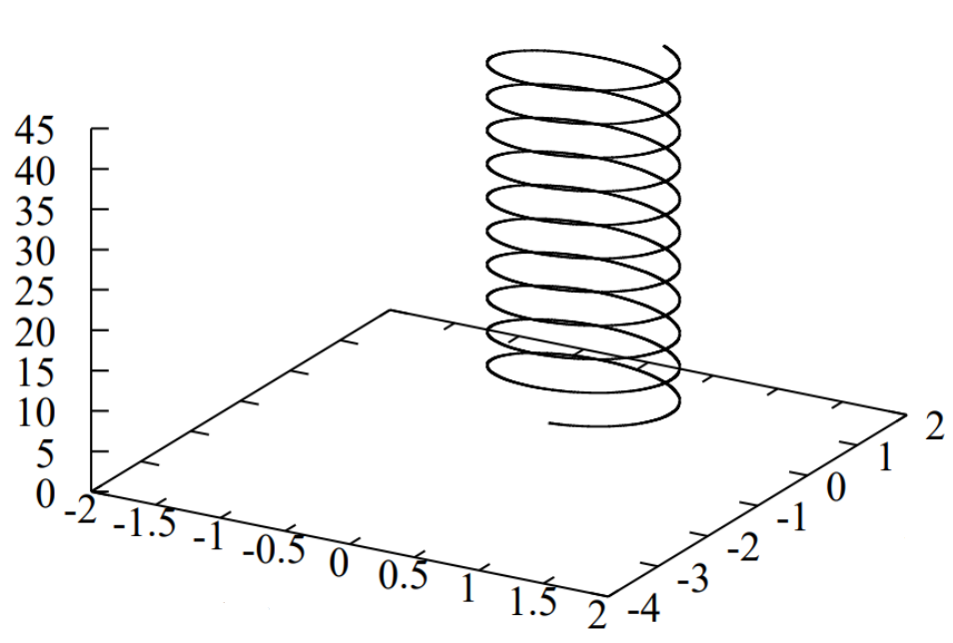
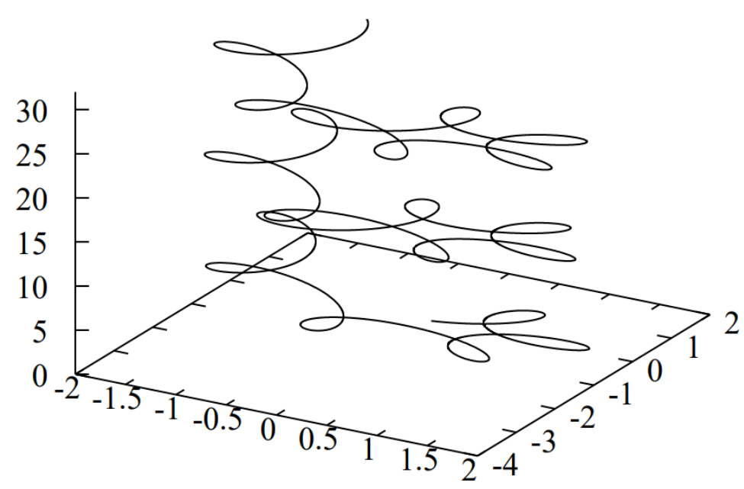
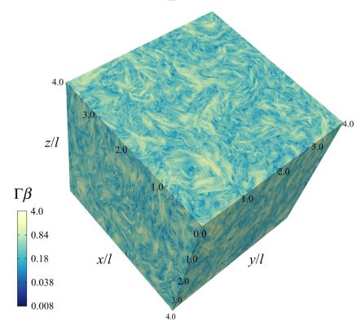
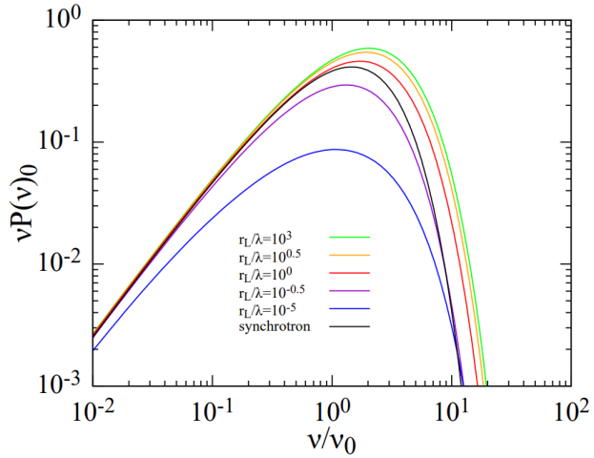
What radiation in relativistic jet of GRB?
Radiation in relativistic Alfven wave
High energy electron
Low energy electron
$$r_{L}>λ$$
$$r_{L}<λ$$
Comisso & Sironi 2019
Singh et al. 2016
Relativistic turbulence in jet
Notes:
Previous simulations suggest that relativistic turbulence can be driven in relativistic jets.
(left figures)
Strong electric field in relativistic turbulence may change radiation spectrum from synchrotron radiation.
Goto-kun is calculating electron trajectories and radiation spectra in relativistic magnetohydrodynamic wave.
In the radiation in relativistic Alfven wave, strong electric field is changing radiation spectrum from synchrotron radiation.

Slide 15
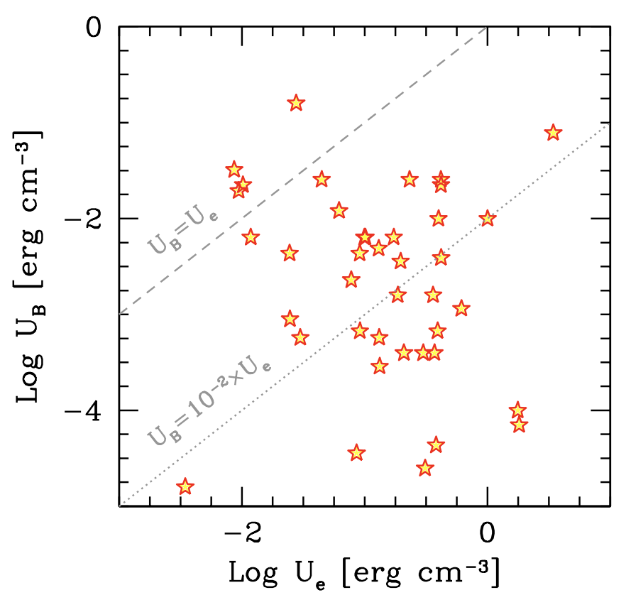
Magnetization problem in Relativistic Jets
$γ$ ray emission site: $σ≪1$
Relativistic jet
Tavecchio & Ghisellini (2016)
$$σ<1$$
Accretion Disk
Magnetic energy $\left[erg {cm}^{−3}\right]$
Blandford & Znajek (1977)
SMBH
launching site: $σ≫1$
$$σ=\frac{Magnetic energy}{particle energy}$$
Disk
$$\left(e^{±},p\right)$$
Electron energy$\left[erg {cm}^{−3}\right]$
Notes:
Relativistic jets are seen in AGNs, GRBs, and PWNe. (アニメーション開始).
Theoretically, they are magnetically dominated at their launching site.
However, observation of gamma rays tells us the energetically weak magnetic field at the emission site.
So, there is a huge magnetization gap in relativistic jets.
From its launching site to the emission site
This means the magnetic energy should be dissipated while propagation.

Slide 16
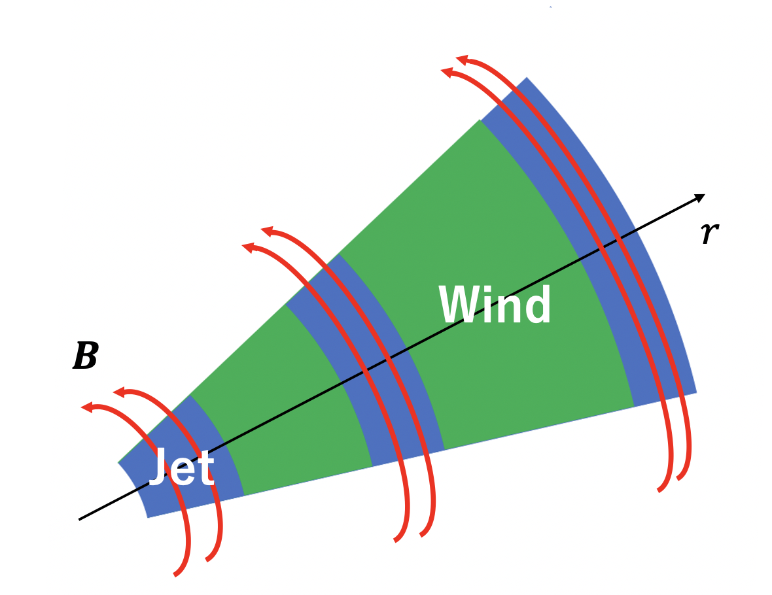
Alternative Scenario – Intermittent Jets and Wind
Intermittent
Jets
$γ$ ray emission site: $σ≪1$
Wind
1D Relativistic MHD simulation
Problems (reconnection)
・$σ∼1$ (Sironi et al., 2015)
・Inconsistent with IXPE
(Di Gesu et al., 2022,2023)
Accretion Disk
launching site: $σ≫1$
Problems (internal shock)
・$σ≫1$ $→$ $f_{dissipation}≪1\%$
(Kennel & Coloniti, 1984)
・inefficient DSA for $σ≫1$
(Sironi et al., 2015)
SMBH
Wind
Disk
Notes:
However, traditional dissipation mechanisms such as magnetic reconnection and internal shock model have some theoretical and observational problems.
So, he propose a new scenario. (アニメーション開始).
He assumes that jets are ejected intermittently, and the wind blows off from the disk.
Far from the central engine, the wind may penetrate between jets.
Then, He expect that collisions with jets and winds can transfer the magnetic energy of the jets into the thermal energy of winds by shock waves.
He implement a suitable 1D simulation code and investigate dissipation efficiency.

Slide 17
Thank you
Black hole
Cosmic ray
Milky way (all)
Kawashima
Nishiwaki
Shimoda
Goto
Kusafuka
（Ohmura）
Wada
Jet/GRB
FRB
Notes:
Each young researcher study different research fields like this figure.
I will introduce the research of each young researcher.

